Slide 1
Corona virus
Team name : Codercamps
Leader : prakhar agarwal
Other team members: ayush Verma, Shruti tiwari and pragya Yadav

Slide 2
Corona virus as a global pandamic
Any of a group of RNA viruses that cause a variety of respiratory, gastrointestinal, and neurological diseases in humans and other animals.

Slide 3
About our project
We all four members of code camp have created a website name infectometer
This website has a very modest representation of the data

Slide 4
Specialization of data in our website
The data in our website is well catagorized . We have data all over India along with top most infected states of India.
The data contains total number of cases,active cases,recovered patients data ,track of death record ,number of beds available in public and private sector , vaccination records , availability of ventilators and ICU beds in India along with top five infected states…Maharashtra, Delhi and uttarpradesh.

Slide 5
Data prediction in our website
We have used linear regression technique which analysis the past 24 days data . And find a polynomial equation that satisfies the data and predict the future data of next 20 days . On this basis we have calculated number of beds needed in next 20 days.

Slide 6
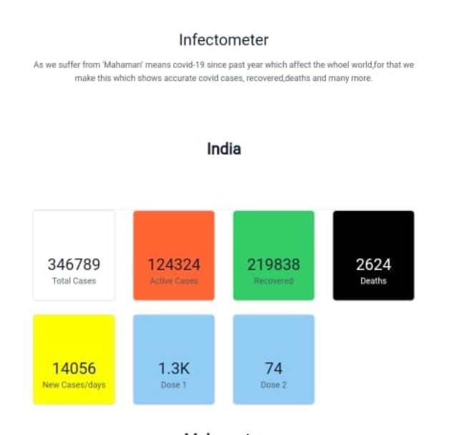
Some glimpse of our website

Slide 7
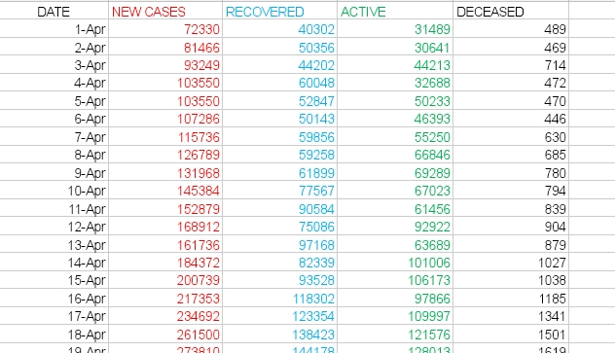
Glimpse of data that we have stored

Slide 8
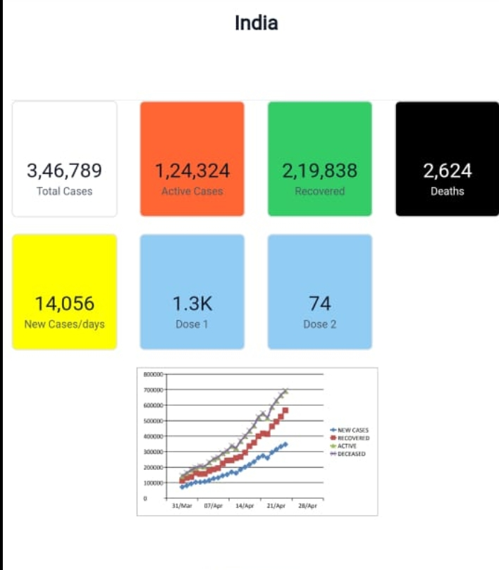
Graph analysis in our website

Slide 9
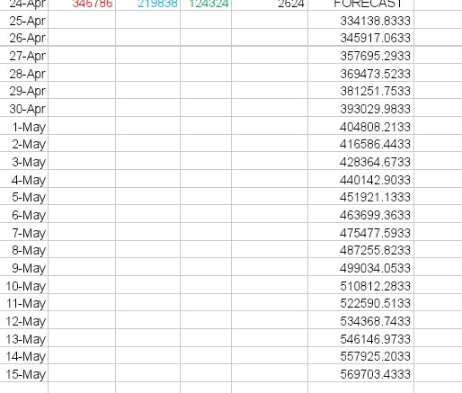
Data prediction :number of active cases in next 20 days

Slide 10
Prediction Of number of beds required in next 20 days
We have used exponential regression method to predict the data . In this prediction we have assumed that only 20 percent of patients will require beds and rest 80 percent patients will be in home isolation .

Slide 11
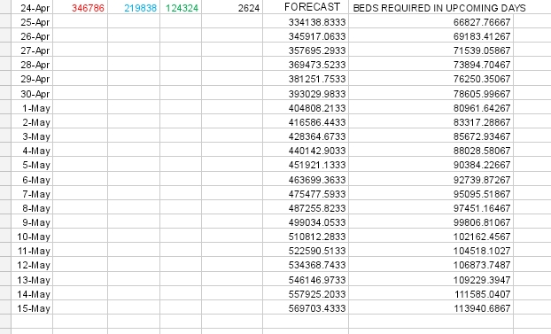
Prediction of beds Required in next 20 days

Slide 12
Covid related information in our website
Link of arogya setu app
Some important helpline numbers
Symptoms of covid 19
Precautions

Slide 13
Conclusion
Our website is an static website but it contains all authentic information related covid 19
The crunch in our website is the prediction of active cases and beds required in next 20 days

Slide 14
Thank you

