Slide 1
praCTES* IAP Workshop Series
Lecture 1: Introduction to Scientific Programming
January 2020
*Practical Computing Tutorials for Earth Scientists

Slide 2
Why should Earth scientists learn programming?
Interpreting data (field, experimental, simulation). E.g. statistical tools & machine learning
Presenting data: making clean and informative plots
Organizing data and workflow
Modelling the natural world (from theory, to idealized, to more realistic)
Enable reproducible science (standardized tools, practices, etc.)

Slide 3
Which programming language to pick?
 | Matlab | Python | Julia | R
Licensing | Proprietary | Free | Free | Free
Ease of use | Easy | Easy/Moderate | Easy/Moderate | Easy/Moderate
Community | Large | Large | Small | Large
Online help | Extensive | Very good | Limited but growing | Good
Performance | Comparable | Comparable | Potentially comparable to C. | Generally slower than python/matlab
Distinguishing features | Simulink | TensorFlow, xarray, dask | GPU, multiple dispatch | Graphic libraries, statistics.

Slide 4
What makes a good code?
Clarity: Easy to read by you and anyone else (sensible variable names, indentation, comments and conventions)
Efficiency: minimum number of operations, and memory usage.
Modularity: splitting code into components that can be independently modified.
Simplicity: start simple and build complexity progressively.

Slide 5
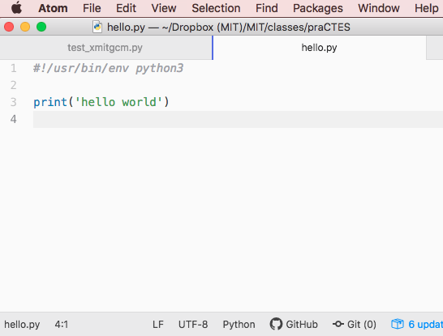
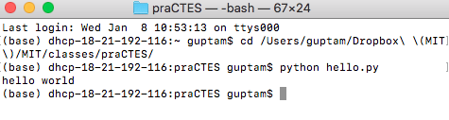
Programming environments: Text editors
Text editor
Terminal window

Slide 6
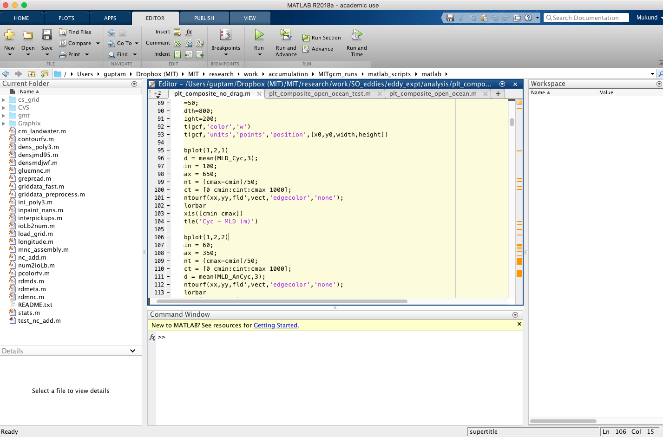
Programming environments: IDEs

Slide 7
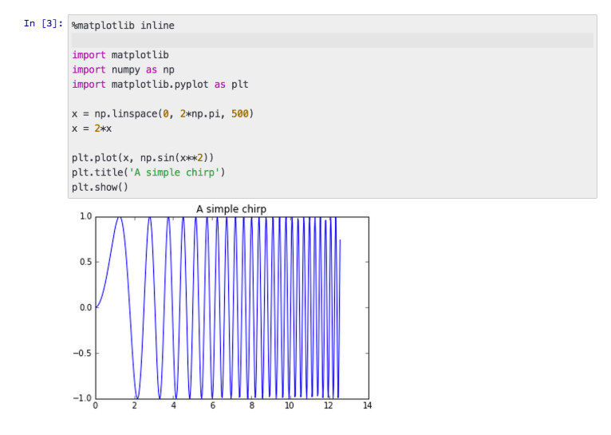
Programming environments: Notebooks

Slide 8
Resources
Basic python: https://www.w3schools.com/python
Numpy arrays: https://docs.scipy.org/doc/numpy/reference/generated/numpy.array.html

