Slide 1
Introduction to PL/SQL

Slide 2
Introduction to PL/SQL
Procedural Language extension for SQL
Integration of SQL
Portable within Oracle data bases
Callable from any client

Slide 3
Structure of PL/SQL
PL/SQL is Block Structured
A block is the basic unit from which all PL/SQL programs are built. A block can be named (functions and procedures) or anonymous
Sections of block
1- Header Section
2- Declaration Section
3- Executable Section
4- Exception Section

Slide 4
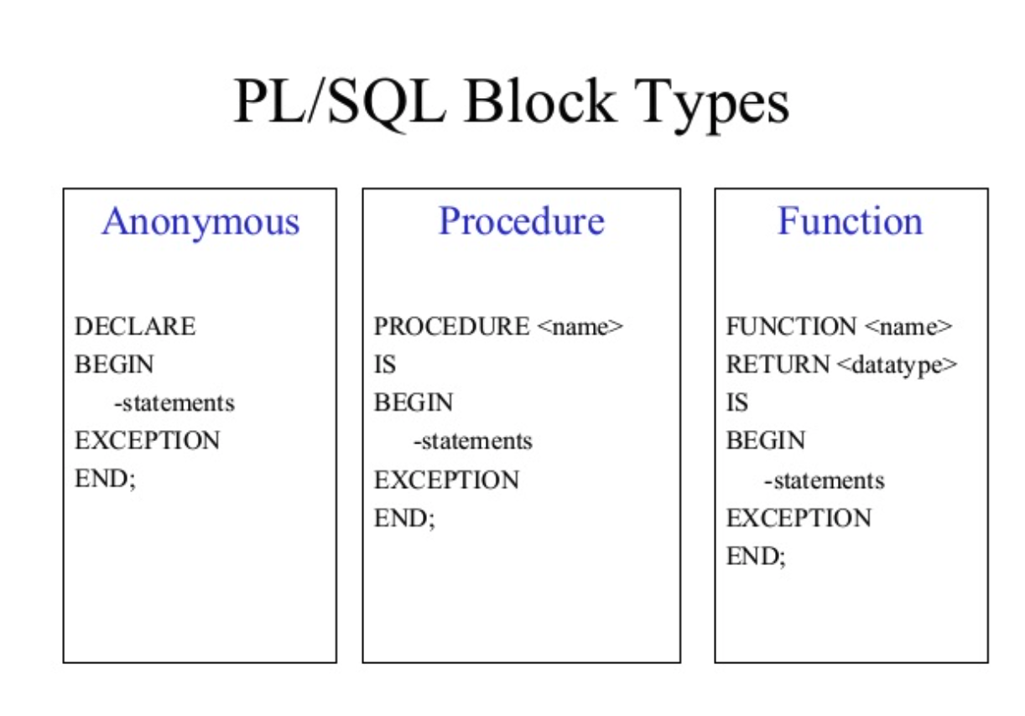

Slide 5
Structure of PL/SQL
HEADER
Type and Name of block
DECLARE
Variables; Constants; Cursors;
BEGIN
PL/SQL and SQL Statements
EXCEPTION
Exception handlers
END;

Slide 6
Structure of PL/SQL
DECLARE
a number;
text1 varchar2(20);
text2 varchar2(20) := “HI”;
BEGIN
---------- ---------- ----------
END;
Important Data Types in PL/SQL include NUMBER, INTEGER, CHAR, VARCHAR2, DATE etc
to_date(‘02-05-2007','dd-mm-yyyy') { Converts String to Date}

Slide 7
Structure of PL/SQL
Data Types for specific columns
Variable_name Table_name.Column_name%type;
This syntax defines a variable of the type of the referenced column on the referenced table

Slide 8
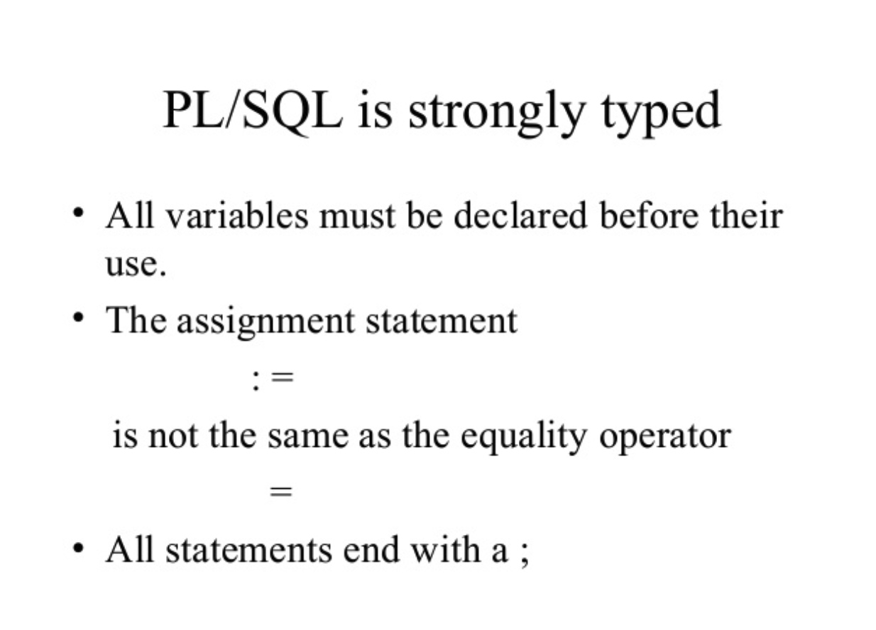

Slide 9
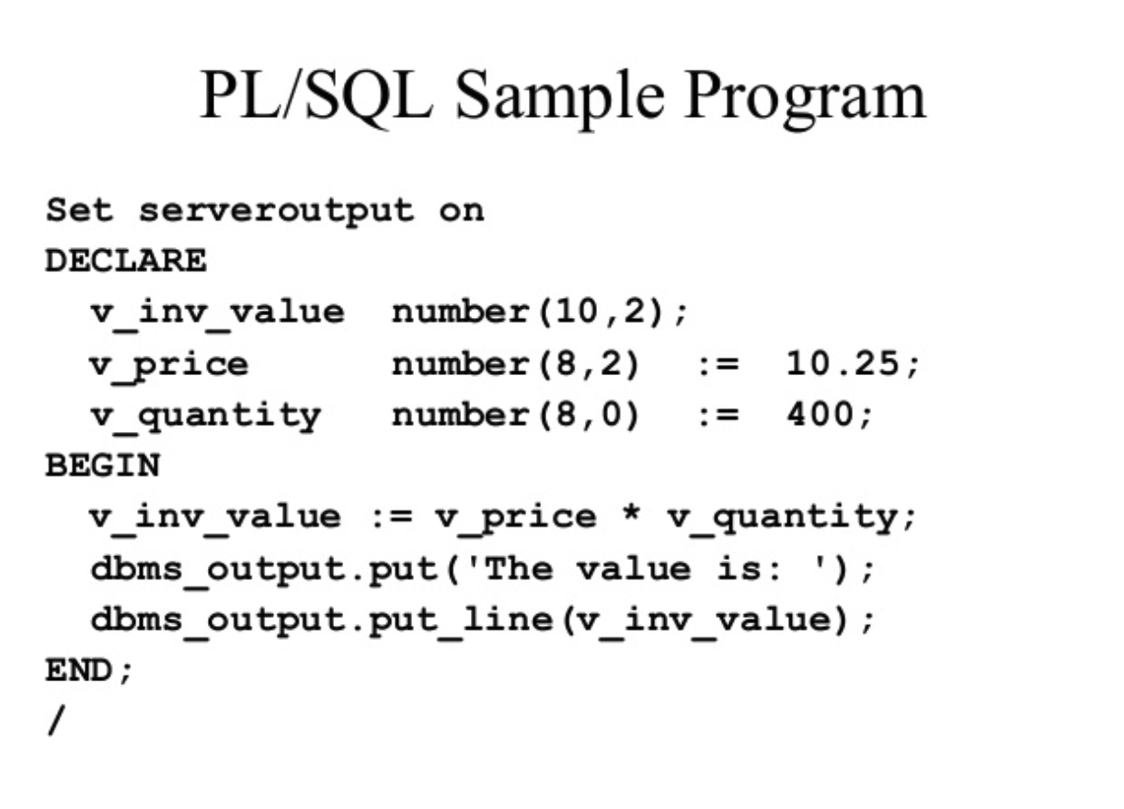

Slide 10
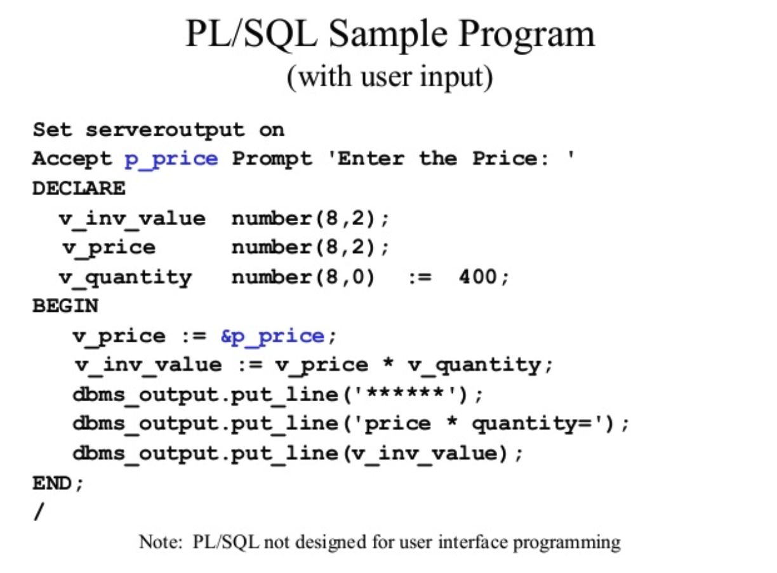

Slide 11
PL/SQL Control Structure
PL/SQL has a number of control structures which includes:
Conditional controls
Iterative or loop controls.
Exception or error controls
It is these controls, used singly or together, that allow the PL/SQL developer to direct the flow of execution through the program.

Slide 12
PL/SQL Control Structure
Conditional Controls
  IF....THEN....END IF;
  IF....THEN...ELSE....END IF;
  IF....THEN...ELSIF....THEN....ELSE....END IF;

Slide 13
PL/SQL Control Structure
LOOP
...SQL Statements...
EXIT;
END LOOP;
WHILE condition LOOP
...SQL Statements...
END LOOP;
FOR loops
FOR <variable(numeric)> IN [REVERSE] <lowerbound>..<upperbound> LOOP .... ..... END LOOP;

Slide 14
PL/SQL Control Structure
Cursor
DECLARE
name varchar2(20);
Cursor c1 is
select t.name
from table t
where date is not null;
BEGIN
OPEN c1;
LOOP
FETCH c1 into name;
exit when c1%NOTFOUND;
END LOOP;
CLOSE c1;
END;

Slide 15
Debuging
show error
DBMS_OUTPUT.PUT_LINE(‘ .. ‘);

Slide 16
Execution
How to execute a function in PL/SQL?
Var issue_flag;
exec :issue_flag:=fun_name(arg1,arg2,. . . .);
PRINT :issue_flag;
How to execute a procedure in PL/SQL?
Exec procedure_name(arg1,arg2,. . . .);

Slide 17
Exception Handling
Predefined exceptions are error conditions that are defined by PL/SQL.
User-defined exceptions are exceptions specific to your application

Slide 18
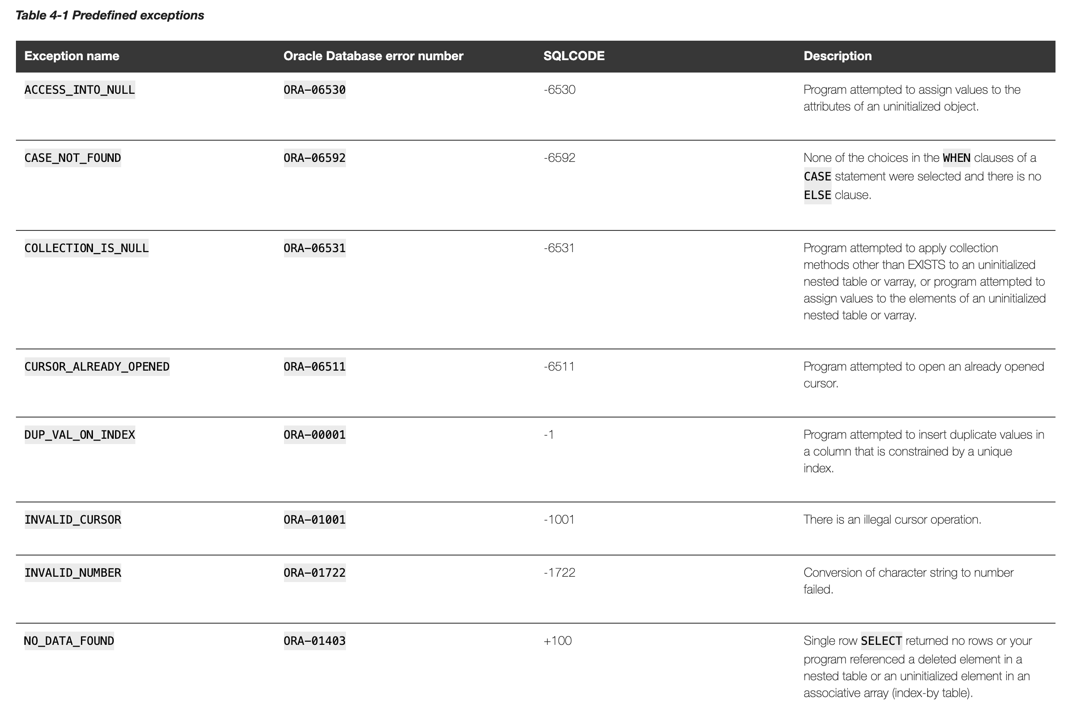

Slide 19
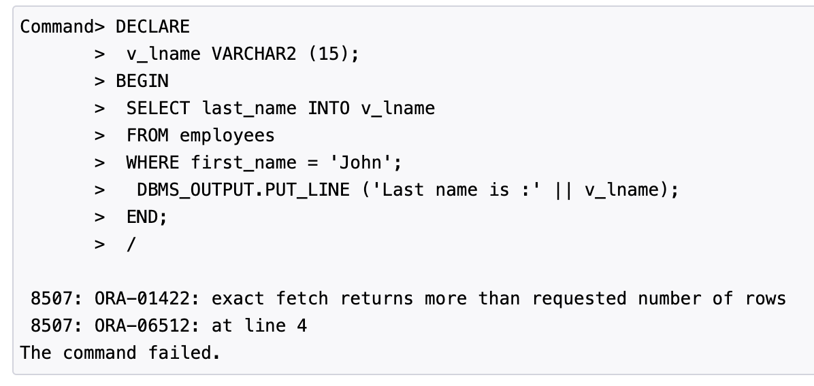
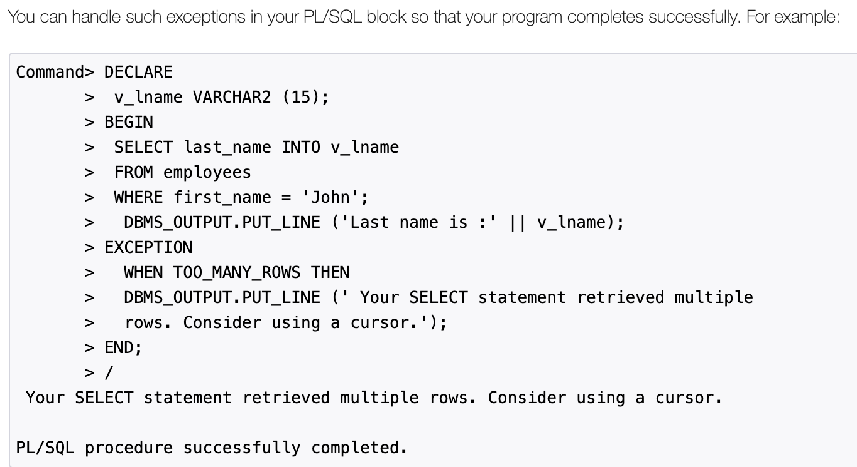
ora

Slide 20
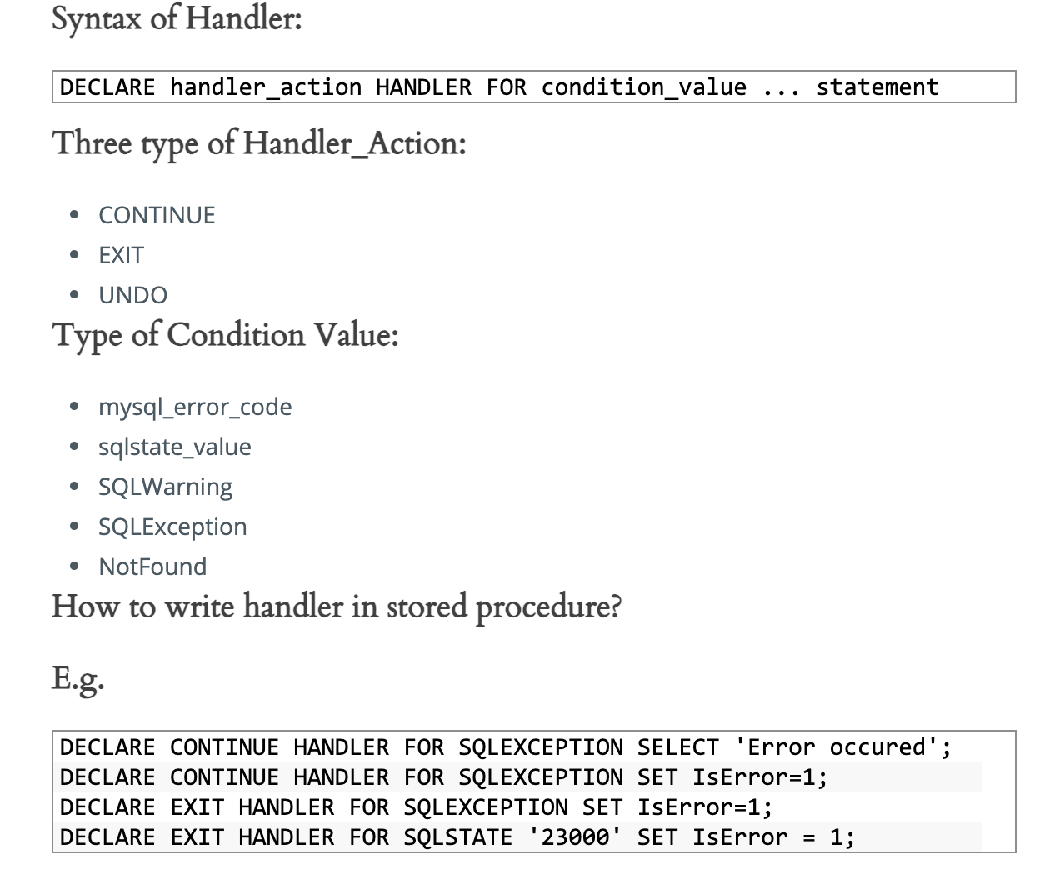
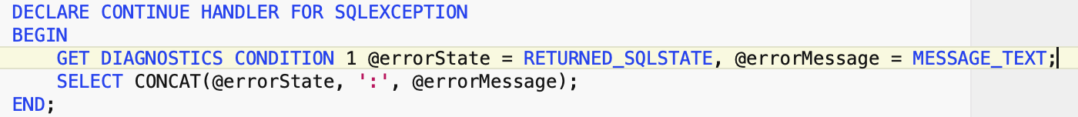
mysql

Slide 21
Views
Simplify complex queries and huge table data - performance
Extra security layers – provide access only to view than disclosing the actual table
Types :-
Read Only
Updatable

Slide 22
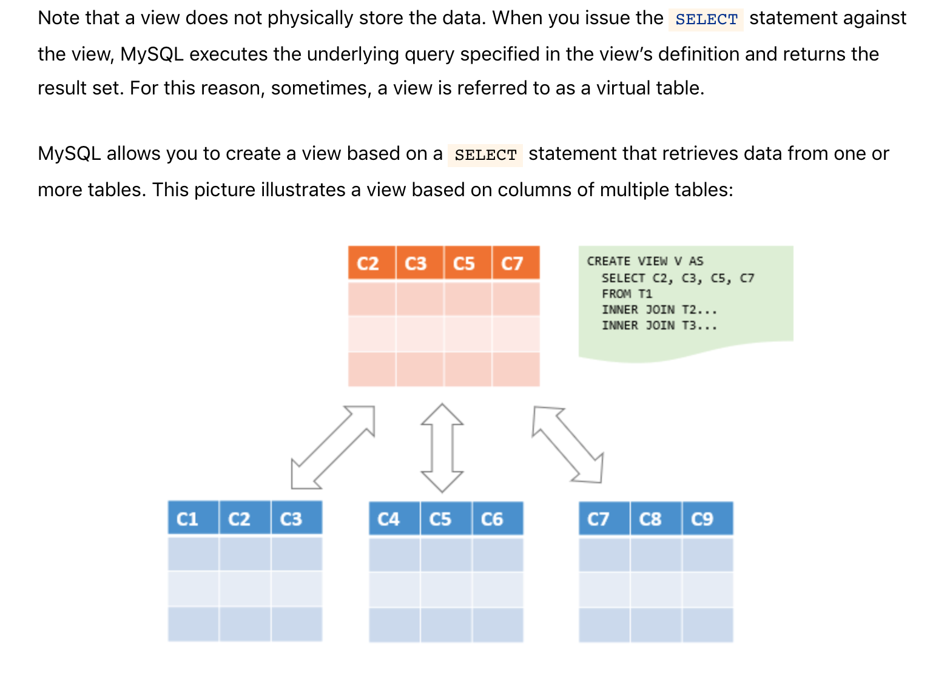

Slide 23
THANK YOU

Slide 24
References
[1] http://www.csee.umbc.edu/help/oracle8/server.815/a67842/01_oview.htm#740
[2] http://en.wikipedia.org/wiki/PL/SQL
[3] http://www.skillbuilders.com/Tutorials-V2/ora9i_Intro_to_PLSQL/ora9i_Intro_to_PLSQL.cfm

