Slide 1

Low-Power SRAM Cell Design via Transistor Sizing Optimization
Minimizing power consumption in SRAM without compromising stability, speed, or reliability — through precise transistor dimension optimization.

Slide 2

Why SRAM Power Matters
SRAM is ubiquitous across modern digital systems — from high-performance processors to resource-constrained IoT endpoints. As array sizes scale, SRAM becomes one of the dominant contributors to total chip power budget.
Processors
Embedded Systems
IoT Devices
Cache hierarchies dominate die area and leakage
Tight power envelopes demand ultra-low standby current
Battery life directly tied to memory power efficiency

Slide 3

The Core Design Challenge
Stability. Speed. Minimum Power.
Achieving all three simultaneously in a single SRAM cell requires careful, multi-objective transistor sizing — not simply shrinking dimensions across the board.

Slide 4
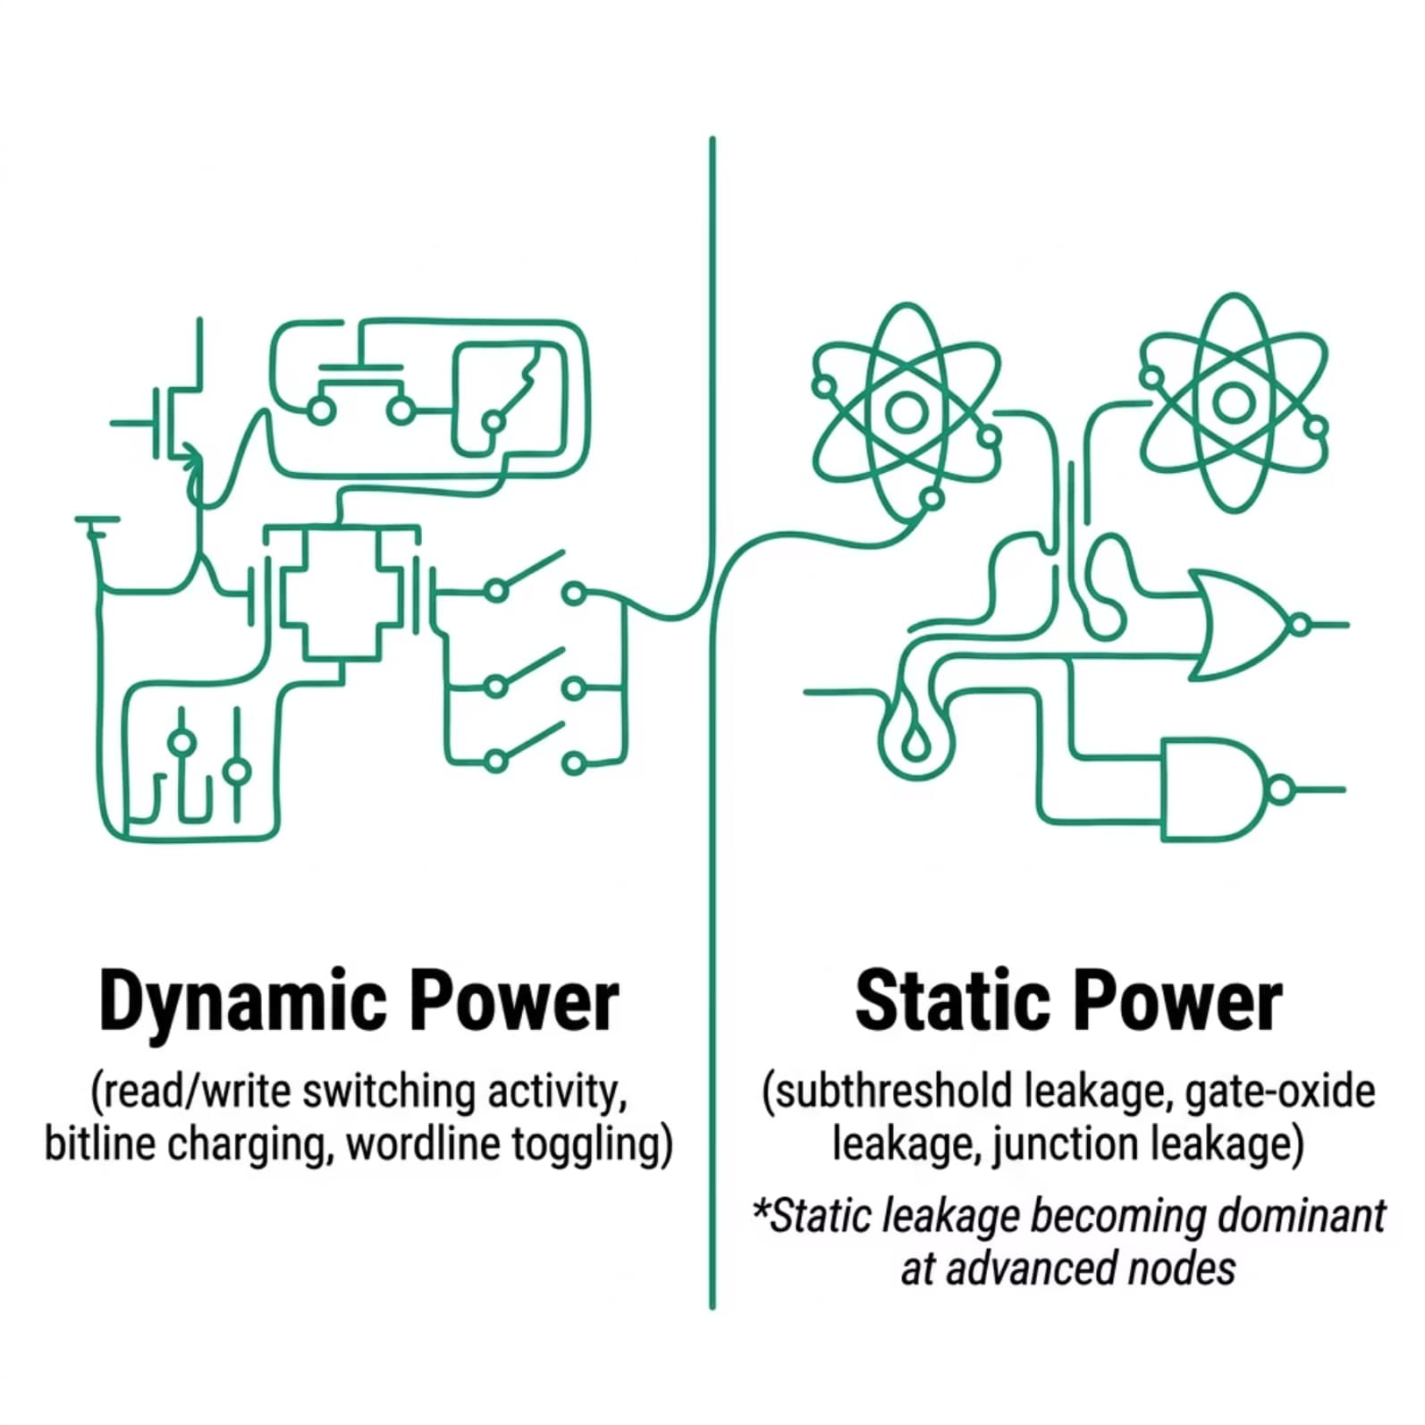


SRAM Power Breakdown
At advanced process nodes, static leakage power increasingly dominates total SRAM power consumption. Even when idle, large memory arrays dissipate significant energy through subthreshold and gate-oxide leakage currents.
Leakage reduction is the primary target of transistor sizing optimization in low-power SRAM design.

Slide 5

The Optimization Levers: Transistor Sizing
The width-to-length ratio (W/L) of each transistor in the 6T SRAM cell governs the tradeoff between drive strength, leakage, and stability margins.
Leakage Reduction
Read/Write Stability
Access Time
Wider L suppresses subthreshold current; narrow W reduces gate area and oxide leakage
Pull-up to pull-down ratios (β ratio) set the Static Noise Margin (SNM) for read operations
Access transistor sizing balances write margin against read disturbance without sacrificing speed

Slide 6

The Sizing Optimization Flow
Parametric Sweep
SPICE Simulation
Vary W/L ratios across cell transistors.
Evaluate power, stability, and speed metrics.
Define Constraints
Optimal Sizing
Set SNM, timing, and voltage targets.
Select Pareto-optimal design point.
Iterative SPICE-level simulation across the W/L design space yields a Pareto-optimal sizing that minimizes leakage while satisfying read SNM and write margin specifications.

Slide 7

Stability Metrics Under Sizing Constraints
Key Figure of Merit
The Static Noise Margin (SNM) is the primary stability metric. It is extracted from the butterfly curve of the SRAM cell and must remain positive under worst-case process, voltage, and temperature (PVT) corners.
1
Read SNM
2
Write Margin
3
Hold SNM
Constrained by pull-down to access transistor ratio (cell ratio)
Constrained by access to pull-up transistor ratio (pull-up ratio)
Maximized when access transistors are minimally sized

Slide 8
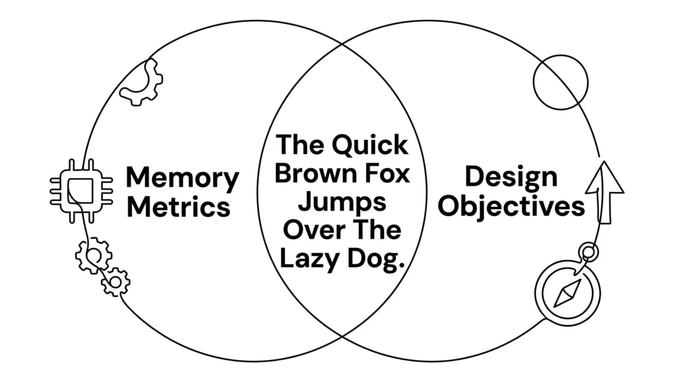

Multi-Objective Design Tradeoffs
No single transistor sizing simultaneously minimizes all three objectives. The optimization target is the Pareto frontier — the set of designs where no objective can be improved without degrading another.

Slide 9

Key Takeaways
01
Transistor sizing is the primary design variable
W/L ratios directly control leakage, drive strength, and noise margins in the 6T cell
02
Leakage dominates at advanced nodes
Static power reduction must be the first-order optimization objective in modern SRAM arrays
03
Stability and power are coupled constraints
SNM and write margin set hard lower bounds that the power optimization must respect
04
Pareto-optimal sizing is the goal
The design target is the balanced point minimizing power while meeting speed and stability specs

Slide 10
Design Objective — In One Line
Optimize transistor dimensions in SRAM cells to minimize power consumption while preserving stability and performance.
Minimize
Maintain
Achieve
Leakage & dynamic power across all operating modes
Read/write SNM above PVT worst-case threshold
Competitive access time within target clock frequency

