Slide 1

Spam Classification Using Machine Learning Algorithms
Submitted by:
Purushottam Prabhakar
17352220
MCA -V Semester

Slide 2
TABLE OF CONTENT
PROBLEM STATEMENT
LOADING PYTHON LIBRARIES AND UCI DATASET
CREATE THE TRAINING AND TESTING DATA
MODEL TRAINING WITH OUR “TRAINING” DATASET(Naïve bayes & svm)
CONFUSION MATRIX
MODEL EVALUATION
IMPROVING MODEL ACCURACY

Slide 3
Introduction
Email is one of the most efficient and effective mode of communicating with one another.
Today a serious problem for web users and web services is caused by inflow of large number of spam emails.
Spam mails are called the unwanted mails or unsolicited mails or bad emails which user receives without any prior information of the sender
To avoid irrelevant mails, need of effective mail filtering method is a timely requirement.

Slide 4
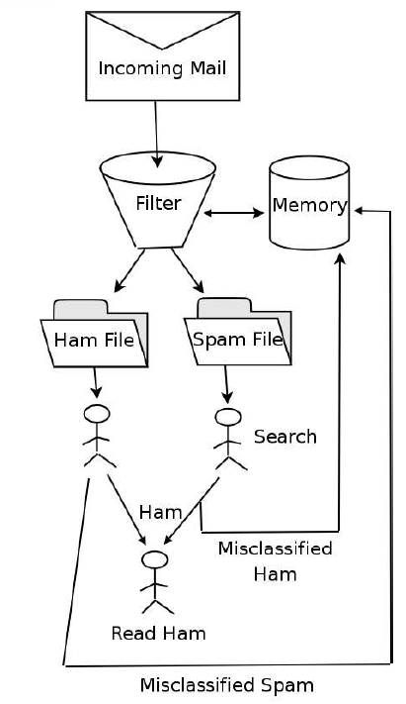
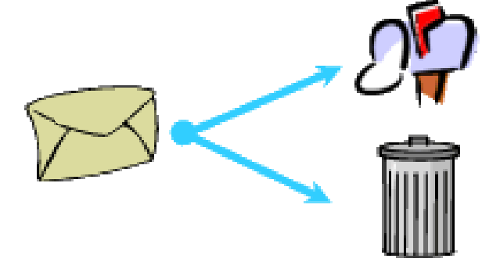
Problem Statement
Our task is to classify the messages in two different categories Ham or Spam.
30
Ham
Spam

Slide 5
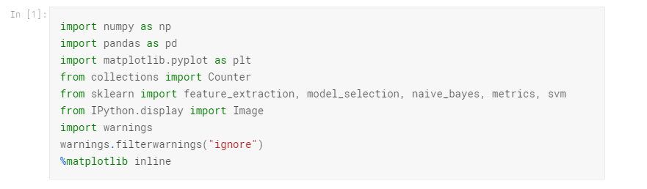
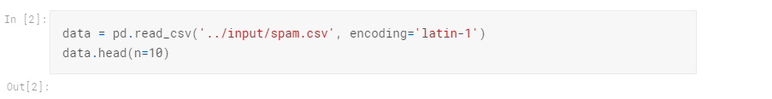
Loading Python Libraries and UCI Spam Dataset

Slide 6
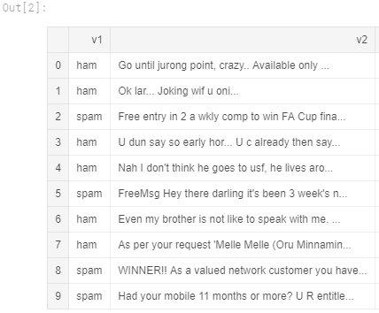
Let’s view the data in a Dataframe

Slide 7
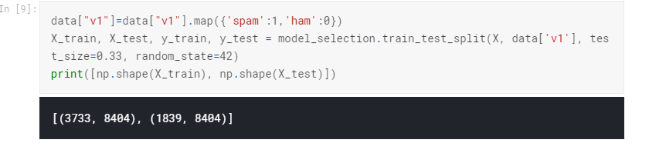
Create the training and testing data
Training data = the subset of our data used to train our model.
Testing data = the subset of our data that the model hasn’t seen before (We will be using this dataset to test the performance of our model).

Slide 8
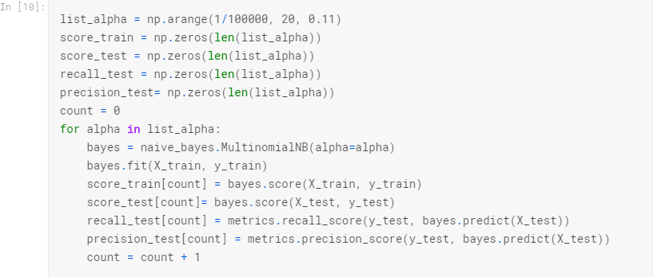
Model Training with our “training” dataset
We train different bayes models changing the regularization parameter α.
We evaluate the accuracy, recall and precision of the model with the test set.

Slide 9
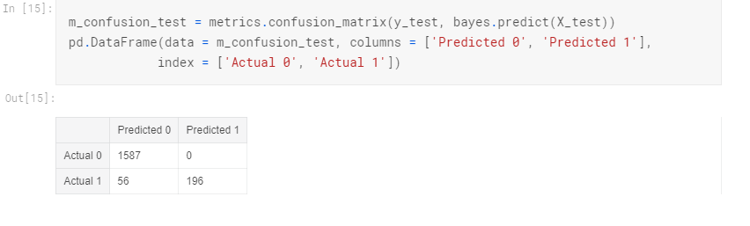
MODEL EVALUATION
We misclassify 56 spam messages as non-spam emails whereas we don't misclassify any non-spam message.

Slide 10
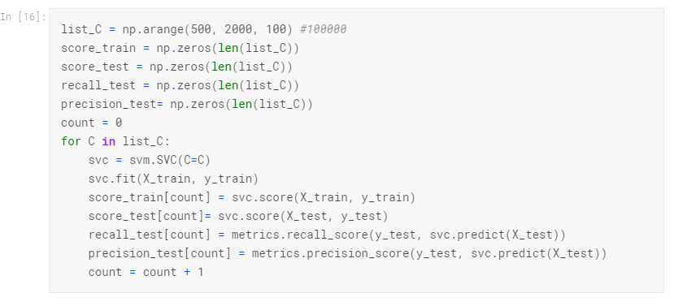
MODEL CREATION SUSING SVM

Slide 11
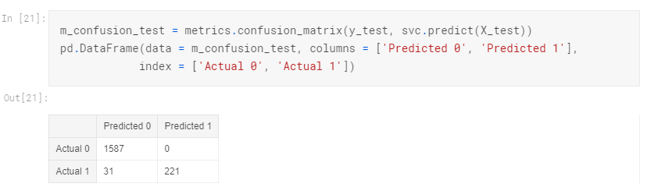
Confusion Matrix for SVM model
We misclassify 31 spam as non-spam messages whereas we don't misclassify any non-spam message.

Slide 12
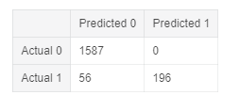
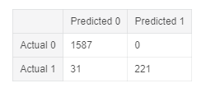
Comparing Naive Bayes classifier with SVM through Confusion matrix.
Naive Bayes
SVM
Conclusion
The best model I have found is support vector machine with 98.3% accuracy.
It classifies every non-spam message correctly (Model precision)
It classifies the 87.7% of spam messages correctly (Model recall)

Slide 13
THANK YOU

