Slide 1

ADHIYAMAAN COLLEGE OF ENGINEERING (AUTONOMOUS)
DEPARTMENT OF ECE
BATCH NUMBER-34
A Rainfall Forecasting Estimation based on natural statics and Gabor features Using Satellite Image Processing Technology
Internal Supervisor,
Mr. J .Subhash M.E (Asst. Prof)
Presented by,
Naveen kumar C (AC15UEC101)
Prabakaran S (AC15UEC116)
Prem kumar R (AC15UEC199)

Slide 2
Contents
Objective
Abstract
Existing methods
Existing method disadvantages
Proposed method
Proposed method advantages
Process Flow
Working Algorithm
Predicted output
References

Slide 3
Objective
The main objective is used to forecast the rainfall based on natural statics and Gabor features using satellite image processing technology. It allows to predict the rainfall in accurate range.

Slide 4
Abstract
Cloud detection is an important task in remote sensing satellite image processing. Numerous cloud detection algorithms have been developed. However, most existing methods suffer from the weakness of omitting small and thin clouds, and from an inability to discriminate clouds from photo metrically similar regions, such as buildings and snow.
Here, we derive a novel cloud detection algorithm for satellite images. First, a simple linear iterative clustering algorithm is adopted that is able to segment potential clouds, including small clouds.

Slide 5
Then, a natural scene statistics model is applied to the super pixels to distinguish between clouds and surface buildings. Finally, Gabor features are computed within each super pixel and it is used to distinguish clouds from snow regions. Finally we can predict the types of rainfall cloud and the status of rainfall easily in particular area by using cloud mask algorithm.

Slide 6
Existing method
Various cloud algorithms are used to predict the rainfall range in satellite images based on color, texture, structure.
The extracted texture information using Gabor filtering in image without taking pixel intensities and regional structure into account.
Support vector machine (SVM) is neglected the small clouds in the image.
The convolution neural network (CNN) to divide images into thick clouds, thin clouds, and non cloudy regions, but the network has difficulty in distinguishing clouds from snow.

Slide 7
Existing method disadvantages
This features performs only the particular action for cloud detection in satellite images.
It may avoid the identification of small and thin clouds and inability to discriminate clouds form similar regions such buildings and snow.
So the prediction of rainfall range is not accurate.

Slide 8
Proposed method
To address the above-mentioned drawbacks, we propose
a novel cloud detection method that exploits a complementary combination of natural scene statistic (NSS) and Gabor features.
First, the simple linear iterative clustering (SLIC) algorithm is applied to segment the image into ambiguous super pixels. Then, the NSS features are used to classify the ambiguous super pixels into possible thick clouds, thin clouds, and non clouds.
Gabor features are used to separate clouds from snowy areas. Finally, We can predict the types of cloud and its range by using cloud mask algorithm.

Slide 9
Proposed method advantages
It produces the accurate range of rainfall in this analysis.
It is better when compared to other techniques for prediction of rainfall.
It is efficient and effective.

Slide 10
Process flow
Satellite Cloud images
SLIC algorithm
To segment the image into ambiguous pixels
Spatial Domain in NSS
To identify the cloud and snow part in image
Gabor features and SVM
SSeparation of clouds from the snowy areas
Cloud Mask Algorithm
Prediction of types of clouds and its range of rainfall

Slide 11
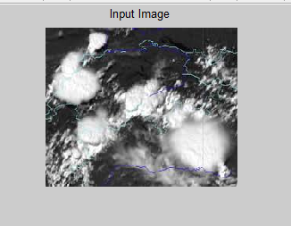
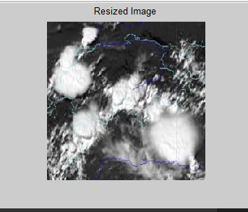
Working Algorithm
STEP 1:
Initially to get the file from the database by using the command [aa bb] = uigetfile('.jpg'). Then the extracted image will be read and write in the editor box.
STEP 2:
Later the processed image will be resized by the command I1=imresize(I,[256 256]).

Slide 12
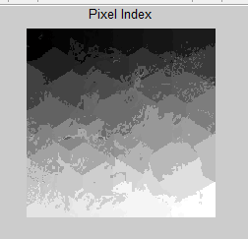
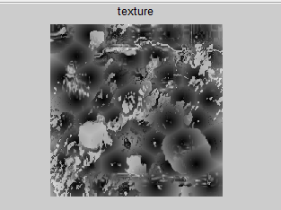
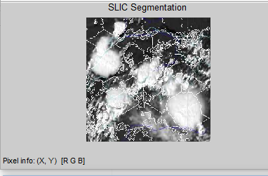
STEP 3 :
The resized image under goes the process of SLIC segmentation. It is the state of the art algorithm to segment super pixels which doesn’t require much computational power.
SLIC performs a local clustering of pixels in 5-D space defined by the L, a, b values of the CIELAB color space and x, y coordinates of the pixels. It has a different distance measurement which enables compactness and regularity in the super pixel shapes, and can be used on grayscale images as well as color images.

Slide 13
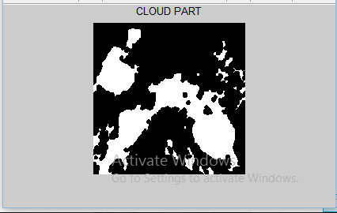
STEP 4:
The above extracted image (xy-plane) will be processed in spatial domain in NSS features. Spatial domain is refers to a space in an image. It works based on the modifying the value of pixels in the image.
By using this domain, the cloud part in the image can be extracted easily in accurate level.
STEP 5:
Sometimes the Separated image has Snow as well as cloud. So, we need to separate the snow and cloud in image by using Gabor features.

Slide 14
Gabor filter is a linear filter used for texture analysis, which means that it basically analyzes whether there are any specific frequency content in the image in specific directions in a localized region around the point or region of analysis.
This method is separated the snow and cloud in accurate level.
STEP 6 :
Then the predicted image can be processed by using Cloud mask algorithm.
The basic idea of this approach is to detect cloud, cloud shadow and its range by using the difference reflectance values between clear pixels and cloud and cloud shadow contaminated pixels.

Slide 15
Predicted output
The basic characters of cloud like shape, color, texture, edge are obtained to prediction of rainfall by image processing.
The rainfall forecast estimation by applying image processing technology has been developed to monitor the daily rainfall amounts accurately around the world.

Slide 16
Reference
C. Solomon and T. Breckon, “Fundamentals of Digital Image
Processing: A Practical Approach with Examples in MATLAB,” A John
Wiley & Sons, Ltd., Publication, 2016.
X. Hu, Y. Wang, and J. Shan, “Automatic recognition of cloud images
by using visual saliency features,” IEEE Geosci. Remote Sens. Lett.,
vol. 12, no. 8, pp. 1760–1764, Aug. 2015.
M. P. Darji, V. K. Dabhi, and H. B. Prajapati, “Rainfall forecasting using neural network: A survey,” 2015 Int. Conf. Adv. Comput. Eng. Appl., no. March, pp. 706–713, 2015.
P. Li, L. Dong, H. Xiao, and M. Xu, “A cloud image detection method
based on SVM vector machine,” Neurocomputing, vol. 169, no. 2,
pp. 34–42, Dec. 2015.
C. S. Thirumalai, “Heuristic Prediction of Rainfall Using Machine Learning Techniques,” no. May, 2017.

Slide 17
Any Queries???

Slide 18
Thank you…!

