Slide 1

ADHIYAMAAN COLLEGE OF ENGINEERING (AUTONOMOUS)
AUTOMATIC HUMP CONTROLLER FOR EMERGENCY VEHICLES BY USING WIFI TECHNOLOGY
DEPARTMENT OF ECE
BATCH NUMBER-34
Internal Supervisor,
Mr. J .Subhash.
Presented by,
Naveen kumar C (ACUEC101)
Prabakaran S (AC15UEC116)
Prem kumar R (AC15UEC199)

Slide 2
Contents
Objective
Abstract
Existing Method
Existing Method disadvantages
Proposed method
Block diagram
Advantages
Circuit diagram
Expected output
Further Enhancement
Gantt chart
References

Slide 3
Objective
The project is used to implement the automatic hump controller for emergency vehicles by using WIFI technology. It allows the vehicles to maintains same speed & results in saving humans life.

Slide 4
Abstract
In this world, Emergency vehicles moving in the traffic area is very crucial task, and presence of hump slows down the movement of vehicles. This problem can be overcome by using WIFI Technology with point to point protocol.
The Transmitter of the WIFI module is to be fitted in the emergency vehicles (ambulance and fire services). In the other side the Receiver can be fixed to the hump along with a microcontroller.
When the transmitter comes into range of receiver, the hump is reduced to level of the road. Then the emergency vehicle maintains with same speed while crossing the hump.
This operation is controlled by the DC motor and allows the drivers to work efficiently and effectively.

Slide 5
Exisiting method
In this system , IR sensor is used to detect motion of the vehicle. If vehicle speed is low, then hump goes to the level of the road. otherwise the hump present in own position.
It controls the speed of vehicles.

Slide 6
Existing method disadvantages
Vehicles has to maintain their low speed, then only hump goes to level of the road.
At the place, the vehicles speed will be reduced for safe driving. So the emergency vehicle passing the area is very crucial one.

Slide 7
Proposed method
This problem is overcome by using WIFI technology with point to point protocol.
The transmitter of WIFI module is fixed to the emergency vehicle with arduino NANO by using power supply .
In hump, the receiver of WIFI module is attached with the microcontroller(arduino NANO).
The transmitter and receiver is gets into contact automatically transmitter passes signal to the receiver .

Slide 8
Then the receiver of WIFI module connected to micro controller by using relay module to control the DC electric motor.
By using this motor to create the hump goes to road level . After certain time the mismatch of WIFI transmitter and receiver module the hump return its own position.
By using this technology, the emergency vehicles goes in the road safe without any disturbances.

Slide 9
Block diagram
Transmitter side
External power supply
Ardiuno NANO
Wifi transmitter
ESP8266
Receiver side
Transmitter sidef
To control the Hump
Relay module
Ardiuno NANO
Electric DC motor
Wifi receiver ESP8266

Slide 10
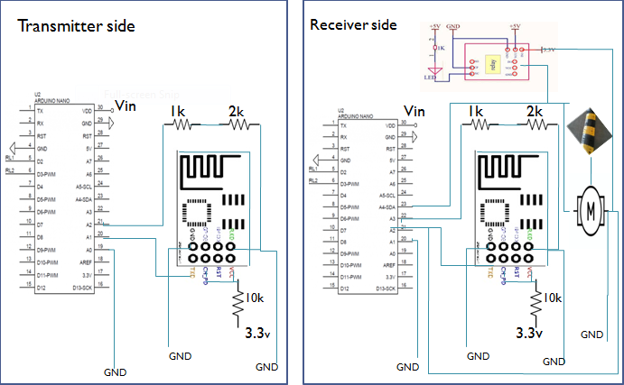
Circuit Diagram

Slide 11
Advantages
Automatically control the hump without any interface while crossing emergency vehicles.
Emergency vehicles maintain same speed at any time.
So this vehicles reach their exact location at certain time.

Slide 12
Expected output
By using this microcontroller, WIFI module, relay and dc motor, we can easily control the hump in the road.
Its cause the emergency vehicles to move same speed while crossing the hump.
It is efficient and effective.

Slide 13
Further Enhancement
Individual identity numbers for every emergency vehicles can be created by using IP address. After this id’s data is fetched to the server.
This vehicles reaches certain zone in area then the data matches to the server. As a result server is connected to receiver side automatically & easily control the hump in the road.

Slide 14
Gantt Chart
ACTIVITY | TIME IN WEEKS
 | 1 | 2 | 3 | 4 | 5 | 6 | 7 | 8 | 9 | 10 | 11 | 12
Preliminary investigation
Data analysis
Purchase of Equipments
Circuit Analysis
Algorithm Development
Soldering
Testing
Evaluation of Results
Final Reports
c
completed
t
To be completed

Slide 15
Reference
[1] The International Journal of Engineering and Science (IJES) ||Volume|| 2 ||Issue|| 11 ||Pages|| 25-27 ||2013|| ISSN(e): 2319 – 1813 ISSN (p): 2319 – 1805
[2] International Journal of Advances in Engineering & Technology, May, 2014. Piyush Bhagdikar , Shubham Gupta, VIT University Chennai Campus, Vandalur - Kelambakkam Road, Chennai 600127, India.0
[3]. Mukherje Chakrabarti , 2005, Fundamentals of renewable energy systems, New Age international limited publishers, New Delhi

Slide 16
Any Queries???

Slide 17
Thank you…!

