Slide 1
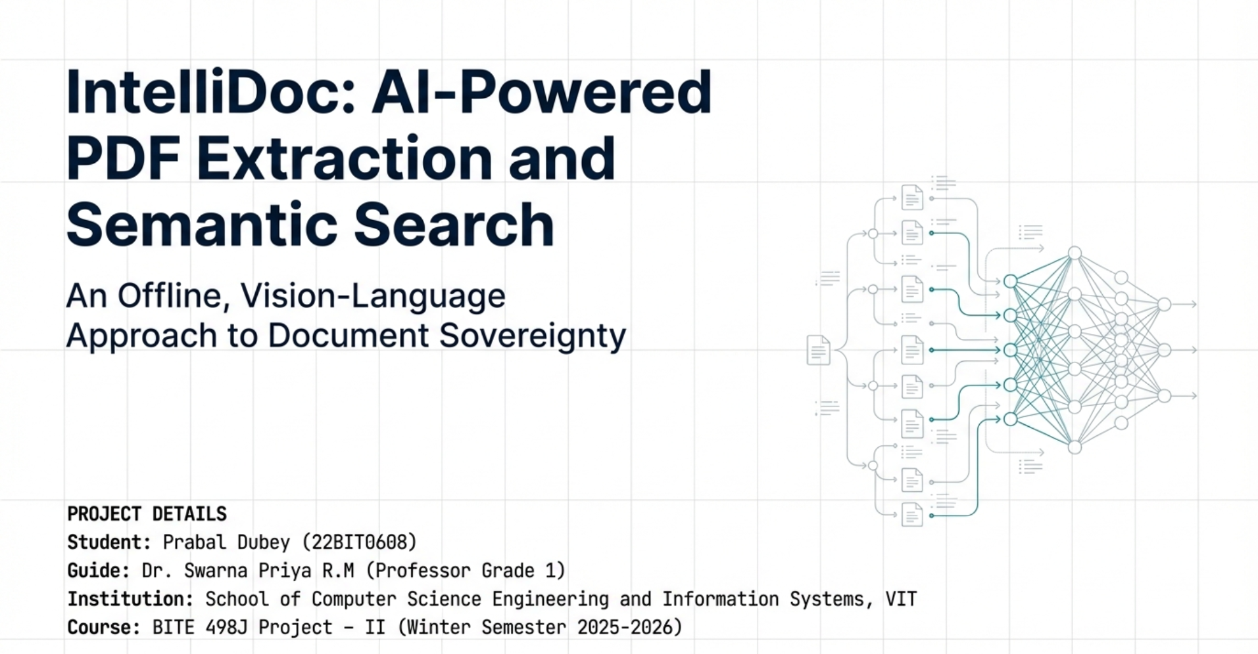

Slide 2



The Evolving Landscape of Document Interaction
The Rise of LLMs
The PDF Challenge
The Need for Grounding
Large Language Models have revolutionized natural language interfaces, offering unprecedented capabilities in search, summarization, and question-answering.
PDFs, the standard for academic, legal, and financial documents, pose significant hurdles for AI due to their complex layouts and structured content.
Document-centric tasks demand answers strictly rooted in the file's content, preventing reliance on general training data for accuracy.

Slide 3
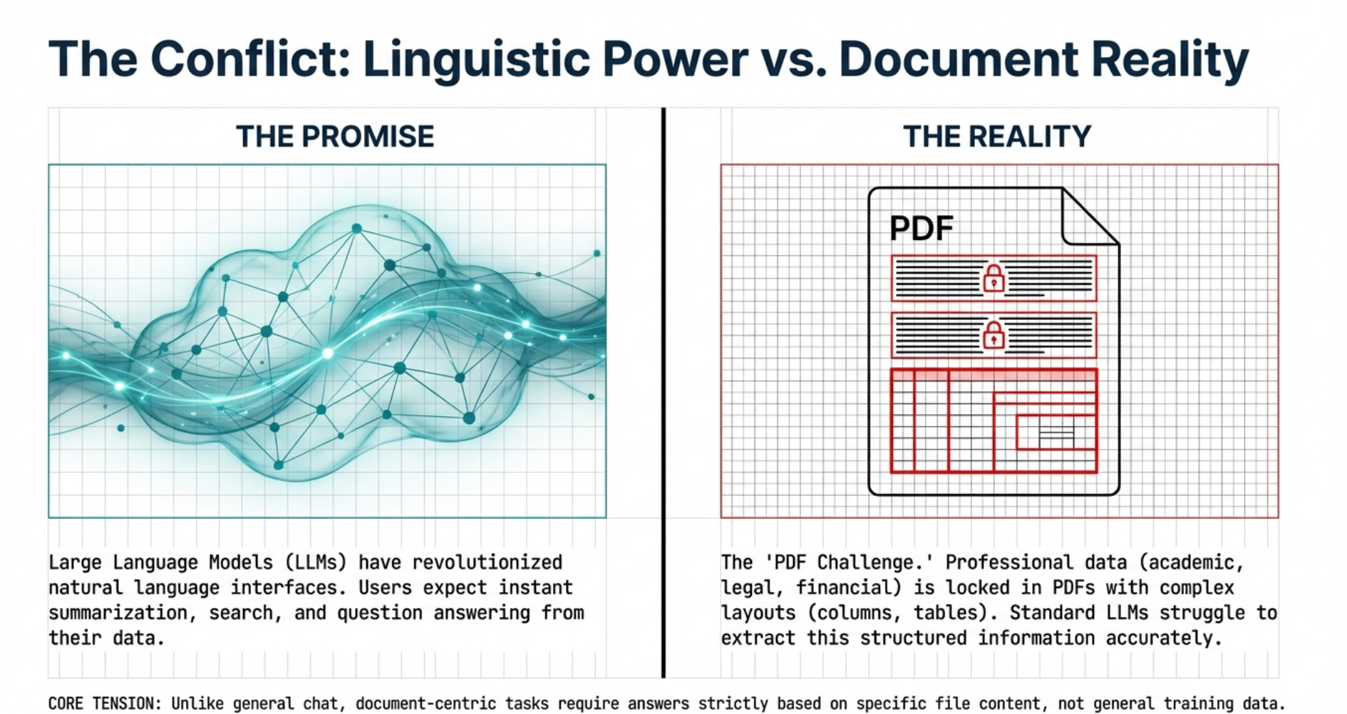

Slide 4



Bridging the Gap in Current AI Capabilities
Semantic Limitations
Privacy Risks
Hallucinations
Traditional keyword searches often miss the user's true intent, leading to irrelevant or incomplete results.
Many AI solutions utilize external cloud APIs, creating security vulnerabilities for sensitive or confidential data.
LLM assistants frequently generate plausible but entirely fabricated information, undermining trust and reliability.

Slide 5
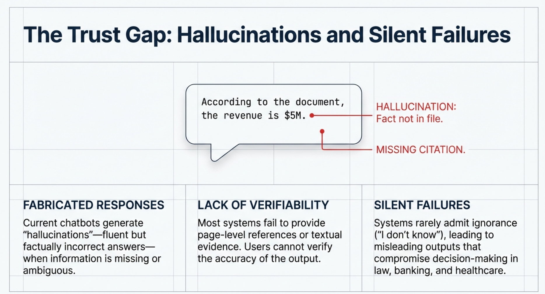

Slide 6
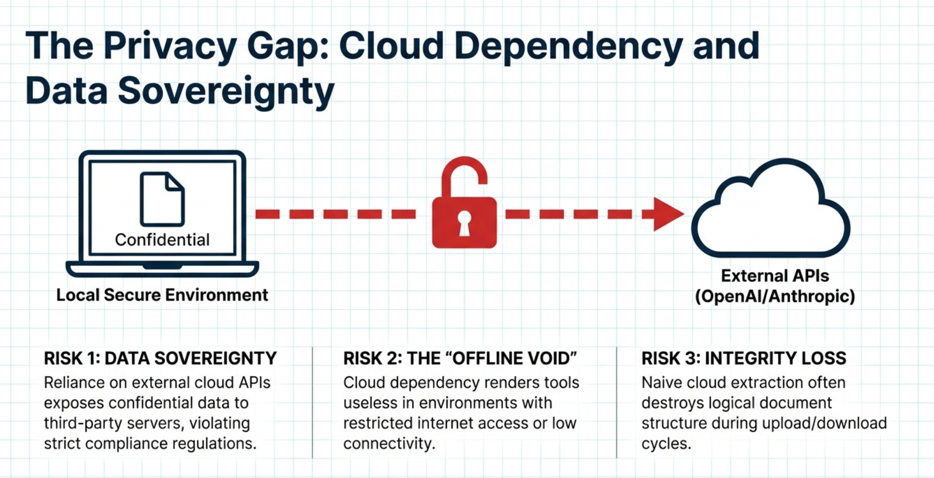

Slide 7
Motivation: The Drive for a Secure and Accountable AI
Privacy-First AI
Accountability in AI
User Control & Data Adherence
There is a critical need for systems that operate entirely offline, ensuring sensitive documents never leave the user's local machine and maintaining absolute confidentiality.
In high-stakes domains such as law and compliance, AI systems must provide verifiable, evidence-grounded answers to ensure accountability and mitigate risks.
Users require a solution that seamlessly combines the power of advanced LLMs with strict adherence to their own provided data, giving them complete control over their information.

Slide 8
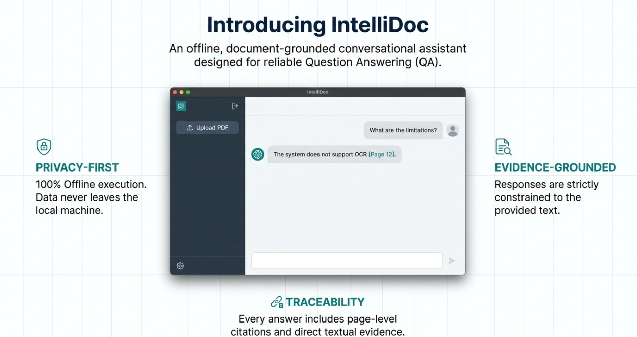

Slide 9



OBJECTIVE
Developing an Offline, Evidence-Based Conversational Assistant
Offline Conversational Assistant
Develop a system that enables natural language interaction with PDFs without internet dependency, providing instant, secure access to information.
Evidence-Based Generation
Minimize hallucinations by strictly grounding all responses in the uploaded document content, ensuring accuracy and reliability.
Local Infrastructure
Ensure complete data privacy and security by processing all data exclusively on local hardware, protecting sensitive information.

Slide 10
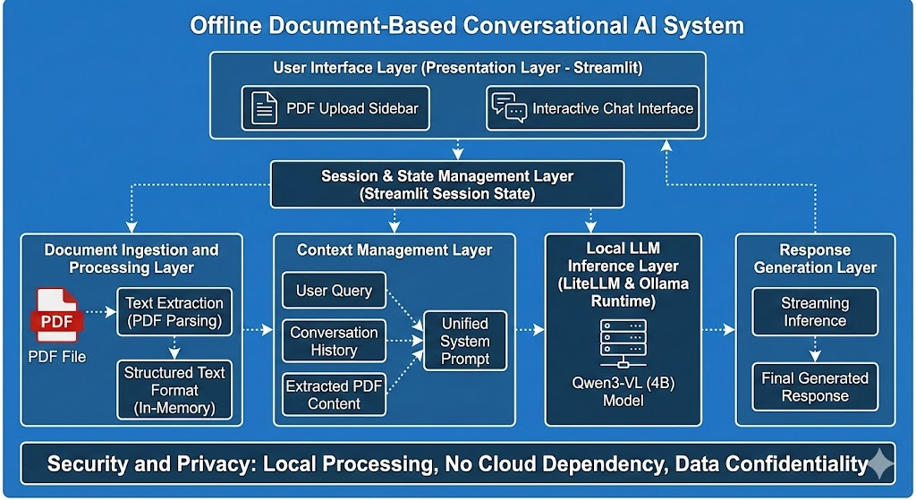
SYSTEM ARCHITECTURE

Slide 11
SPECIFIC OBJECTIVES
Key Technical Goals for IntelliDoc
1
2
Context Preservation
Local Inference Integration
Extract text while meticulously maintaining page-level structure to improve traceability and ensure accurate referencing.
Integrate the Qwen3-VL (4B) vision-language model via Ollama for efficient, high-performance offline processing.
3
4
Controlled Prompting
Transparency in Reporting
Implement robust mechanisms that restrict the model to answer solely using the provided document text, preventing fabrication.
Explicitly report when information is absent within the document rather than generating a fabricated answer, building user trust.

Slide 12
PROJECT SCOPE
IntelliDoc: Capabilities and Limitations
Current Capabilities
Current Limitations
Input Support: Designed for single format, text-based PDF documents.
Operational Environment: Fully offline; no reliance on external cloud services or APIs.
Target Domains: Optimized for education, legal analysis, research, and compliance verification.
Does not support OCR for image-only PDFs.
Does not support multi-format document knowledge bases for broader searches.

Slide 13
OVERVIEW
Document Question Answering: 2023-2025 Survey
Research Scope
Key Trend: Groundedness
Emerging Tech: Multimodal RAG
Analyzed 15 recent research papers focusing on Document Question Answering (DQA) and Retrieval-Augmented Generation (RAG) to identify key trends and emerging technologies.
A distinct shift from pure language generation toward "groundedness" and evidence-based systems to combat hallucinations and ensure factual accuracy.
Growing focus on "Multimodal RAG" to handle complex document elements like tables, charts, and images, enhancing comprehensive understanding.

Slide 14



KEY FINDINGS
Enhanced Capabilities in DQA and RAG
Retrieval Augmentation
Advanced Prompting Strategies
Structured Understanding
Injecting relevant document segments into the prompt significantly improves factual correctness and contextual relevance of generated responses.
Techniques like "Chain-of-Evidence" prompting successfully enforce reliability, trace information back to its source, and reduce misinformation risks.
New models (2024-2025) are better at comprehending visually rich documents, moving beyond raw text to interpret complex layouts and data representations.

Slide 15
KEY FINDINGS
Current Limitations in Document Question Answering and RAG Systems
Privacy Gaps
Resource Intensity
The Offline Void
Most state-of-the-art systems still rely on cloud-based Large Language Models (LLMs), posing significant risks for handling confidential or sensitive data.
Multimodal approaches are often computationally expensive, demanding specialized hardware and significant processing power, limiting widespread accessibility.
There is a significant lack of research and practical solutions for fully offline, locally hosted systems designed for sensitive document analysis.

Slide 16
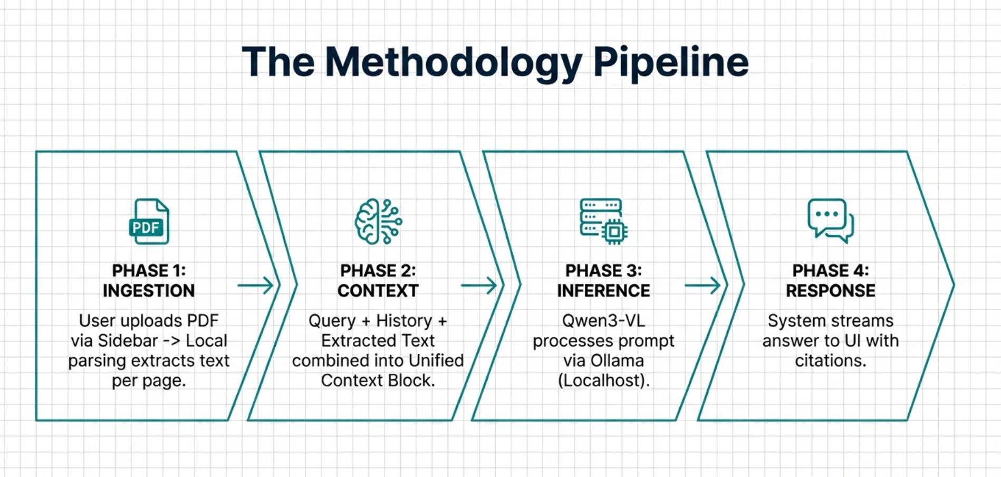
OUR SOLUTION
Modular System Design and Methodology
Our system implements a robust, four-phase methodology to ensure privacy-preserving and evidence-backed document analysis, from initial upload to final answer.

Slide 17

PHASE 1
Document Ingestion & Preprocessing
The initial phase focuses on secure and efficient document handling, prioritizing user control and data privacy from the outset.
User Action
Text Extraction
Users upload PDF documents directly through the Streamlit sidebar interface, maintaining local control.
A local PDF parsing library extracts textual content, segmenting it by page to preserve original document structure.
This design choice guarantees that no user data ever leaves the local environment.
Secure Storage
Extracted content is stored strictly in Session State (memory), avoiding persistent storage to protect sensitive data.

Slide 18
PHASE 2
Context & Prompting for Grounded Responses
1
2
3
Unified Context Creation
Controlled System Prompt
Strict Grounding Logic
The system dynamically combines the user's current query, the ongoing conversation history, and extracted PDF text into a single, comprehensive context block.
The prompt explicitly forbids the model from leveraging outside knowledge, significantly reducing the potential for factual inaccuracies and hallucinations.
A "controlled prompting mechanism" meticulously injects the document text and strictly instructs the model to use only this provided data for its responses.

Slide 19
PHASE 3
Local LLM Inference for Real-Time Answers
This phase leverages local processing to deliver immediate, accurate, and privacy-preserving responses directly on the user's machine.
Model Engine: Qwen3-VL (4B)
By operating entirely offline, we ensure that sensitive information remains secure and confidential.
Utilizes Qwen3-VL (4B), an efficient open-source model hosted locally via the Ollama runtime for robust inference.
Communication Layer: LiteLLM
LiteLLM acts as an abstraction layer, standardizing communication between the application and the local model, ensuring seamless operation.
Streaming Responses
Responses are generated incrementally (streaming), ensuring the user sees the answer being built in real-time, enhancing user experience.

Slide 20
CORE PRINCIPLE
Unwavering Commitment to Security & Privacy
Local-Only Processing
In-Memory Handling
Enhanced Confidentiality
All computations, from document ingestion to response generation, occur exclusively on the user's local machine; no data is ever transmitted to the cloud.
Document data is processed entirely in RAM and is not stored permanently on disk, effectively mitigating data residue and breach risks.
This architecture makes the system ideally suited for handling strictly confidential academic, legal, and enterprise documents where data privacy is paramount.

Slide 21
SYSTEM BENEFITS
Key Features of Our DQA System
Evidence-Grounded Answers
Page-Level Citations
Responses are strictly derived from the provided document; if information is not found, the system transparently states its inability to answer, preventing fabrication.
Every generated response includes precise references to the specific page(s) within the document where the information was located, enhancing trustworthiness.
Real-Time Performance
Transparency in Information
Streaming inference provides immediate feedback to the user, enhancing the overall experience and making interactions feel seamless and responsive.
The system explicitly reports when information is missing, fostering trust by avoiding the fabrication of plausible but incorrect responses.

Slide 22
CONCLUSION
Project Summary: Offline, Privacy-Preserving DQA
Achieved a Robust Solution
Solved Critical Problems
Demonstrated Feasible Performance
Directly addressed the prevalent issues of hallucination and data privacy commonly found in cloud-based RAG systems, enhancing reliability.
Successfully designed and implemented an offline, privacy-preserving conversational assistant for document question answering.
Proved that consumer-grade hardware can effectively handle long-form document QA using efficient local models, democratizing access to advanced NLP.

Slide 23
CONCLUSION
IntelliDoc: Trust, Transparency, and Feasibility
Trustworthy AI
User Confidence
Feasibility
IntelliDoc ensures every output is directly traceable to the source document, providing unprecedented explainability and transparency in AI-driven analysis.
The system's strict evidence enforcement builds profound trust, making it a robust and reliable tool for rigorous academic research and demanding legal applications.
IntelliDoc demonstrates that high-quality document analysis is achievable without expensive cloud subscriptions or compromising data privacy and security.

Slide 24
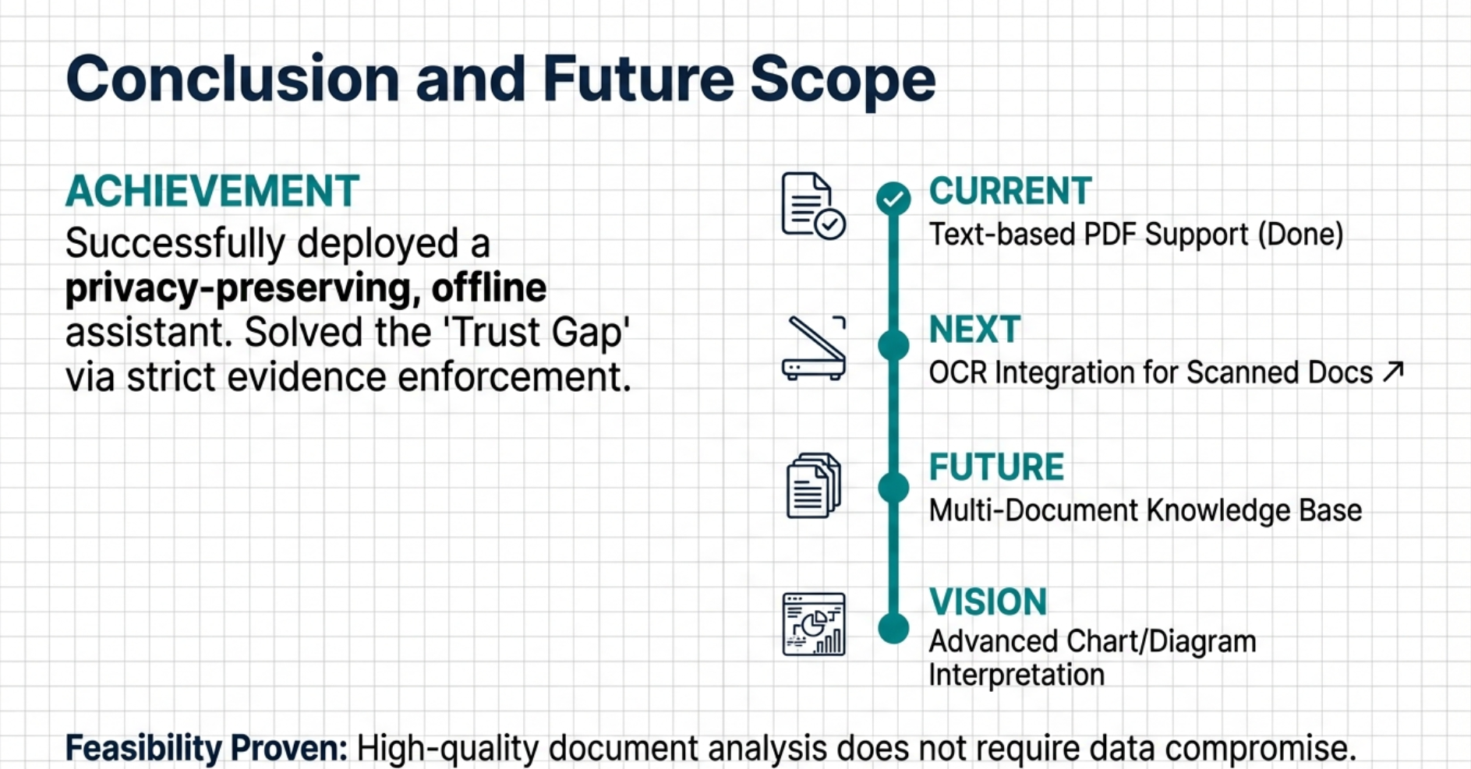

Slide 25
RESOURCES
Key References for IntelliDoc's Foundation
NeuSym-RAG: Hybrid Neural Symbolic Retrieval with Multiview Structuring for PDF QA (2025)
PDF Retrieval Augmented Question Answering (2025)
A foundational paper detailing techniques for enhancing question answering by augmenting with information from PDF documents.
This seminal work explores advanced retrieval methods crucial for complex PDF question-answering systems.
Groundedness in Retrieval-Augmented Generation (2024)
Retrieval-Augmented Generation for NLP: A Survey (2025)
Addresses the critical aspect of ensuring AI-generated content is well-supported by verifiable sources, central to IntelliDoc's trustworthiness.
A comprehensive overview of the field of Retrieval-Augmented Generation, providing context and state-of-the-art developments.

