Slide 1
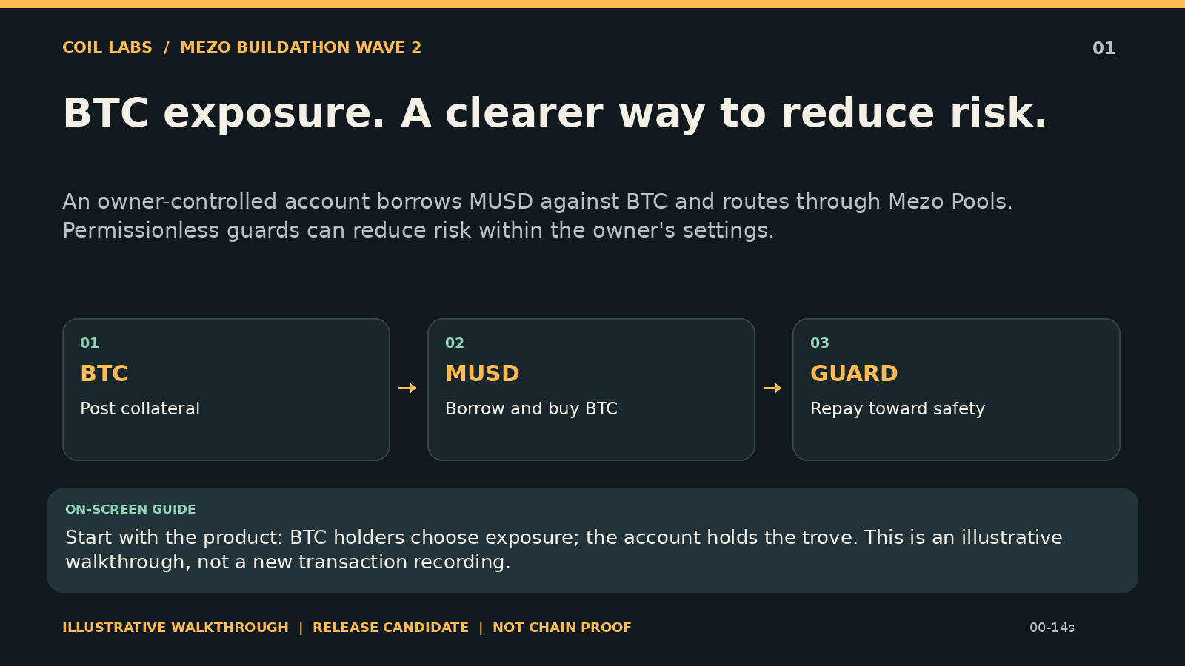
Notes:
BTC exposure. A clearer way to reduce risk.
An owner-controlled account borrows MUSD against BTC and routes through Mezo Pools. Permissionless guards can reduce risk within the owner's settings.
Start with the product: BTC holders choose exposure; the account holds the trove. This is an illustrative walkthrough, not a new transaction recording.
Illustrative release candidate. Historical receipts: ../../DEPLOYMENTS.md. No new on-chain proof.

Slide 2
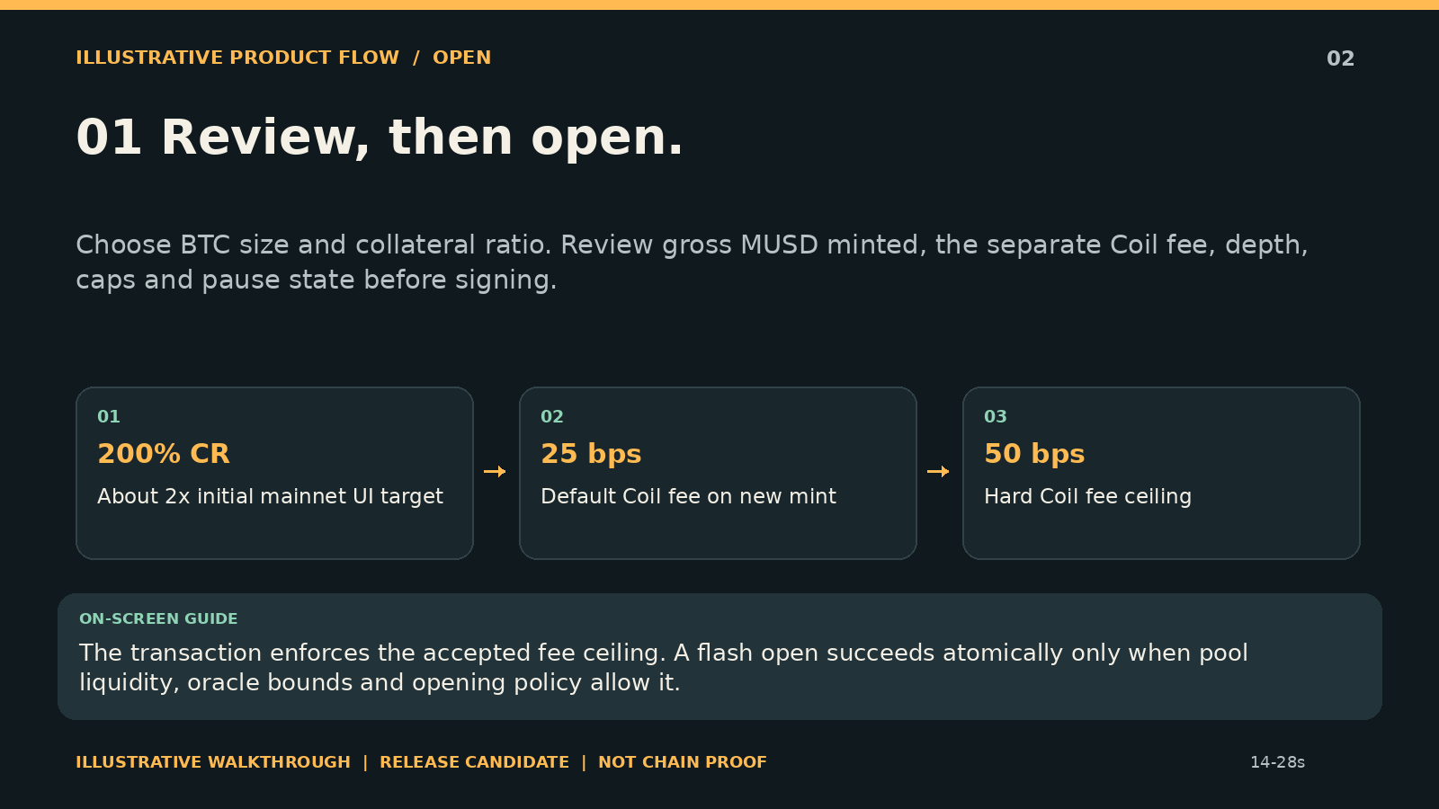
Notes:
01 Review, then open.
Choose BTC size and collateral ratio. Review gross MUSD minted, the separate Coil fee, depth, caps and pause state before signing.
The transaction enforces the accepted fee ceiling. A flash open succeeds atomically only when pool liquidity, oracle bounds and opening policy allow it.
Illustrative release candidate. Historical receipts: ../../DEPLOYMENTS.md. No new on-chain proof.

Slide 3
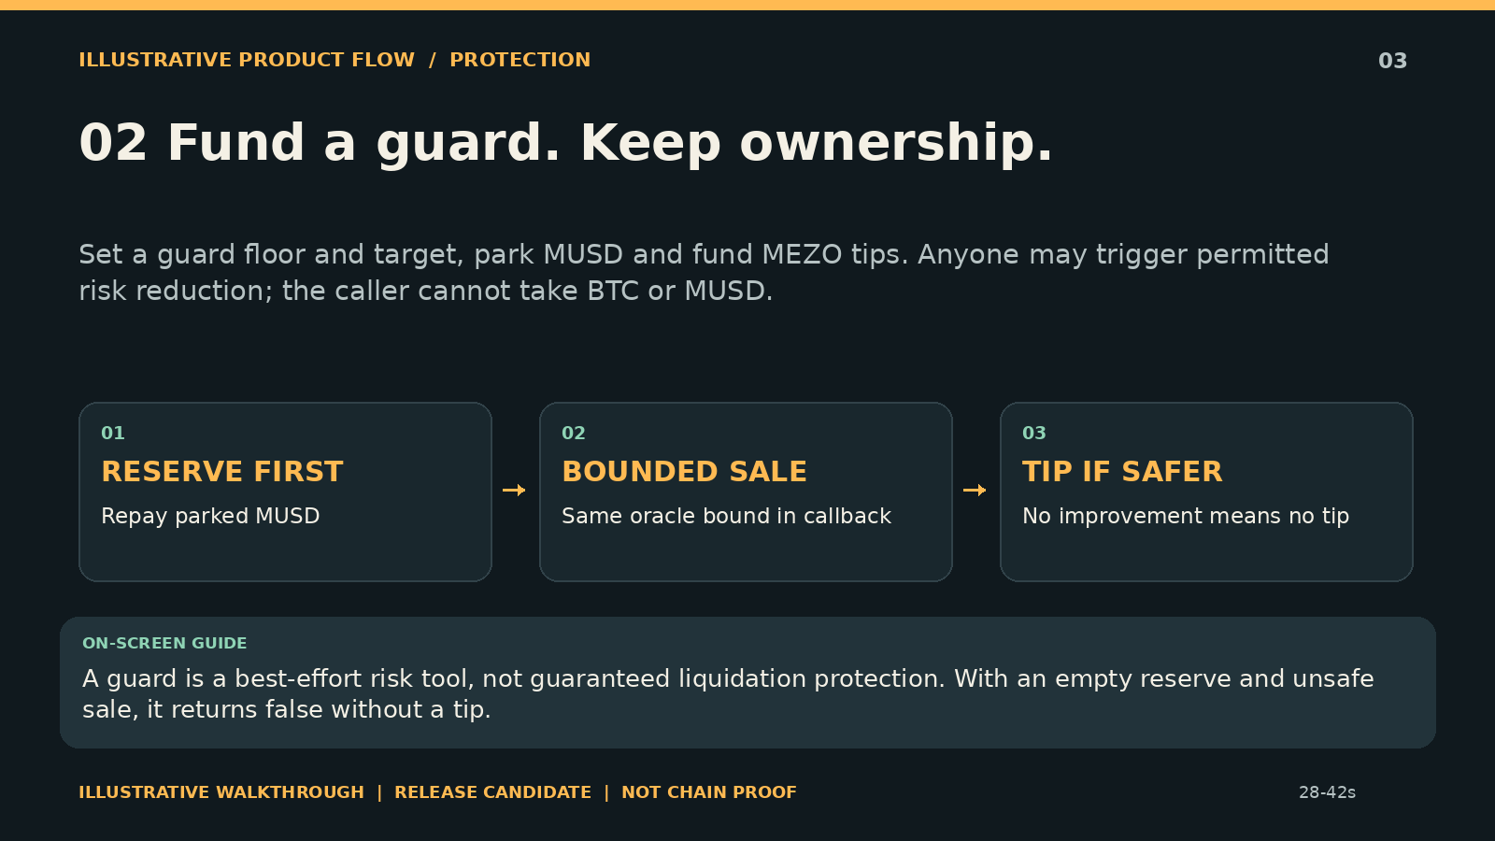
Notes:
02 Fund a guard. Keep ownership.
Set a guard floor and target, park MUSD and fund MEZO tips. Anyone may trigger permitted risk reduction; the caller cannot take BTC or MUSD.
A guard is a best-effort risk tool, not guaranteed liquidation protection. With an empty reserve and unsafe sale, it returns false without a tip.
Illustrative release candidate. Historical receipts: ../../DEPLOYMENTS.md. No new on-chain proof.

Slide 4
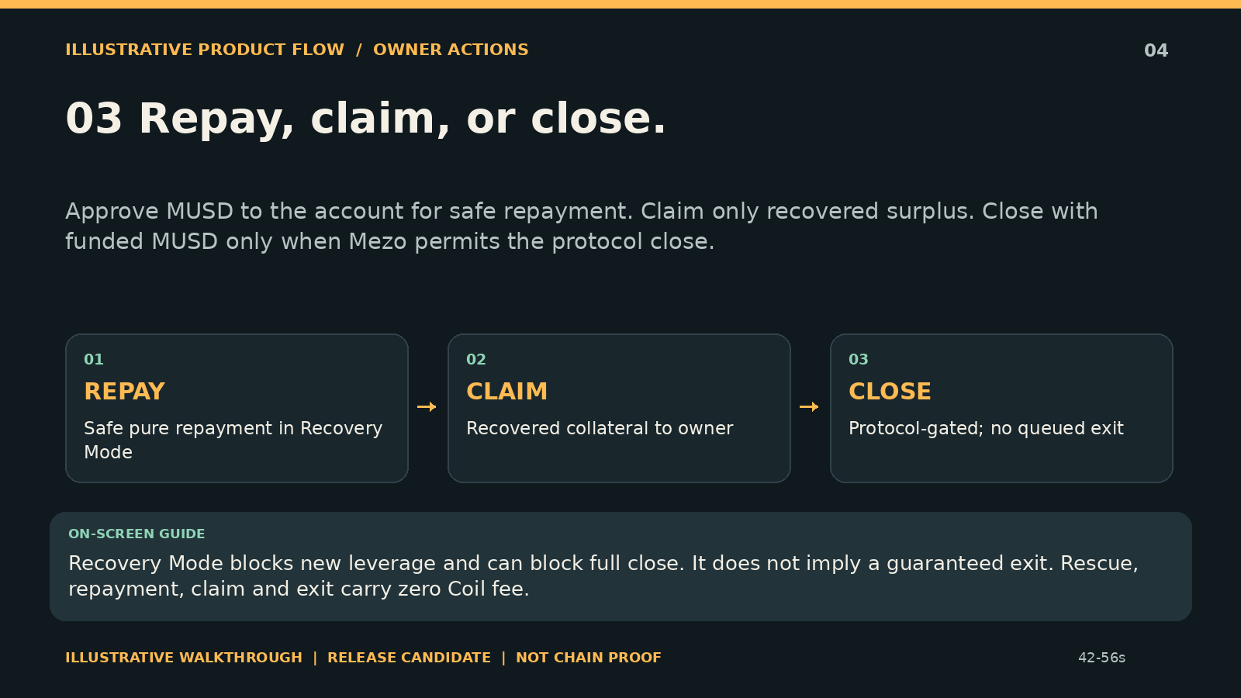
Notes:
03 Repay, claim, or close.
Approve MUSD to the account for safe repayment. Claim only recovered surplus. Close with funded MUSD only when Mezo permits the protocol close.
Recovery Mode blocks new leverage and can block full close. It does not imply a guaranteed exit. Rescue, repayment, claim and exit carry zero Coil fee.
Illustrative release candidate. Historical receipts: ../../DEPLOYMENTS.md. No new on-chain proof.

Slide 5
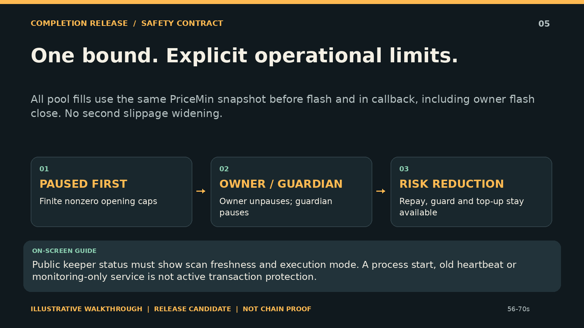
Notes:
One bound. Explicit operational limits.
All pool fills use the same PriceMin snapshot before flash and in callback, including owner flash close. No second slippage widening.
Public keeper status must show scan freshness and execution mode. A process start, old heartbeat or monitoring-only service is not active transaction protection.
Illustrative release candidate. Historical receipts: ../../DEPLOYMENTS.md. No new on-chain proof.

Slide 6
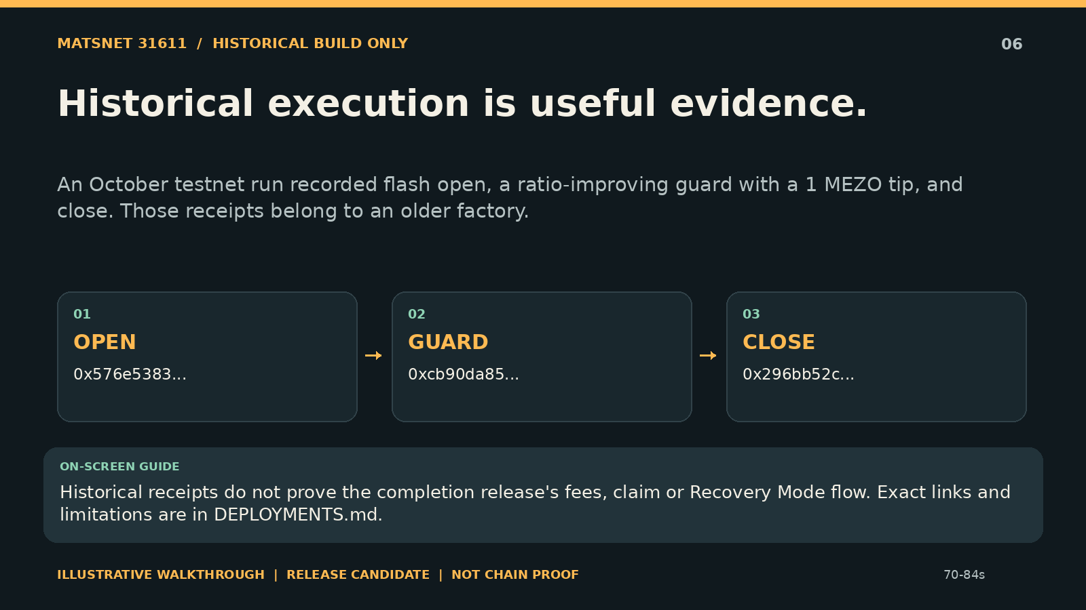
Notes:
Historical execution is useful evidence.
An October testnet run recorded flash open, a ratio-improving guard with a 1 MEZO tip, and close. Those receipts belong to an older factory.
Historical receipts do not prove the completion release's fees, claim or Recovery Mode flow. Exact links and limitations are in DEPLOYMENTS.md.
Illustrative release candidate. Historical receipts: ../../DEPLOYMENTS.md. No new on-chain proof.

Slide 7
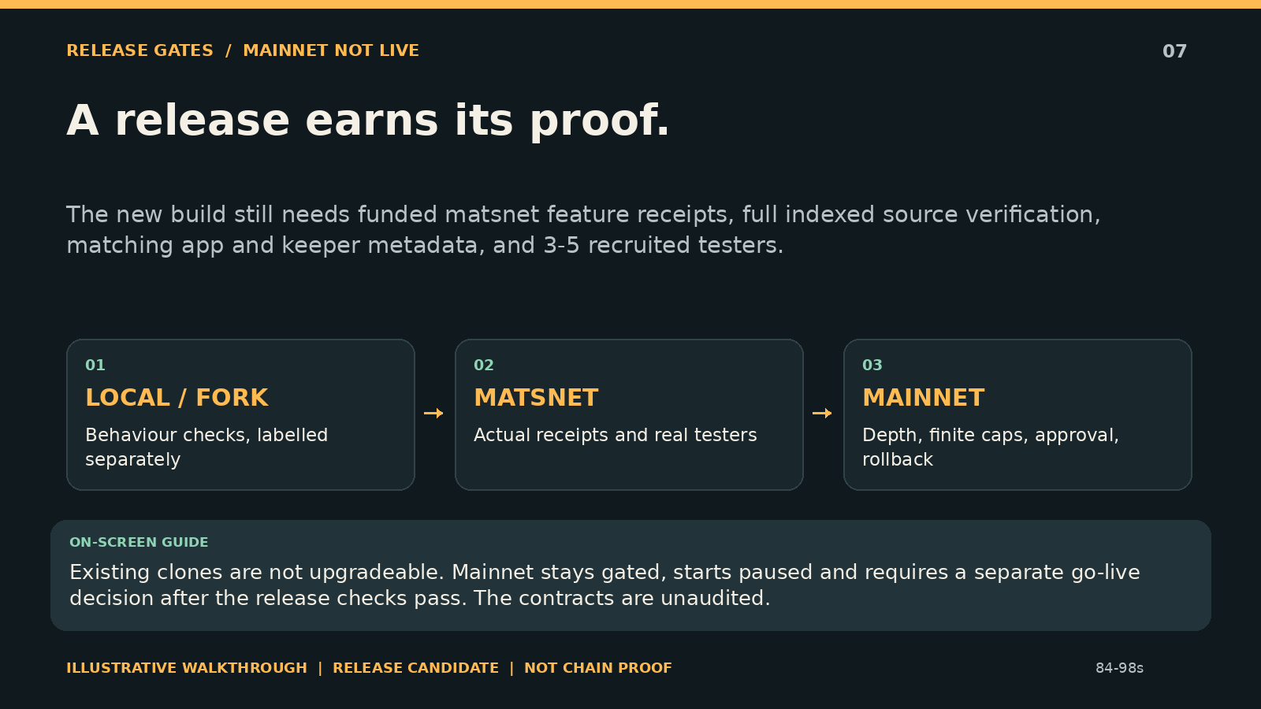
Notes:
A release earns its proof.
The new build still needs funded matsnet feature receipts, full indexed source verification, matching app and keeper metadata, and 3-5 recruited testers.
Existing clones are not upgradeable. Mainnet stays gated, starts paused and requires a separate go-live decision after the release checks pass. The contracts are unaudited.
Illustrative release candidate. Historical receipts: ../../DEPLOYMENTS.md. No new on-chain proof.

Slide 8
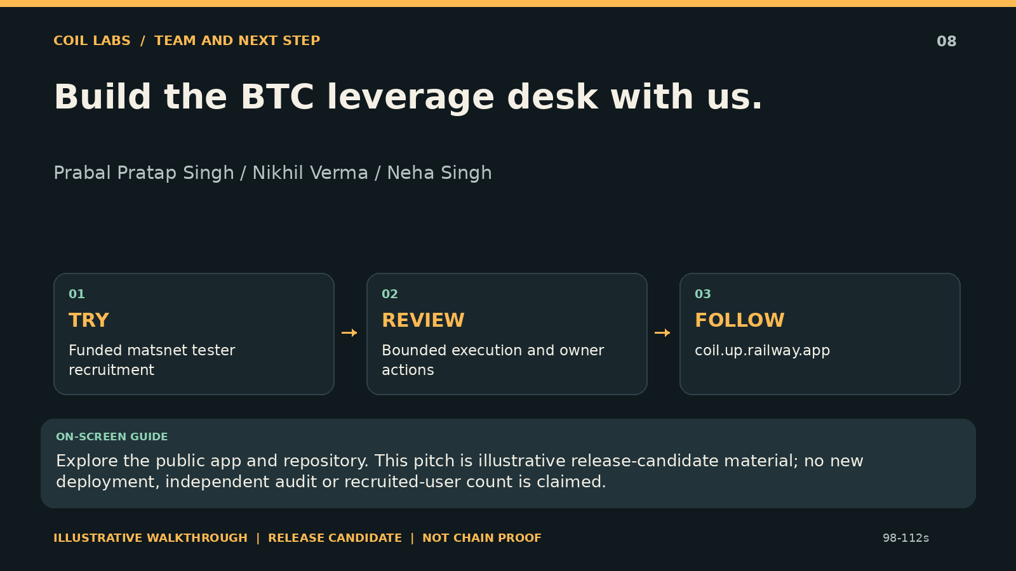
Notes:
Build the BTC leverage desk with us.
Prabal Pratap Singh / Nikhil Verma / Neha Singh
Explore the public app and repository. This pitch is illustrative release-candidate material; no new deployment, independent audit or recruited-user count is claimed.
Illustrative release candidate. Historical receipts: ../../DEPLOYMENTS.md. No new on-chain proof.

