Slide 1

Seasonal Agriculture Performance Analysis
[Prabgun Mokha
Dr. Akhilesh Das Gupta Institute of Professional Studies ]
AICTE STU ID : STU699c35e18daf61771845089

Slide 2

PROBLEM STATEMENT
Agricultural activities are influenced by seasonal variations in environmental conditions, farming practices, resource availability and market conditions. As a result, agricultural performance may differ from one season to another. However, raw agricultural data does not clearly explain how agricultural performance changes across seasons or what patterns can be observed in different seasonal conditions. The problem is to analyze the given agricultural dataset and investigate seasonal differences in agricultural performance by identifying meaningful patterns, trends, relationships and variations within the available data.

Slide 3
Project Description
This project analyzes seasonal agriculture performance using farm-level data across crops, locations and growing seasons. The dataset includes rainfall, temperature, soil condition, irrigation method, fertilizer use, yield, production, cost, revenue, profit, water use and crop health risk. The analysis focuses on comparing Kharif, Rabi and Zaid seasons to understand how farm outcomes change with seasonal conditions. It uses data cleaning, statistical summaries, visualizations and seasonal comparison tables to identify important patterns, performance differences and practical insights.

Slide 4

WHO ARE THE END USERS?
Farmers
agricultural planners
students
researchers

Slide 5

Technology Used
Pandas
NumPy
Matplotlib
Seaborn
Jupyter Notebook
CSV Dataset

Slide 6
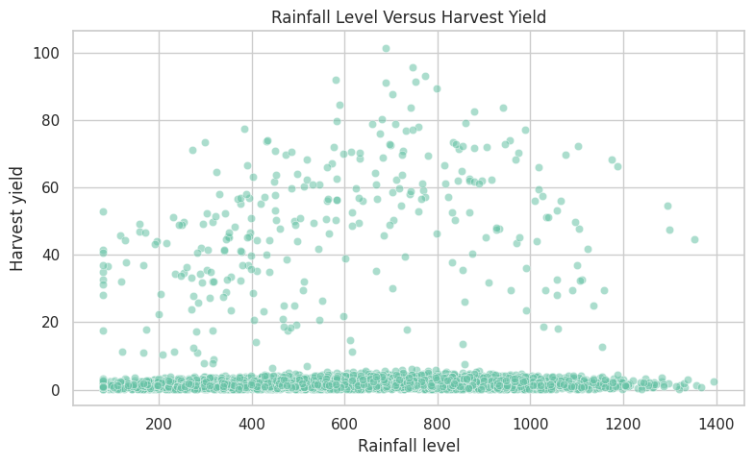
RESULTS
[Add screen shots of your code ]

Slide 7
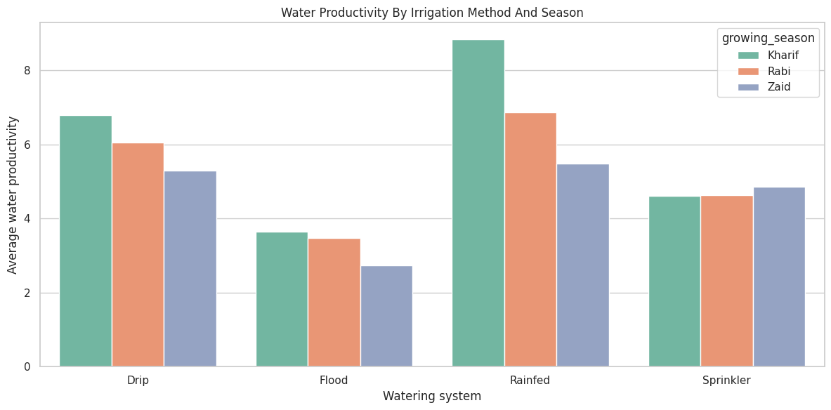
RESULTS

Slide 8
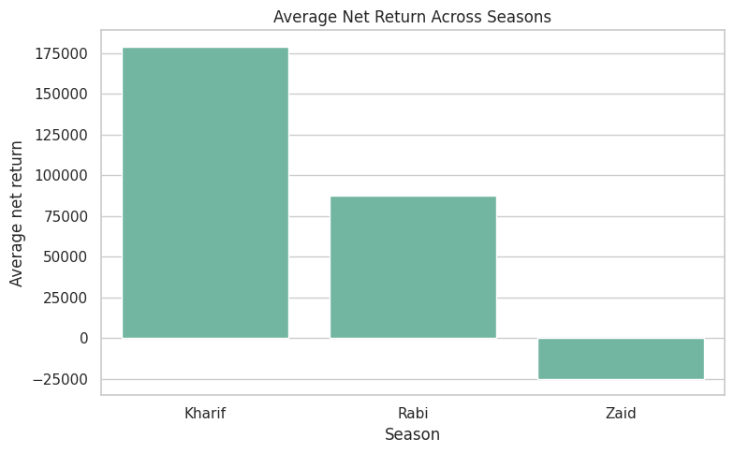
RESULTS
[Add screen shots of your code ]

Slide 9
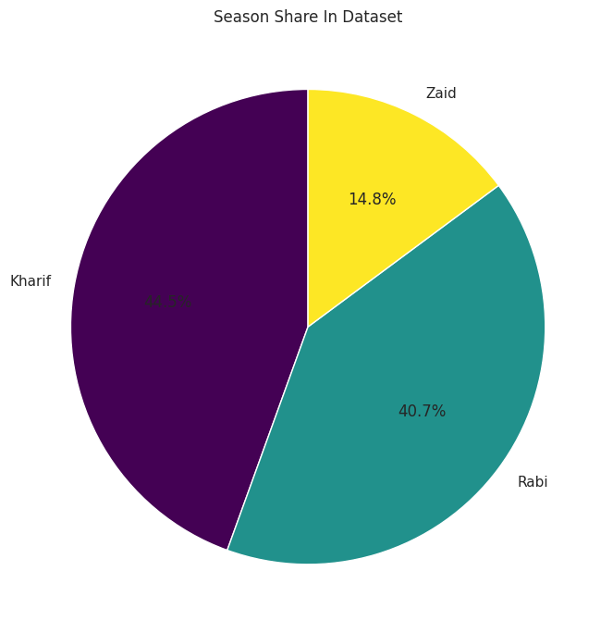
RESULTS
[Add screen shots of your code ]

Slide 10
Future scope
Add more seasonal data from multiple years for stronger comparison.
Include region-wise climate data for deeper seasonal analysis.
Study crop-specific performance across different irrigation methods.
Compare cost, revenue and profit trends over time.
Add market price trends to understand economic changes.
Use advanced statistical methods to test seasonal differences.
Build a dashboard in future for easy visual monitoring.

Slide 11
GitHub Link
https://github.com/PrabgunMokha/Seasonal-Agriculture-Performance-Analysis.git

Slide 12
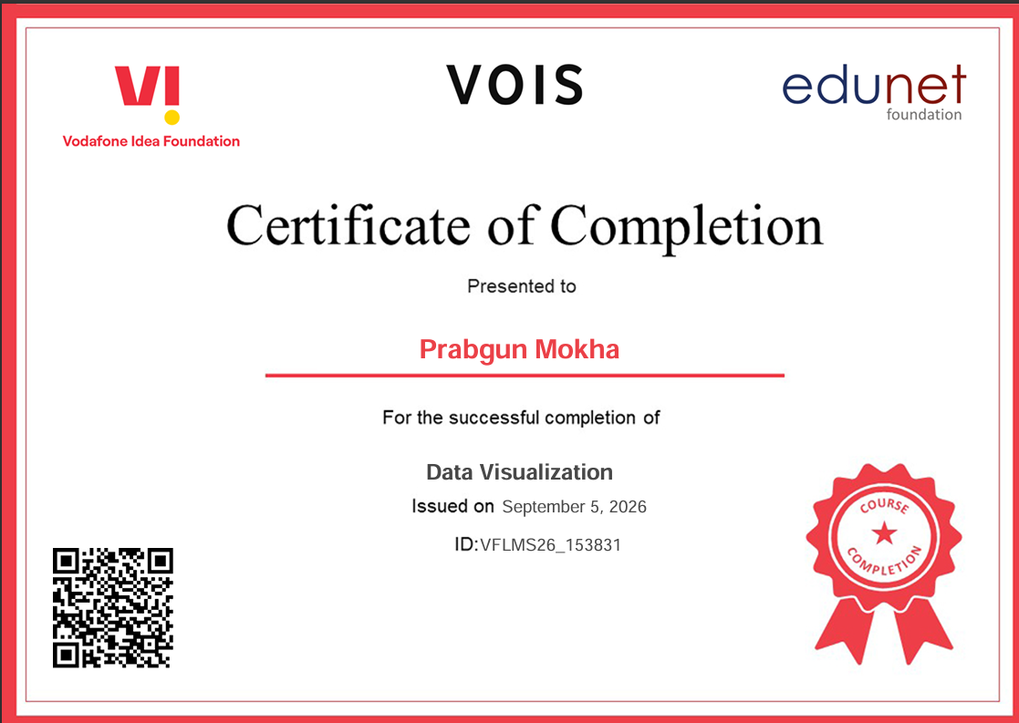
VOIS Course completion certificate - Course name- Data Visualization

Slide 13
Thank you
.
.

