Slide 1
MRA PROJECT
BUSINESS REPORT

Slide 2
SECTION ONE
Exploratory Data Analysis: Exploratory Analysis of data & an executive summary (in PPT) of your top findings, supported by graphs.

Slide 3

Overview of the Data
Objective:
To understand consumer behavior, item preferences, and pricing trends to provide recommendations for revenue growth.
Total Records: 5964 transactions
Key Columns:
Transaction_ID: Unique identifier for each transaction
Item_Ordered: Name of the menu item
Order_Time: Time of order placement
Price, Tax, Total: Pricing details per order
Category: Type of item (e.g., FOOD, LIQUOR)

Slide 4
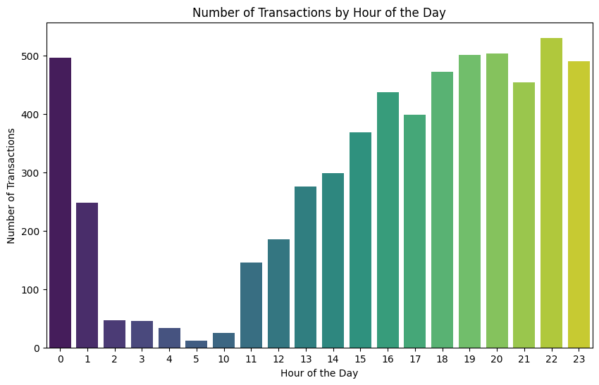
Distribution of Orders Over Time
Key Insight:
The number of transactions peaks around 12 PM to 2 PM (lunch time) and 6 PM to 9 PM (dinner time), with significant consumer activity during these hours. Late-night orders are minimal but consistent.

Slide 5
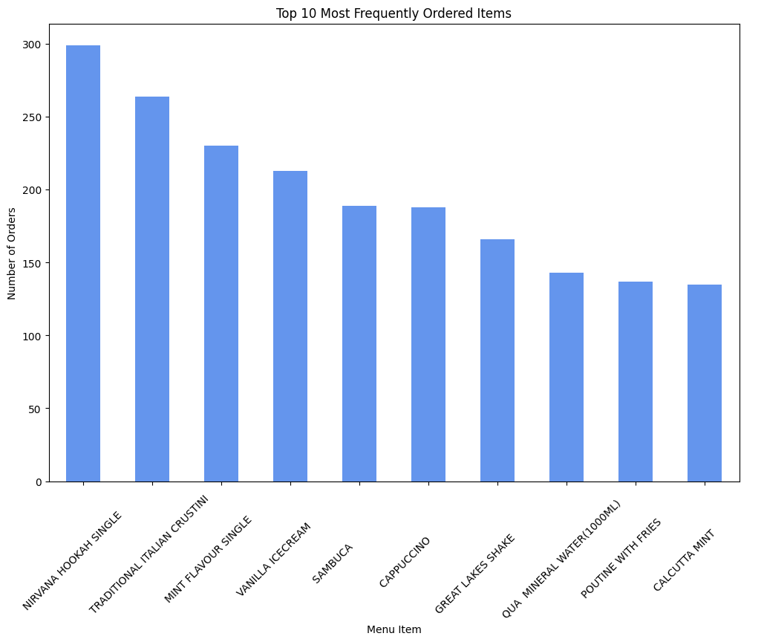
Distribution of Transactions by Hour of the Day
Key Insight:
Popular items like "Nirvana Hookah single," "Traditional Italian Crustini," and "Mint Flavour Single" are among the most frequently ordered, reflecting consumer preferences for comfort food and quick bites.

Slide 6
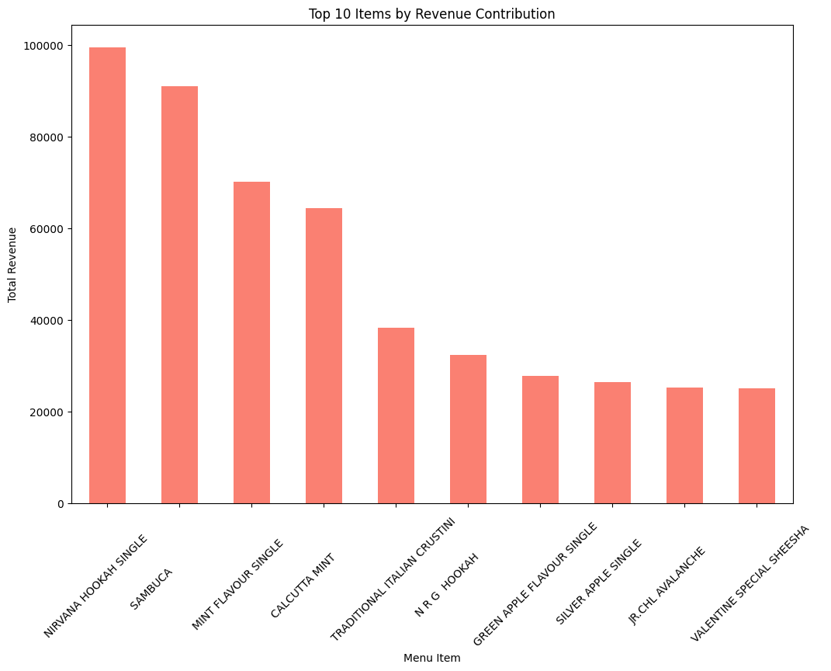
Top 10 Items by Revenue Contribution
Key Insight:
While frequently ordered items bring in regular sales, high-priced items like "Nirvana Hookah single" and "Sambuca" generate significant revenue, making them key contributors to overall sales.

Slide 7
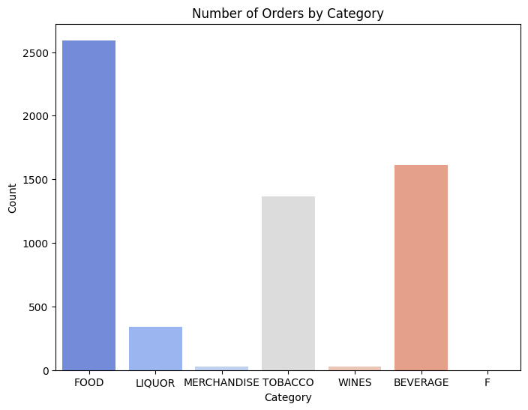
Category-wise Distribution of Orders
Key Insight:
The majority of orders fall within the "Food" category, suggesting a strong customer preference that could be leveraged for upselling or cross-selling related food items.

Slide 8
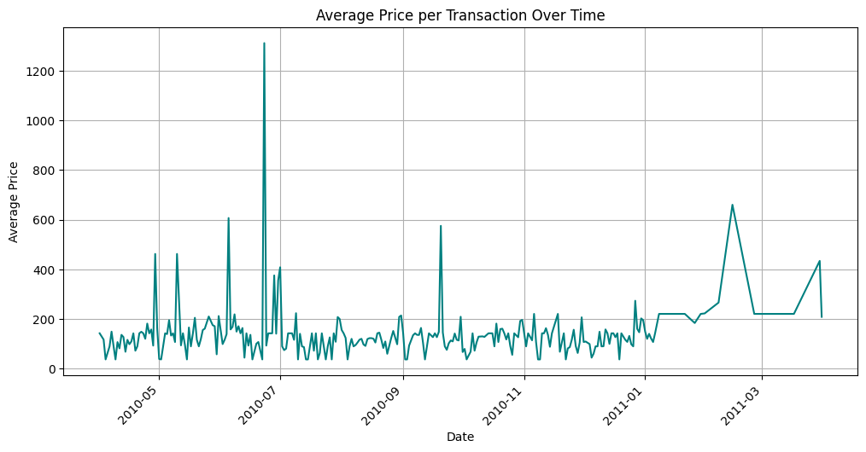
Daily Average Price Over Time
Key Insight:
Variations in average transaction prices over time highlight trends in customer spending behavior, while missing dates indicate potential data quality issues that may need addressing for better insights.

Slide 9


Conclusion & Recommendations
Emphasizing peak hours for promotions and leveraging high-demand items can enhance sales, while exploring underperforming categories may uncover new revenue opportunities.
ADD YOUR TEXT
2
1
ADD YOUR TEXT

Slide 10
SECTION TWO
What kind of trends do you notice in terms of consumer behavior over different times of the day and different days of the week? Can you give concrete recommendations based on the same?

Slide 11
Introduction to Consumer Behavior Trends
Introduction: In today's competitive market, understanding consumer behavior is crucial for optimizing sales and enhancing customer satisfaction. This analysis focuses on transaction patterns, examining how consumer preferences vary by time of day and day of the week. By evaluating transaction volumes and revenue contributions across different periods, we can identify peak times for sales and popular menu items, enabling targeted strategies to boost revenue and tailor marketing efforts effectively.
ADD YOUR TEXT
2
1
ADD YOUR TEXT

Slide 12
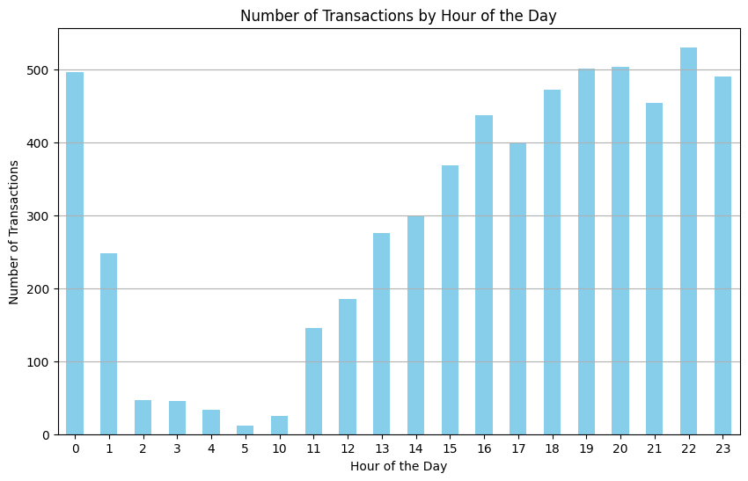
Peak Hours for Transactions
Content: Present the bar chart showing transactions by hour.
Key Insight: Highlight peak hours and low activity periods.

Slide 13
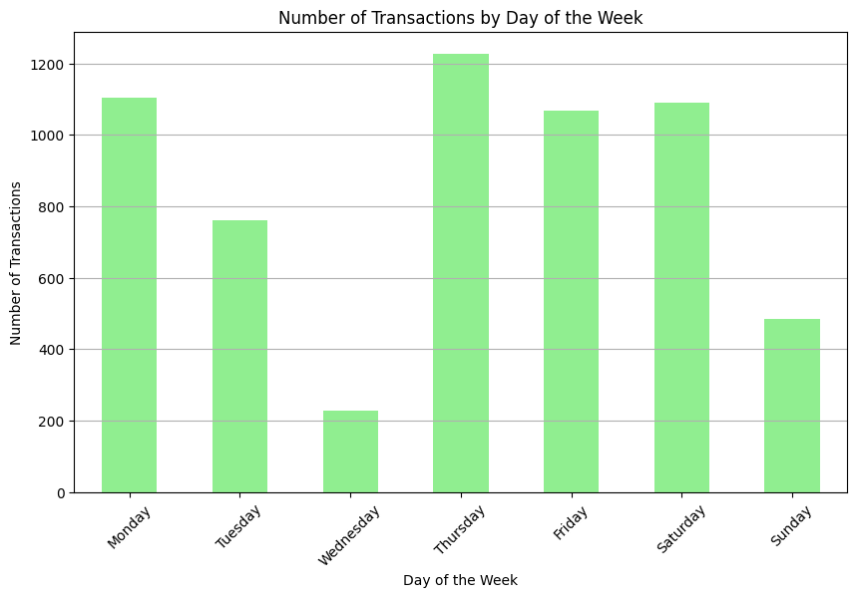
Weekly Transaction Patterns
Content: Present the bar chart showing transactions by day.
Key Insight: Emphasize the days with the highest and lowest transactions.

Slide 14
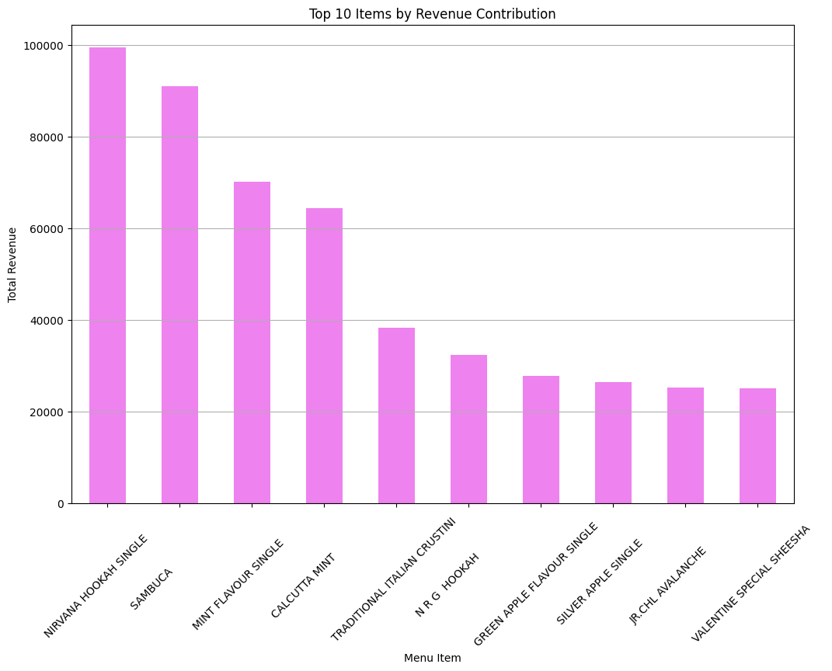
Top 10 Items by Revenue Contribution
Content: Insert the bar chart generated from your code displaying the total revenue for the top 10 menu items.
Key Insight:
While various items contribute to overall sales, premium items like "Nirvana Hookah Single" and "Sambuca" lead in revenue, indicating a strong consumer preference for high-value offerings. This suggests that focusing on promoting these high-revenue items could enhance profitability.

Slide 15
SECTION THREE
Are there certain menu items that can be taken off the menu?

Slide 16
Identifying Candidates for Menu Removal
Introduction: In evaluating the café's menu performance, it is crucial to identify items that do not contribute significantly to overall sales. This analysis focuses on menu items that exhibit low total orders and revenue, providing insights into potential candidates for removal. By strategically streamlining the menu, the café can optimize operational efficiency and enhance the customer experience by focusing on high-performing items.
ADD YOUR TEXT
2
1
ADD YOUR TEXT

Slide 17
Key Insights:
Underperforming Items:
A significant number of items, including "Cheddar Cheese", "Mushroom," and "Add Cottage Cheese," have only one order and very low revenue, indicating a lack of customer interest.
Zero Sales:
The item "210" has no recorded sales, highlighting that it may not resonate with customers or is not promoted effectively.
Low Revenue Concerns:
Many items, such as "Banana Walnut Muffin" and "Great Lakes Float w/ Vanilla," show low total revenue despite having several orders, suggesting that they may not offer adequate profitability.
Menu Optimization:
Items with fewer than 10 total orders or less than $1000 in total revenue could be reviewed for potential removal. This action would allow the café to focus on high-demand, profitable items, which can lead to better inventory management and increased customer satisfaction.

Slide 18
SECTION FOUR
Are there trends across months that you are able to notice?

Slide 19
Monthly Trends Analysis
Data Quality Check:
1
Only one record found for January 1900, indicating potential data entry issues.
Requires review of Order_Date to identify incorrect or missing entries.
2
Limited Trends Analysis:
Insufficient data to identify consumer behavior trends across months.
3
4
Recommendations:
Check Data Entry: Validate the accuracy of date entries in the dataset.
Correct Date Parsing: Ensure dates are parsed correctly during data import.
Gather Additional Data: If available, pull in more extensive datasets for comprehensive analysis.

Slide 20
SECTION FIVE
Menu Analysis: Use of Market Basket Analysis (Association Rules) 1. Write Something about the association rule and its relevance in this case. 2. Add KNIME workflow Image or Python package used 3. Write about threshold values of Support and Confidence

Slide 21
Menu Analysis: Use of Market Basket Analysis (Association Rules)
Overview of Association Rules:
Definition: Association rules identify relationships between menu items based on transaction data. They help understand consumer behavior by revealing which items are frequently purchased together.
Relevance: This analysis can inform menu design, promotional strategies, and cross-selling opportunities. By recognizing popular item pairings, the café can optimize offerings to enhance customer experience and increase sales.

Slide 22
Menu Analysis: Use of Market Basket Analysis (Association Rules)
Tools Used:
KNIME Workflow: A visual data analytics platform used to create the Market Basket Analysis workflow.
(Insert the actual image path or file)
Python Libraries: mlxtend library was used for generating frequent itemsets and association rules through the Apriori algorithm.

Slide 23
Menu Analysis: Use of Market Basket Analysis (Association Rules)
Threshold Values:
Support: Set at 0.01, indicating an itemset must appear in at least 1% of transactions to be considered significant.
Confidence: A minimum threshold of 0.6 was applied, meaning there is a 60% probability that the consequent item will be purchased when the antecedent item is bought.

Slide 24
SECTION SIX
Association Rules Identified. 1. Put the associations in a tabular manner. 2. Explain about support, confidence, & lift values that are calculated.

Slide 25
Association Rules Identified:
Antecedents | Consequents | Support | Confidence | Lift
HASH BROWN OMELETTE | CHICKEN SALAMI PANINI | 0.3333 | 1.0 | 3.0
CHICKEN SALAMI PANINI | HASH BROWN OMELETTE | 0.3333 | 1.0 | 3.0
FRENCH FRIES | COTTAGE CHEESE PANINI | 0.3333 | 1.0 | 3.0
COTTAGE CHEESE PANINI | FRENCH FRIES | 0.3333 | 1.0 | 3.0

Slide 26
Explanation of Values:
Support:
Definition: Support indicates the proportion of transactions that include the itemset.
Interpretation: A support value of 0.3333 means that 33.33% of transactions included both items in the association, highlighting their popularity together.
Confidence:
Definition: Confidence measures the likelihood that the consequent item is purchased when the antecedent item is purchased.
Interpretation: A confidence value of 1.0 (or 100%) indicates that whenever the antecedent is purchased, the consequent is always bought as well, suggesting a strong relationship between the two items.
Lift:
Definition: Lift compares the observed support of the association with the expected support if the items were independent.
Interpretation: A lift value of 3.0 indicates that the presence of the antecedent increases the likelihood of the consequent being purchased by 3 times compared to random chance, which suggests a strong positive association.

Slide 27
THANK YOU

