Slide 1
T-SQL

Slide 2
Programming Basics

Slide 3
Outlines :
T-SQL Introduction
Variable Declaration
Comments in T-SQL
Control Flow of Statements

Slide 4
Introduction
T-SQL stands for Transact Structure Query Language which is a Microsoft product and is an extension of SQL Language.
The American National Standards founded the SQL server T-SQL in 2014.
T-SQL expands the SQL to include procedural programming, local variables, functions and Triggers
SQL | T-SQL
Non-procedural | Procedural
Data manipulation and data controlling | Local variable and procedural programming language
One by one submission | transfer in bulk
Exceptions not handling | We can handle the exceptions

Slide 5
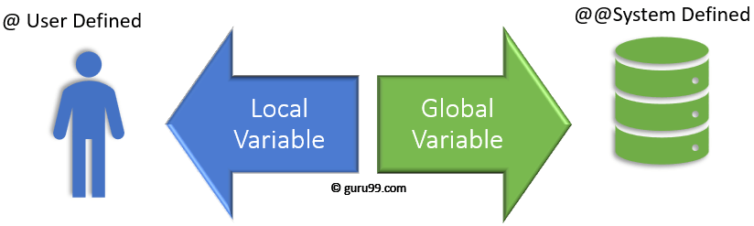
SQL Variables
Variables are the object which acts as a placeholder to a memory location
Variable hold single data value
MS SQL has two types of variables
1. Local variable 2. Global variable
Global variables stores session related information
Examples for Local variable : Declare @Id=1001
Global variable: @@Version

Slide 6
Declare a Local Variable
Syntax : DECLARE { @LOCAL_VARIABLE[AS] datatype [ = value ] }
Examples of Declaring a variable
DECLARE @Member_id AS INT
DECLARE @Customer_name VARCHAR (10)
DECLARE @COURSE_ID AS INT, @COURSE_NAME VARCHAR (10)
Assigning a value to SQL Variable
3 ways You can assign a value to a variable
1. During variable declaration 2. Using SET 3. Using SELECT
Examples: DECLARE @COURSE_ID AS INT = 5
SET @COURSE_ID = 5
SELECT @COURSE_ID = 5

Slide 7
Global variables or System defined variables
1. @@CONNECTIONS
This variable returns the number of login attempts since SQL Server was last started
2. @@ERROR
The error number for the last T-SQL statement executed. If this value is zero than there were no errors otherwise
it returns the error
3. @@IDENTITY
Return the last identity value entered into a table
4. @@IDLE
This variable returns the number of milliseconds SQL Server has been idle since it was last started
5. @@CPU_BUSY
Returns the number of milliseconds the CPU has spent working since SQL Server was last started
6. @@LANGUAGE
Returns the name of the language that is currently used by the SQL Server.

Slide 8
7. @@ROWCOUNT
Returns the number of rows affected by the last Transact-SQL statement
8. @@SERVERNAME
Returns the name of the service under which SQL Server is running.
9. @@ Total_ERRORS
Returns the number of disk read/write errors encountered by SQL Server since it was last started.
10. @@VERSION
Returns the current version of the SQL Server Software.
Examples:
SELECT @@SERVERNAME as 'Server Name’
SELECT @@VERSION as 'SQL Server Version’
select @@CONNECTIONS as 'Number of Login Attempts’

Slide 9
Display the Output in T-SQL
Two ways we can display the output (Either Custom messages or Variable output)
1. Using Print 2. Using Select
Examples:
1. print 'welcome’ 2. select 300*5
declare @doj datetime ='2022-08-19’
print @doj
select @doj
Storing query result in a variable and Print it
Using variables in a query and display the output
Selecting a record into variables and display the output
Display the variable output with custom message

Slide 10
Comments in SQL Server
Two Types of Comments are available
1. Single line comment
Begin the comment with -- (two hyphens)
2. Multiple line comment
/* -----------------
----------------- */
BEGIN...END statement
The BEGIN...END statement is used to define a statement block.
A statement block consists of a set of SQL statements that execute together.
BEGIN
{ sql_statement | statement_block}
END
Syntax :

Slide 11
Control-of-flow statement
IF ELSE – execute a statement block based on a condition.
WHILE – repeatedly execute a set of statements based on a condition as long as the condition is true.
BREAK – exit the loop immediately and skip the rest of the code after it within a loop.
CONTINUE – skip the current iteration of the loop immediately and continue the next one.

Slide 12
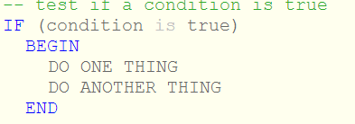
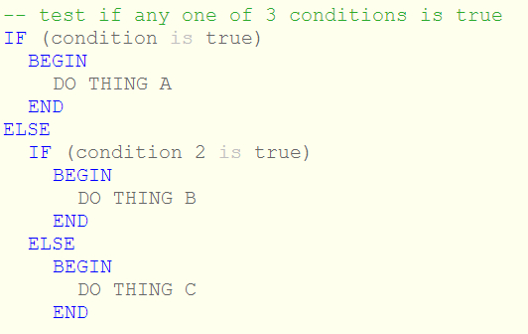
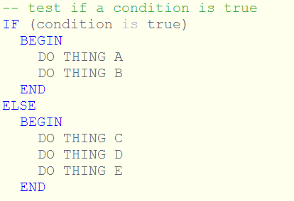
Syntax for IF Else Statements
IF Statement
IF ELSE Statement
Nested IF
Notes:
https://www.sqlshack.com/sql-if-statement-introduction-and-overview/
https://www.wiseowl.co.uk/blog/s340/if-else.htm
Tutorials Teacher

Slide 13

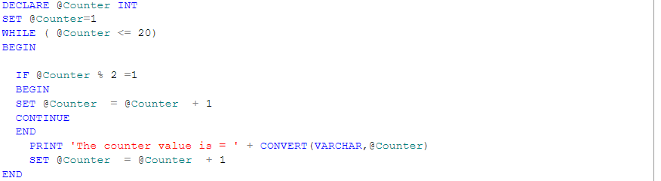
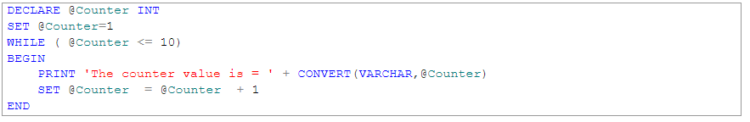
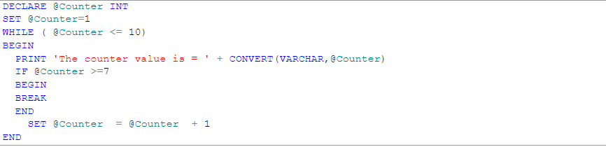
While Loop
Syntax :
While with Continue
Example
While with Break
Notes:
https://www.sqlshack.com/sql-while-loop-with-simple-examples/
https://www.tutorialsteacher.com/sqlserver/loops

Slide 14
Quiz Time
1. What is the full form of T-SQL?
a) Transact Structured Query Language
b) Transaction Structure Query Language
c) Transcript Structure Query Language
2.Is T-SQL a nonprocedural language?
a) Yes b) No
Which of the following is valid variable declaration in T-SQL ?
a) set @id b) declare @id C) print @id d) declare id
Which of the following is a proprietary extension of SQL for Microsoft SQL Server?
a) PL/SQL b) PostgreSQL c) T-SQL d) P-SQL
The below ways we can assign the values to the variables in T-SQL ?
a)variable declaration time b) using set keyword c) using select keyword d) all of the above

Slide 15
Quiz contd..
6. Which of the following is valid global variable ?
a) @timestamp b) @name c)@@version d)@@servername
7. The below statement is True or False
PRINT 'The number of products is ' + @product_count
8. Which Loop support by the T-SQL ?
a) For loop b) do while c) while d) All of the above
9. Which key word is required to exit the loop once condition is met ?
a) Skip b) Continue c) Break d) Case
10 . Which of the following is equivalent to multiple IF-ELSIF statements ?
a) Case b) Decode c) While loop d) For loop

Slide 16
Cursors

Slide 17
Outline
What is Cursor
Cursor Life Cycle
Why and When use a Cursor
Types of Cursors in SQL Server
How to implement cursors ?
What are the limitations of a SQL Cursor
How can we replace SQL Cursors

Slide 18
What is Cursor and When use Cursor ?
A SQL cursor is a database object that is used to retrieve data from a result set one row at a time.
A SQL cursor is used when the data needs to be updated row by row.
For example, a SELECT statement returns a set of rows which is called a result set.
Sometimes the application logic needs to work with one row at a time rather than the entire result set at once. This can be done using cursors.

Slide 19
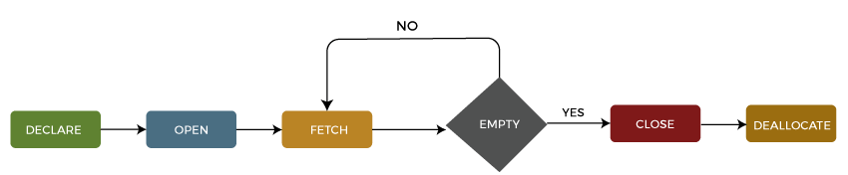
Cursor Life Cycle
1: Declare Cursor
DECLARE cursor_name CURSOR
FOR select_statement;
2: Open Cursor
OPEN cursor_name;
3: Fetch Cursor
FETCH NEXT FROM cursor INTO variable_list;
4: Close Cursor
CLOSE cursor_name;
5: Deallocate Cursor
DEALLOCATE cursor_name;

Slide 20
Types of Cursors
1.Static Cursors
A static cursor is slower and use more memory in comparison to other cursor
No UPDATE, INSERT, or DELETE operations are reflected in a static cursor
2.Dynamic Cursors
dynamic cursor is sensitive to any changes to the data source and supports update, delete operations
3.Forward-Only Cursors
The typical default cursor type, called a forward-only.
it only supports fetching rows from the start to the end of the result set.
4.Keyset Cursors

Slide 21
Key set cursors
When a cursor is opened with a Key Set option, it generates a unique set of key values for the rows that it will access.
When data is accessed with a Key Set cursor, SQL Server creates temporary tables to store
the result set and uses the keys to quickly locate and access the desired rows.
This can improve performance, especially when dealing with large amounts of data.
Syntax :
DECLARE MyCursor CURSOR KEYSET FOR SELECT * FROM MyTable
OPEN MyCursor
FETCH NEXT FROM MyCursor
CLOSE MyCursor
DEALLOCATE MyCursor

Slide 22
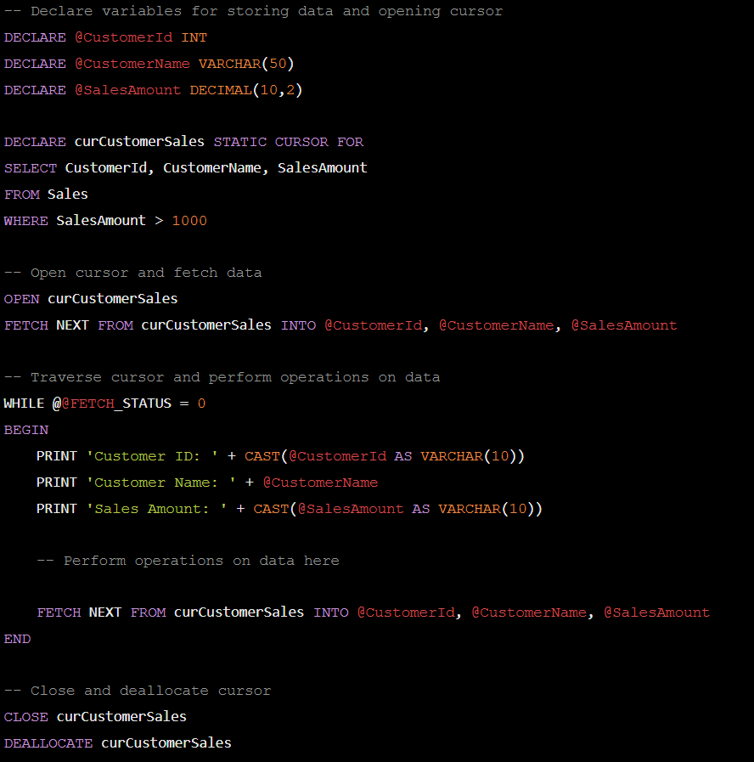
Example for Static Cursor

Slide 23
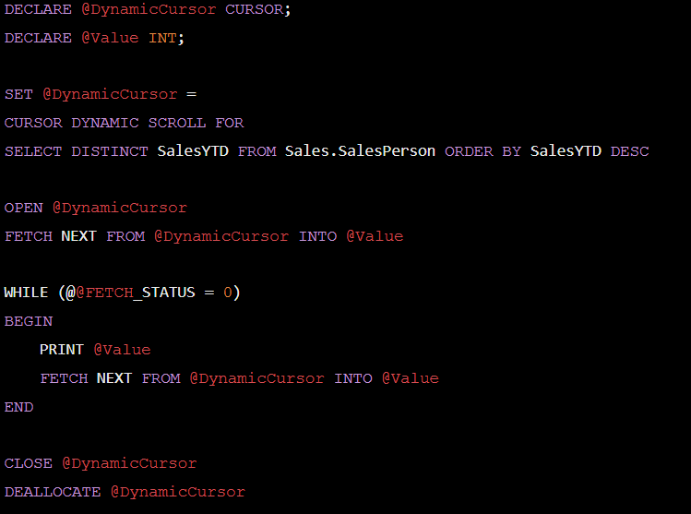
Example for Dynamic cursor

Slide 24
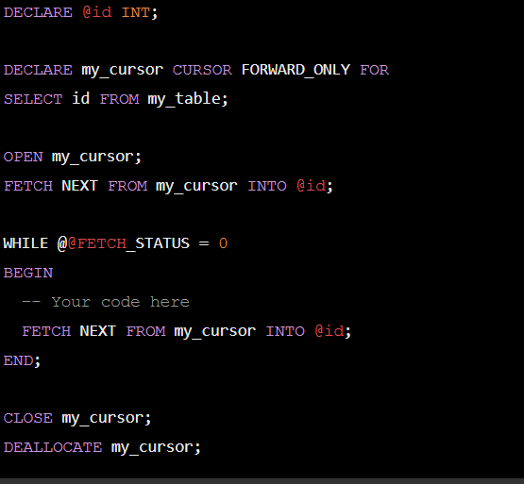
Example for Forward_Only Cursor
Notes:
https://zzzcode.ai/code-explain

Slide 25
Limitations of SQL Cursors
Cursor consumes network resources
A cursor is a memory resident
It imposes locks on a portion of the table or the entire table when processing data
The cursor's performance and speed are slower because they update table records one row at a time.
Cursors are quicker than while loops, but they do have more overhead.

Slide 26
How can we replace the Cursors
Using the SQL while loop
The easiest way to avoid the use of a cursor is by using a while loop that allows the inserting of a result set into the temporary table.
User-defined functions
Sometimes cursors are used to calculate the resultant row set. We can accomplish this by using a user-defined function that meets the requirements.
Using Joins
Reduces the lines of code that give faster performance than cursors in case huge records need to be processed.

Slide 27
Quiz Time
1. Life cycle of typical cursor involves how many steps in SQL Server
4 b) 3 c) 5 d) 2
2. How many type of cursor is present in SQL Server ?
a) 2 b) 4 c) 3 d) 6
3. SQL Server static cursors are always_____________
a) Read-only b) Write-only c) Read, Write d) update -only
4. A dynamic cursor in SQL Server allows you to see ____data.
a) Inserted b) Deleted c) Updated d) All of the above
5. ____ cursor is sensitive to any changes to the data source.
a) Static b) Dynamic c) keyset d) All of the above
Notes:
https://engineeringinterviewquestions.com/mcqs-on-cursor-answers/

Slide 28
How to Implement Cursors : Examples
1. Print the All-Departments details
2. Display the only 30th and 40th Department employees

Slide 29
Exceptions

Slide 30
Exception Handling in SQL Server
What is Exception handling in SQL Server?
Types of exceptions in SQL Server
Try Catch in SQL Server
Exception handling in procedure
Throw a custom exception in procedure
Exception handling in function
Error handling Best Practices

Slide 31
What is Exception and How to handle the Exception ?
An error condition during a program execution is called an exception and the mechanism for resolving such an exception is known as exception handling.
These errors can be generated because of various reasons and the application is not able to handle these errors, causing the program to break and throw an exception.
Usually, these are generated because of unexpected human input such as passing an unexpected data type input e.g., passing an integer at the place of a string value.
But in real-life scenarios, the program is not supposed to be broken down, but execute flawlessly.
SQL Server provides TRY, CATCH blocks for exception handling

Slide 32
Types of Exceptions
There are two types of exceptions in SQL Server. These are:
1. System Defined Exceptions
2. User-Defined Exceptions
System Defined Exceptions: These are the exceptions that are generated by the system during the program execution. The error messages are predefined in the system and the final user will see the predefined message on the console.
User-Defined Exceptions: These are the exceptions that are thrown explicitly by the programmer. The programmer can raise exceptions at any part of the SQL code according to the logic he has implemented in the program.
The programmer can also create custom messages that he finds will be interactive and meaningful to the user.

Slide 33
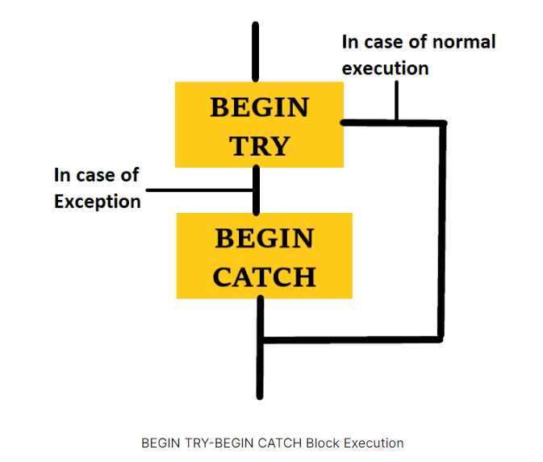
Try Catch in SQL Server
General Syntax for Try and Catch Block:
Try : SQL statements that may cause an exception
Catch : used for handling the flow of the program in case the exception is triggered.
BEGIN TRY
--SQL Statements where exception may encounter
END TRY
BEGIN CATCH
--SQL statements to handle exceptions
END CATCH

Slide 34
Built In Exception Functions
These functions store the information about the exception that is encountered
ERROR_NUMBER() returns the error number
ERROR_SEVERITY() returns the severity of the exception.
ERROR_STATE() returns the state number of the error.
ERROR_PROCEDURE() returns the name of the stored procedure in which the error occurred.
ERROR_MESSAGE() returns the message to be displayed to the user.
ERROR_LINE() returns the line number of the procedure at which the error occurred.

Slide 35
Custom Exceptions in SQL Server
Throwing a custom exception means you can cause an exception to encounter an error at any part of your code according to your logic.
We use the THROW statement or the RAISERROR function for throwing a custom exception
Microsoft suggests using the THROW statement as it is easier to use and has more functionalities than the RAISERROR function.
THROW statement threw an error. It takes three parameters:
1. Error number, which should be always greater than or equal to 50000 and less than the INT range.
2. Error message, which you want to show to the user. It should be enough informative to the user.
3. Error state, the current state of the error. It can have values between 0 to 255 as it supports the TINYINT data type.
Syntax for Throw statement:
Throw (Error number, Error message, Error state)

Slide 36
Error handling Best Practices
some tips regarding the use of exception handling in SQL server 2019
Always use the TRY CATCH block where you think there is a logical group of statements. In these situations, there are higher chances of errors.
Try to hide the technical details from the user. The user may not understand the technical details sometimes. These can also confuse the user.
Print user-friendly messages. The message that you print should be clear and easy to understand for the user.
Use generic code for error handling. Do not use too much complex code for exception handling, such as nesting at multiple levels.

Slide 37
Quiz Time
1. An exception is an error condition during a program execution.
a) True b) False
2. Which of the following blocks are used for error handling in SQL Server ?
a) Try .. Catch b) Try .. Final c) Begin .. End d) Catch .. Try
3.Which of the following statements can be checked for Errors ?
a) Insert b) select c) Update d) delete
4. Exception handling is possible in SQL Server using ---------
a) Final b) Catch c) Throw d) Finally
5. Which of the following is a global variable for error handling ?
a)@@ Exception b) @Error c) @@Error d) @@ER
Notes:
https://www.interviewbit.com/sql-mcq/

Slide 38
Examples:
Example for System defined exceptions
Example for User defined exceptions
Example for Throw Custom Exceptions
Exceptions in Procedures and Functions
Example for System defined exception functions

Slide 39
Procedure

Slide 40
Outlines
What is Stored Procedure ?
What are the Benefits of using a Stored Procedure in SQL?
Types of Stored Procedures
Syntax for creating sample Procedure
How to call / Execute the Procedure
How to Rename Stored Procedure
How to Modify Stored Procedure
How to delete/drop stored procedures in SQL Server?

Slide 41
Contd …
Parameterized Procedure
a) Input parameter
b) Output parameter
c) Optional / Default Parameter
Why Do You Use SET NOCOUNT ON?
How to Create a Temporary Stored Procedure in SQL?
Local Temporary Stored Procedure
Global Temporary Stored Procedure

Slide 42
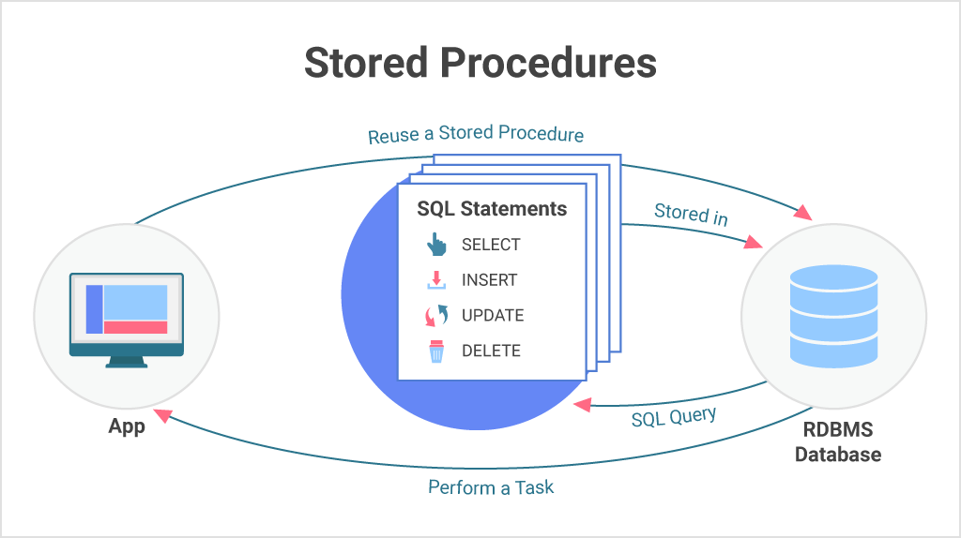
What is Procedure
A stored procedure is a group of one or more pre-compiled SQL statements into a logical unit. It is stored as an object inside the database server.
it can perform one or multiple DML operations on the database, and return value, if any.
Syntax for Procedure creation
Create / Alter Procedure name [Parameter list]
as
Begin
SQL statements
End;

Slide 43
Syntax for Procedure
Syntax :
CREATE PROCEDURE [schema_name].procedure_name
@parameter_name data_type,
....
parameter_name data_type
AS
BEGIN
-- SQL statements
-- SELECT, INSERT, UPDATE, or DELETE statement
END
Schema_name : Name of your database name. by default procedure associated with current dbname.
Procedure_name : Name of your procedure
Parameter_name : Represents the no.of parameters. It may be 0 or more.

Slide 44
How to call / execute the Stored procedure
We can use the EXEC command to call/execute stored procedures in SQL Server.
Syntax : EXEC procedure_name; (Or) EXECUTE procedure_name;
SSMS :
If we are using the SSMS, we need to use the below steps to execute stored procedures:
Navigate to the Programmability -> Stored Procedures.
Next, select the Stored Procedure menu and expand it. You will see the available stored procedures.
Right-click on the stored procedure you want to execute and choose the Execute Stored Procedure

Slide 45
How to rename stored procedures in SQL Server?
SQL Server does not allow us to change the name of a stored procedure. Because renaming a stored procedure does not modify the name of the corresponding object in the sys.sql_modules.
Therefore, if we need to change the existing stored procedure, simply DROP and recreate it with a new name.
Use the system stored procedure sp_rename to rename an existing stored procedure.
Syntax : sp_rename 'uspGetEmployeeList','uspGetEmployees'

Slide 46
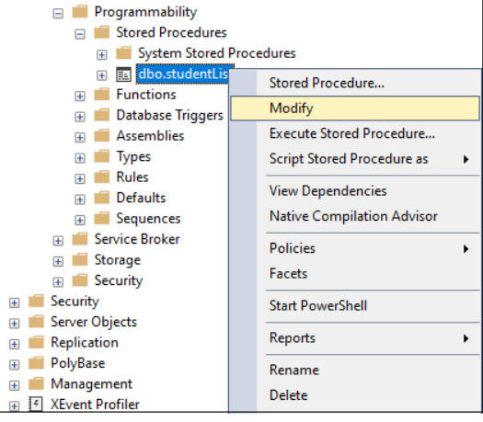
How to modify stored procedures in SQL Server?
We need to update or modify the stored procedure over a period of time. SQL Server allows us to update or modify an existing stored procedure in two ways:
Using T-SQL Query
Using SQL Server Management Studio
ALTER PROCEDURE [dbo].[Employee]
AS
BEGIN
SET NOCOUNT ON;
SELECT name, salary
FROM STUDENT
ORDER BY salary;
END;

Slide 47
View the Existing SP List / Text (code)
To see the current database all procedures
Syntax:
SELECT * FROM sys.procedures;
To see the all user defined SP from the current database
Syntax:
SELECT * FROM db_name.INFORMATION_SCHEMA.ROUTINES
WHERE ROUTINE_TYPE = 'PROCEDURE’
To see the text of an existing stored procedure
Syntax :
sp_helptext [Procedure_name]

Slide 48
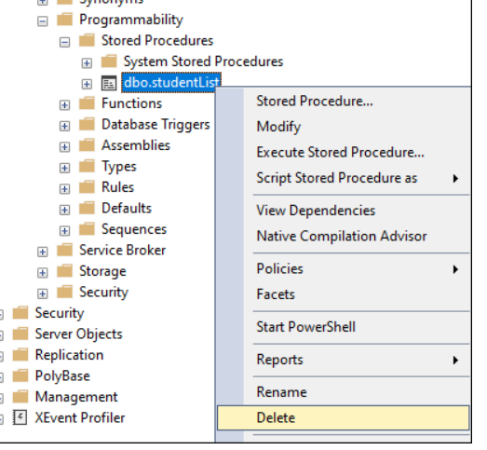
delete/drop stored procedures
Syntax : IF OBJECT_ID ('procedure_name', 'P') IS NOT NULL
DROP PROCEDURE procedure_name;
SSMS

Slide 49
Stored Procedure Parameters
A stored procedure can have zero or more INPUT and OUTPUT parameters.
A stored procedure can have a maximum of 2100 parameters specified.
If not specified any parameter type, then by default, it is Input.
Parameter variables can be either user-defined or system variables like @spid
Support 3 types of Parameters
1. Input Parameter
2. Output Parameter
3. Optional Parameter / Default Parameter

Slide 50
Input Parameter
CREATE PROCEDURE uspUpdateEmpSalary
(
@empId int
,@salary money
)
AS
BEGIN
UPDATE dbo.Employee
SET Salary = @salary
WHERE EmployeeID = @empId
END
Example :
Calling the above procedure
EXEC dbo.uspUpdateEmpSalary @EmpId = 4, @Salary = 25000
-- or
EXEC dbo.uspUpdateEmpSalary 4, 25000

Slide 51
Output Parameters
The OUTPUT parameter is used when you want to return some value from the stored procedure. The calling program must also use the OUTPUT keyword while executing the procedure.
Example :
CREATE PROCEDURE uspGetManagerID
@empId int,
@managerId int OUTPUT
AS
BEGIN
SELECT @managerId = ManagerID
FROM dbo.Employee
WHERE EmployeeID = @empId
END
Calling the procedure :
DECLARE @managerID int
EXECUTE uspGetManagerID @empId = 2, @managerId OUTPUT
PRINT @managerId

Slide 52
Optional Parameter
It allows you to skip the parameters that have default values when calling a stored procedure.
The default value is used when no value is passed to the parameter or when the DEFAULT keyword is specified as the value in the procedure call.
Example :
CREATE PROCEDURE uspUpdateEmpSalary
(
@empId int
,@salary money = 1000
)
AS
BEGIN
UPDATE dbo.Employee
SET Salary = @salary
WHERE EmployeeID = @empId
END
EXEC uspUpdateEmpSalary 4

Slide 53
SET NOCOUNT ON in Stored Procedure
This statement prevents the message that displays the number of rows affected by SQL queries from being shown.
NOCOUNT denotes that the count is turned off.
It means that if SET NOCOUNT ON is set, no message would appear indicating the number of rows affected.

Slide 54
Temporary Stored Procedure
We can divide the temporary procedures into two types:
Local Temporary Stored Procedures
Global Temporary Procedures
Local Temporary Stored Procedures: We can create this type of procedure by using the # as prefix and accessed only in the session in which they were created. When the connection is closed, this process Immediately terminated.
CREATE PROCEDURE #Temp
AS
BEGIN
PRINT 'Local temp procedure'
END
Example

Slide 55
Contd..
Global Temporary Stored Procedure: We can create this type of procedure by using the ## as a prefix and accessed from any sessions. When the connection that was used to create the procedure is closed, this procedure is automatically terminated.
CREATE PROCEDURE ##TEMP
AS
BEGIN
PRINT 'Global temp procedure'
END
Example

Slide 56
Exceptions in SP
Examples :
CREATE PROCEDURE uspUpdateEmpSalary
(
@empId int
,@salary float
)
AS
BEGIN TRY
UPDATE dbo.Employee
SET Salary = @salary
WHERE EmployeeID = @empId
END TRY
BEGIN CATCH
SELECT
ERROR_NUMBER() AS ErrorNumber
,ERROR_SEVERITY() AS ErrorSeverity
,ERROR_STATE() AS ErrorState
,ERROR_MESSAGE() AS ErrorMessage;
END CATCH
If an error is encountered in the TRY block, the control is
then passed to the CATCH block which will have another set of SQL statements to handle the error.

Slide 57
Benefits of using a Stored Procedure
Reusable: Multiple users and applications can easily use and reuse stored procedures by merely calling it.
Easy to modify: You can quickly change the statements in a stored procedure as and when you want to, with the help of the ALTER TABLE command.
Security: Stored procedures allow you to enhance the security of an application or a database by restricting the users from direct access to the table.
Low network traffic: The server only passes the procedure name instead of the whole query, reducing network traffic b/w Application and DB Server.
Increases performance: Upon the first use, a plan for the stored procedure is created and stored in the buffer pool for quick execution for the next time.

Slide 58
Disadvantages of Stored Procedures
Difficult to debug
Debugging stored procedures is never simple
Specific to a Vendor
Stored procedures written in one platform cannot run on another.
Memory usage
Many stored procedures can increase memory use
Expensive:
Stored procedures are costly to manage in terms of DBA
A DBA is much more qualified to handle complex database procedures

Slide 59
Quiz Time
1. How many types SQL Server categorizes the stored procedures ?
a) 3 b) 4 c) 2 d) 1 e) None of the above
2. Can we use the SELECT command to call/execute the stored procedures in SQL Server?
a) Yes b) No
3. What are the features of Stored Procedures in SQL Server?
A. Reduced Traffic
B. Easy Maintenance
C. Easy Maintenance Reusable & Stronger Security
D . All of the above

Slide 60
Quiz Contd..
4. Can we call the function inside procedure
a) Yes b) No
Which of the following one shows the existing procedure text/code ?
a) sp_help b) sp_text c) sp_owner d) sp_exec
6. --- parameter is used when you want to return some value from the Procedure .
a) Optional b) Input c) Output d) Default
7.

Slide 61
Functions

Slide 62
Outlines
What is User Defined Function and use of Functions ?
Types of User defined functions
Syntax for Creation of User Defined Function
Advantages of UDFs
Limitations of Functions
Differences b/w Procedure and Functions

Slide 63
User Defined Functions [UDF]
A user-defined function is a function created by a user and will perform an operation specified by the user.
The UDF or User Defined Functions in SQL Server are like methods in any other programming language that accepts the parameters, performs complex calculations, and returns the result value.
A user defined function is a database object .
For example, if we want to perform some complex calculations, then we can place them in a separate method and store it in the database. Whenever we need the calculation, we can call it.
There are two types of SQL functions:
1. Scalar Function
2. Table valued Function
Inline Table valued Function
Multi Statement Table valued Function

Slide 64
Scalar Function
Scalar functions can be used almost anywhere in T-SQL statements.
Scalar functions accept one or more parameters but return only one value, therefore, they must include a RETURN statement.
Scalar functions can use logic such as IF blocks or WHILE loops.
Scalar functions cannot update data. They can access data but this is not a good practice.
Scalar functions can call other functions.

Slide 65
i) Calling Scalar Function :
SELECT sales.udfNetSale(10,100,0.1) net_sale;
ii) Modifying a scalar function :
iii) Removing Scalar Function:
DROP FUNCTION [schema_name.]function_name;
ALTER FUNCTION [schema_name.]function_name (parameter_list)
RETURN data_type AS
BEGIN
statements
RETURN value
END

Slide 66
Syntax
Syntax to create a function
CREATE FUNCTION function_name (input_parameter)
RETURNS return_type
AS
BEGIN
DECLARE
--Local Variables to be declared
--SQL statements
RETURN return_value
END
Create function Gross_Sal
( @Sal int , @bonus int )
returns int
as
begin
return @Sal+@bonus;
end;
Example :

Slide 67
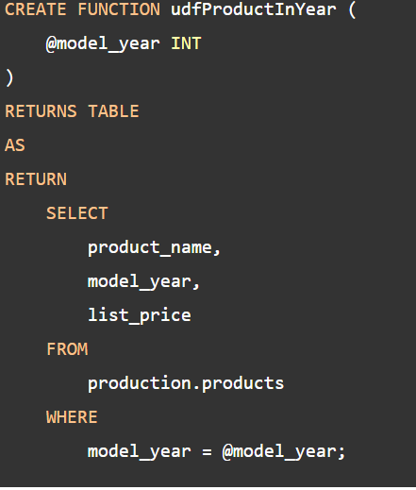
Table valued function
A table-valued function is a user-defined function that returns data of a table type. The return type of a table-valued function is a table.
Syntax :
Create function fun_name (Parameter_List)
Returns Table
As
Return
select */col_names from [tabl_name] where [condition]

Slide 68
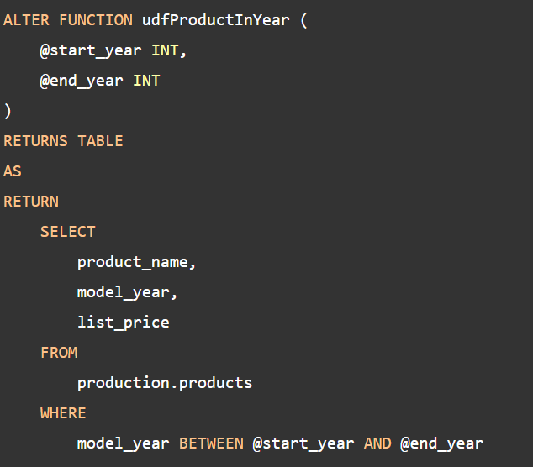
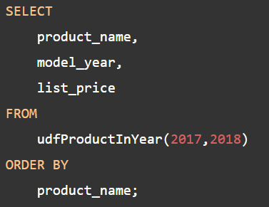
Contd..
Executing a table-valued function:
Syntax: select * /col_name from fun_name(Para_value)
Modifying a table-valued function
Calling function :

Slide 69
Multi-statement table-valued functions (MSTVF)
A multi-statement table-valued function or MSTVF is a table-valued function that returns the result of multiple statements.
The multi-statement-table-valued function is very useful because you can execute multiple queries within the function and aggregate results into the returned table.
To define a multi-statement table-valued function, you use a table variable as the return value.

Slide 70
Drop UDF Function / Functions
Syntax :
To drop existing single function :
DROP FUNCTION [ IF EXISTS ] [ schema_name. ] function_name;
Example : DROP FUNCTION IF EXISTS sales.udf_get_discount_amount;
Drop Multiple functions :
Syntax:
DROP FUNCTION [IF EXISTS]
schema_name.function_name1,
schema_name.function_name2,
...;

Slide 71
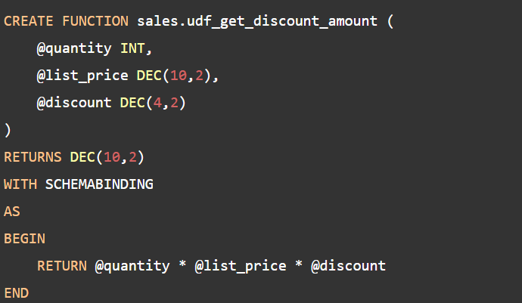
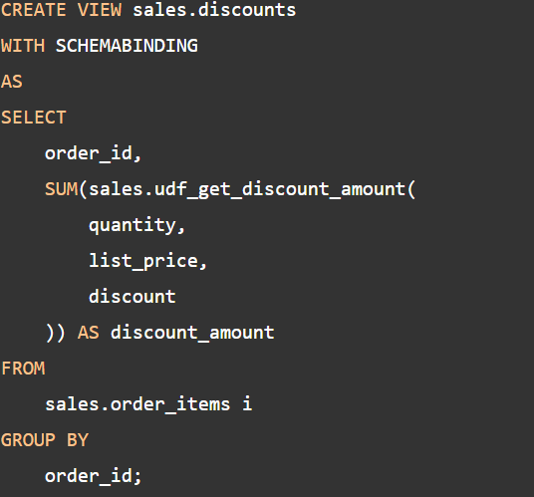
FUNCTION with SCHEMABINDING
Schema binding, we can use in functions or views. indicates that your UDF or View will be strictly bound to database objects

Slide 72
Contd..
Function calling inside view. Now directly function not dropped.
First you can drop the view then drop the function.
DROP VIEW sales.discounts;
DROP FUNCTION sales.udf_get_discount_amount;

Slide 73
Advantages of UDF
User defined functions prevent us from writing the same logic multiple times.
Within the Database, you can create the method once and call it n number of times.
They reduce the compilation time of queries by catching the execution plan and reusing them.
This UDF can help us to separate the complex calculations from the regular query so that we can understand and debug the query quicker and better.
It reduces the network traffic because of its cache plan
They are also used in the WHERE Clause as well. By this, we can limit the number of rows sent to the client.

Slide 74
Limitations of UDF
UDF can not return multiple result sets
UDF does not support error handling, such as TRY..CACHE, RAISEERROR, or @ERROR
We cannot call a Stored Procedure from UDF
They do not support the temporary tables, but they will allow the Table variable.
SET statements are not allowed in UDFs
We cannot use the UDF in SQL Server to modify the database state

Slide 75
Stored Procedure vs UDF
Stored Procedure | User Defined Function -UDF
SP can return zero, single or multiple values | Function can return one value which is mandatory
We can use Transactions in SP | We can’t use Transactions in Functions
SP can have input/output parameters | Only Input Parameter
We can call function from SP | We can’t call SP from function
We can’t use SP in where/Having but we can use select/ Insert/update/delete. | We can use UDF in Select/where/Having but UDF not allowed DML statements
SP supports Exception handling using Try catch | We can’t use Try catch block in UDF
SP can fire Triggers | UDF can’t fire Triggers
SP can execute Dynamic SQL | UDF cannot be execute Dynamic SQL

Slide 76
Quiz Time
1. How many types of user defined function is provided by SQL Server?
a) 3 b) 2 c) 4 d) 5
2. Which of the following is not a User defined function?
a) Inline Table valued function b) Max() c) Scalar function d) Getdate()
3. User defined scalar function can return more than one value. Is it True/False
a) True b) False
4. Function cannot be used for __________ statement.
a) create b) insert c) select d) Drop
5. We can call SP from functions. IS it True / False
a) True b) False

Slide 77
Triggers

Slide 78
Outlines
What is Trigger and use of Triggers in SQL ?
Types of Triggers
Syntax for Trigger creation
How to show Triggers list in SQL ?
How to modify the existing Triggers ?
How to delete / drop the Triggers from DB?
Disadvantages of Triggers

Slide 79
What is Trigger
The trigger is a database object like a stored procedure that is executed automatically when an event occurs in a database.
There are different kinds of events:
Insert /Update / Delete
User logging into a database
Table creation, Altered and Dropped
Use of Triggers
1. Triggers can be useful for inspecting the data
changes in tables.
2. Triggers provide another way to check the
integrity of data
3. There are two clear scenarios when triggers are the
best choice: auditing and enforcing business rules.
Syntax for Trigger Creation
Syntax for Trigger Creation
CREATE TRIGGER schema_name.trigger_name
ON table_name
AFTER {INSERT | UPDATE | DELETE}
AS
BEGIN
-- Trigger Statements
-- Insert, Update, Or Delete Statements
END

Slide 80
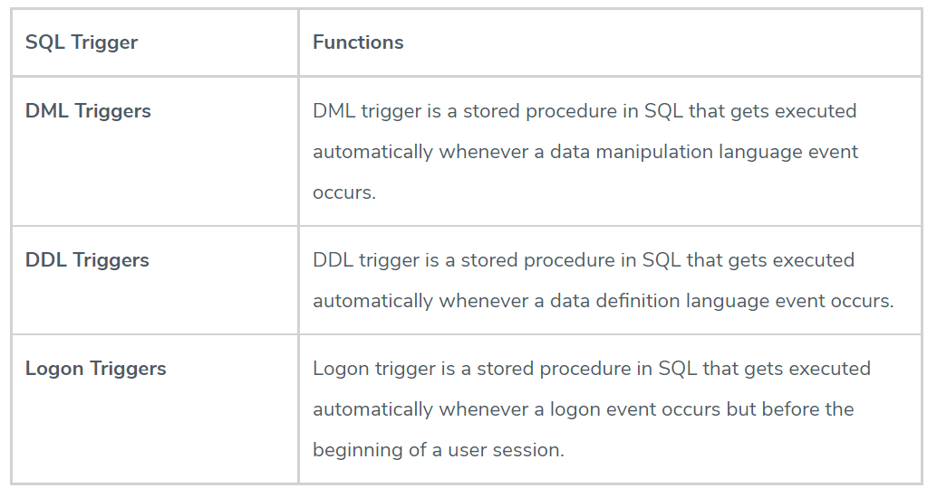
Types of Triggers

Slide 81
DML Triggers
DML trigger is gets executed automatically whenever DML (Insert, Update, Delete)event occurs.
DML triggers help in the prevention of malicious attacks and protect the integrity and security of the database when incorrect DML statements are being performed on the database.
There are two types of DML triggers :
1. AFTER Triggers: AFTER Triggers are executed after an insert, delete or update query has been performed. Hence, their primary purpose is not to check constraint violations.
2. INSTEAD OF Triggers: INSTEAD OF Triggers are executed before an insert, delete or update query has been performed. Hence, they can be used for constraint processing.
CREATE [ OR ALTER ] TRIGGER trigger_name ON table_name [BEFORE | AFTER] {INSERT , UPDATE, DELETE} AS Trigger_body
Syntax for DML Triggers

Slide 82
DDL Triggers
DDL trigger is gets executed automatically whenever DDL (Create, Alter, Drop events occurs.
DDL triggers are mostly used for recording the list of DDL events that have been performed on the database in order to ensure its integrity or to prevent changes in the database.
DDL trigger fires only after the events that fired them are executed successfully.
They cannot be used as Instead of Triggers
DDL Triggers are Respond to a change in the database schema.
DDL T
CREATE TRIGGER trigger_name
ON { DATABASE | ALL SERVER}
[WITH ddl_trigger_option]
FOR {event_type | event_group }
AS {sql_statement}
Syntax for DDL Triggers

Slide 83
Logon Triggers
Logon trigger is a stored procedure in SQL that gets executed automatically whenever a logon event occurs but before the beginning of a user session.
We can define more than one LOGON trigger on a server.
A LOGON trigger can be used in controlling server sessions by tracking login activity, restricting logins to the SQL Server, or limiting the number of sessions for a particular login.
These triggers are created to prevent unauthorized access to the database and hence enhance its security.
CREATE [ OR ALTER ] TRIGGER trigger_name
ON ALL SERVER
WITH logon_trigger_options
{FOR | AFTER} LOGON
AS
Trigger_body
Syntax for Logon Triggers

Slide 84
Enable or Disable Triggers in SQL Server
Triggers when created in SQL Server are enabled by default. You can disable a trigger temporarily using the DISABLE TRIGGER statement
Disable trigger does not delete the trigger. The trigger exists in the current database but it doesn't fire.
Enable trigger reactivates the disabled trigger. Use the ENABLE TRIGGER statement to enable a trigger to fire when an event occurs.
DISABLE TRIGGER [schema_name.][trigger_name] ON [object_name | DATABASE | ALL SERVER]
ENABLE TRIGGER [schema_name.][trigger_name] ON [object_name | DATABASE | ALL SERVER]

Slide 85
Modify or Delete Triggers in SQL Server
The ALTER TRIGGER statement is used to modify the definition of an existing trigger without altering the permissions or dependencies.
You can delete multiple triggers using the DROP TRIGGER statement by specifying the trigger names separated by a comma.
ALTER TRIGGER trigger_name
ON { Table name or view name }
[ WITH ]
{ FOR | AFTER | INSTEAD OF }
{ [INSERT], [UPDATE] , [DELETE] }
AS
sql_statements
Drop Trigger [IF Exists ] [Schemname.] Trigger1, Trigger 2……….Trigger n

Slide 86
Delete DDL or LOGON Triggers
Use the DROP TRIGGER ON statement to delete DDL or LOGON triggers
Example: Delete DDL Trigger
Example: Delete Lonon Trigger
DROP TRIGGER [ IF EXISTS ] trigger_name [ ,...n ]
ON { DATABASE | ALL SERVER };
DROP TRIGGER IF EXISTS trgTablechanges ON DATABASE;
DROP TRIGGER IF EXISTS trgLoginConnection ON ALL Server;

Slide 87
How to List of Triggers in SQL Server?
When we have many databases with multiple tables, the show or list trigger comes in handy.
we can see a list of all the triggers available in SQL Serve
SELECT name, is_instead_of_trigger
FROM sys.triggers
WHERE type = 'TR';
Disadvantages of Triggers
Triggers are invoked automatically, and their execution is invisible to the user. Therefore, it isn't easy to troubleshoot what happens in the database layer
Triggers may increase the overhead of the database server.

Slide 88
Quiz Time
Which of the following specifies when the trigger will be executed?
A. BEFORE B. AFTER C. INSTEAD OF D. All of the above
2. Which of the operation are not specifies in triggers?
A. Alter B. UPDATE C. INSERT D. DELETE
3. How can we specifies a row-level trigger?
A. Using ON ROW B. Using FOR EACH COL C. Using FOR EACH ROW D. Using OR ROW

Slide 89
Dynamic SQL

Slide 90
Outlines
What is Dynamic SQL ?
When to use Dynamic SQL ?
Example for Dynamic SQL ?
Different execution methods for DSQL
Advantages and Disadvantages of Dynamic SQL

Slide 91
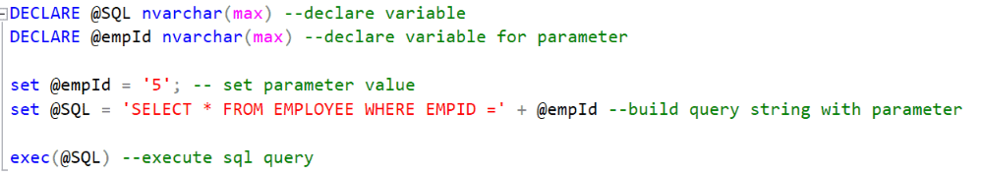
Dynamic SQL
Dynamic SQL is a programming technique where you build SQL query as a string and execute it dynamically at runtime.
For example, the following is a dynamic SQL.
Note : The dynamic SQL query string can be executed using EXEC or EXECUTE command or using the sp_executesql

Slide 92
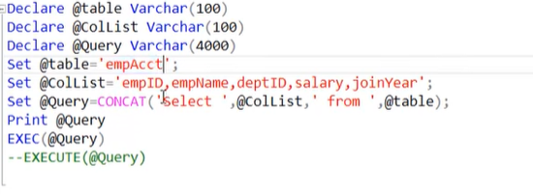
Examples
Dynamic SQL for
1. DML statements
2. Procedure
3. DDL statement
Notes:
https://www.tutorialsteacher.com/sqlserver/dynamic-sql
https://www.youtube.com/watch?v=Kn2TratOqz4

Slide 93
Dynamic SQL Pro’s and Con’s
Advantages of Using Dynamic SQL
Dynamic SQL is flexible and can be reused by using parameters in building the query.
Performance is improved as a better execution plan is generated.
Disadvantages of Using Dynamic SQL
Hard to debug.
Error management is difficult and unreliable.
It is vulnerable to SQL injection and can cause security concerns.
Dynamic SQL is slower than static SQL as SQL Server must generate an execution plan every time at runtime.
Dynamic SQL requires the users to have direct access permission on all accessed database objects like tables and views.

Slide 94
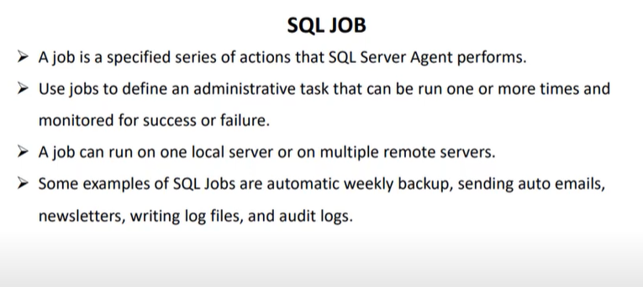
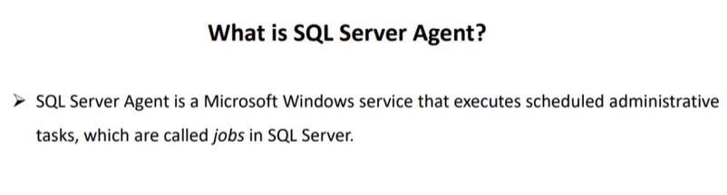
SQL Server Job – How to create and execute
Notes:
https://www.youtube.com/watch?v=A0rRXqzASdQ

Slide 95
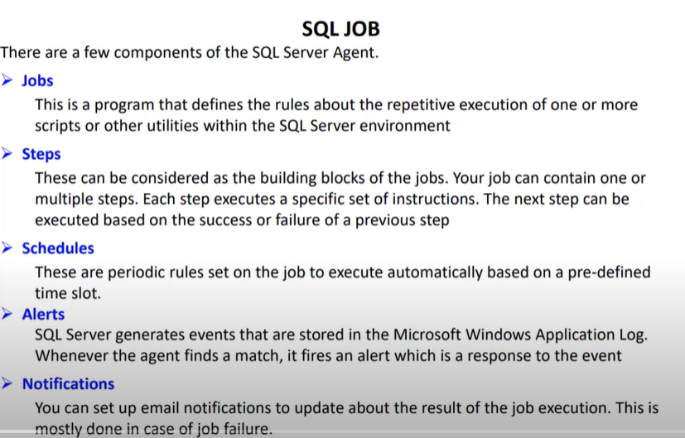
Contd..

Slide 96
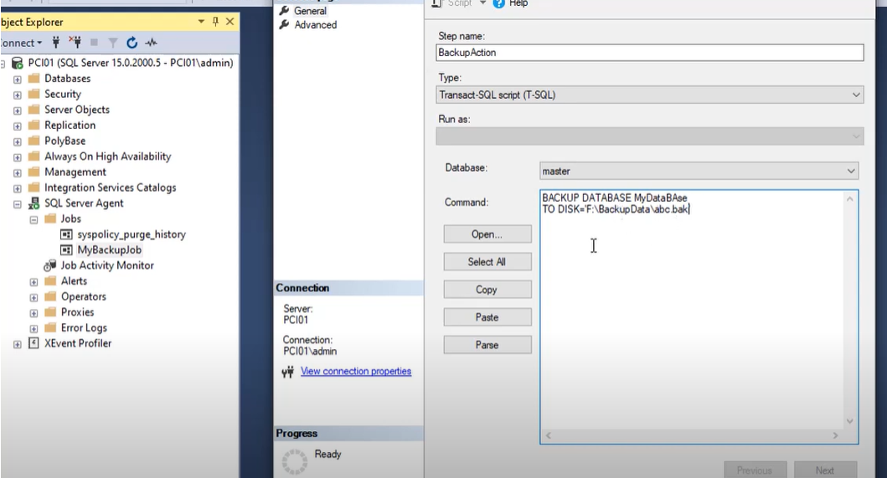
Script for Backup database

Slide 97
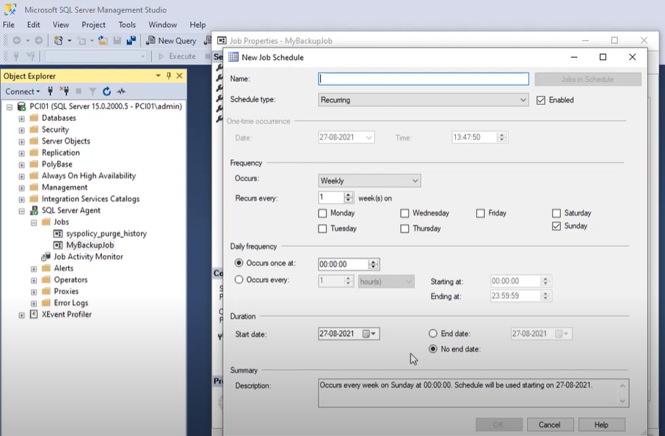
Job Schedule window

Slide 98
E mail notification either Job success or failure
The purpose to configure is to intimate the user to take care of failed jobs.
Some examples of SQL jobs are daily, weekly, monthly and quarterly reports, sending auto emails, newsletters, writing log files, and audit logs to be sent automatically on local or remote locations.
On job failure, we need to know on an immediate basis to get rid of the problem.
We will cover how to configure Database Mail, Email profile, SMTP Configuration, Operator to send email, notification, and SQL Server Agent configuration
Notes:
https://www.youtube.com/watch?v=6hiNsfrauCs
https://www.c-sharpcorner.com/article/email-notification-on-sql-job-failure/

Slide 99
SQL Server 2019 new features
1. Big Data Clusters
2. UTF-8 Support
3. Resumable Online Index Create (CTP 2.0)
4. Intelligent Query Processing (CTP 2.0)
5. Always On Availability Groups
6. Machine Learning on Linux
7. SQL Server on Linux
8. Enhanced Security
Notes:
https://mindmajix.com/sql-server-2019

Slide 100
SQL Server 2017 vs 2019
Topics | SQL Server 2017 | SQL Server 2019
Big Data clusters | Was not included | A new feature of big data cluster incorporated to handle the big data problems
Security | Always Encrypted” feature encodes data. Encoded data cannot handle any mathematical or relational operations on them. | “Secure Enclaves” improvises over the previously encoded data by allowing the basic mathematical or relational operations on encoded data.
Intelligent Query Processing | Adaptive Joins in batch mode and memory feedback in batch mode supported. | Along with previous version features, includes memory feedback in row store mode and Scalar UDF Inlining.
Indexes | Resumable Online Index Rebuilding | Resumable Online Index Create
Always On availability groups | 2 replicas | 5 replicas Secondary to primary index replica redirection
Linux | Doesn’t support the OpenLDAP | Supports OpenLDAP

Slide 101
Q
A
Thank you

