Slide 1
Student Name : Prabhakar Puligadda
Project Name : KEY LOGGER AND SECURITY
-Understanding the Threat and how to protect against it

Slide 2

ProblemStatement:
Keyloggers pose a significant threat in today's digital landscape, targeting both individuals and organizations by covertly capturing keystrokes on computers and mobile devices. These malicious tools surreptitiously intercept sensitive information like passwords and financial details, compromising user privacy and potentially leading to substantial financial losses and reputational damage. Given their stealthy operation and the growing reliance on digital platforms for communication and commerce, detecting and mitigating keyloggers has become increasingly critical to ensuring cybersecurity and protecting sensitive data.

Slide 3


Table of Contents:
Introduction to Keyloggers
How keyloggers work
Methods of Keylogger Distribution
Detection and Prevention
Your solution and its value proposition
Security
Modelling
Advantages,Disadvantages and Algoruthms
Results
Project link
3/21/2024 Annual Review

Slide 4
INTRODUCTION TO KEYLOGGER :
Keyloggers - A keylogger is a type of surveillance software or hardware designed to record keystrokes on a device without the user's knowledge.
It captures keystrokes entered on a keyboard, which can include sensitive information such as passwords, credit card numbers, and personal messages.
Security -Security refers to the protection of computer systems and networks from unauthorized access, attacks, and damage to hardware, software, or electronic data.
Types :
Software Keyloggers:
Malicious programs covertly installed on computers to record keystrokes and compromise sensitive information.
Hardware Keyloggers:
Physical devices installed between keyboards and computers to intercept and record keystrokes, evading software detection.

Slide 5
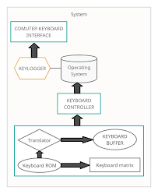
HOW KEYLOGGERS WORK?
Keyloggers record keystrokes on a device by running silently in the background or intercepting signals between the keyboard and computer. Software keyloggers are installed as malicious programs, capturing and storing keystrokes in log files, while hardware keyloggers are physical devices that intercept keyboard signals directly. Captured data is either stored locally or transmitted to remote servers controlled by attackers.

Slide 6

METHODS OF KEYLOGGER DISTRIBUTION :
1.Malicious Emails:
Phishing emails with malicious attachments or links.
Social engineering tactics to trick users.
2. Drive-by Downloads:
Compromised websites and malicious scripts.
Exploiting browser or plugin vulnerabilities.
3. Bundled Software:
Keyloggers hidden in free or pirated software.
Deceptive installers with additional software.
4. Physical Access:
Direct installation by someone with physical access.
Keyloggers on public or shared computers.
5. Removable Media:
Infected USB drives and other storage devices.
Automatic installation upon insertion.
6. Social Media and Messaging Apps:
Malicious links shared via social media or messaging.
Fake profiles and direct messages with links.

Slide 7

DETECTION AND PREVENTION :
Detection : Detecting keyloggers requires a combination of methods including using anti-malware software, conducting regular security scans, and implementing behavioral monitoring. These approaches help in identifying and mitigating the risks associated with keylogging malware.
Anti-Malware Software
Regular Security Scans
Behavioral Monitoring
Prevention :Preventing keyloggers involves adopting proactive measures such as practicing safe internet habits, regularly updating software, and employing encryption technologies. These steps help mitigate the risks of unauthorized keystroke monitoring and data theft.
Use Virtual Keyboards
Multi-Factor Authentication (MFA)
Monitor System Activity
3/21/2024 Annual Review

Slide 8
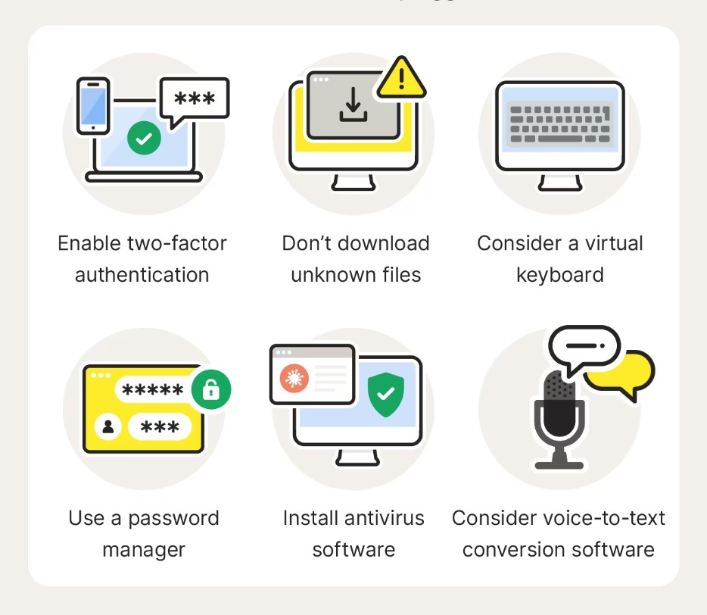
YOUR SOLUTION AND ITS VALUE PROPOSITION
Our solution focuses on implementing comprehensive prevention strategies to safeguard against keyloggers, ensuring robust protection for sensitive information and systems. By adopting our solution, organizations can effectively mitigate the risks associated with keyloggers, uphold data integrity, and maintain trust with stakeholders.
Advanced Anti-Malware Software
Behavioral Monitoring and Anomaly Detection
Encryption Technologies
Regular Security Audits and Updates
Comprehensive Protection
Adaptability and Scalability

Slide 9

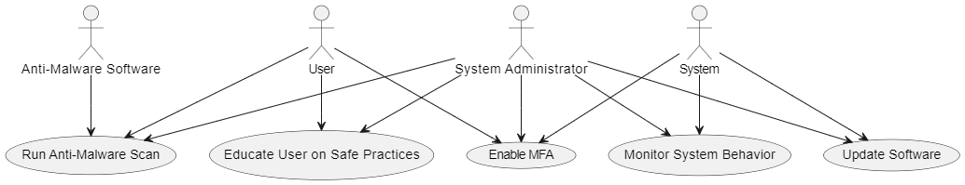
Use-case diagram:
SECURITY:
Ensuring robust security is paramount in preventing keylogger attacks. Key security measures include deploying advanced anti-malware software to detect and remove keyloggers, keeping all systems and applications up-to-date with the latest security patches, and implementing multi-factor authentication (MFA) for an added layer of protection. Additionally, educating users on safe online practices and monitoring system behavior for any unusual activities can significantly reduce the risk of keylogger intrusions. By integrating these comprehensive security strategies, we can safeguard sensitive information and maintain a secure computing environment.
9

Slide 10
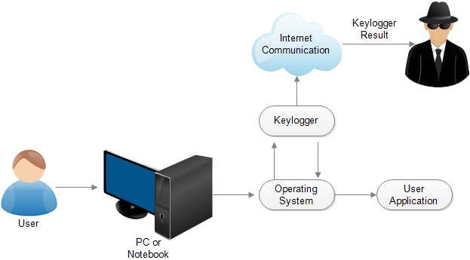
MODELLING :
END USERS:
Individuals
Businesses
Financial Institutions
Government Agencies
10

Slide 11
MODELLING:
Modeling a keylogger prevention tool involves identifying potential threats, analyzing system vulnerabilities, and assessing risks. The tool must integrate advanced anti-malware capabilities, provide regular software updates, and support multi-factor authentication. Continuous monitoring and real-time alerts, combined with user education, ensure swift detection and response to keylogger activities, effectively safeguarding sensitive data
1.Identify Potential Threats:Determine the types of keyloggers that could target the system. 2.Analyze System Vulnerabilities:Assess the system's weaknesses to identify points of entry for keyloggers.
3.Conduct Risk Assessment:Evaluate the likelihood and impact of potential keylogger attacks. 4.Design Mitigation Strategies:Develop advanced anti-malware capabilities and support software updates.
5.Enable Continuous Monitoring:Set up real-time monitoring and alerts for unusual system activities.
6.Provide User Education:Educate users on safe computing practices and recognizing phishing attempts
7.Test and Validate:Perform testing to ensure effective detection and mitigation of keyloggers.
8.Deploy and Monitor:Roll out the tool and continuously monitor its effectiveness.
9.Review and Improve:Regularly review the tool's performance and update it to counter new threats.
11

Slide 12
ADVANTAGES & DISADVANTAGES
Advantages:
Monitoring and Surveillance
Parental Control
Password Recovery
Law Enforcement
Debugging
Disadvantages:
Privacy Concerns
Malware Threat
Legal Issues
False Sense of Security
Detection and Removal Challenges
ALGORITHMS
Form Grabbing
Memory Injection
Keyboard Hooks
API Hooking
Network-based Keylogging

Slide 13
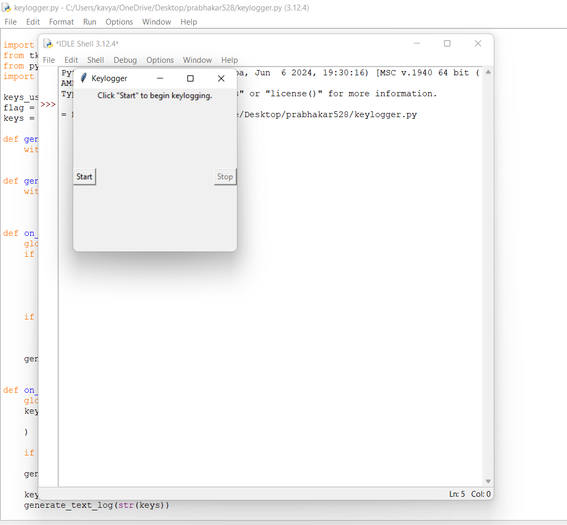
RESULTS :
13

Slide 14
Project link :
https://github.com/PrabhakarPULIGADDA/prabhakar-Project.git

