Slide 1
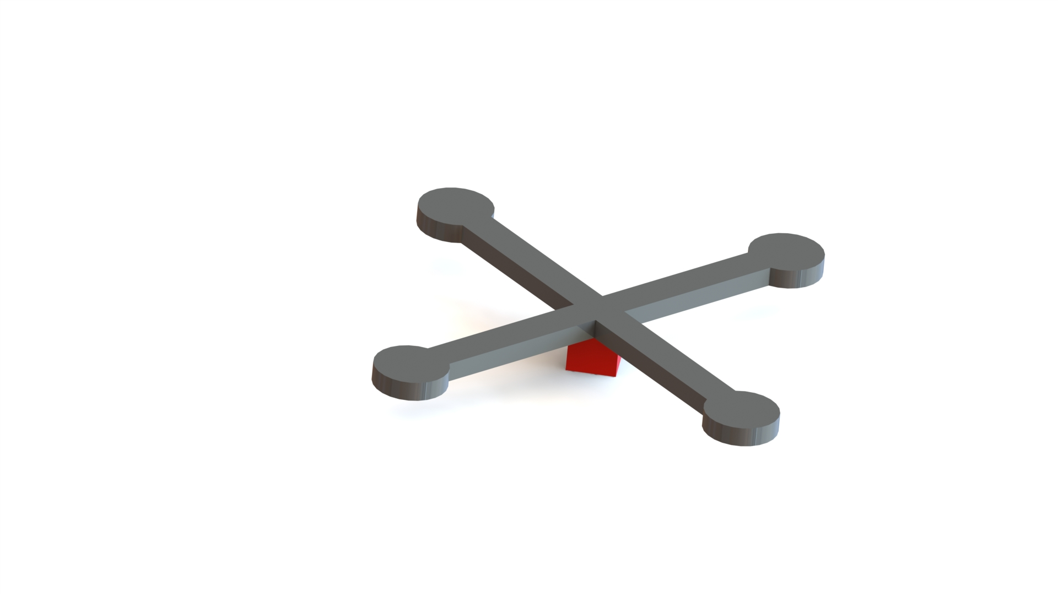
Body Frame
Z
X
Y
Z
Y
X
Earth Frame

Slide 2


$$U=[Motors′ Thrust]$$
Inputs
$$X=\left[\begin{matrix}Linear Positions \\ Linear Velocities \\ \begin{matrix}Angular Positions \\ Angular Velocities\end{matrix}\end{matrix}\right]$$
Next State
State
UAV (Plant)

Slide 3
Mission Plan
Delivery Mo
Target Waypoints

