Slide 1

SDM Institute of Technology, Ujire Department of Computer Science and Engineering
“E-Billing by Vraio”
Under the guidance of
Mr. H Manoj Gadiyar T.
Assistant Professor
Department of CSE
Presented by :
Name : Jois Prabhanjan.
USN: 4SU18CS032.
Notes:
1

Slide 2
Contents
1. Introduction
2. About company
3. Weekly report
4. Workflow
5. Snapshots
6. Conclusion
7. Scope for future work
Notes:
2
2

Slide 3
Introduction
In this internship, I worked on an E-Billing Interface project using Html, CSS, and JavaScript.
Some of the resources like templates icons are fetched online during the component design phase.
The web interface is mainly designed to use in Billing websites to fulfill the basic design.

Slide 4
About company
Vraio Software Solutions Pvt Ltd is a website design and development company.
The team of designers and programmers collectively bring a few years of experience to help provide us with a great-looking site. The company recognizes the importance of implementing the right solution for our business. It offers a wide range of services to build a solution that is right for our business needs.

Slide 5
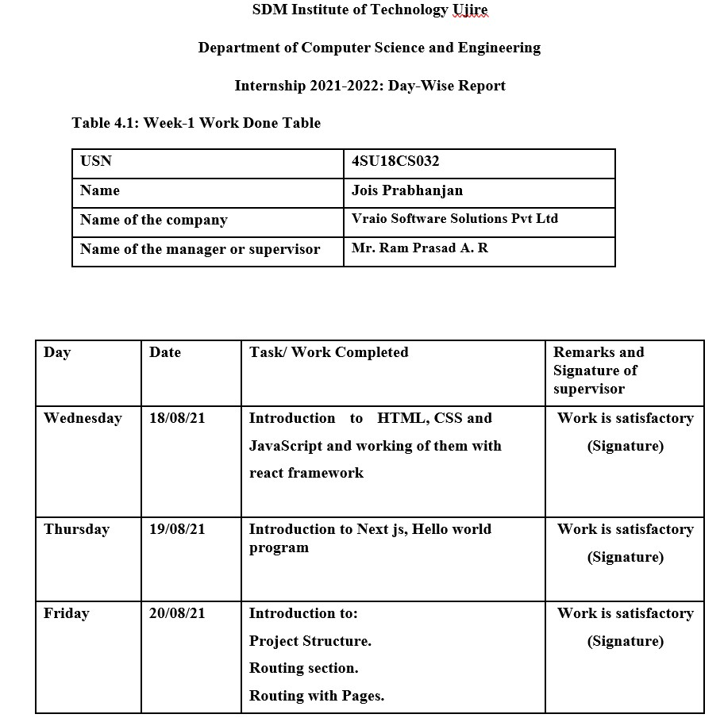
Weekly Report

Slide 6
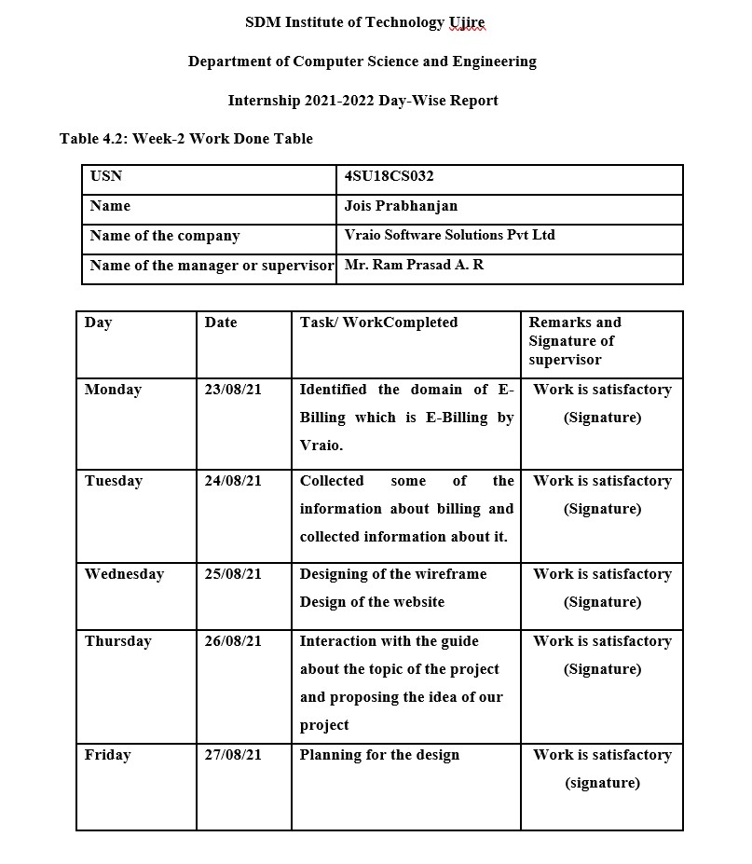

Slide 7
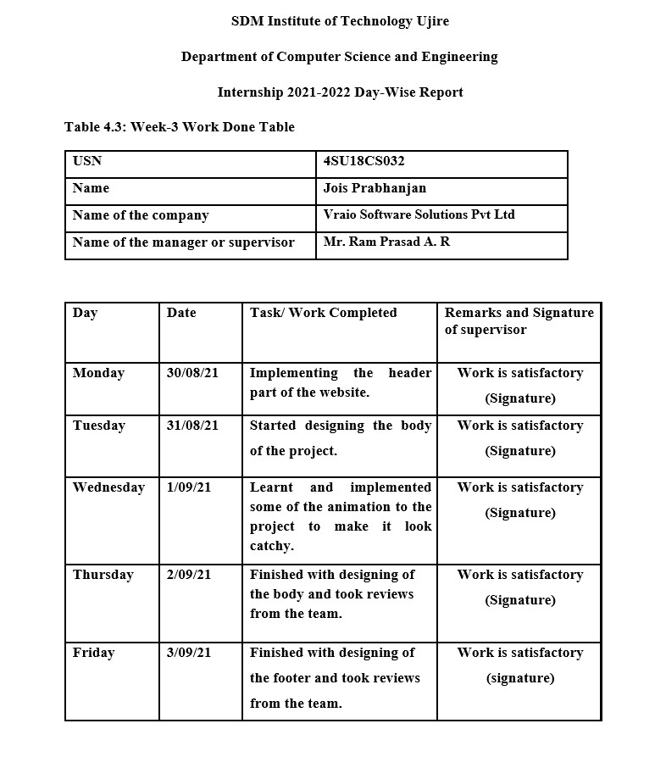

Slide 8
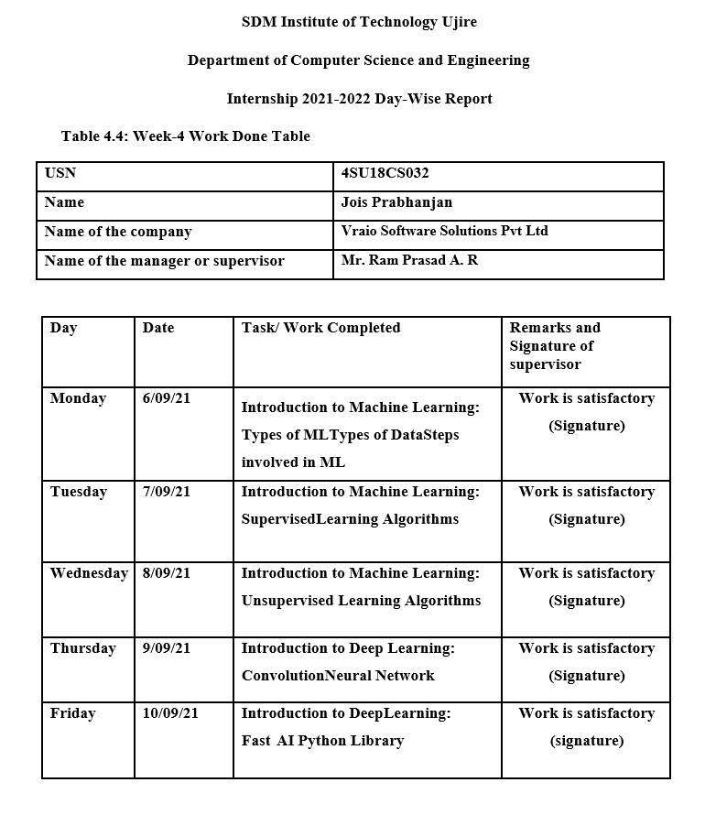

Slide 9
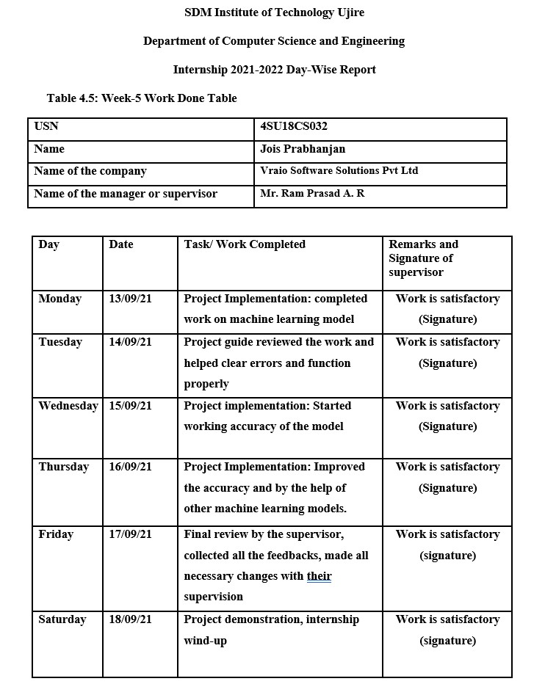

Slide 10
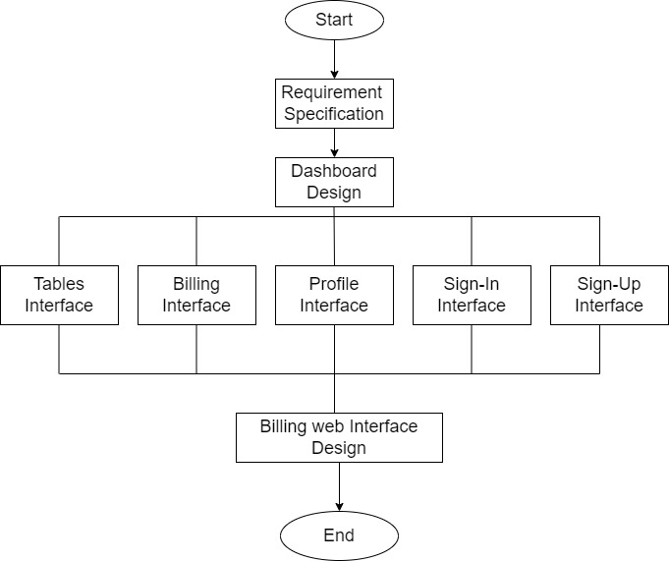
Workflow
Figure 4.1

Slide 11
This is the Github repository link where the web interface design is been done and well documented
https://github.com/PrabhanjanJois/React_Internship
The Machine Learning part of the Internship is also been uploaded to the GitHub repository is also been done and well documented.
https://github.com/PrabhanjanJois/ML_model_on_twitter_gender_classification

Slide 12
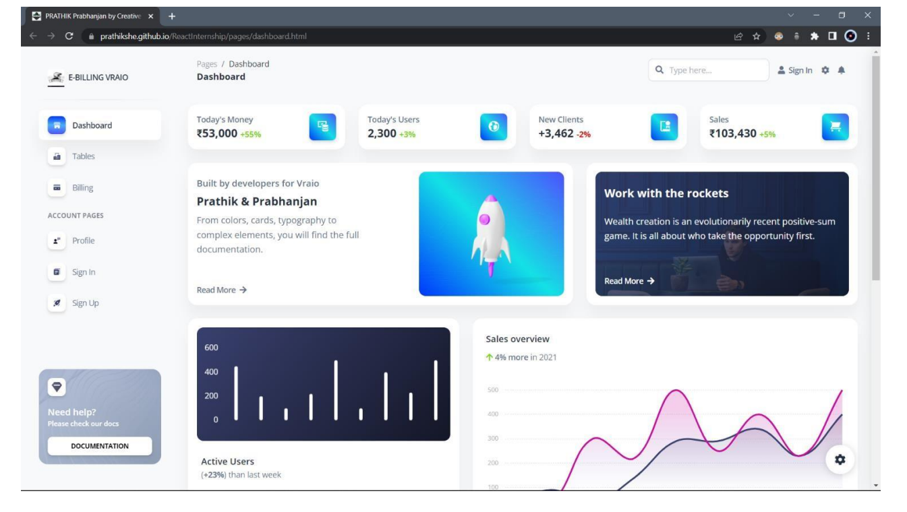
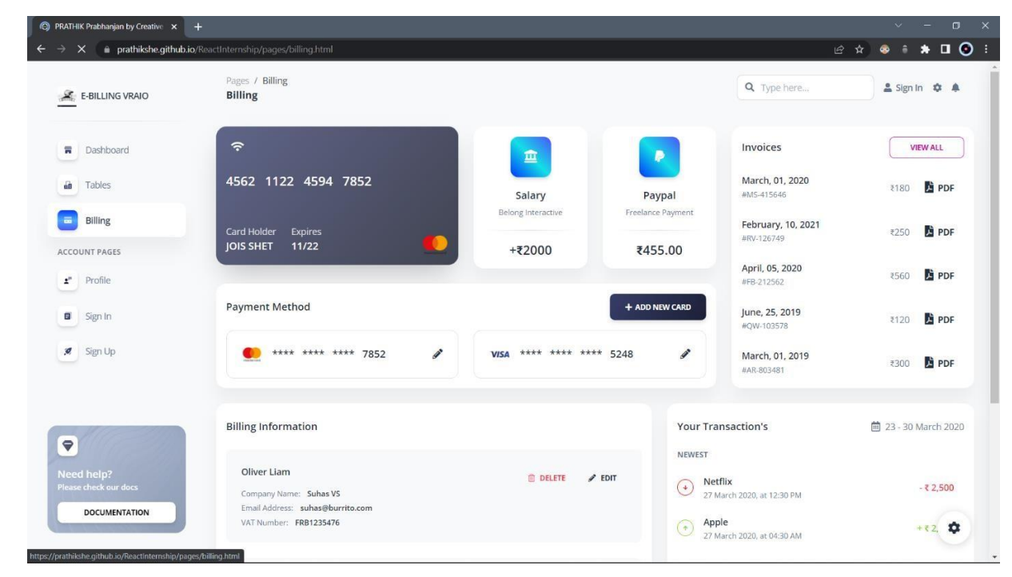
Figure 5.1: User Dashboard
Figure 5.2: Billings Interface

Slide 13
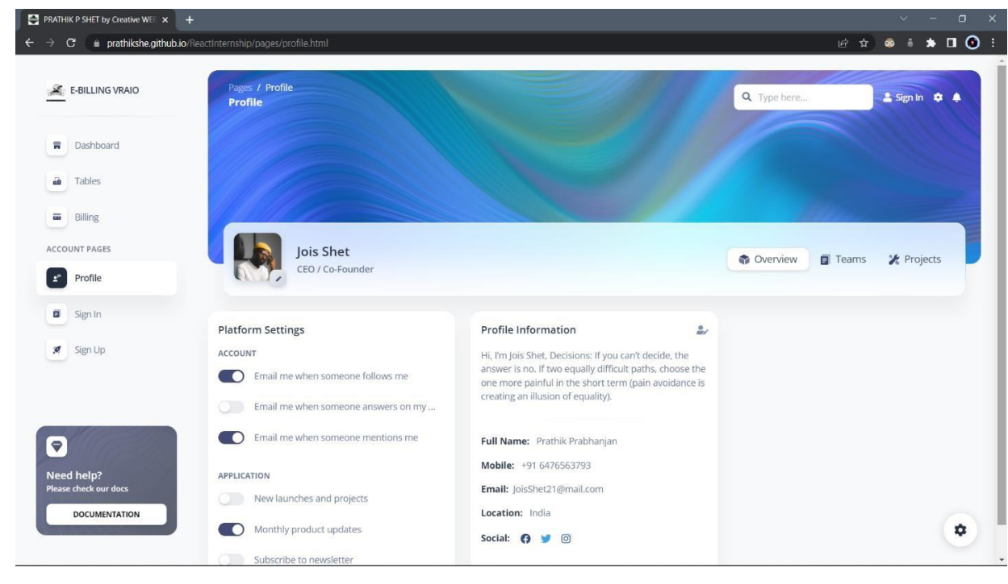
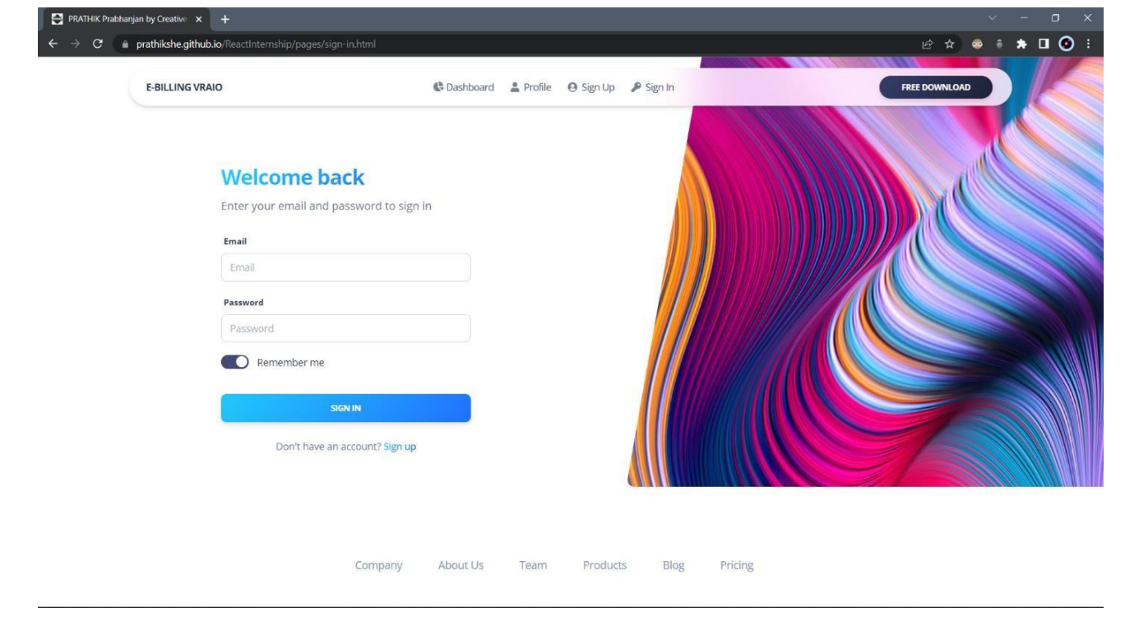
Figure 5.4: Sign In Page
Figure 5.3: User Profile Page

Slide 14
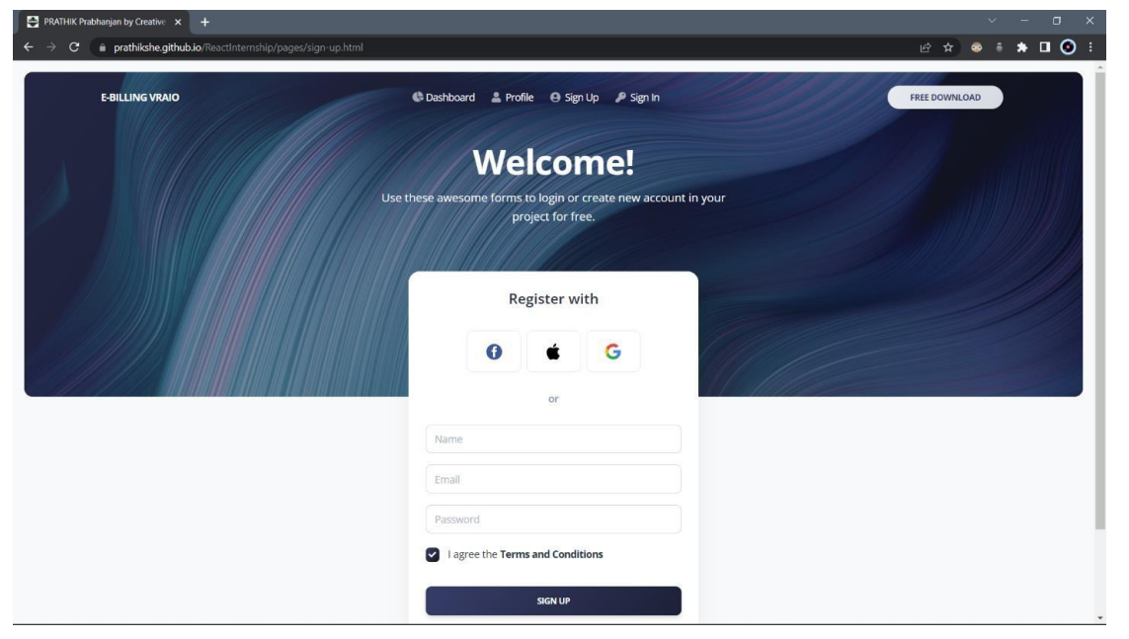
Figure 5.4: Sign Up Page

Slide 15
Conclusion
The internship in Vraio Software was a great opportunity for me. One of the most important thing I gained from internship is newfound knowledge, I learnt new and improved skills and how to apply them. Working in a professional setting for the first time can be difficult to get used to. But it is the best way to learn how to navigate the working world through real-life, hands-on experience. One of the most valuable skill I had learnt is the ability to speak with people in a professional setting.

Slide 16
Scope for future work
It has been a great pleasure for me to work on this exciting and challenging project. It provided knowledge about the latest technology used in JavaScript that will be great demand in future. This will provide better opportunities and guidance in future in developing projects independently.

