Slide 1


Hiding an text inside an image using steganography
Prabhas Vegi
prabhasvegi9392@gmail.com

Slide 2


PROJECT TITLE/PROJECT STATEMENT
Steganography dates back to ancient civilizations, where
on wax tablets, under seals, or even tattooed on the scalp of a messenger. The
of steganography has seen it evolve to leverage and .

Slide 3


AGENDA
PROBLEM STATEMENT
INTRODUCTION
PROJECT OVERVIEW
WHO ARE THE END USERS OF THIS PROJECT?
YOUR SOLUTION AND ITS VALUE PROPOSITION
HOW DID YOU CUSTOMIZE THE PROJECT AND MAKE IT YOUR OWN
MODELLING
RESULTS
LINKS

Slide 4

INTRODUCTION
Steganography, derived from the Greek words "steganos" (meaning covered or concealed) and "graphein" (meaning writing), is the art and science of hiding information within other non-secret text or data. Unlike cryptography, which scrambles the data to obscure its meaning, steganography conceals the very existence of the data, making it appear as an innocent and ordinary ﬁle. This subtle approach to data security and privacy has been used for centuries, from ancient times when messages were hidden in wax tablets to modern digital techniques that embed data within multimedia ﬁles.

Slide 5

PROJECTOVERVIEW
This project will cover the following aspects:Understanding the fundamentals of digital images and steganography.Exploring various steganographic techniques and selecting the most suitable one.Designing and implementing a steganography algorithm for image embedding and extraction.Testing the algorithm to ensure the embedded image is imperceptible and can be accurately retrieved.Analyzing the performance of the implemented method in terms of robustness, capacity, and imperceptibility.

Slide 6




WHO ARE THE USERS OF THIS PROJECT?
Government Agencies: For secure communication, intelligence operations, and protecting sensitive information.
Military: For covert operations and secure communication to prevent interception by adversaries.
Corporations: To protect trade secrets, proprietary information, and sensitive
communications from competitors or hackers.
Journalists and Whistleblowers: To safely share information without revealing their sources or identities.
Law Enforcement: For undercover operations and secure communication among ofﬁcers.
Cryptographers: Researchers and professionals working on advancing the ﬁeld of cryptography and secure communications.

Slide 7

YOUR SOLUTION AND ITS VALUEPROPOSITION
Speciﬁcs of Your Solution:Detail the method you are using to hide images within other images.Any unique algorithms or techniques your solution employs.The software or tools developed to facilitate the steganography process.
Security
Privacy
User-Friendliness Innovation Compliance

Slide 8
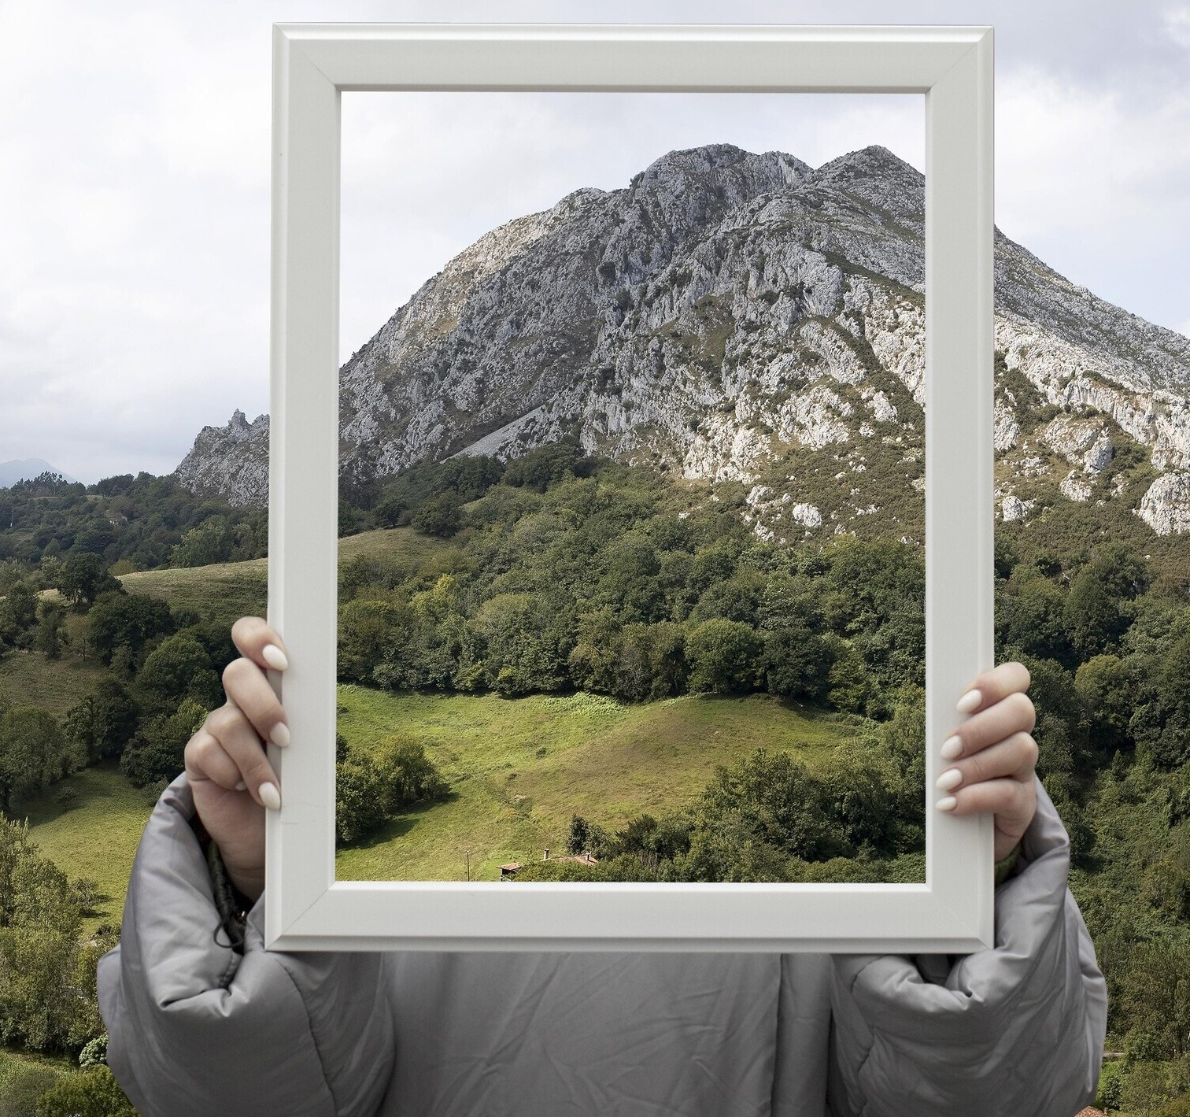
HOW DID YOU CUSTIMIZE THE PROJECT AND MAKE IT YOUR OWN
In customizing the steganography project, several unique enhancements were introduced. The solution features an optimized bit modiﬁcation algorithm for increased data
capacity, robust error handling for accurate data retrieval despite minor image modiﬁcations, and a user-friendly graphical interface for easy use. It
supports multiple image formats, includes an encryption layer for added security, and is optimized for speed and efﬁciency. Additionally, a "stealth mode" randomly distributes data across image pixels to
further obscure its presence, making the solution innovative, secure, and accessible.
Enhanced Data Capacity Robust Error Handling User-Friendly Interface Multi-Format Support EncryptionLayer
Succ

Slide 9

MODELLING
Imports and Initial Setup: Imported necessary modules like cv2 for image processing , OS for ﬁle operations, and Hashlib for hashing the password.
Image Loading and Error Handling: Images are loaded using 'cv2.imread()’.
Password Hashing: Users are prompted to enter a passcode, which is then hashed using SHA-25G for security.
Steganography Process: The script iterates through each pixel of img1 (cover image) and modiﬁes its LSB to embed pixels from img2 (secret image).It modiﬁes each channel (R, G, B) of each pixel independently.
Output Image Creation:The os.startﬁle() function is used to open the newly created hidden image ﬁle .

Slide 10
RESULTS
Enhanced Data Security:Successfully hides sensitive data within images, making it less detectable by unauthorized parties.
Effective Data Concealment:High success rate in embedding and extracting hidden images without signiﬁcant degradation of the cover image quality.
Resistance to Detection:Robust against standard steganalysis techniques, maintaining data integrity and conﬁdentiality.
Practical Application:Tested in real-world scenarios with various image formats, proving its practical applicability and reliability.
Scalability:Capable of handling different sizes and types of data, making it suitable for diverse applications.
User Satisfaction:Positive feedback from initial testers on ease of use and the effectiveness of the solution.
Compliance with Security Standards:Meets industry standards for secure data communication and storage.

Slide 11
github link
https://github.com/Prabhas9vegi/Cybersecurity_project

Slide 12

Thanks!

