Slide 1
1 · THE PROBLEM
Revenue is growing. Profit isn't keeping up.
Leadership receives four disconnected weekly reports (stores, e-commerce, finance, returns) that disagree.
Revenue grew in 2025, but no one could say where profit was being made or lost.
Suspected causes: weak-margin categories, heavy discounting, rising returns, under-performing stores.
This project builds one trusted source of truth and answers: what is happening, why, where, and what to do.
Revenue 2025
Gross profit 2025
£4.58M
£1.88M
+15.7% vs 2024
+9.4% vs 2024
Gross margin
Return rate
41.0%
8.3%
−2.4 pts vs 2024
+1.2 pts vs 2024
NorthStar Retail UK (fictional) · simulated data · portfolio project
1
Notes:
Open with the tension: growth looks healthy, but profit grew at less than two-thirds the rate of revenue.

Slide 2
2 · BUSINESS OBJECTIVES
What leadership asked for
# | Objective | Measure of success
O1 | One trusted source of truth | KPIs reconcile SQL ↔ Power BI
O2 | See where profit is made or lost | Drill company → region → store → product
O3 | Quantify the cost of discounting | Margin by discount band, break-even discount
O4 | Explain rising returns | By category, channel, brand and reason
O5 | Understand customer value | Segments, retention, RFM
O6 | Recommend prioritised actions | ≥ 8 recommendations with stated assumptions
Out of scope: inventory, marketing spend, overheads → we report gross profit, not net profit.
NorthStar Retail UK (fictional) · simulated data · portfolio project
2

Slide 3
3 · DATA & APPROACH
185,858 order lines, 24 months, one star schema
Pipeline: raw CSV extracts → Python validation & cleaning → PostgreSQL star schema → 40 SQL business questions → Power BI model + DAX → insights.
Scale: 89,528 orders · 9,530 known customers · 1,220 products · 24 stores + online · 12 UK regions · Jan 2024 – Dec 2025.
Model: FactSales (grain = order line) + FactReturns, sharing six dimensions (Date, Customer, Product, Store, Region, Channel).
Synthetic data with designed business patterns: seasonality, channel shift, discounting, supplier issues.
DimDate DimProduct
\ /
DimCustomer — FactSales — DimStore
/ \
DimChannel DimRegion
FactReturns shares the same dimensions
(return date active; order date inactive
→ USERELATIONSHIP in DAX)
NorthStar Retail UK (fictional) · simulated data · portfolio project
3

Slide 4
4 · DATA QUALITY
Messy sources, measured and fixed, not hidden
Check | Before | After
Sales validity (date, qty, discount, channel) | 91.7% | 100%
Channel labels (target 4) | 14 | 4
Category labels (target 8) | 28 | 8
Duplicate sales rows | 900 | 0
Duplicate customers (same email) | 180 | 0
Returns linked to a sale | 99.87% | 100%
40 documented rules: fix if certain, flag if uncertain, quarantine if untrustworthy.
90 sales rows quarantined (0.05%): impossible dates, negative quantities, unknown SKUs.
Guest (blank) customers kept as a legitimate 'unknown member', not deleted.
Proof: 100% of cleaned lines match the answer key; 13/13 SQL checks pass.
NorthStar Retail UK (fictional) · simulated data · portfolio project
4

Slide 5
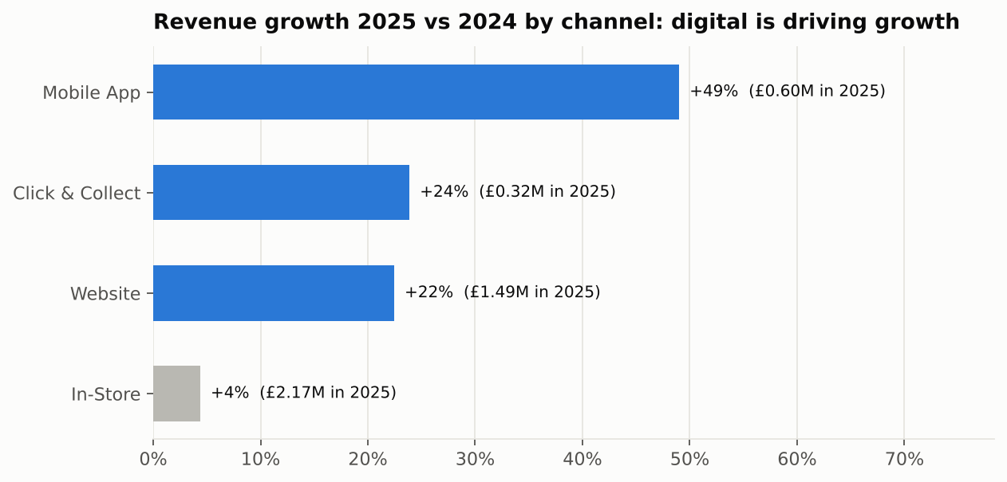
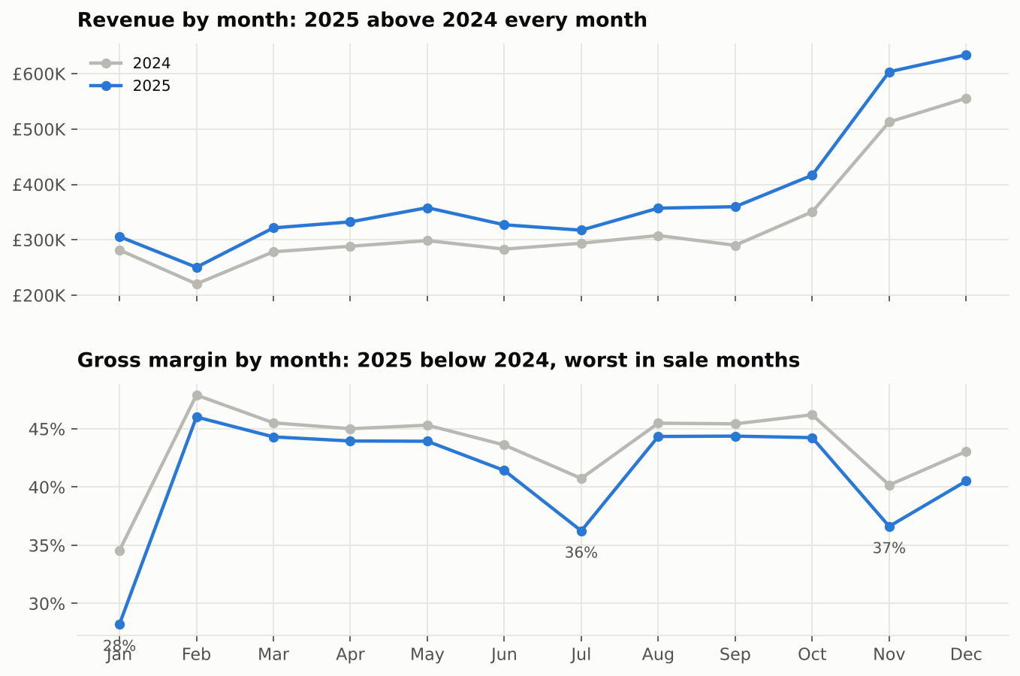
5 · SALES
Growth is digital; stores are flat like-for-like
Mobile App +49%, Website +22%, Click & Collect +24%, In-Store +4%.
Like-for-like stores +5.3% vs online hub +29%. Headline growth flatters the store estate.
NorthStar Retail UK (fictional) · simulated data · portfolio project
5

Slide 6
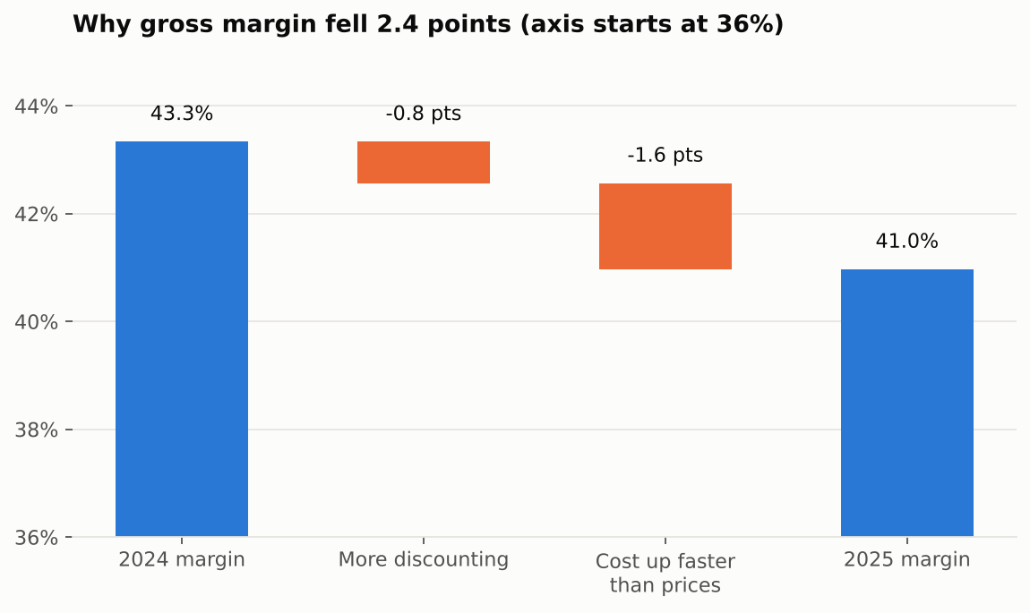
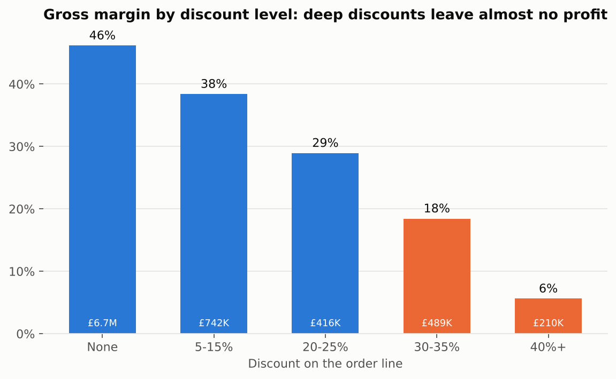
6 · PROFITABILITY
Margin fell 2.4 pts: discounting and unrecovered cost inflation
Electronics: 19% of revenue, 6% of profit. 2025 revenue +14.6% but gross profit −13%. Breaks even at an 18.7% discount.
Lines discounted 30%+ in 2025: £406K revenue, only £56K gross profit.
NorthStar Retail UK (fictional) · simulated data · portfolio project
6

Slide 7
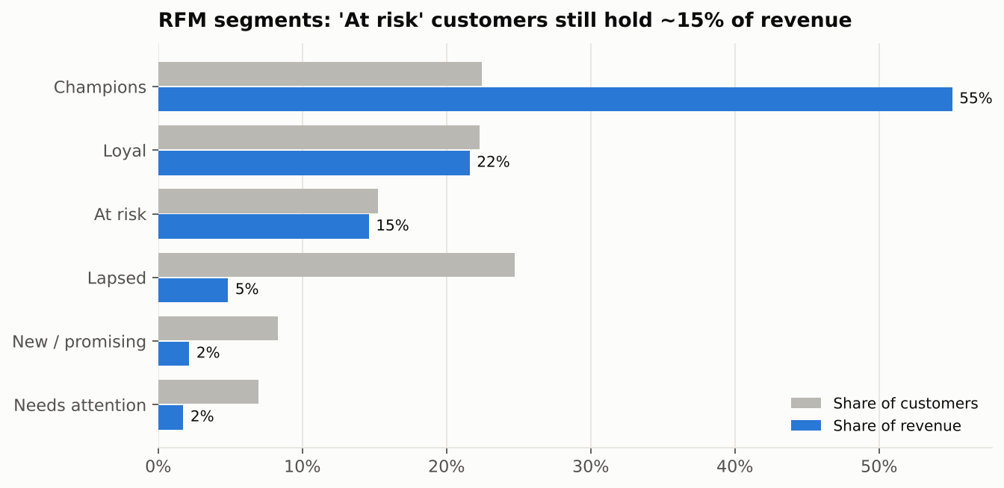
7 · CUSTOMERS
A loyal core, and 1,450 valuable customers drifting away
14% of customers generate 50% of known-customer revenue; 38% generate 80%.
Returning customers place ~93% of orders.
Premium: £1,380 per customer, buys every ~20 days (median).
'At risk' segment: formerly loyal (avg 7.7 orders), no purchase for ~8 months, 14.6% of revenue.
32–34% of in-store revenue is anonymous: can't be retained or analysed.
NorthStar Retail UK (fictional) · simulated data · portfolio project
7

Slide 8
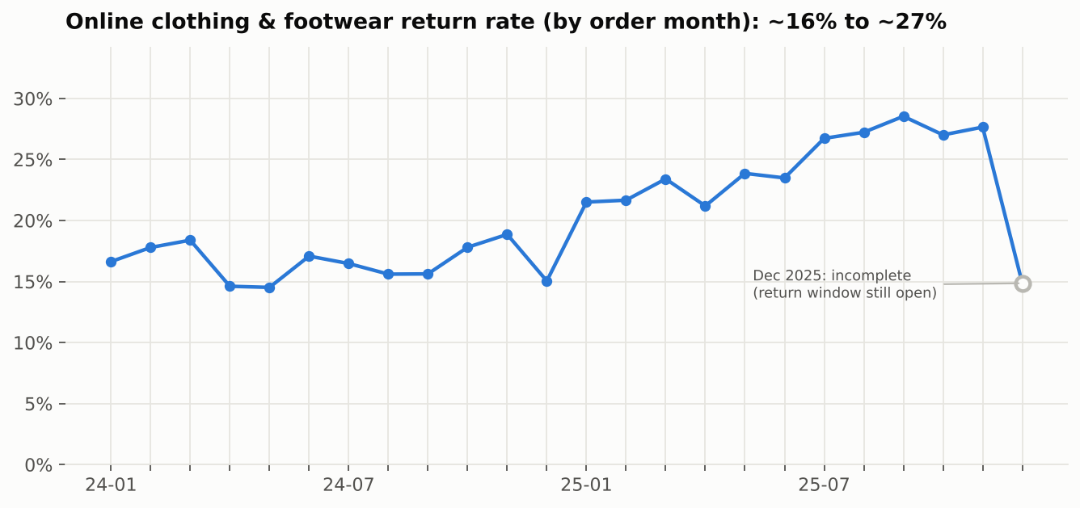
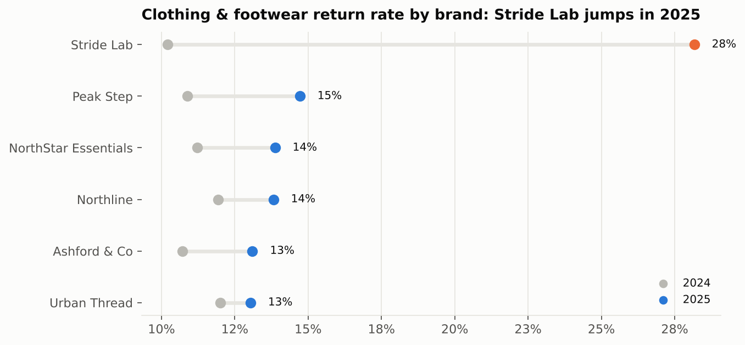
8 · RETURNS
Online returns rising, driven by one footwear supplier
Online clothing & footwear return rate ~16% → ~27%; refunds £83K → £160K.
Stride Lab 10% → 28% (83% 'wrong size / fit'). Voltix smart home: 22% vs 6% for other brands ('faulty').
After refunds, website margin is 28% vs 39% in store.
NorthStar Retail UK (fictional) · simulated data · portfolio project
8

Slide 9
9 · KEY INSIGHTS
Five things leadership should know
1
Profit grows slower than sales
Margin −2.4 pts: −1.6 cost inflation not passed on, −0.8 more discounting.
2
Electronics sells volume, not profit
11% margin in 2025; discounts over ~19% sell below cost.
3
Deep discounts don't pay
30%+ discounts: 14% margin on £406K of 2025 revenue.
4
Returns are a supplier & sizing problem
Stride Lab sizing and Voltix faults explain most of the spike.
5
Two stores discount like outlets
Newcastle 15% average discount vs ~5% at peers → 37% margin vs ~44%.
NorthStar Retail UK (fictional) · simulated data · portfolio project
9

Slide 10
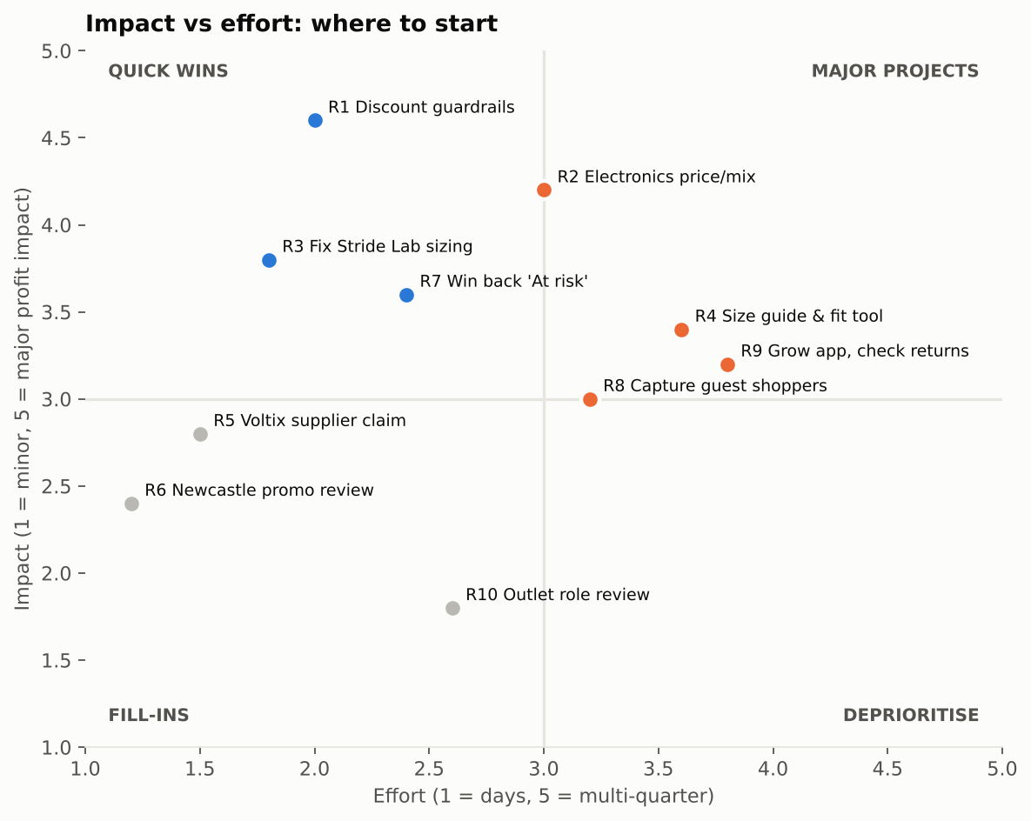
10 · RECOMMENDATIONS & NEXT STEPS
Start with the quick wins: ~£120–140K gross profit a year
30 days: discount guardrails by category (Electronics max 15%), ~£28K;
Stride Lab & Voltix supplier action, ~£30–49K; Newcastle promotion sign-off, ~£6K.
60 days: size guidance on top apparel lines (~£20K per 3 pts of returns); win-back campaign, ~£13K.
90 days: Electronics price/cost review, ~£25K; till customer capture; report margin after returns per channel.
Estimates are illustrative, based on simulated data with stated assumptions (insights/02_recommendations.md).
NorthStar Retail UK (fictional) · simulated data · portfolio project
10

