Slide 1
NORTHSTAR / INDEPENDENT SIMULATED PORTFOLIO
NorthStar Manufacturing UK
SAP S/4HANA Order-to-Cash
Business Process Analysis & Transformation
• Independent simulated portfolio
• Public Edition 2602 research reference
• Free documentation and synthetic-data route
11 October 2026 · No production implementation or achieved savings claimed
01
Notes:
Explain that no real client, production configuration or implementation is represented.

Slide 2
NORTHSTAR / INDEPENDENT SIMULATED PORTFOLIO
The business problem
Three connected operational problems
• Poor visibility → repeated enquiries and unclear ownership
• Stock delays → unsupported promises and partial-delivery decisions
• Manual billing handoffs → eligible deliveries waiting for review
11 October 2026 · No production implementation or achieved savings claimed
02
Notes:
Consequences are hypotheses from the supplied fictional scenario, not real observed findings.

Slide 3
NORTHSTAR / INDEPENDENT SIMULATED PORTFOLIO
Scope and representative order
One company · one warehouse · domestic B2B · GBP
• NS-ORD-1001: 100 brackets × £25 = £2,500 net
• 60 physically on hand; availability remains unresolved
• Requested receipt 9 October; no confirmed promise invented
• Order receipt through payment allocation and reporting
11 October 2026 · No production implementation or achieved savings claimed
03
Notes:
Manufacturing planning, procurement redesign, international trade, complex tax, full migration and deployment are excluded.

Slide 4
NORTHSTAR / INDEPENDENT SIMULATED PORTFOLIO
Discovery and process choices
Role-play reveals decisions, not stakeholder approval
• Validate data before confirmation; retain the original promise
• Require agreement for partial delivery; keep remainder open
• Finance owns credit release and billable-population review
• Separate physical dispatch, goods-issue posting and receipt
11 October 2026 · No production implementation or achieved savings claimed
04
Notes:
Explain alternative causes for late billing; email handoff is a hypothesis, not a proven root cause.

Slide 5
NORTHSTAR / INDEPENDENT SIMULATED PORTFOLIO
Requirements to validation
One traceable evidence chain
• 23 requirements: 3 business + 15 functional + 5 non-functional
• 15 stories and 12 rules with explicit exceptions
• Example: PROB-002 → BR-002 → FR-004 → PC-004
• US-004 → TC-005/006 → KPI-003
11 October 2026 · No production implementation or achieved savings claimed
05
Notes:
All requirements and stories are proposed. Trace links exist but actual business validation is pending.

Slide 6
NORTHSTAR / INDEPENDENT SIMULATED PORTFOLIO
SAP standard-first assessment
Documented capability is not demonstrated configuration
• Seven official sources reviewed; two pages explicitly unverified
• BD9 stock-sales reference and payment handling researched
• 15 functional fit assessments remain desk-based
• Validate exact roles, corrections, receipt capture and audit coverage
11 October 2026 · No production implementation or achieved savings claimed
06
Notes:
Reference is Public Edition 2602; Learning pages are not release-pinned. Entitlements and configuration are not established.

Slide 7
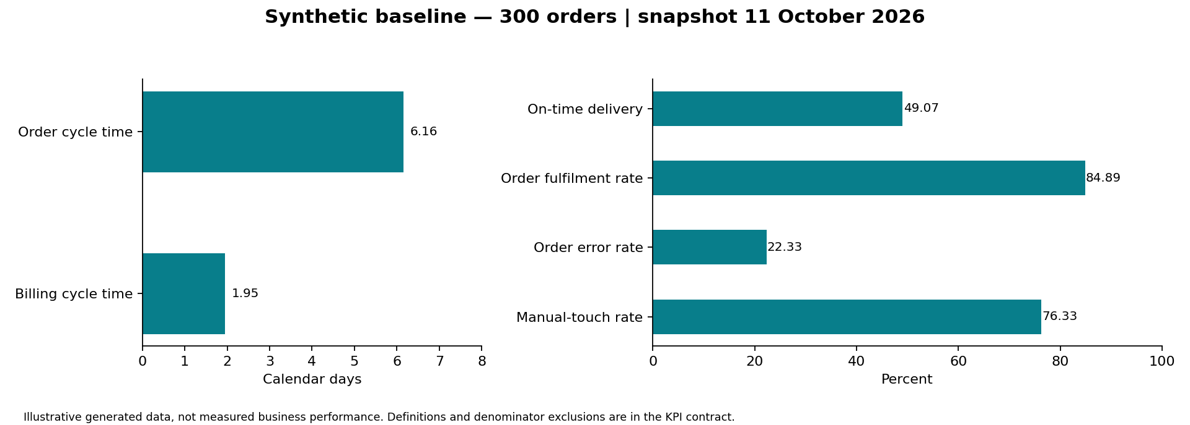
NORTHSTAR / INDEPENDENT SIMULATED PORTFOLIO
Synthetic baseline
Reproducible analysis, not achieved performance
11 October 2026 · No production implementation or achieved savings claimed
07
Notes:
Single-line orders, net-only finance, seeded data. On-time denominator includes overdue open orders. Cycle time excludes unfinished orders; billing mean excludes unbilled deliveries.

Slide 8
NORTHSTAR / INDEPENDENT SIMULATED PORTFOLIO
Validation and remaining gates
Honest execution status
• 24 synthetic data checks passed; six Python/SQL KPIs agree
• 22 SAP UAT cases designed; 0 executed
• Desk walkthrough issues kept separate from SAP defects
• Learner explanation, real discovery and tenant testing remain pending
11 October 2026 · No production implementation or achieved savings claimed
08
Notes:
Do not turn data check success into a passed SAP UAT case or personal experience claim.

Slide 9
NORTHSTAR / INDEPENDENT SIMULATED PORTFOLIO
Options and illustrative economics
Improve controls before assuming a large investment
• Compare manual controls, process standardisation and SAP-aligned design
• 6,000 orders × 5 minutes = 500 hours annual capacity
• At £25/hour: £12,500 capacity equivalent, not cash savings
• No cash ROI/payback claimed; costs are planning placeholders
11 October 2026 · No production implementation or achieved savings claimed
09
Notes:
Recommend manual ownership/reconciliation first, then validate process standardisation. No SAP price quote or achieved benefit is represented.

Slide 10
NORTHSTAR / INDEPENDENT SIMULATED PORTFOLIO
What this portfolio demonstrates
A reviewable foundation, with explicit limits
• Problem → evidence → requirements → design → validation reasoning
• Reproducible synthetic analysis and source-labelled SAP research
• Next: learner review, policy validation and system demonstration
• AI drafted/generated artifacts; personal contribution must be stated accurately
11 October 2026 · No production implementation or achieved savings claimed
10
Notes:
Final learning gate remains open until the learner can explain decisions without reading a script. No employment guarantee.

