Slide 1
SERVLET

Slide 2

WEB
The World Wide Web, commonly known as the Web, is an information system enabling documents and other web resources to be accessed over the Internet.
Documents and downloadable media are made available to the network through web servers and can be accessed by programs such as web browsers using web applications.

Slide 3

APPLICATIONS
An application, or application program, is a software program that runs on your computer.
For example, Web browsers, e-mail programs, word processors, games, and utilities are all applications. The word "application" is used because each program has a specific application for the user.

Slide 4
Types of Applications

Slide 5
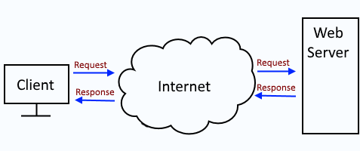
Web Application
A Web application (Web app) is an application program that is stored on a remote server and delivered over the Internet through a browser interface.

Slide 6
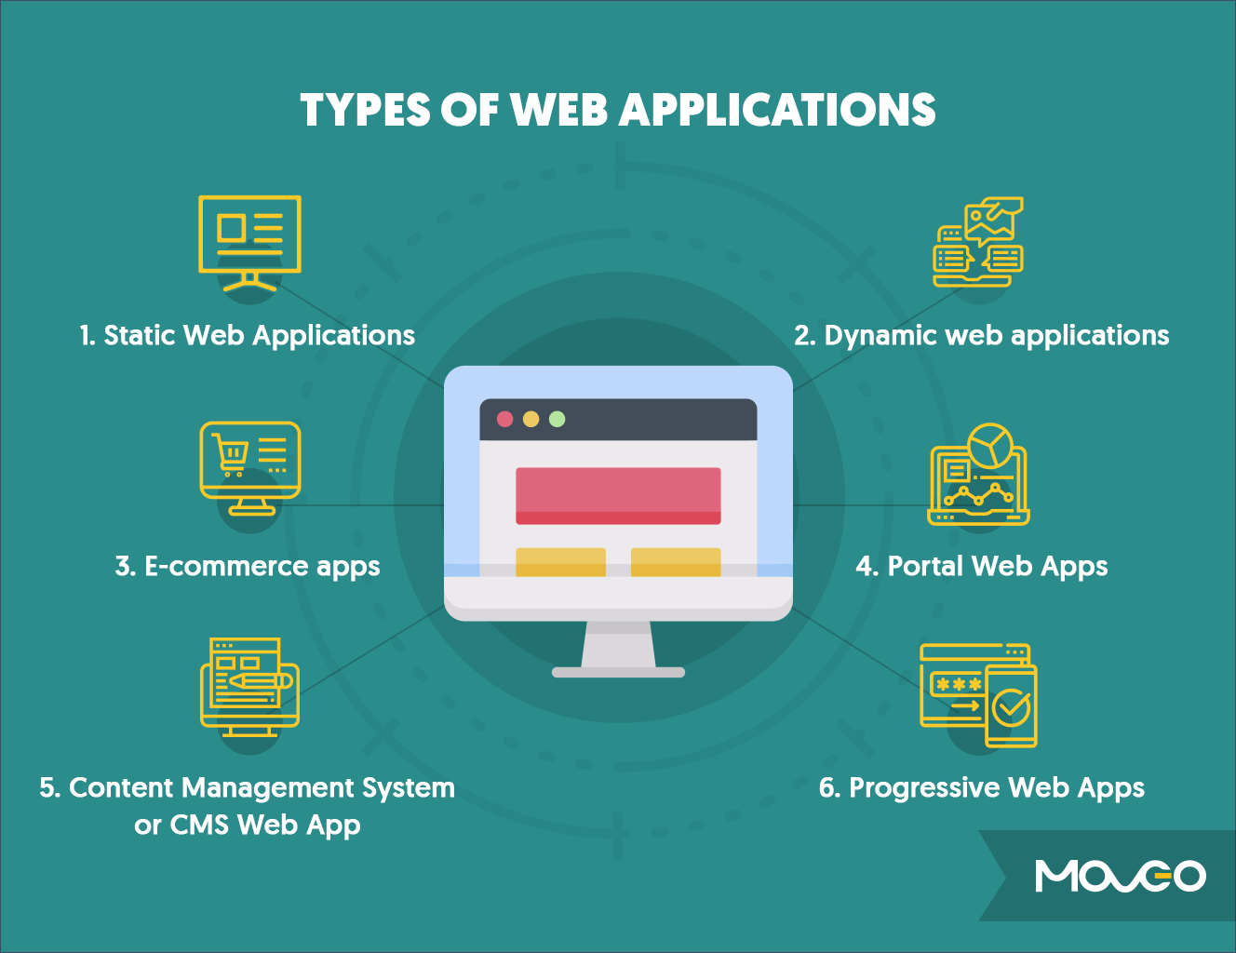
Types of Web Application
Static web application
Dynamic web application
E-Commerce web application
Portal web application

