Slide 1
SKILLUP HACKATHON × IBM SKILLSBUILD
Algo Trade Simulator
Pre-trade cost analysis: slippage, fees, market impact
Prabhat Kumar · solo · IIT Kharagpur
Does not place trades. Shows what a market order would cost.
Algo Trade Simulator · SkillUp × IBM SkillsBuild · Prabhat Kumar, IIT Kharagpur
1/12

Slide 2
The problem
What people see
Mid price on a chart or backtest
A fill assumed at that mid
PnL that looks clean on paper
What they pay
Slippage walking the book
Exchange fees by VIP tier
Impact that moves the mid
Why it hurts
A thin book kills a small edge
Live results look worse than the backtest
Hard to tell strategy vs cost
Algo Trade Simulator · SkillUp × IBM SkillsBuild · Prabhat Kumar, IIT Kharagpur
2/12

Slide 3
Who it is for
Students and people writing their first algo — not a broker.
No exchange API keys. Nothing is sent to a venue.
Safe to open in a browser and change size / side / fee tier.
If Redis or a live feed is down, a synthetic book still runs.
Algo Trade Simulator · SkillUp × IBM SkillsBuild · Prabhat Kumar, IIT Kharagpur
3/12

Slide 4
What I built
Pre-trade cost tool
Takes a live or synthetic L2 book
Estimates slippage, fees, impact, maker/taker
Shows net cost in dollars and percent
Flags a one-sided or zero-spread book
Saves named setups when Redis is on
Dashboard
Ticker: mid, spread, imbalance, depth
Presets: market, scalp, swing, large order
Depth + mid-price + cost charts
History of the last simulations
Health: /healthz and /readyz
Algo Trade Simulator · SkillUp × IBM SkillsBuild · Prabhat Kumar, IIT Kharagpur
4/12

Slide 5
How data moves
Feed → Orderbook → TradeSimulator → Dash UI
FeedManager picks Redis, websocket, or a local generator.
TradeSimulator is the only place that runs the four cost models.
MarketState is the lock around the book so the UI and the feed do not race.
create_app() builds one process. Gunicorn imports that factory.
Algo Trade Simulator · SkillUp × IBM SkillsBuild · Prabhat Kumar, IIT Kharagpur
5/12

Slide 6
Feeds — why a demo actually loads
auto
Redis if it is set
else synthetic
default
synthetic
Always a local book
No keys
Used for judging
websocket
Direct L2 URI
Reconnects
Optional
redis
Subscriber only
Skipped if unset
No localhost hang
Algo Trade Simulator · SkillUp × IBM SkillsBuild · Prabhat Kumar, IIT Kharagpur
6/12

Slide 7
Cost models
Fees
VIP0–VIP5 schedule
Spot vs futures
Slippage
Regression if trained
Else size / vol / imbalance
Returned as a total $ cost
Market impact
Almgren–Chriss style
Temp ~ sqrt(participation)
Permanent ~ linear
Maker / taker
Logistic model or heuristic
Shown as a split, not a fill
Algo Trade Simulator · SkillUp × IBM SkillsBuild · Prabhat Kumar, IIT Kharagpur
7/12

Slide 8
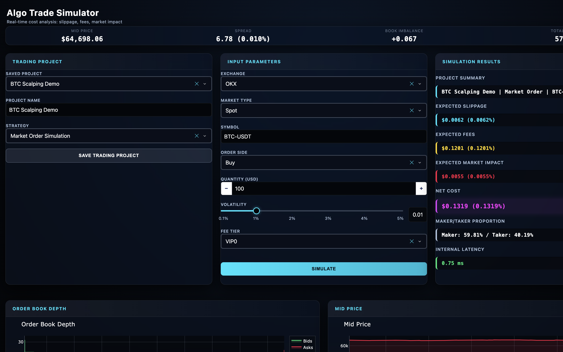
Dashboard
Algo Trade Simulator · SkillUp × IBM SkillsBuild · Prabhat Kumar, IIT Kharagpur
8/12

Slide 9
One run — BTC-USDT buy $100, VIP0
Book
Mid ~ $64,700
Spread ~ 0.01%
Synthetic L2 feed
Connected, sub-second updates
Costs
Slippage $0.0062 (0.0062%)
Fees $0.1201 (0.1201%)
Impact $0.0055 (0.0055%)
Net $0.1319 (0.1319%)
What that means
Fees dominate a small order
Impact stays tiny at $100
Same notional on a thin book would look different
Internal latency 0.75 ms
Algo Trade Simulator · SkillUp × IBM SkillsBuild · Prabhat Kumar, IIT Kharagpur
9/12

Slide 10
IBM Bob
Plan
Map book → net cost
One Railway service
Synthetic if Redis is down
Ask
Slippage was a per-unit offset
Impact was a flat 1%
Kept participation-based AC
Rejected depth-as-ADV
Agent
Feed manager + synthetic book
Skip unconfigured Redis
Local CSS (no CDN)
pytest suite
Algo Trade Simulator · SkillUp × IBM SkillsBuild · Prabhat Kumar, IIT Kharagpur
10/12

Slide 11
Run and deploy
Local: python -m trading.src.main → http://localhost:8050
Docker: docker compose up --build → http://localhost:8080
Railway: Dockerfile + railway.toml. Health check is /healthz.
Do not set REDIS_HOST=localhost on Railway.
No API keys. MIT license.
Algo Trade Simulator · SkillUp × IBM SkillsBuild · Prabhat Kumar, IIT Kharagpur
11/12

Slide 12
THANKS
Algo Trade Simulator
github.com/Prabhat-190/algo-trade-simulator
IBM_BOB.md · docs/hackathon/Algo_Trade_Simulator.pptx
Prabhat Kumar · TradeSim · IIT Kharagpur
Algo Trade Simulator · SkillUp × IBM SkillsBuild · Prabhat Kumar, IIT Kharagpur
12/12

