Slide 1

Predictive Maintenance and Condition-Based Monitoring (CBM) for Maritime Drive Systems Using Machine Learning Techniques
PRABHAT JHA

Slide 2

Problem Statement
This dataset records operational performance metrics of a ship's gas turbine propulsion system. Each row represents a set of measurements taken under specific conditions, likely at different times or operational states. The parameters captured include various torque measurements, rates of revolutions, temperatures, pressures, fuel flow, and state coefficients. These metrics are crucial for monitoring and analyzing the propulsion system's performance, efficiency, and maintenance needs.
The data can be used for predictive maintenance, performance optimization, and anomaly detection. By analyzing the relationship between these parameters, one can identify patterns that indicate potential issues or areas for improvement in the propulsion system.

Slide 3

What is Predictive Maintenance?
Predictive maintenance allows the maintenance frequency to be as low as possible to prevent unplanned reactive maintenance, and without doing too much preventive maintenance.
Reactive Maintenance is an unplanned maintenance and involves restoring equipment after it fails or breakdowns. The cost of reactive maintenance is high due to the unplanned production downtime, damaged machinery and overtime.
Preventive maintenance is maintenance that is carried out regularly and routinely to reduce the chances of equipment failure even when the machine is in good condition and doesn't need a repair or maintenance.
Predictive maintenance tackles both the disadvantages by predicting from historical and real-time data to anticipate problems before they happen using Machine Learning Algorithm.

Slide 4
Benefits of Condition-Based Monitoring (CBM)
Increased Reliability and Safety
Cost Savings
Extended Equipment Lifespan
Improved Operational Efficiency
Data-Driven Decision Making
Environmental Benefits

Slide 5
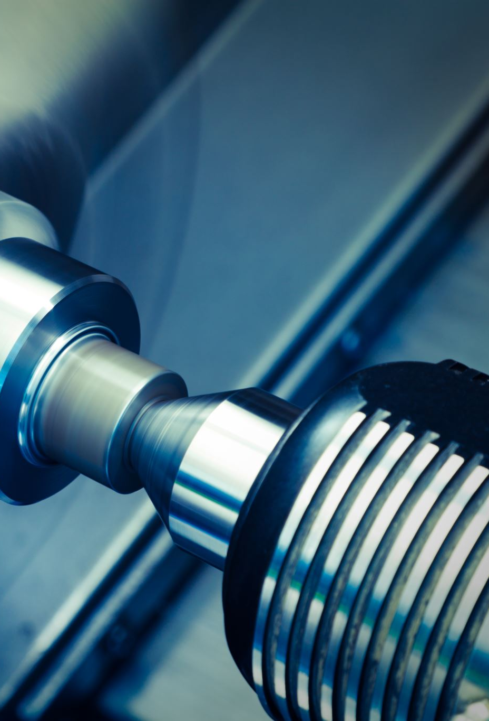
Data Summary
Lever position: Position of the ship's lever
Ship speed (v): Speed of the ship, likely in knots
Gas Turbine (GT) shaft torque (GTT): Torque on the gas turbine shaft in kN m
GT rate of revolutions (GTn): Revolutions per minute (rpm) of the gas turbine
Gas Generator rate of revolutions (GGn): Revolutions per minute (rpm) of the gas generator
Starboard Propeller Torque (Ts): Torque on the starboard propeller in kN
Port Propeller Torque (Tp): Torque on the port propeller in kN
High Pressure (HP) Turbine exit temperature (T48): Temperature at the exit of the high-pressure turbine
GT Compressor inlet air temperature (T1): Temperature of inlet air to the gas turbine compressor(C)
GT Compressor outlet air temperature (T2): Temperature of outlet air from the gas turbine compressor(C)
HP Turbine exit pressure (P48): Pressure at the exit of the high-pressure turbine in bar
GT Compressor inlet air pressure (P1): Pressure of inlet air to the gas turbine compressor in bar
GT Compressor outlet air pressure (P2): Pressure of outlet air from the gas turbine compressor in the bar
GT exhaust gas pressure (Pexh): Pressure of exhaust gas from the gas turbine in the bar
Turbine Injection Control (TIC): Control parameter for turbine injection in percentage
Fuel flow (mf): Rate of fuel flow into the gas turbine in kg/s

Slide 6
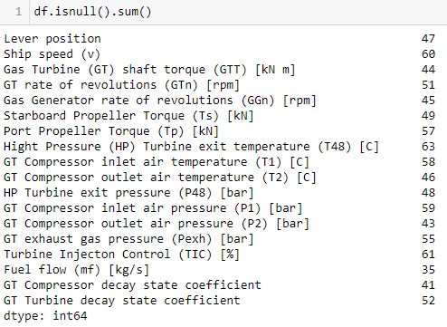
Data Preprocessing & Data cleaning
Handling Missing Values
Identified Missing Values: Used isnull() to detect missing data in the dataset.
Removed Missing Data: Dropped rows with missing values to ensure data quality and integrity.
Checked for Outliers using Boxplot, there is no outliers present in the data.

Slide 7
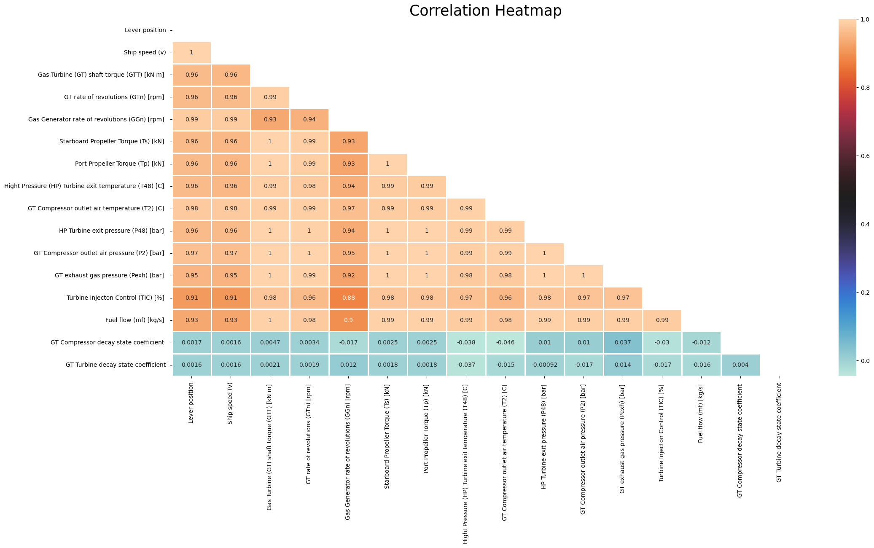
Data Preprocessing & Data cleaning
There exists a very strong positive correlation among all the input features
As you can see most of the input features have a correlation value of 0.97 and above
This means that when an input feature increases by one unit the correlated feature corresponding to that input feature also increases by one unit
Both the output labels have almost no correlation with any of the input features
Based on the correlations, potential interaction terms can be considered while improving the model. Ex. Ship Speed & Lever position, Tp & Ts, P2 & P48, Pexh & P48 etc.

Slide 8
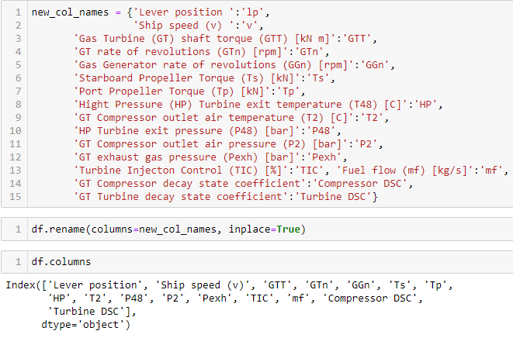
Data Preprocessing & Data cleaning
Renamed the columns to understand the data more precisely.
Dropped T1 and P1, as these are constant value and won’t be impacting the correlation

Slide 9
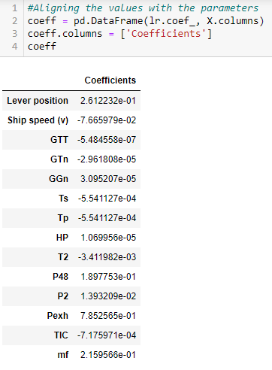
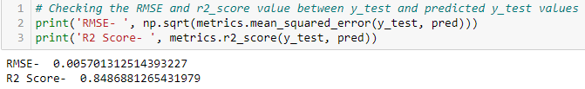
Model Building
Model 1(Regression): Predicting GT Compressor decay state coefficient based on 14 features.
Here we will be building multiple linear regression model to predict GT Compressor decay state coefficient based on all 14 features from lever position to fuel flow
The R2 Score comes around 0.8486

Slide 10
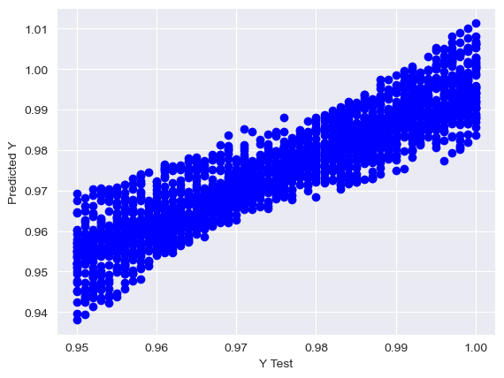
Model Building
Scatterplot shows the relationship between the actual target values (Y Test) and the predicted values (Predicted Y) from the regression model
The tight clustering around the diagonal line suggests that the model has performed well, accurately predicting the target values.
The spread indicates that while the model is generally accurate, there are instances where the predictions deviate from the actual values.

Slide 11
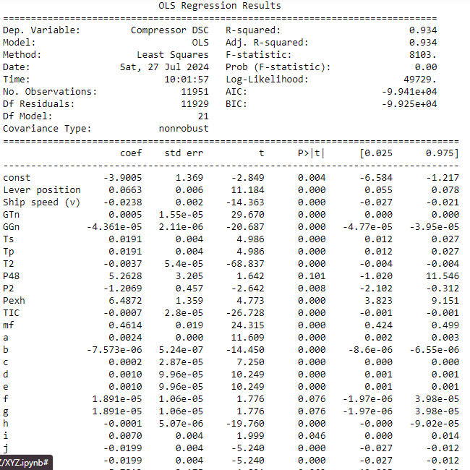
Inference
As we saw earlier, in order to improve the accuracy of the model, we will be going forward with Interaction terms.
We have an increased R-squared of 93.5% or 0.935 which is very high.
We will stop here and declare this model as the most suitable for predicting GT Compressor decay state coefficient.

Slide 12
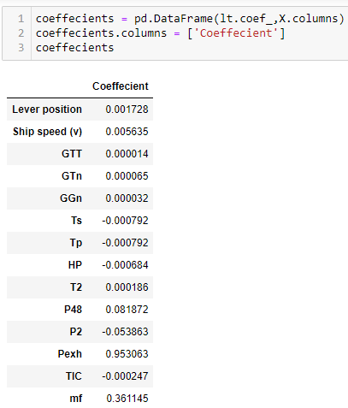
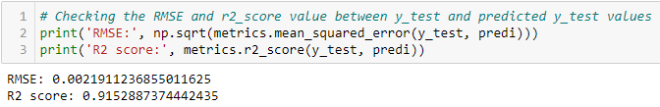
Model Building
Model 2(Regression): Predicting Turbine Compressor decay state coefficient based on 14 features.
Here we will be building multiple linear regression model to predict Turbine Compressor decay state coefficient based on all 14 features from lever position to fuel flow
The R2 Score comes around 0.8486

Slide 13
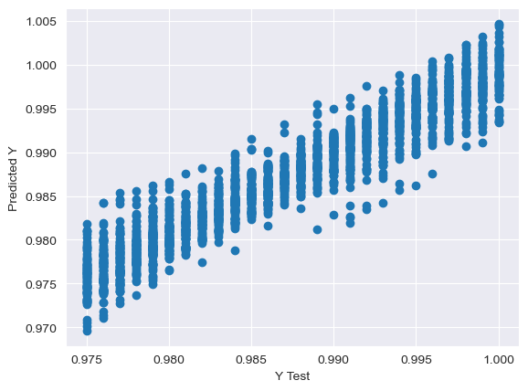
Model Building
Clustering: The data points are clustered tightly along a diagonal line, suggesting that the model's predictions are closely aligned with the actual Y values.
Spread: While the clustering is tight, there is still some spread in the data points. This indicates that there is some variability in the model's predictions.
No Outliers: There are no visible outliers in the data, which suggests that the model is performing consistently well across the range of Y test values.

Slide 14
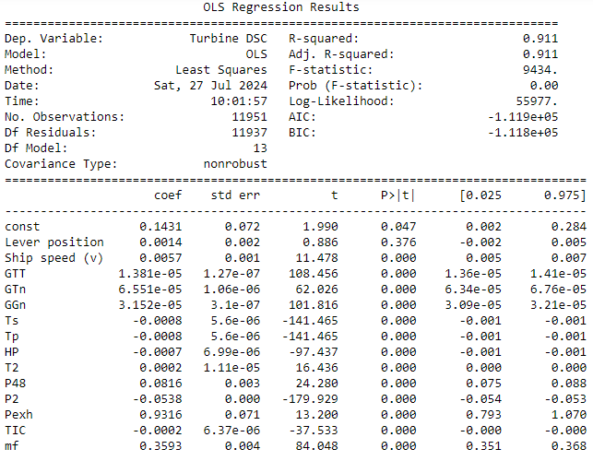
Inference
The R-squared value is 0.911 which states that about 91.1% of proportion of variability in data can be explained by this linear regression model. The R-squared is the most important parameter for a model evaluation. Higher the value, better is the fit.
We have an R-squared of 91.1% or 0.911 which is very high. Hence, we will stop here and declare this model as the most suitable for predicting GT Turbine decay state coefficient.

Slide 15
Summary
We have studied the relationship between the 14 features and the 2 labels.
The GT Turbine decay state coefficient behaves perfectly with the 14 features considered whereas the GT Compressor decay state coefficient behaves linearly with only 12 features as the remaining 2 features were irrelevant in predicting the coefficient.
During Model 1, initially the R-squared value was just 84.3% and the model is further improved by considering interaction terms based on the correlation heatmap after which the R-squared value has been increased to 93.5% and thus declaring the model as the most suitable for predicting GT Compressor decay state coefficient.

Slide 16

Thank you

