Slide 1
Consultant Summary
Name
Skill (Auto Complete)
Q2 2017
Is Active
Search
Onboard New
C ID | Name | Phone | Email | Skills | Date of Onboard | Last Active From
C001 | Prabhat Jena | 1234567890 | jenapra@pp.com | JAVA Spring | 01-Sep-2016 | 12-Mar-2017
Edit
|<< << 1 of 10 >> >>|

Slide 2
Consultant Details
Consultant ID
Skills
Name
Date Of On-board
Phone
Last Active From
Date
Email
Is Active
Sex
Save
Close

Slide 3
Out going Financial Log
From date
To date
Search
Add Expense
Summary
No | Date | Category | A/c ID | A/c Name | Amount (INR)
1 | 02-Apr-2017 | Maintenance | M001 | Web Site | 2,000
2 | 03-Apr-2017 | Consultant | C001 | Prabhat Jena | 8,500
3 | 03-Apr-2017 | Consultant | C002 | Anil Shaw | 5,000
4 | 04-Apr-2017 | Maintenance | C003 | Go-Daddy | 3,000
Description | Amount (INR)
Total Incoming | 53,500
Total Outgoing | 18,500
Edit
Edit
Edit
Edit
|<< << 1 of 10 >> >>|

Slide 4
Payment Details
Date
Category
Account ID
Auto fill from Searchable
Account Name
Auto Complete
Amount (INR)
Payment Mode
Check/Bank Transfer
Save
Close

Slide 5
In Coming Financial Log
From date
To date
Search
Add Income
Summary
No | Date | A/c ID | Account Name | Amount (INR)
1 | 02-Apr-2017 | CL001 | Dheeraj | 35,000
2 | 03-Apr-2017 | CL002 | Ganesh | 18,500
Description | Amount (INR)
Total Incoming | 53,500
Total Outgoing | 18,500
Edit
Edit
|<< << 1 of 10 >> >>|

Slide 6
Balance Sheet
From date
To date
Search
Opening Balance :
10,000 INR
Closing Balance :
25,800 INR
Summary
No | Date | Account Name | Credit/Debit | Amount (INR) | Net Balance
1 | 12-Jan-2017 | Dheeraj | Credit | 18,000 | 28,000
2 | 15-Jan-2017 | Prabhat | Debit | 9,000 | 19,000
3 | 15-Jan-2017 | Anil | Debit | 5000 | 14,000
4 | 16-Jan-2017 | Raghu | Credit | 20,000 | 34,000
5 | 16-Jan-2017 | Sunil | Debit | 5000 | 29,000
6 | 17-Jan-2017 | Facebook Ad | Debit | 3200 | 25,800
Description | Amount (INR)
Total Incoming | 53,500
Total Outgoing | 18,500
Balance | 35,000
|<< << 1 of 10 >> >>|
Download

Slide 7

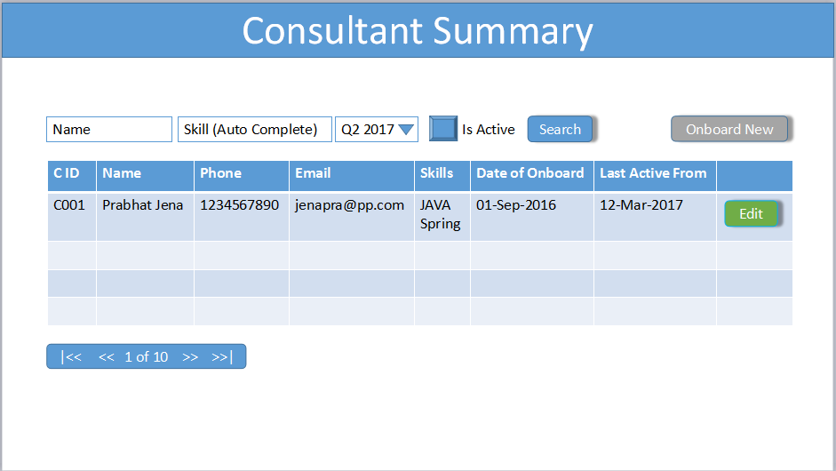
Consult-it Enterprise Platform
Logout
Consultant
Client
Home
Admin
On-board
Finance
Report
Date : 20th April 2017

