Slide 1
Talk-A-Tive
Topic: Chat Application
Team Details:
Prabhat Kumar (2210992048)
Prince Kumar (2210992090)
Pratham Midha (2210992076)
Prince (2210992088)
Submitted To: Mr. Rahul sir
Chitkara University Institute of Engineering and Technology,
Chitkara University, Punjab

Slide 2
Table of Contents
Introduction
Problem Statement
Key Features
Project Highlights/Outcomes
Code Snippets
Conclusion
References/Links used
Appendices

Slide 3
Introduction
In today's digital age, chat applications have become essential for real-time communication, transforming how people connect and interact. The backbone of any successful chat application is its backend system, which manages everything from message delivery and user authentication to data security and real-time synchronization.
This project focuses on developing a robust and scalable backend for a chat application, aiming to provide a seamless messaging experience while ensuring efficient performance. The primary goal is to design and implement a backend system that supports core chat functionalities, including real-time messaging, user management, media sharing, and encryption. The backend will be built using modern technologies and frameworks to ensure scalability, security, and high performance.

Slide 4
Problem Statement
Chat applications have significantly improved real-time communication by overcoming challenges faced in traditional messaging systems. One of the key problems they solve is the need for instant and seamless text-based communication, allowing users to exchange messages in real-time without delays. Unlike older messaging methods that may suffer from synchronization issues, chat applications ensure smooth and continuous interaction across different devices.
Additionally, chat applications provide features such as group chats, media sharing, and message history storage, enabling users to have organized and efficient conversations. Security is another crucial aspect, with many chat applications implementing end-to-end encryption to protect user data and ensure privacy. These advancements make chat applications a reliable, accessible, and user-friendly mode of communication for both personal and professional use.

Slide 5
Key features
Real-Time Messaging – Enables instant text-based communication between users.
User Authentication – Secure login system to protect user accounts.
One-on-One Chats – Allows private conversations between two users.
Group Chats – Users can create and participate in group conversations.
End-to-End Encryption – Ensures secure communication by encrypting messages.
Typing Indicator – Shows when the other user is typing a message.
User Profile Management – Allows users to update their profile information and avatar.
Push Notifications – Sends alerts for new messages and updates.
Scalability – Designed to handle multiple users efficiently.

Slide 6
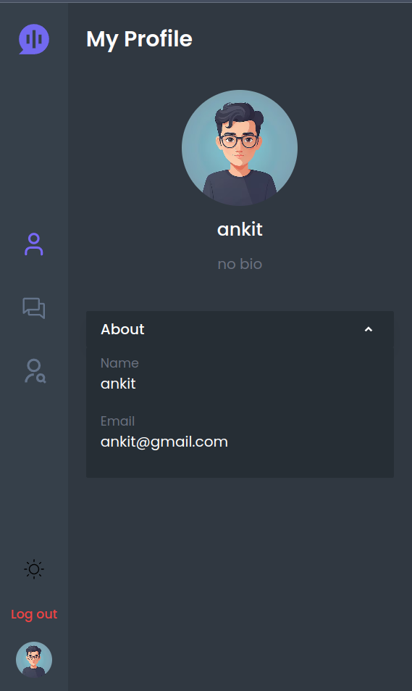
Project Highlights

Slide 7
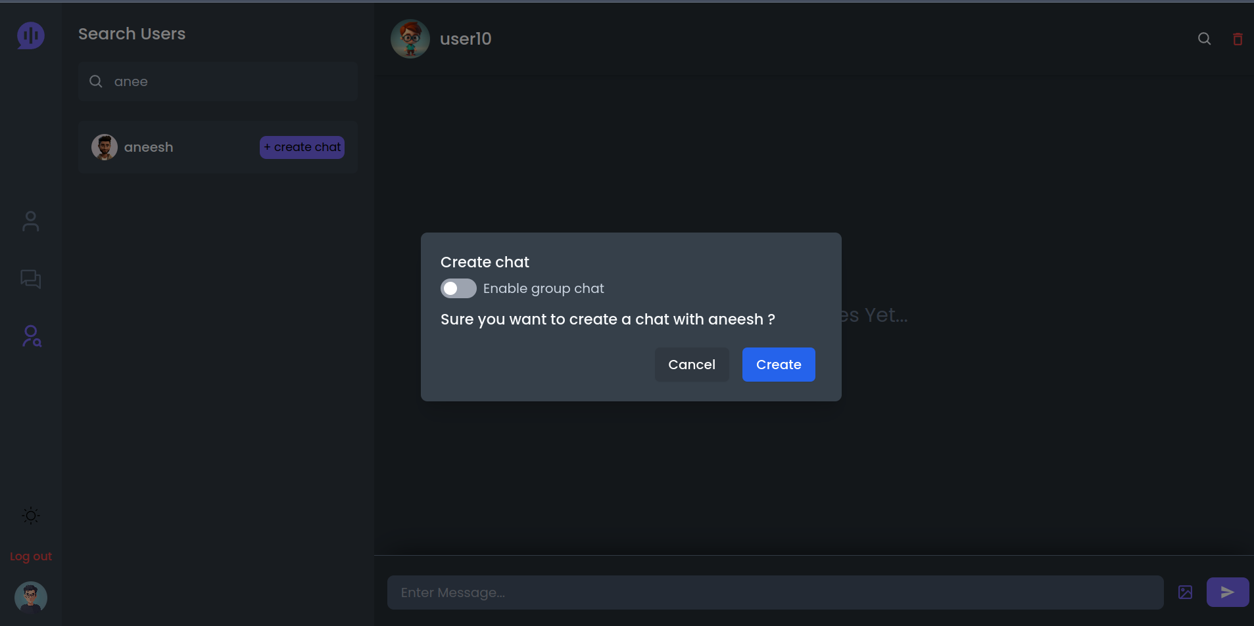

Slide 8
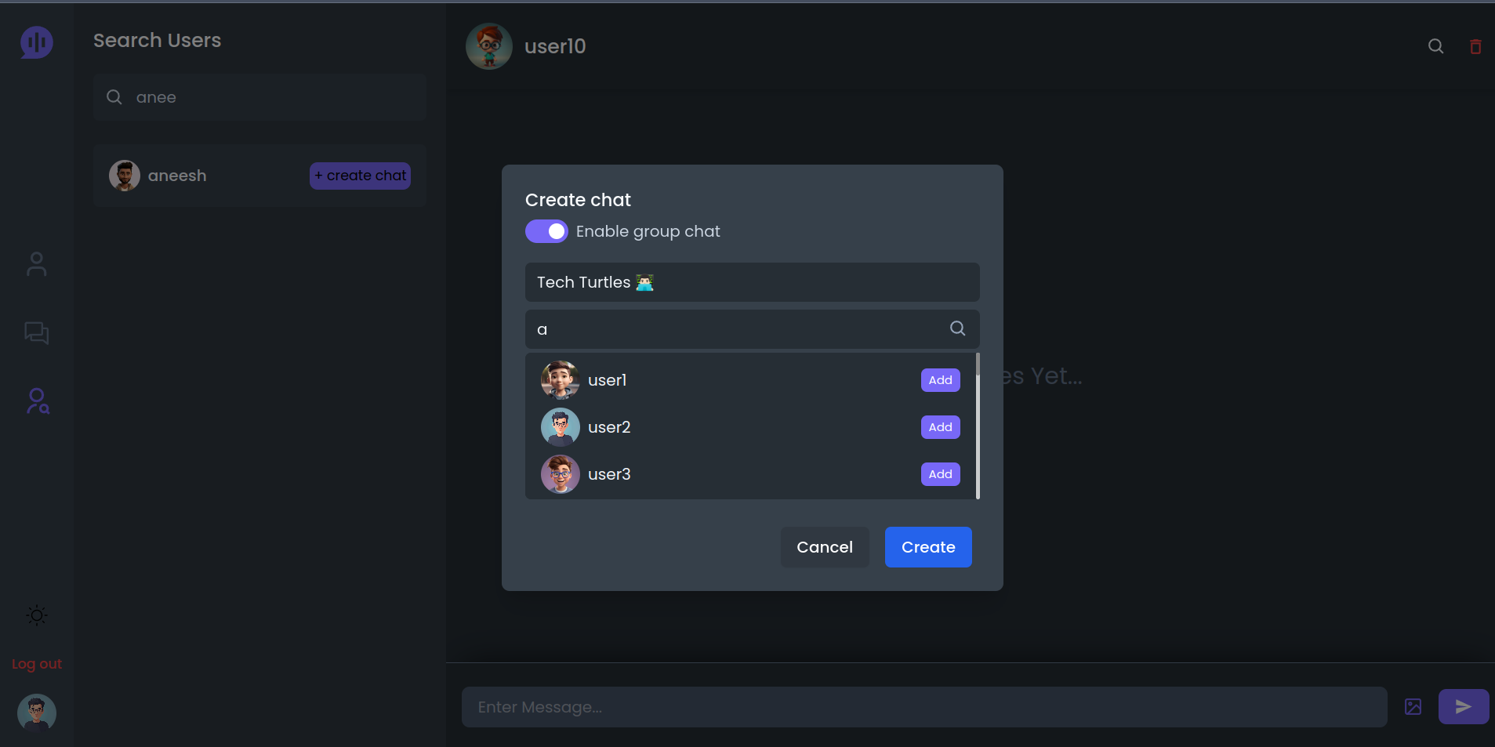

Slide 9
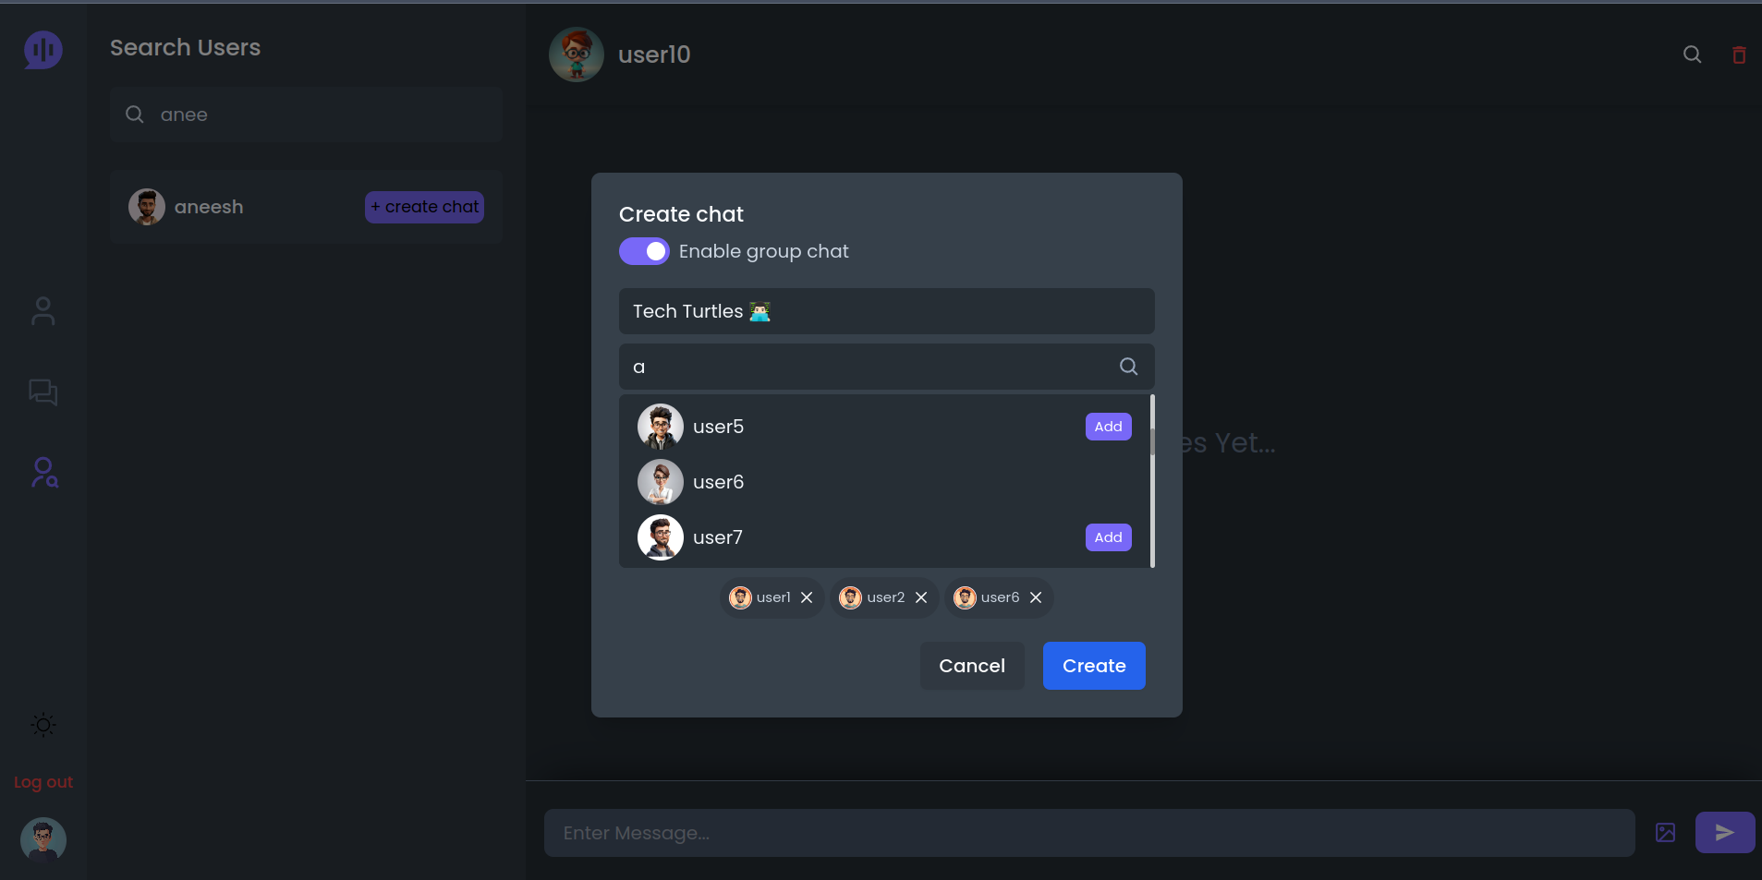

Slide 10
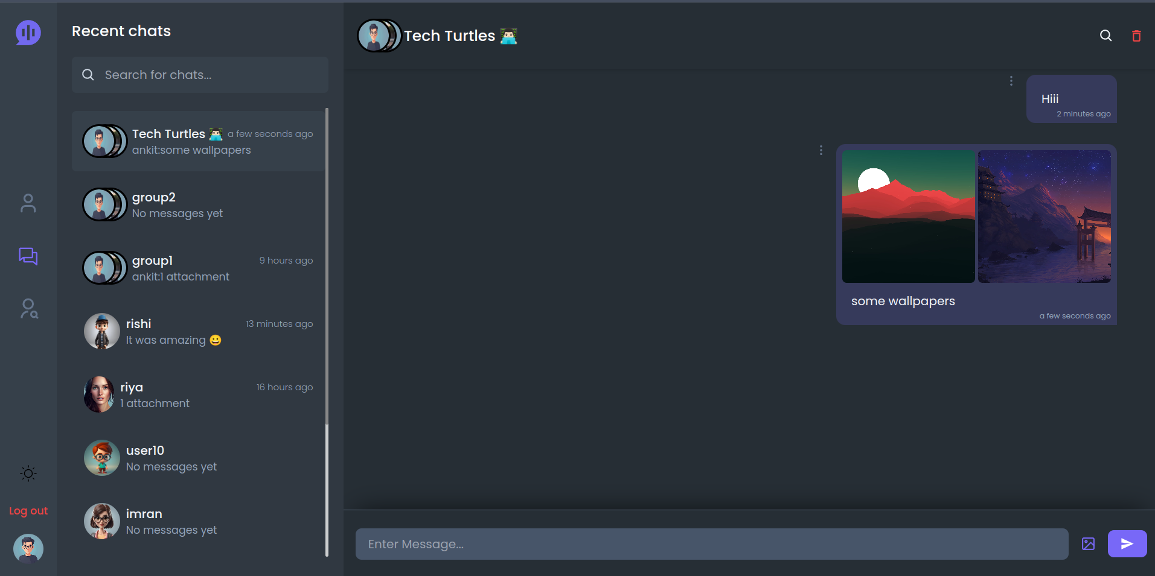

Slide 11
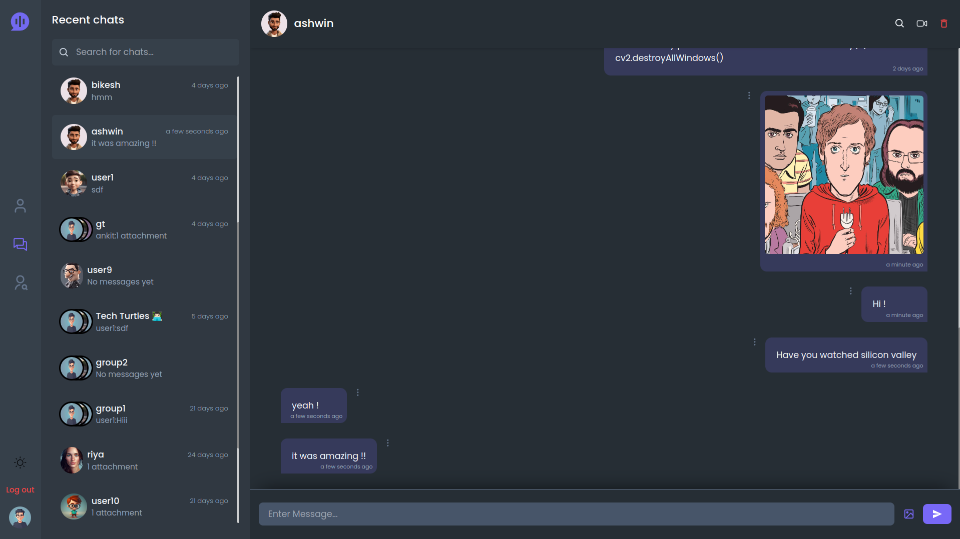

Slide 12
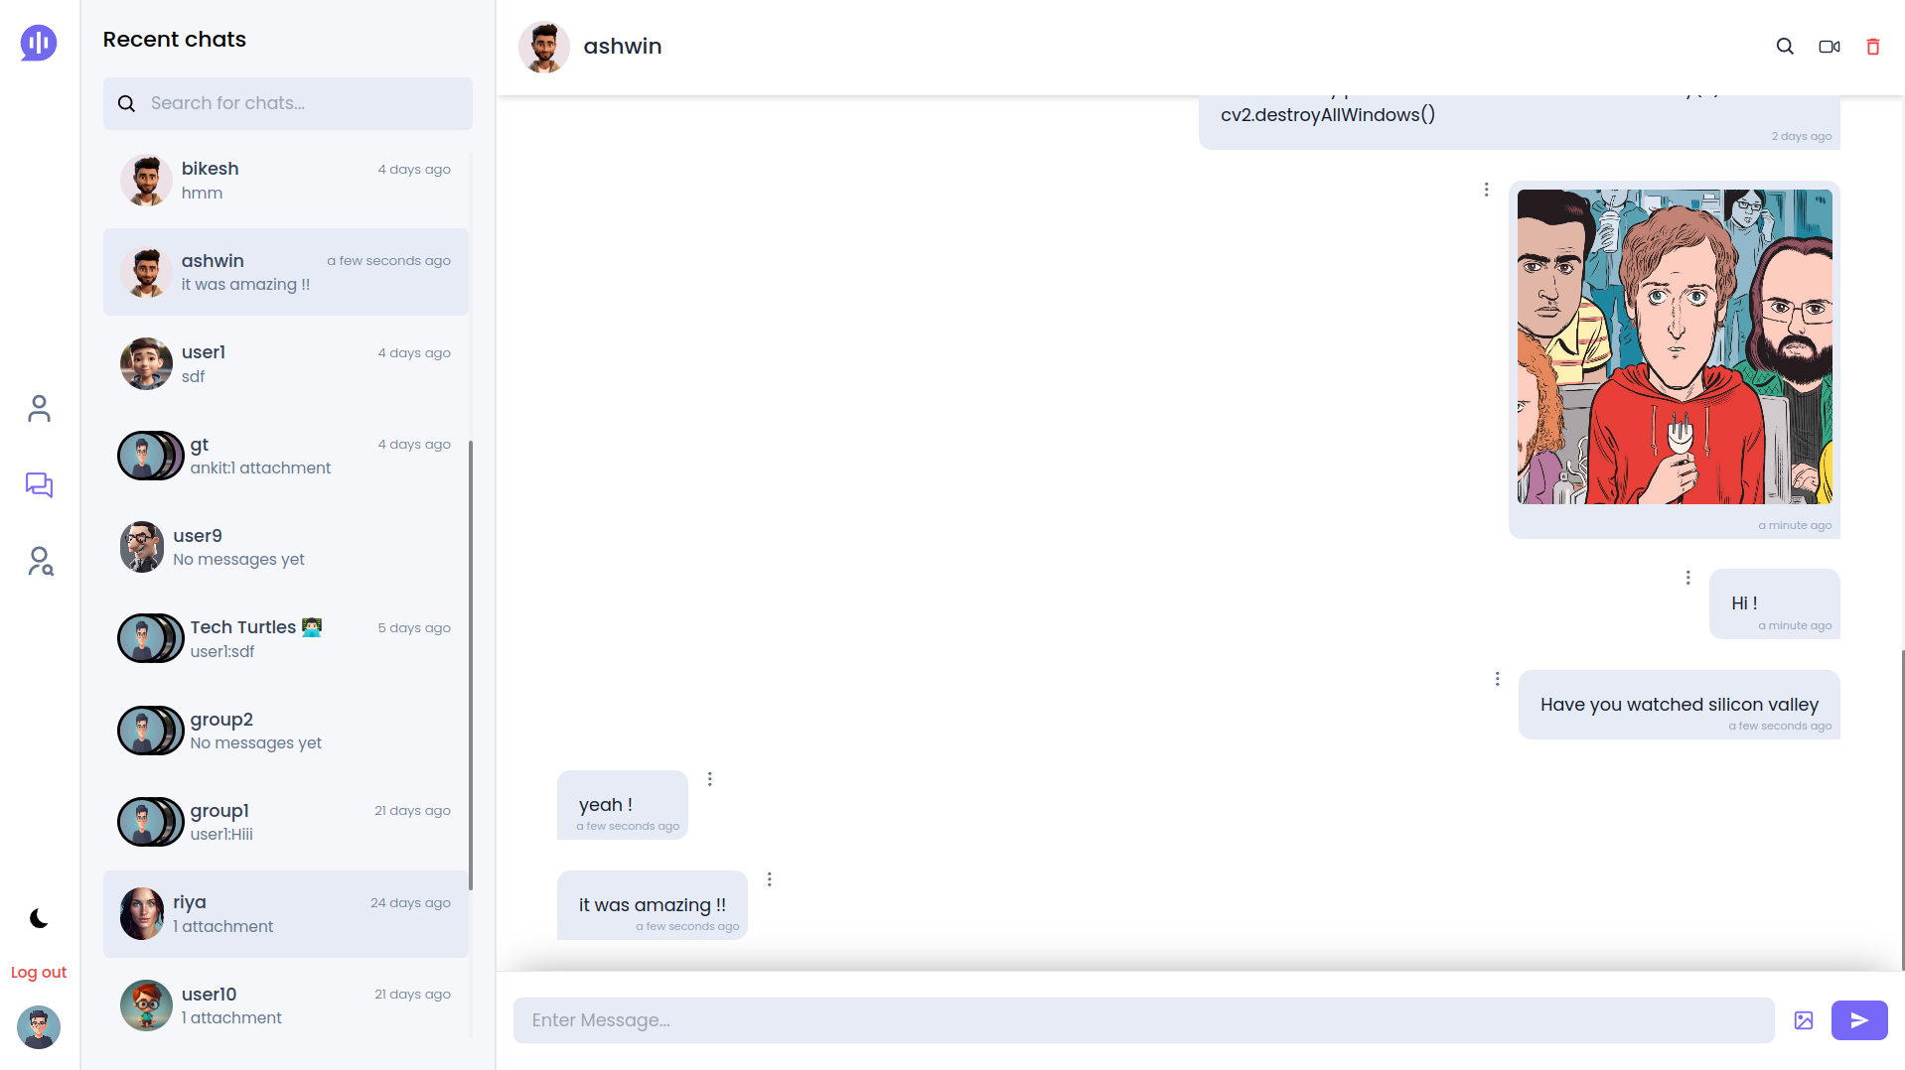

Slide 13
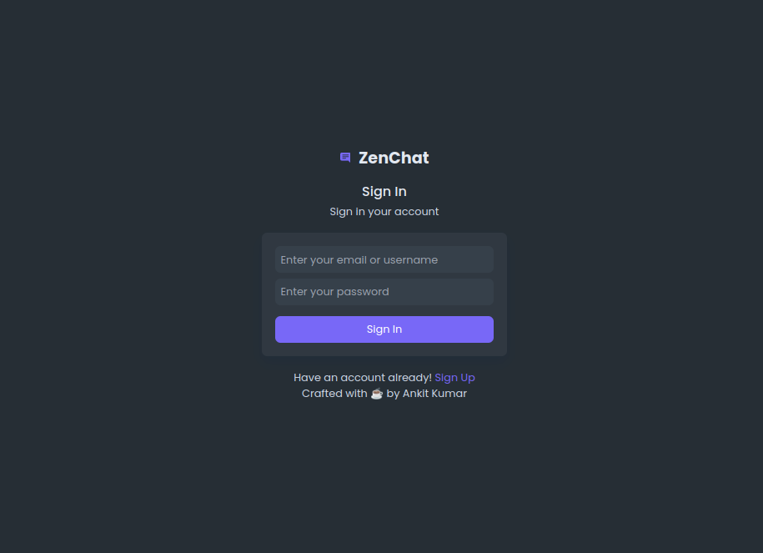

Slide 14
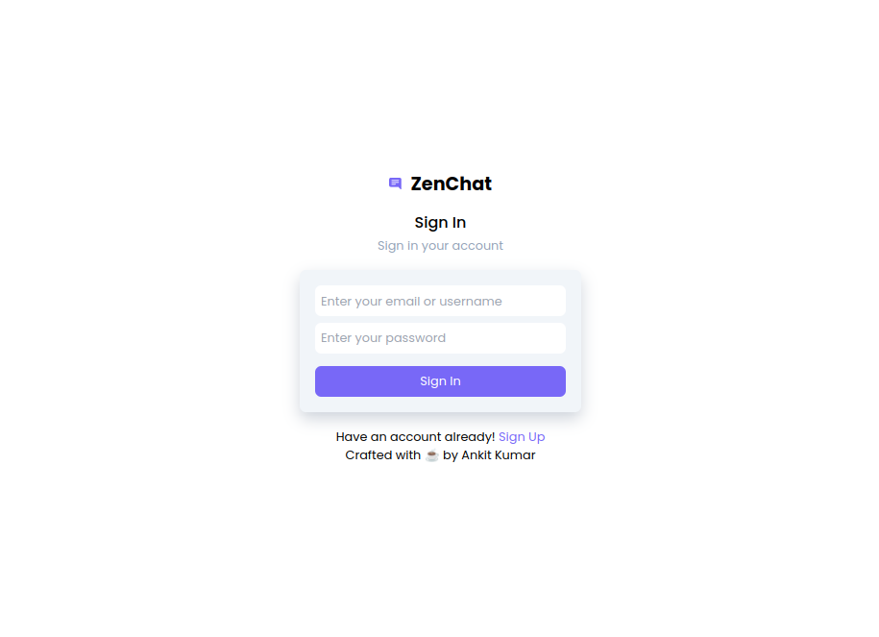

Slide 15
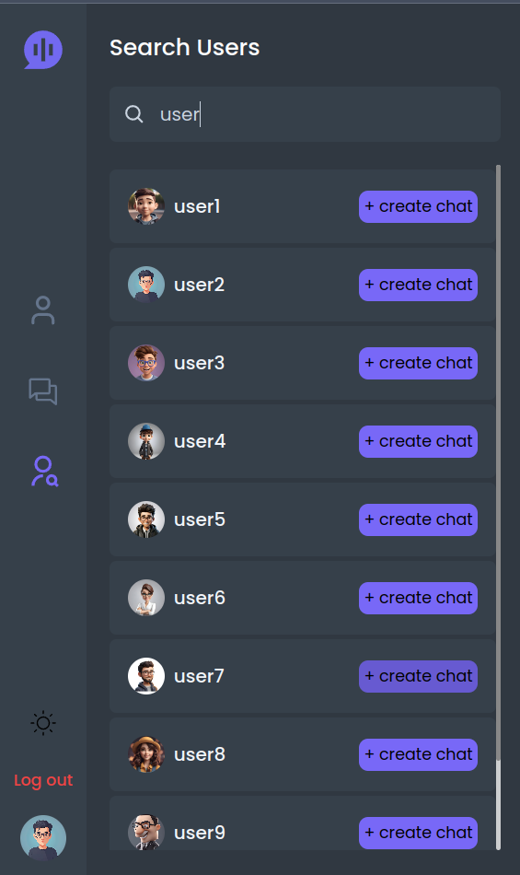

Slide 16
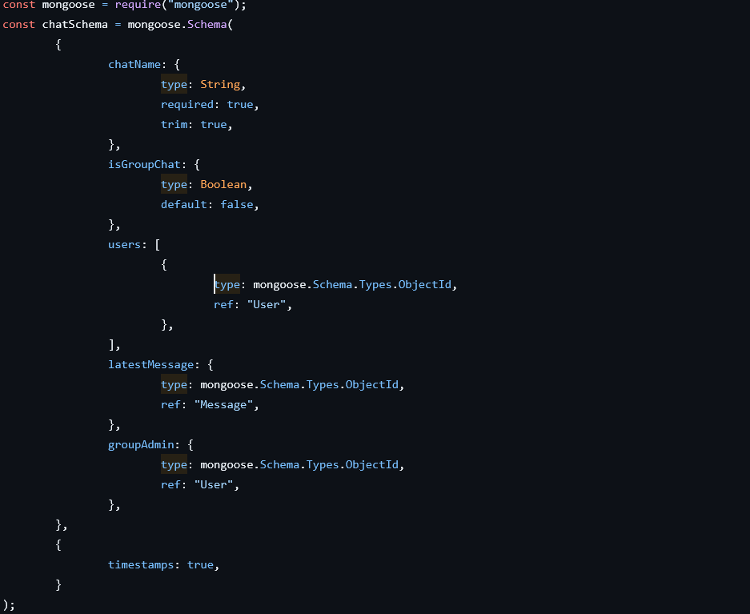
Code Snippets

Slide 17
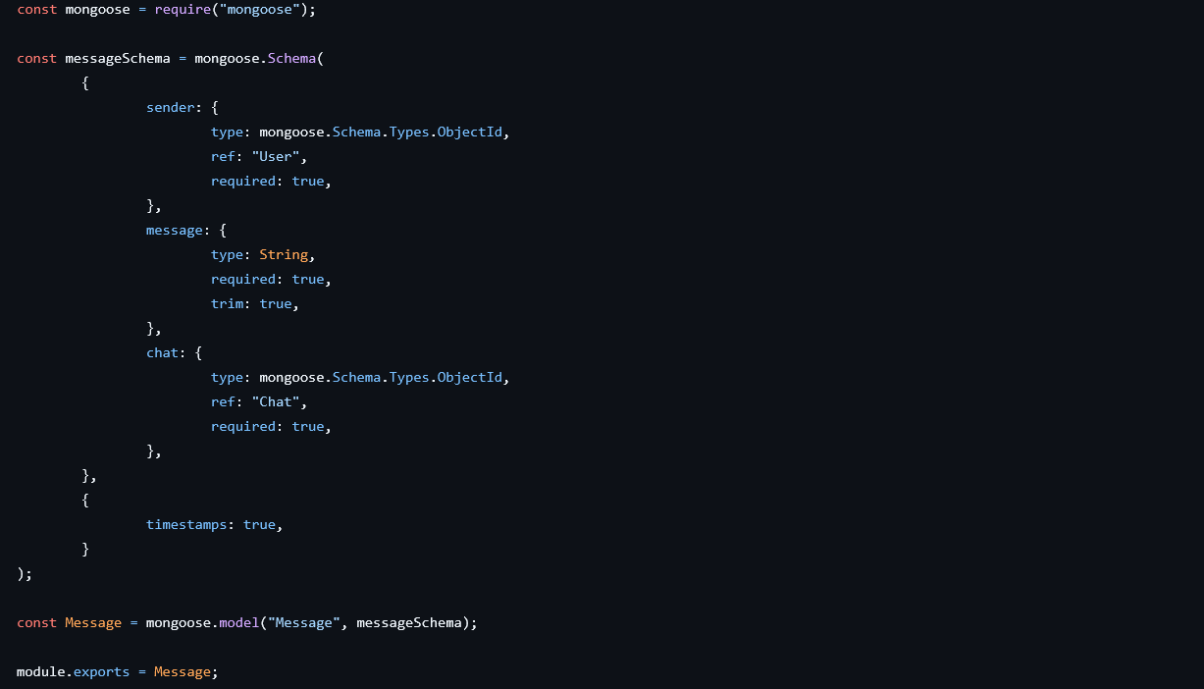
Code Snippets

Slide 18
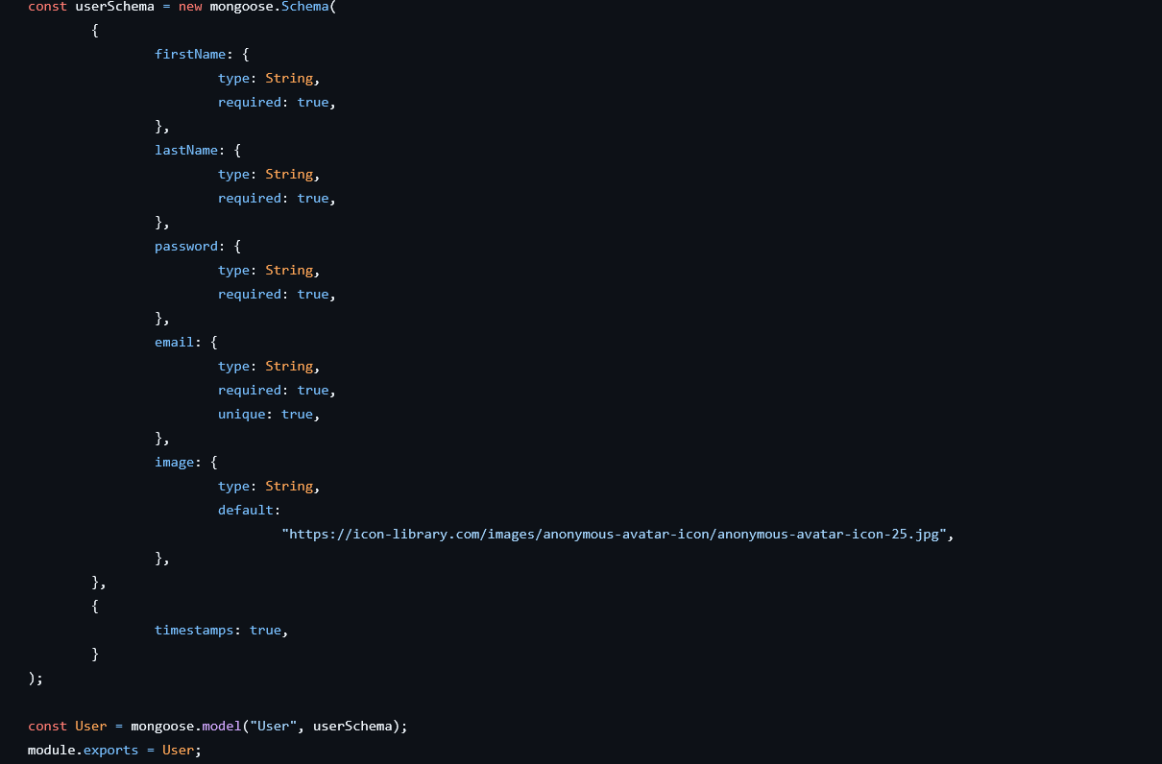
Code Snippets

Slide 19
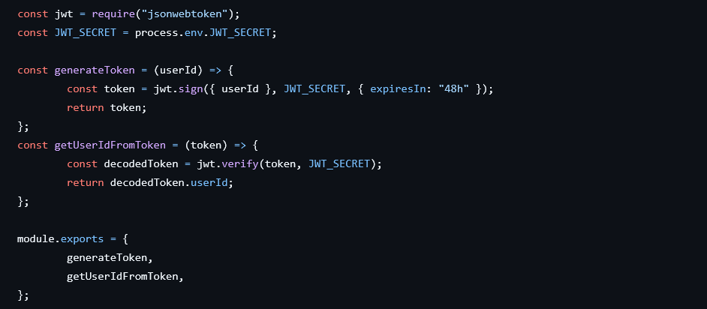
Code Snippets

Slide 20
Conclusion
The completion of the chat application backend project marks a significant milestone in developing a robust and scalable messaging platform. This project has laid the foundation for a seamless and efficient communication experience, addressing the key challenges of real-time messaging and secure data transmission. By integrating modern technologies and best practices, the backend system ensures reliable performance and essential functionalities for a smooth messaging experience.
Scalability and performance have been crucial considerations throughout the development process. The backend is designed to handle high volumes of messages and user interactions, ensuring the platform remains responsive and reliable even during peak usage. This scalability is essential for supporting growing user demands and adapting to future enhancements in the application.

Slide 21
References
React.js: https://react.dev - Official documentation for learning and implementing React.js.
Node.js: https://nodejs.org/docs/latest/api/ - Documentation and guides for setting up and using Node.js.
Express.js: https://expressjs.com/ - Documentation and guides for setting up and using Express.js.
MongoDB: https://www.mongo.db.com- Documentation and guides for setting up and using MongoDB.
React - The Complete Guide: Comprehensive course on building frontend applications with React.js.
The Complete Node.js Developer Course: Covers building backend services using Node.js, Express, and MongoDB.

Slide 22


