Slide 1
Aadhaar Hackathon 2021
Theme– Address Update
Problem Statement – Address Update Challenge in Urban Areas

Slide 2
Team Pentagon
Team Members -
Sr. No | Name
1 | Prabhat Surendra Pandey
2 | Shreesh Vijay Singh
3 | Mukund Rajendra Wagh
4 | Pallavi Dinkar Shingote
5 | Pratiksha Dilip Bhalekar

Slide 3
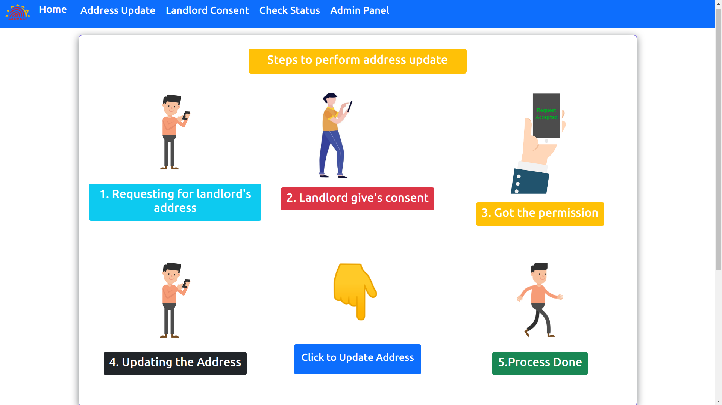

Slide 4
Features -
Real-time address update.
Audit Logs are maintained at every step.
Offline e-KYC extraction.
Offline e-KYC automatically gets deleted after address update.
Simple and User Friendly UI/UX.
Fully Responsive on all kind of devices.

Slide 5
Tech Stack Used -
HTML5
CSS3
Bootstrap5.1
JavaScript
Ajax
Python
Django
Sqlite3

Slide 6
API’s Used -
Aadhaar VID Wrapper
Aadhaar Offline e-KYC API
Geo-Coder API
Fast2SMS API

Slide 7
How to fork and run on your local machine-
Download and install Python
Download and install Git.
Fork the Repository.
Clone the repository to your local machine
$ git clone https://github.com/PrabhatP2000/pentagon-aadhaar.git
Change directory to pentagon-aadhaar $ cd pentagon-aadhaar
Install the requirements: $ pip install -r requirements.txt
Make migrations $ python manage.py makemigrations
Migrate the changes to the database $ python manage.py migrate
Create admin $ python manage.py createsuperuser
Run the server $ python manage.py runserver
Open any web browser and then paste the server address to see the webpage working on your local machine

Slide 8
Demonstration

Slide 9
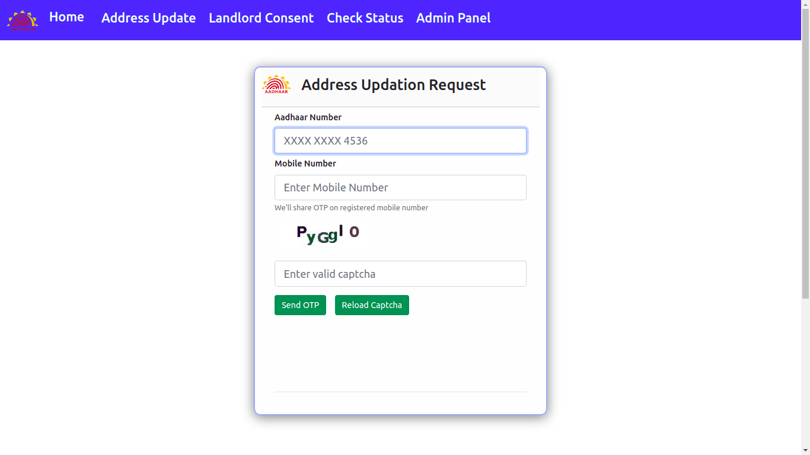
Resident Enters his Aadhaar Number and Mobile Number.

Slide 10
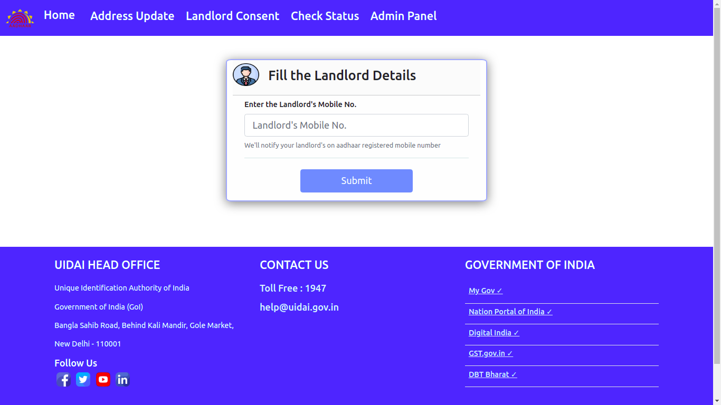
Resident enters Landlord’s mobile number.

Slide 11
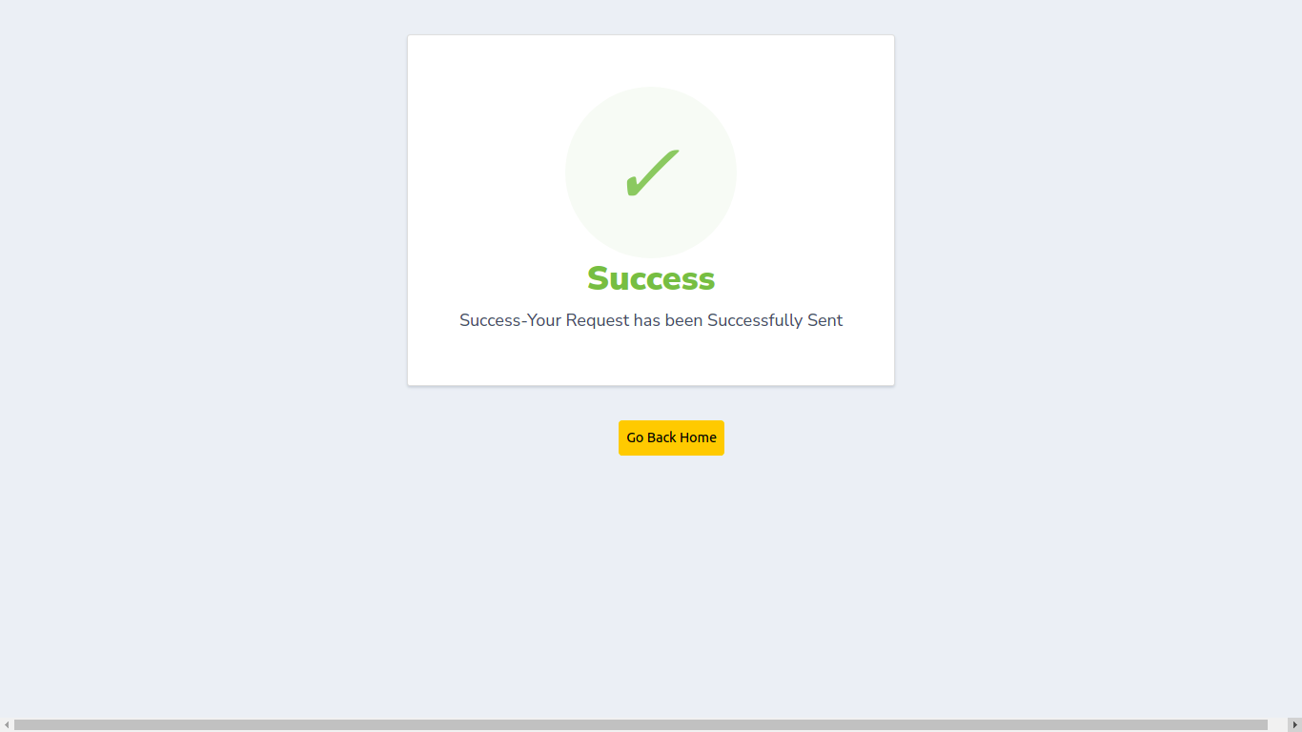
Resident Successfully sent the request to landlord.
At this stage the landlord will get a notification SMS regarding the request of address of his resident.

Slide 12
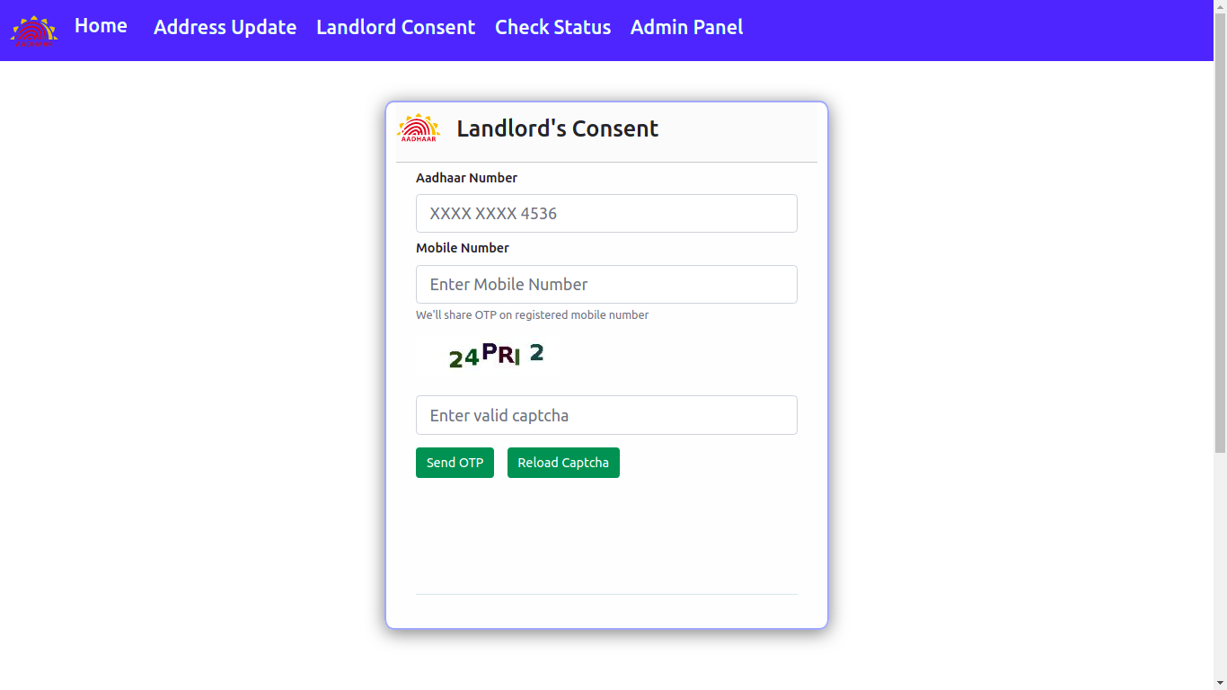
Landlord enters his aadhaar number and mobile number.

Slide 13
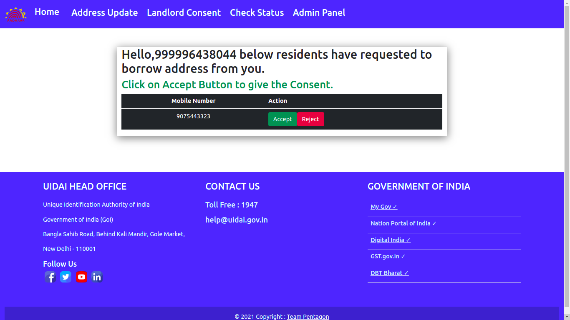
Landlord can see the request.
Landlord can give or reject the consent request.

Slide 14
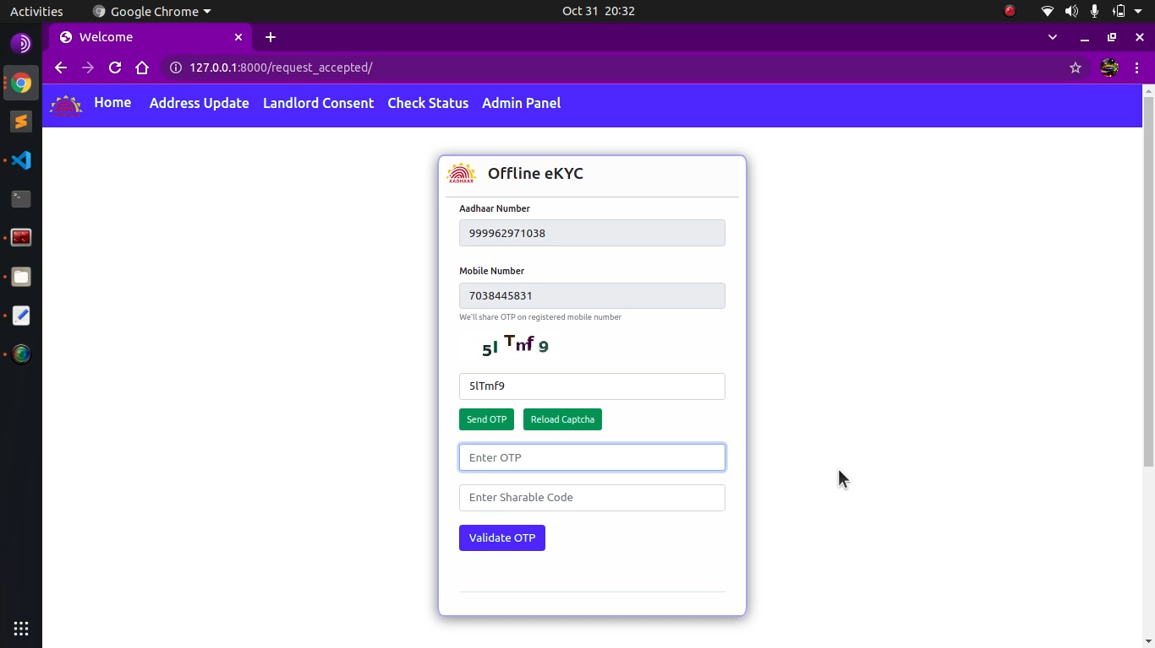
Landlord proceeds for offline e-KYC.
At this stage only he generates the share code.

Slide 15
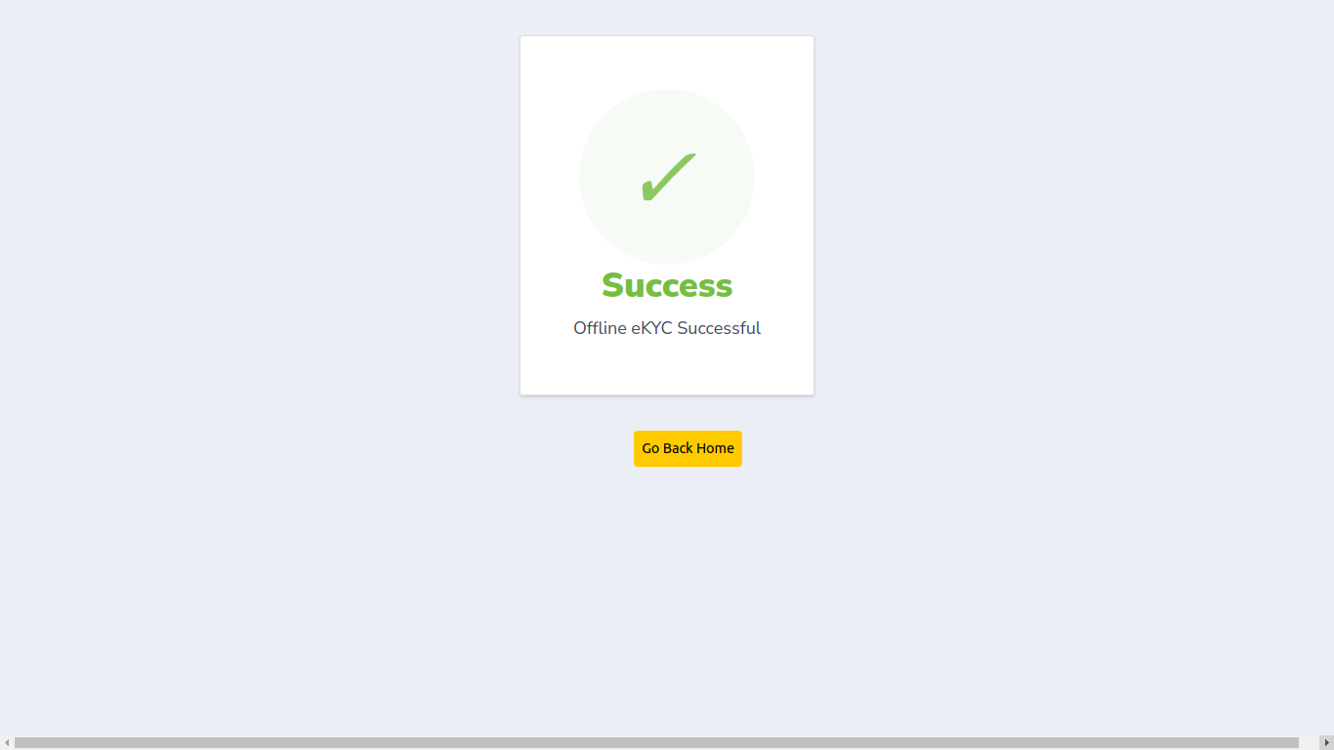
Landlord has successfully done his e-KYC.
At this point the resident will get a SMS alert that the landlord has successfully given the consent and also receives the share code generated by the landlord.

Slide 16
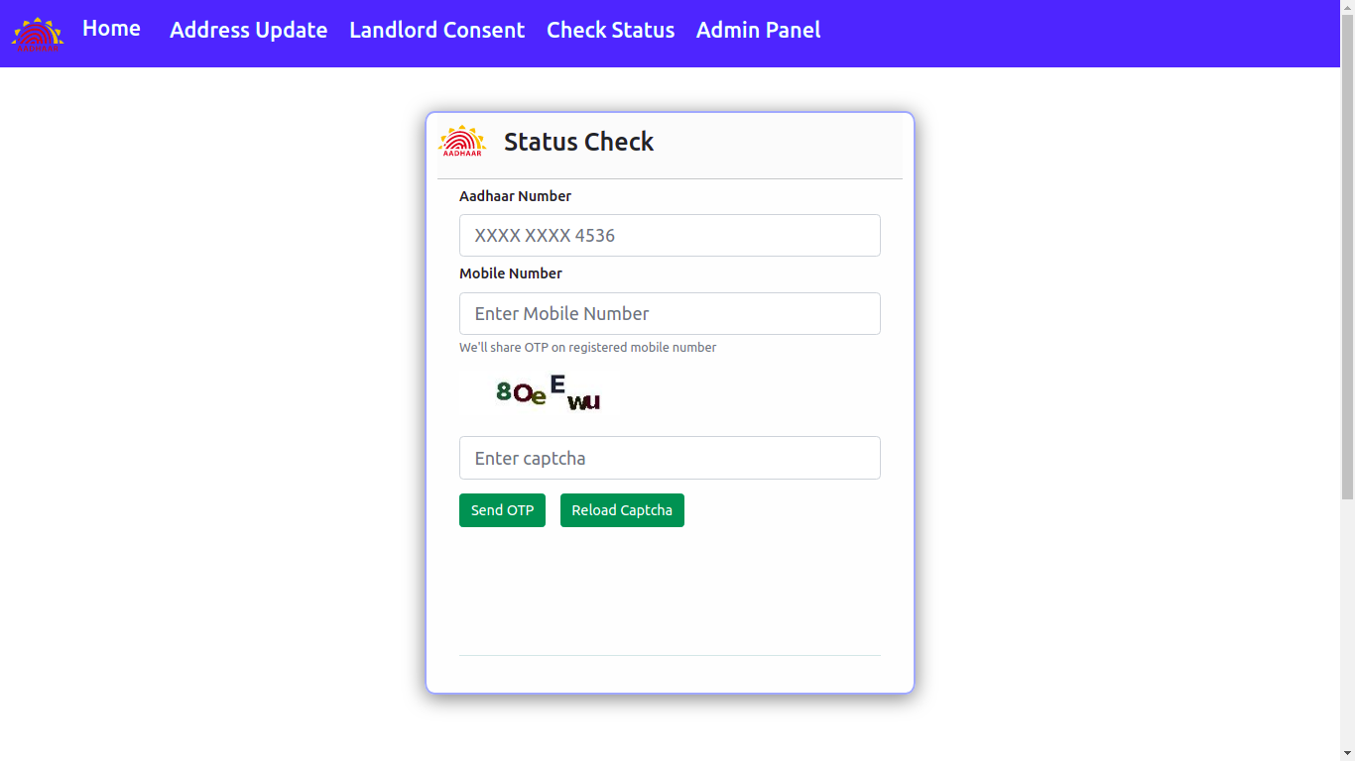
Resident enters his aadhaar number and mobile number to check the status.

Slide 17
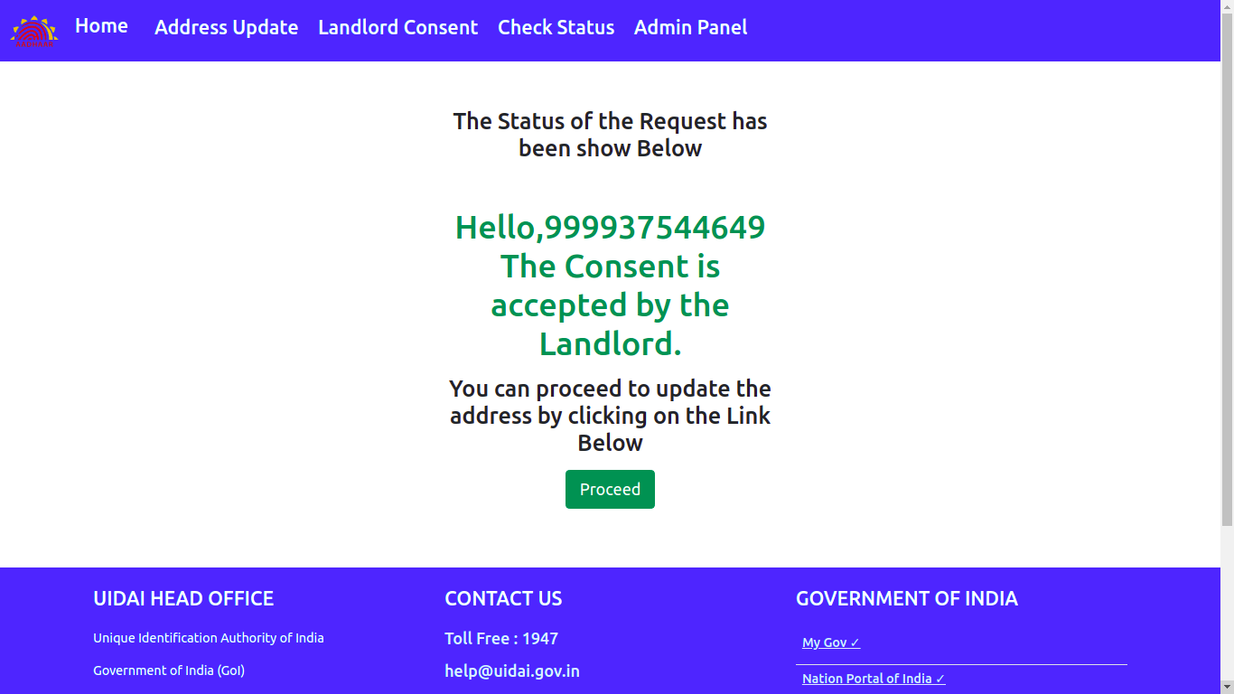
Here ,as landlord has given the consent the resident can proceed to update the address.

Slide 18
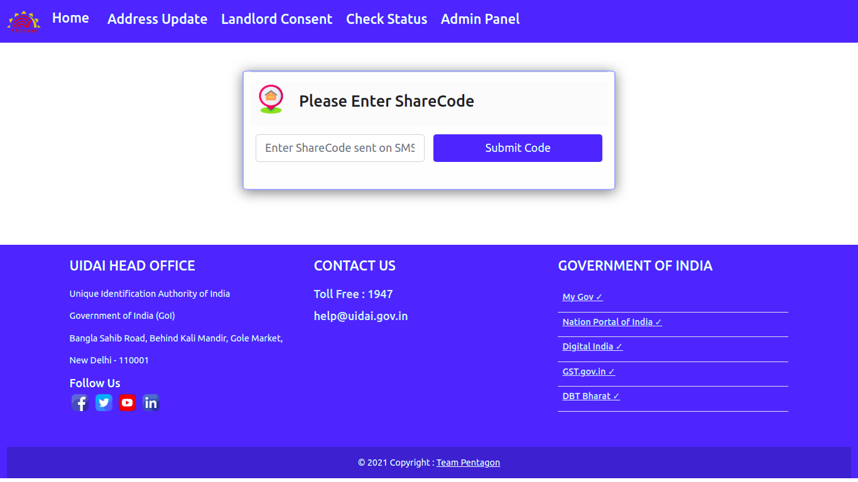
Resident enters the share code generated by the landlord which was received by the resident on the SMS Alert.

Slide 19
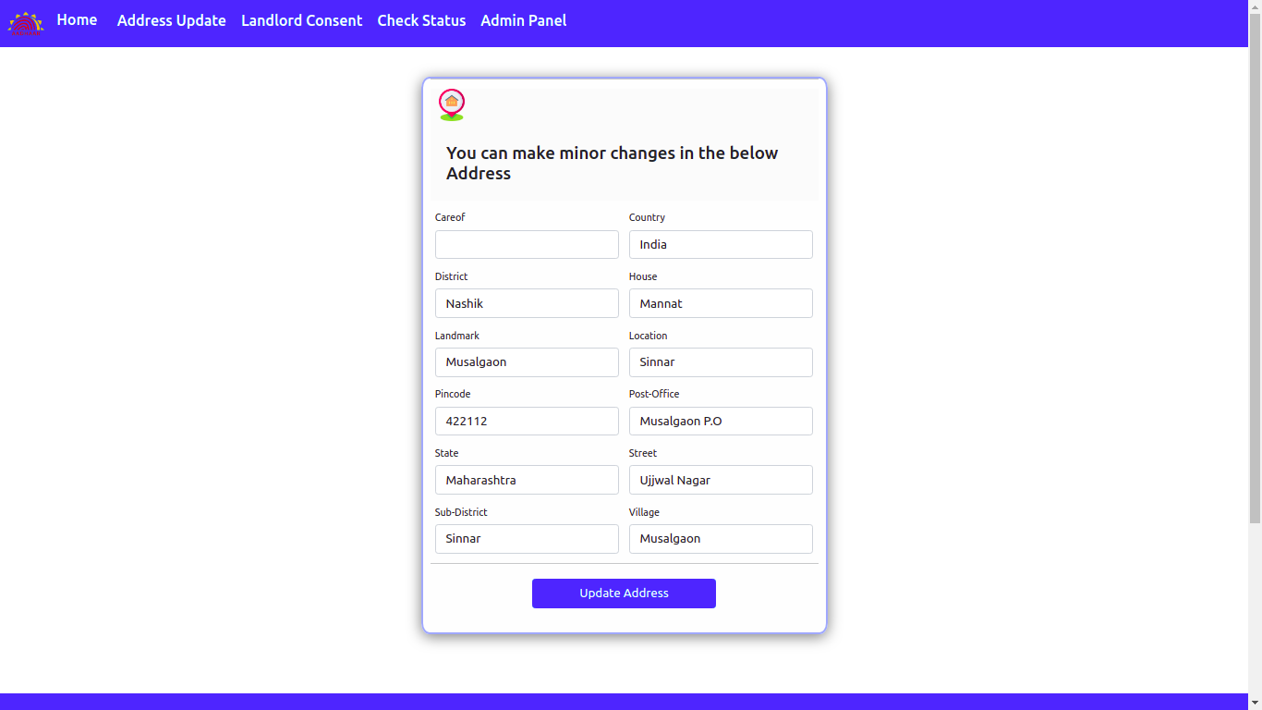
Resident can make minor changes in the form.
The Validation of the address will be performed using the GPS and GeoCode API.

Slide 20
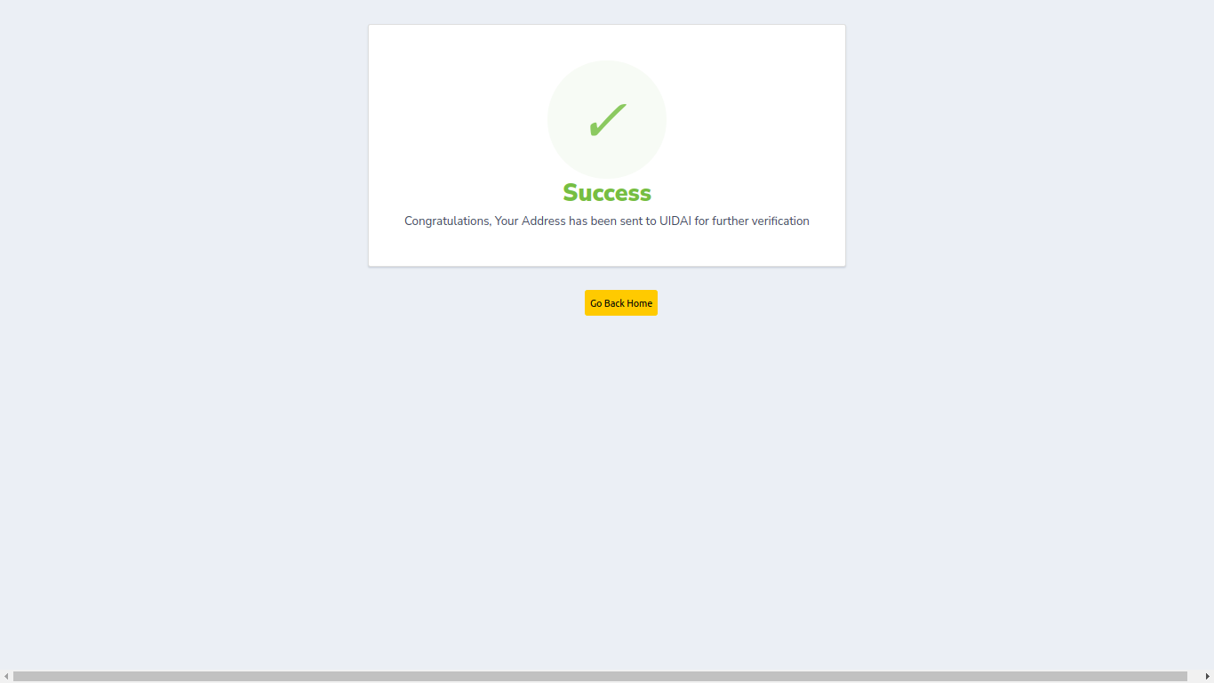
If Validation gets successful his address will be sent to UIDAI for further verification.

Slide 21
Thank You

