Slide 1
UNIVERSITY COURSE ENROLLMENT
Swathi Shelvapulle - 700792797
Puppala Charan Sai - 700787150
Prabhat Bellamkonda - 700794792
Junaid Khan - 700774061

Slide 2
OVERVIEW
Database Design
Technologies Used
ER Diagram
Key Database Tables
Database Integrity & Constraints
Sample Table Definition
LLM Integration – Database Aware of AI
Result & Impact
Future Scope

Slide 3
Database Design – Overview
Relational database implemented in SQLite (university.db).
  Normalized university schema to reduce redundancy.
  Strong use of primary keys and foreign keys for integrity.
  Supports roles (admin, teacher, student) via login_credentials table.
  Enables core operations: registration, scheduling, enrollment, grading.

Slide 4
Technologies Used
Core Language: Python 3.9
  Backend: FastAPI + Uvicorn (REST APIs, business logic)
  Frontend: Streamlit (role-based dashboards)
  Database: SQLite (university.db) with normalized schema
  AI / LLM: Google Gemini (via google-genai)
  Other: sqlite3, pandas, requests, python-dotenv, logging

Slide 5
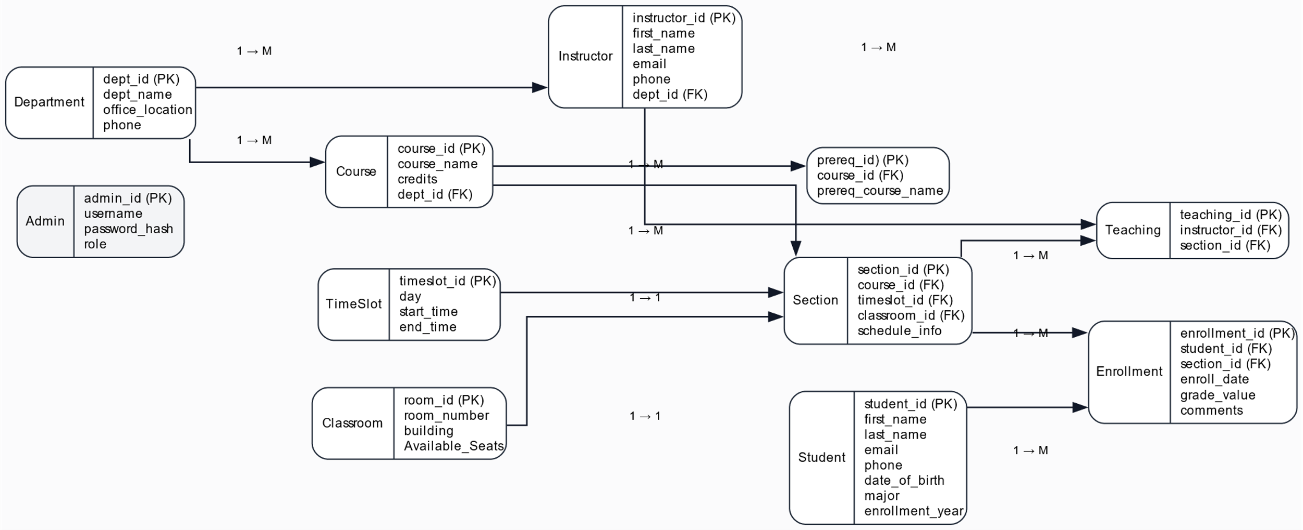
ER-Diagram

Slide 6
Key Database Tables
department – dept_name (PK), building, budget.
  course – course_id (PK), title, dept_name (FK), credits.
  student – ID (PK), name, dept_name (FK), tot_cred.
  instructor – ID (PK), name, dept_name (FK), salary.
  section – course offerings by term: course_id, sec_id, semester, year, building, room_number, time_slot_id, capacity.
  takes & teaches – link students/instructors to sections.
  time_slot, classroom, prereq, advisor – scheduling & relationships.

Slide 7
Database Integrity & Constraints
Primary keys on core entities (course_id, ID, dept_name, etc.).
  Foreign keys enforce relationships (e.g., course.dept_name → department.dept_name).
  section.capacity controls maximum enrollments per section.
  Business rules enforced via SQL queries and backend logic:
  • Avoid duplicate enrollments in the same section.
  • Maintain per-term credit limits for students (e.g., 12 credits).
  • Check schedule conflicts using time_slot information.

Slide 8
Sample Table Definition (SQLite)
CREATE TABLE IF NOT EXISTS course (
course_id VARCHAR(8) PRIMARY KEY,
title VARCHAR(50) NOT NULL,
dept_name VARCHAR(20) NOT NULL,
credits INTEGER NOT NULL,
FOREIGN KEY (dept_name) REFERENCES department (dept_name)
);

Slide 9
LLM Integration – Database-Aware AI
Google Gemini is used to translate natural language questions into SQL.
  Backend exposes /ai_query endpoint to the Streamlit UI.
  Gemini receives schema description (without sensitive tables).
  LLM generates a SELECT-only SQL query, respecting user role and username.
  Backend runs safety checks: no INSERT/UPDATE/DELETE, no sensitive tables.
  Results are executed on SQLite and explained back in natural language.

Slide 10
Results & Impact
(Database-Focused)
Robust relational schema supports enrollment, scheduling, and reporting.
  Referential integrity and constraints prevent inconsistent data states.
  AI-assisted querying enables non-technical users to explore the database safely.
  Credit limits and capacity checks are enforced via database queries.
  Architecture can be migrated from SQLite to PostgreSQL/MySQL for production.
  Foundation is ready for analytics (e.g., course popularity, pass rates) using the same schema.

Slide 11
Future Scope – Database & AI
Migrate to a scalable RDBMS (e.g., PostgreSQL) for multi-user deployment.
  Add indexing and query optimization for large datasets.
  Introduce audit tables to track changes (e.g., enrollment history).
  Refine AI prompts to support more complex analytical SQL while maintaining safety.
  Integrate role-based row-level security for sensitive student data.

Slide 12
THANK YOU

