Slide 2


About
Services
Products
Careers
Let's Connect
Transforming Data into Actionable Insights
A leading data & advanced analytics company. We empower businesses to make data-driven decisions for a smarter future.
This can be scrolling or clickable images about 6 slides

Slide 3

Why Us ?
We fuse masterful craftsmanship with agility, unleashing reliable, scalable innovation
Quality, Reliability & Speed
Data Driven Approach
Innovation Labs
Collaborative Approach
We turn raw data into we turn raw data into meaningful insights, allowing businesses to make informed decisions that drive results and measurable impact
Our commitment to R&D powers the development of exclusive frameworks, research, and PoCs that fast-track value delivery
We build long-term relationships with our clients, working together to achieve common goals and addressing unique business challenges.

Slide 4

What we do !
Drive operational excellence, improve customer experiences, and innovate with data and analytics solutions.
Data & Analytics
Cloud Transformation
AI/ML
Custom Software Engineering
Build a resilient infrastructure, reduce expenses, and enhance agility through cloud migration, optimization, and FinOps practices.
Speed up innovation, strengthen your advantage, and create real business impact through AI/ML development services.
Design, build, and refine custom software—from solution architecture through core engineering to ongoing product evolution and support.
Learn more
Learn more
Learn more
Learn more
Learn more: Direct the links to services page

Slide 5
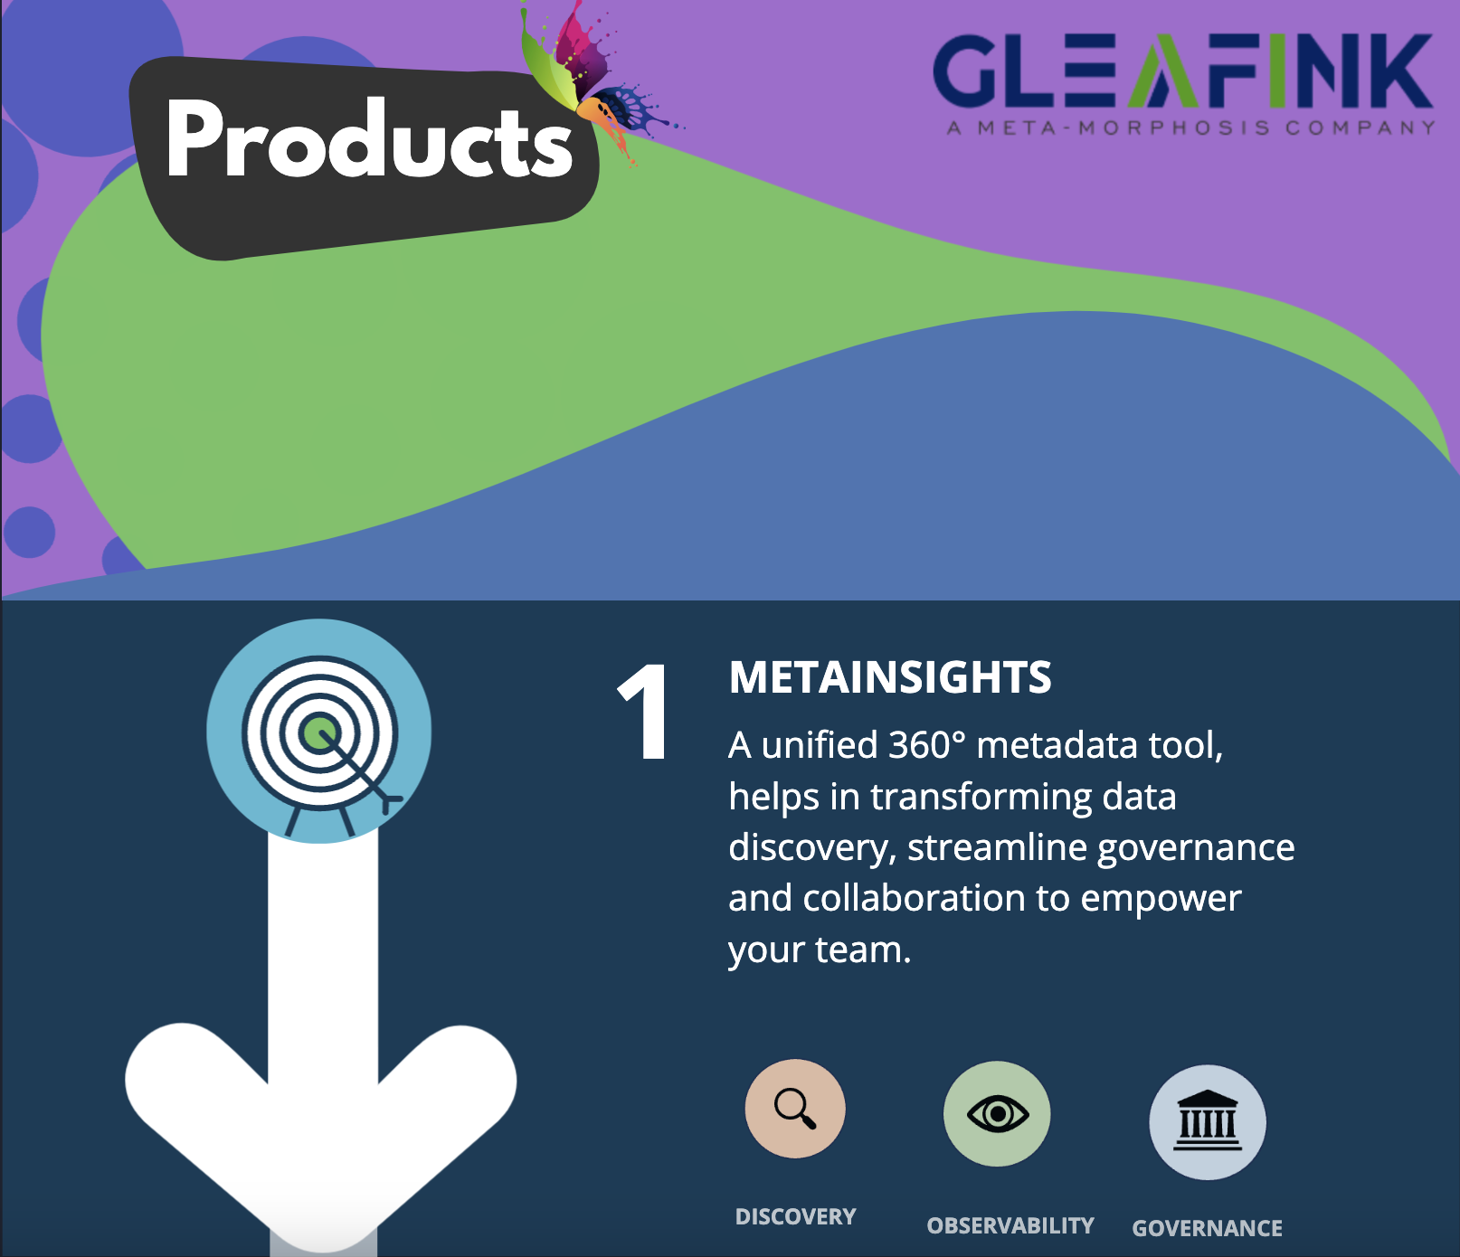

Slide 6
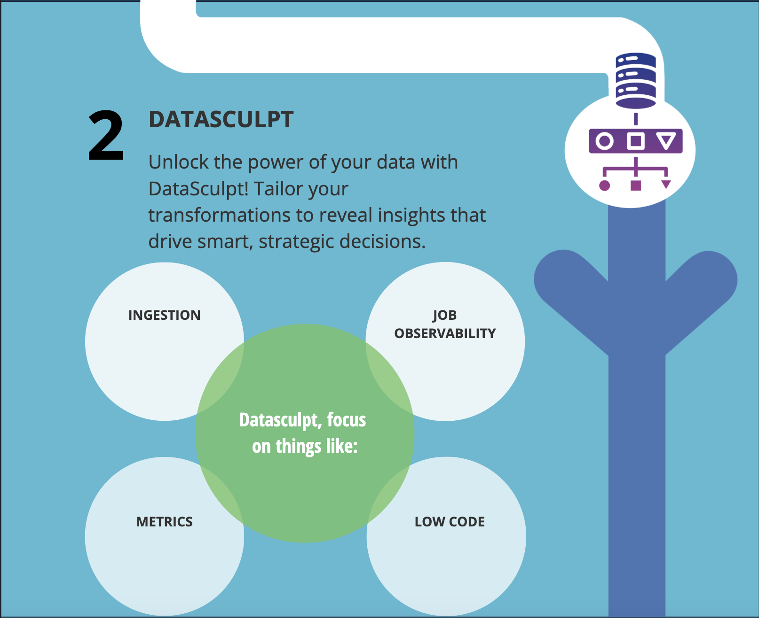

Slide 7
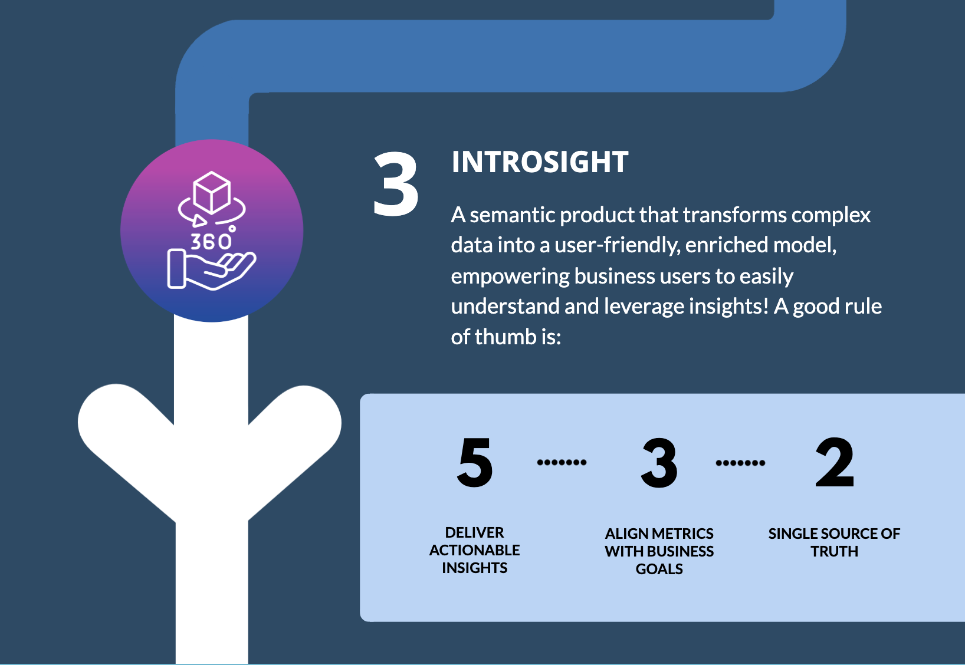

Slide 8
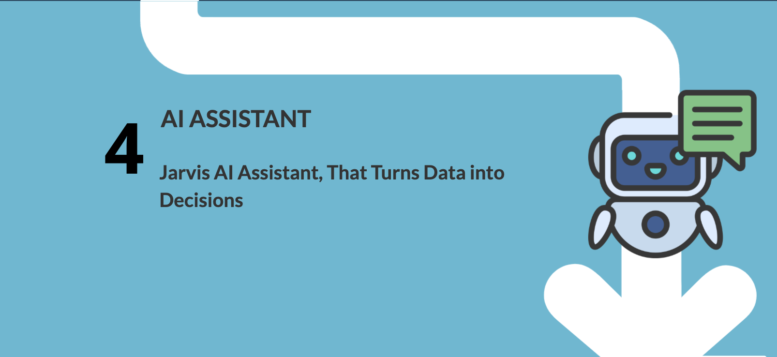

Slide 9
Begin Your Journey with Us Today
First Name
Last Name
Looking for a partner to help accelerate your technology roadmap? Fill out the form to start the conversation today.
Email Address
Company Name
Phone
What would you like to discuss ?
Submit

Slide 10

Key Metrics We elivered
75%
Efficiency Unleashed
Reduced development hours for
data pipelines
12000
Your Data Governed
Governance amplified with onboarding of data assets to
unified governance platform
50%
AI Efficiency
Reduced business user hours by half using
Generative AI
Case study →
Case study →
Case study →

Slide 11





Let’s Build Something Great Together
Company
Services
Industry
Locations
About Us
Cloud Transformation
Custom Software Design
Shipping & Logistics
Wisconsin
Privacy Policy
Data & Analytics
Managed Services
Retail Industry
Dubai
Company Presentation
AI & ML
Gleafink Solution Advisory
Internet
India
@2024 Gleafink Inc
Security
Saas Agreement
Data Processing Agreement

