Slide 1
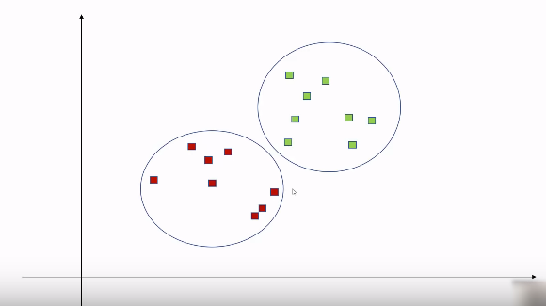
Dividing the dataset into different cluster is called K Means Clustering, This is a un supervise learning and we have to
provide the number of cluster for this process, and the algo perform differently with different value of cluster.
In this case we have 2 Cluster

Slide 2
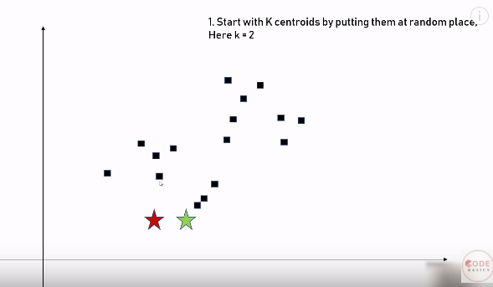
Now considerd we have define cluster value as 2, It's mean we have to find 2 centroid,
So for that -
1) We put centroid any where

Slide 3
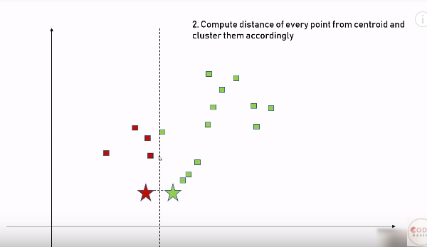
2) Make a perpendicular line and use it to divide the distance b/w centroid in half and one side of perpendicular
is one cluster and other side is other cluster.

Slide 4
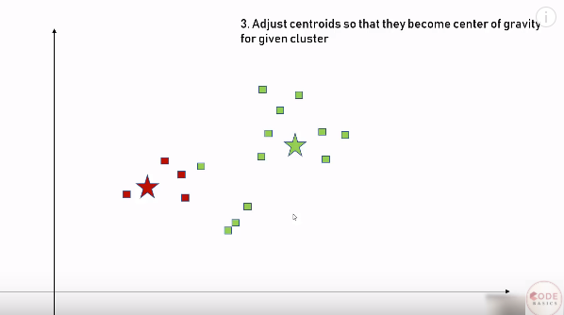
3) After dividing the centroid adjest the centroid according to there cluster so that they are in the center of
cluster.

Slide 5
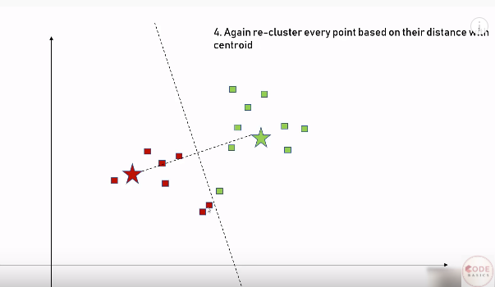
4) Again start with the same process and divide the points in cluster

Slide 6
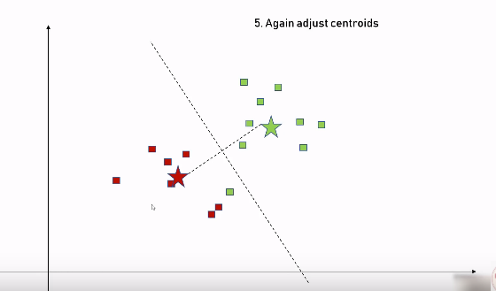
5) Again adjust the centroids

Slide 7
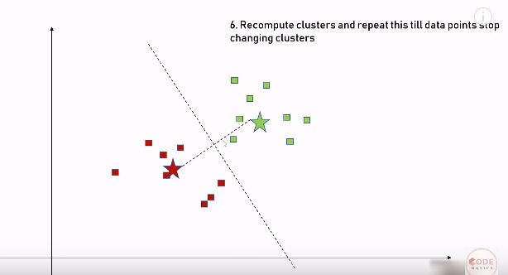
6) Repete the process till no point get changing the cluster

Slide 8
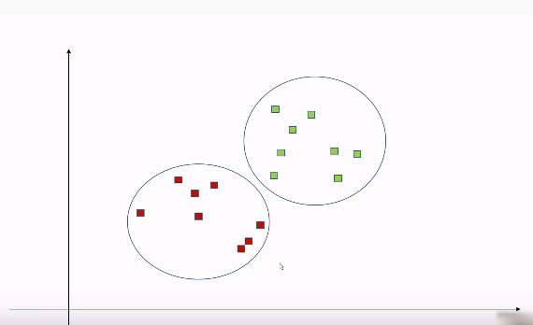
Then finally we have our cluster

Slide 9
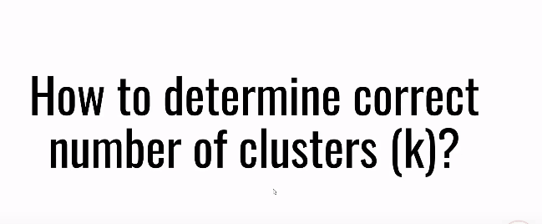

Slide 10
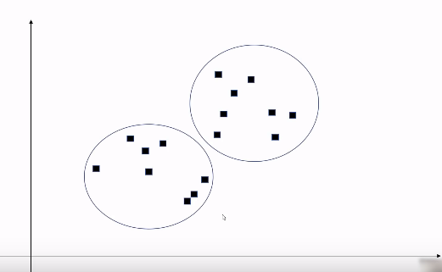
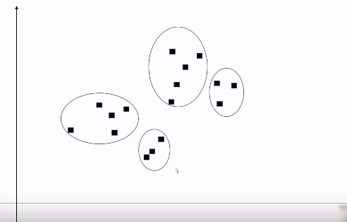
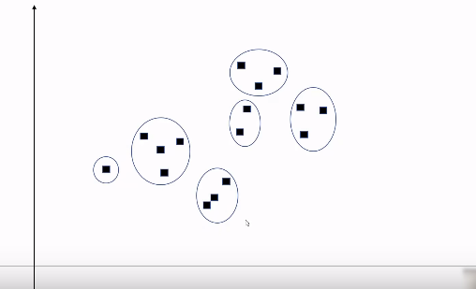
For some one it might be 2 for other it might be 4 or 6,
Then how to find the best value of 'K'

Slide 11
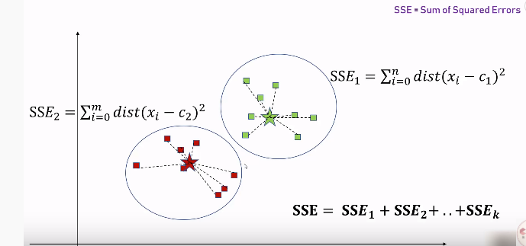
For that we find SSE (Sum of Squared Error)
i.e when K =1, SSE = SSE1
when K =2, SSE = SSE1 + SSE2
.
.
.
when K=n, SSE = SSE1 + SSE2+........+SSEn
and then draw a Graph and find 'ELBOW' and that Elbo point give the correct value of K

Slide 12
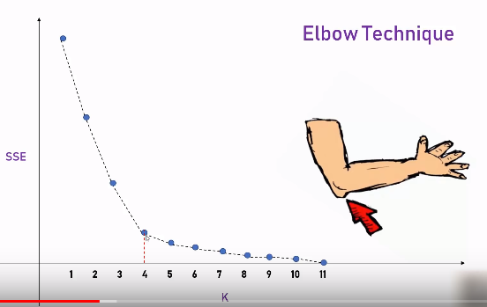
See in the graph we find 'Elbow' at K=4 , so the best no of cluster is 4.
This Algorithm is known as "Elbow Algo"

