Slide 1
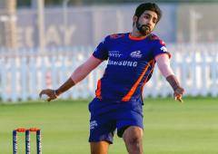
Observers
Subject
Subscriber 1
blog
notify
New Article has been posted.
subscribe
read
Subscriber 2
subscribe
read
New Article has been posted.
notify
Bumrah is the best T20 bowler in the world
read
Subscriber 3
subscribe
notify
New Article has been posted.

