Slide 1
Redux is quite an excellent State Managment Framework usually used with React.js library.
In Single Page Application, data management at client side is far more complicated than just imagine. Now, you are familiar that, ReactJS is relying on the State of the application.
However, In React.js state management is possible, but when the application gets bigger and bigger, unwanted errors and data changes are detected, and which module has changed which state and which view is updated, all these matters get complex, and we feel like, we trapped in our application.

Slide 2
Flux | Redux
Flux complements React’s composable view components by utilizing the unidirectional data flow. When the users interact with views, the views propagates actions through a central dispatcher, to the various stores that hold the application data and logic, which updates all of our views that are affected. Flux has so many stores, and each store is using different small part of the state or data of our application. In other words, each different module has its store. | Redux is the predictable state container for JavaScript applications. Redux is also following the Unidirectional flow, but it is entirely different Redux has a Single Store. Redux can not have multiple stores. The store is divided into various state objects. So all we need is to maintain the single store, or we can say the only source of truth.
The user interacts with the view and view triggers an action. Action dispatch the corresponding function and then that function change the store. When store updates its data, the subscriber views are automatically updated. We do not need to modify the data in different modules manually. | Single source of truth. The state is read-only. Changes are made with pure functions.

Slide 3
Why Should I Use Redux?
Redux helps you manage "global" state - state that is needed across many parts of your application.
The patterns and tools provided by Redux make it easier to understand when, where, why, and how the state in your application is being updated, and how your application logic will behave when those changes occur.
When Should I Use Redux?
Redux is more useful when:
You have large amounts of application state that are needed in many places in the app
The app state is updated frequently over time
The logic to update that state may be complex
The app has a medium or large-sized codebase, and might be worked on by many people
Not all apps need Redux. Take some time to think about the kind of app you're building, and decide what tools would be best to help solve the problems you're working on.

Slide 4
Redux Libraries and Tools​
Redux is a small standalone JS library.
React-Redux​
Redux can integrate with any UI framework, and is most frequently used with React. React-Redux is our official package that lets your React components interact with a Redux store by reading pieces of state and dispatching actions to update the store.
Redux Toolkit​
Redux Toolkit is our recommended approach for writing Redux logic. It contains packages and functions that we think are essential for building a Redux app
Redux DevTools Extension​
The Redux DevTools Extension shows a history of the changes to the state in your Redux store over time

Slide 5
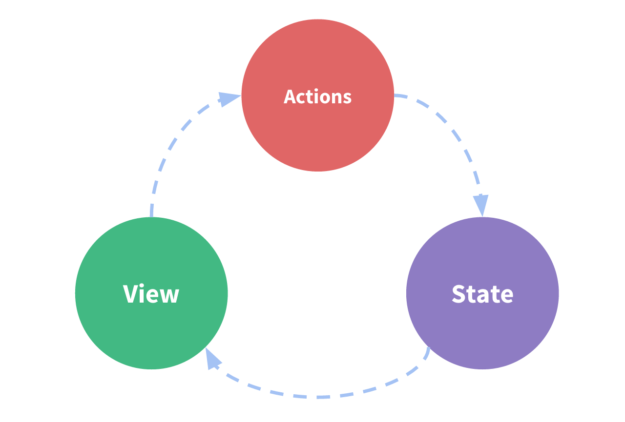
Redux Terms and Concepts
State Management​
Let's start by looking at a small React counter component. It tracks a number in component state, and increments the number when a button is clicked:
function Counter() { // State: a counter value const [counter, setCounter] = useState(0) // Action: code that causes an update to the state when something happens const increment = () => { setCounter(prevCounter => prevCounter + 1) } // View: the UI definition return ( <div> Value: {counter} <button onClick={increment}>Increment</button> </div> ) }
It is a self-contained app with the following parts:
The state, the source of truth that drives our app;
The view, a declarative description of the UI based on the current state
The actions, the events that occur in the app based on user input, and trigger updates in the state

Slide 6
However, the simplicity can break down when we have multiple components that need to share and use the same state, especially if those components are located in different parts of the application. Sometimes this can be solved by "lifting state up" to parent components, but that doesn't always help.
One way to solve this is to extract the shared state from the components, and put it into a centralized location outside the component tree. With this, our component tree becomes a big "view", and any component can access the state or trigger actions, no matter where they are in the tree!
By defining and separating the concepts involved in state management and enforcing rules that maintain independence between views and states, we give our code more structure and maintainability.
This is the basic idea behind Redux: a single centralized place to contain the global state in your application, and specific patterns to follow when updating that state to make the code predictable.

Slide 7
Actions
An action is a plain JavaScript object that has a type field. You can think of an action as an event that describes something that happened in the application.
const addCountAction = { type: ' counter/increment ', payload: 3' }
Action Creators
An action creator is a function that creates and returns an action object
const addCount = no => { return { type: 'counter/increment', payload: no } }
Reducers
A reducer is a function that receives the current state and an action object, decides how to update the state if necessary, and returns the new state: (state, action) => newState. You can think of a reducer as an event listener which handles events based on the received action (event) type.
const initialState = { value: 0 } function counterReducer(state = initialState, action) { // Check to see if the reducer cares about this action if (action.type === 'counter/increment') { // If so, make a copy of `state` return { ...state, // and update the copy with the new value value: state.value + 1 } } // otherwise return the existing state unchanged return state }

Slide 8
Store
The current Redux application state lives in an object called the store .
The store is created by passing in a reducer, and has a method called getState that returns the current state value:
import { configureStore } from '@reduxjs/toolkit' const store = configureStore({ reducer: counterReducer }) console.log(store.getState()) // {value: 0}
Dispatch
The Redux store has a method called dispatch. The only way to update the state is to call store.dispatch() and pass in an action object. The store will run its reducer function and save the new state value inside, and we can call getState() to retrieve the updated value:
store.dispatch({ type: 'counter/increment' }) console.log(store.getState()) // {value: 1}
const increment = () => { return { type: 'counter/increment’ } } store.dispatch(increment()) console.log(store.getState()) // {value: 2}
You can think of dispatching actions as "triggering an event" in the application.
We typically call action creators to dispatch the right action:
Selectors​
Selectors are functions that know how to extract specific pieces of information from a store state value
const selectCounterValue = state => state.value const currentValue = selectCounterValue(store.getState()) console.log(currentValue) // 2

Slide 10
Redux is a library for managing global application state
Redux is typically used with the React-Redux library for integrating Redux and React together
Redux Toolkit is the recommended way to write Redux logic
Redux uses a "one-way data flow" app structure
State describes the condition of the app at a point in time, and UI renders based on that state
When something happens in the app:
The UI dispatches an action
The store runs the reducers, and the state is updated based on what occurred
The store notifies the UI that the state has changed
The UI re-renders based on the new state
Redux uses several types of code
Actions are plain objects with a type field, and describe "what happened" in the app
Reducers are functions that calculate a new state value based on previous state + an action
A Redux store runs the root reducer whenever an action is dispatched

Slide 11
https://redux.js.org/tutorials/essentials/part-2-app-structure
Legacy Example​:For comparison, the original Redux legacy syntax (with no abstractions) looks like this:
import { createStore } from 'redux' /** * This is a reducer - a function that takes a current state value and an * action object describing "what happened", and returns a new state value. * A reducer's function signature is: (state, action) => newState * * The Redux state should contain only plain JS objects, arrays, and primitives. * The root state value is usually an object. It's important that you should * not mutate the state object, but return a new object if the state changes. * * You can use any conditional logic you want in a reducer. In this example, * we use a switch statement, but it's not required. */ function counterReducer(state = { value: 0 }, action) { switch (action.type) { case 'counter/incremented': return { value: state.value + 1 } case 'counter/decremented': return { value: state.value - 1 } default: return state } } // Create a Redux store holding the state of your app. // Its API is { subscribe, dispatch, getState }. let store = createStore(counterReducer)
// You can use subscribe() to update the UI in response to state changes. // Normally you'd use a view binding library (e.g. React Redux) rather than subscribe() directly. // There may be additional use cases where it's helpful to subscribe as well. store.subscribe(() => console.log(store.getState()))
// The only way to mutate the internal state is to dispatch an action. // The actions can be serialized, logged or stored and later replayed. store.dispatch({ type: 'counter/incremented’ })
// {value: 1} store.dispatch({ type: 'counter/incremented’ })
// {value: 2} store.dispatch({ type: 'counter/decremented' }) // {value: 1}

