Slide 1
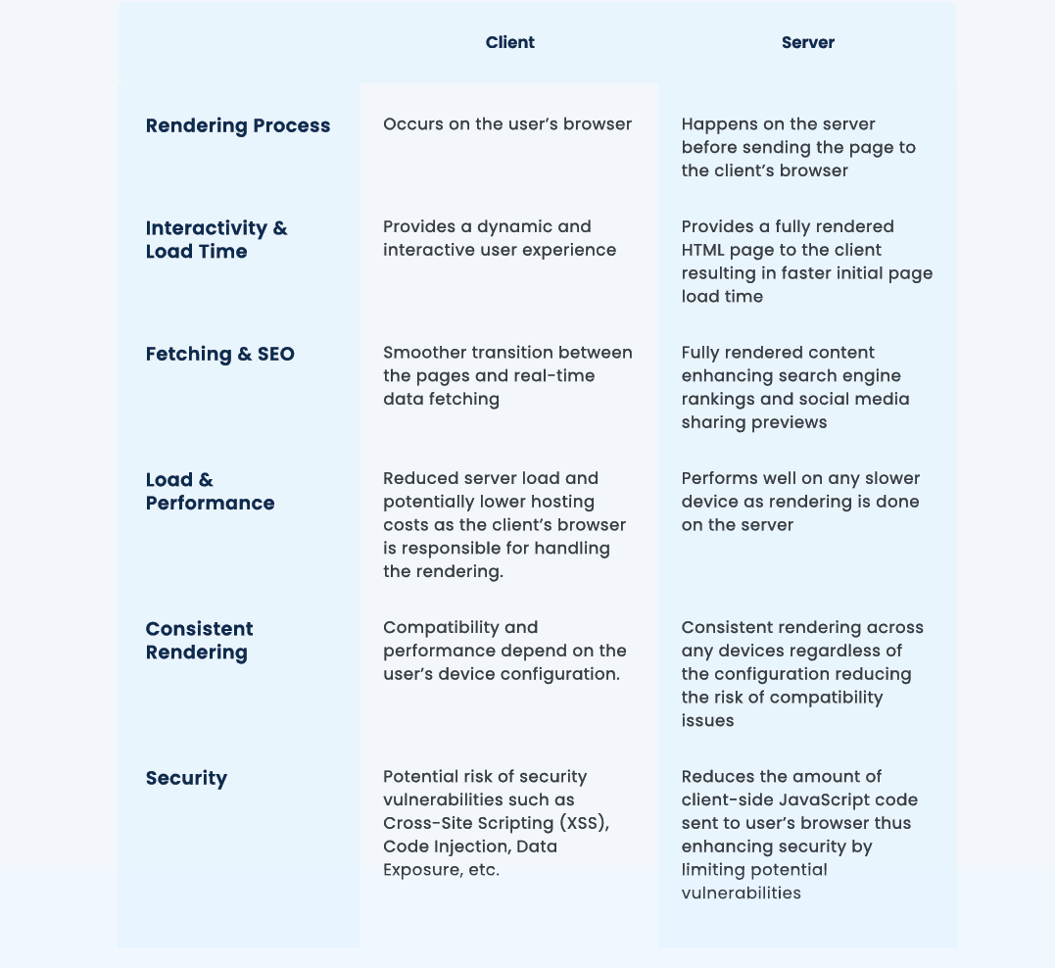

Slide 2
If search engine optimization (SEO), security concerns, and user device specifications are not a priority for you, and your focus is primarily on delivering dynamic interactivity to the user, then client-side rendering (CSR) with technologies like React.js can be a suitable choice.
A use case where this approach is applicable is in the business-to business (B2B) domain.
In such cases, the target audience is specific and known, eliminating the need to prioritize SEO since the product is
not intended for a wide public audience.
This allows you to prioritize developing interactive features and functionalities without dedicating significant resources to SEO optimization.

Slide 3
Static Site Generation
Remember the build time? Well, the famous SSG, static site generation, happens at build time on the server.
During the build process, the content is generated and converted into HTML, CSS, and JavaScript files. It doesn’t require server interaction during runtime.
The generated static files can be hosted on content delivery network (CDN) and then served to the client as-is.
The result, the rendered content, is cached and reused on subsequent requests leading to fast content delivery and less server load.
This minimal processing results in higher performance. Although SSG handles dynamic data during the build process, it
requires a rebuild if you update anything, as it happens during the build time!
An example use case would be any Documentation or Blog & News websites. All the articles or content are static 90% of the time. It doesn’t need any processing. Once built, we can ship it as it is. Whenever we want to update the content, we can rebuild it!
Build time
Static file ready
Html
Css
Server
Client
Request
doesn’t require server interaction during runtime
static files can be hosted on content delivery network (CDN).
rendered content, is cached and reused on subsequent requests leading to fast content delivery and less server load.
Response

Slide 4
Incremental Static Generation
It allows us to update these static pages after we build them without needing to rebuild the entire site.
The on-demand generation of ISR allows us to generate a specific page on-demand or in response to a user’s request. Meaning, a certain part of the websites or pages will be rendered at build time while other is generated only when needed, i.e., at run time.
This reduces the build time and improves the overall performance of the website by updating only requested pages for regeneration. With this hybrid strategy, we now have the flexibility to manage content updates. We can cache the static content as well as revalidate them if needed. An example use case would be the same where we can use SSG for the
article details page and use ISG for showing a list of articles
Build time
1St render some basic static page from CDN
Server
Client
Request 1
at run time
Generate Page
Click to load User details
Request 2
Response
update these static pages after we build them without needing to rebuild the entire site.
to generate a specific page on-demand or in response to a user’s request

Slide 5
Server Side Rendering
Dynamic rendering, in a nutshell, enables the generation of dynamic content for each request, providing fresh and interactive experiences. If we have SSG and ISG, why do we need SSR?
Given the availability of Static Site Generation (SSG) and Incremental Static Generation (ISG), one might wonder why Server Side Rendering (SSR) is still needed.
Both approaches offer valuable benefits, but their suitability depends on specific use cases. SSR excels in situations where a website heavily relies on client-side interactivity and requires real-time updates.
It is particularly well-suited for authentication, real-time collaborative applications such as chat platforms, editing tools, and video streaming services.
SSR involves heavy server-side processing, where the server executes code for every individual request, generates the necessary HTML, and delivers the response along with the required JavaScript code for client-side interactivity.
Due to this dynamic nature, caching content responses becomes challenging, resulting in increased server load when compared to SSG or ISG.
However, the benefits of real-time interactivity and up-to-date content make SSR a valuable choice for specific application requirements. But hey, we have the freedom to choose any of these rendering techniques for any part of your page code! Yes, you read that right. By default, Next.js uses Static Site Generation rendering.
However, we can easily switch to Incremental Static Generation or Server Side Rendering as per our specific requirements for different parts of your application.
The flexibility of Next.js allows us to pick the most suitable rendering approach for each page of our website.

Slide 6
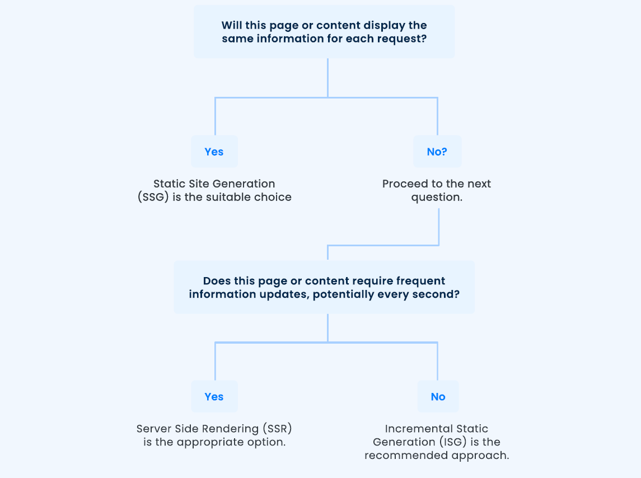

Slide 7
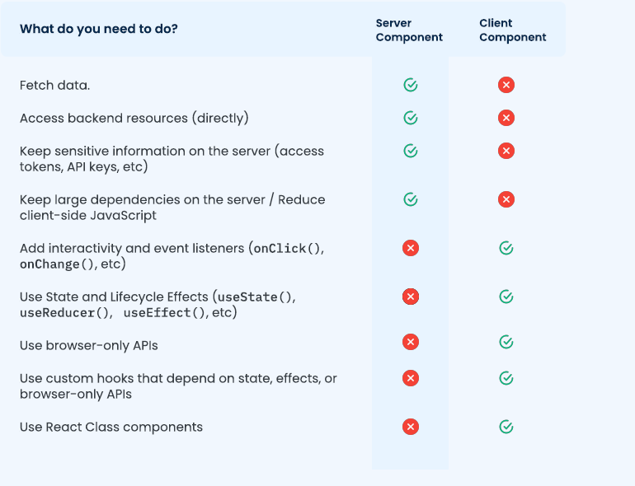

Slide 8
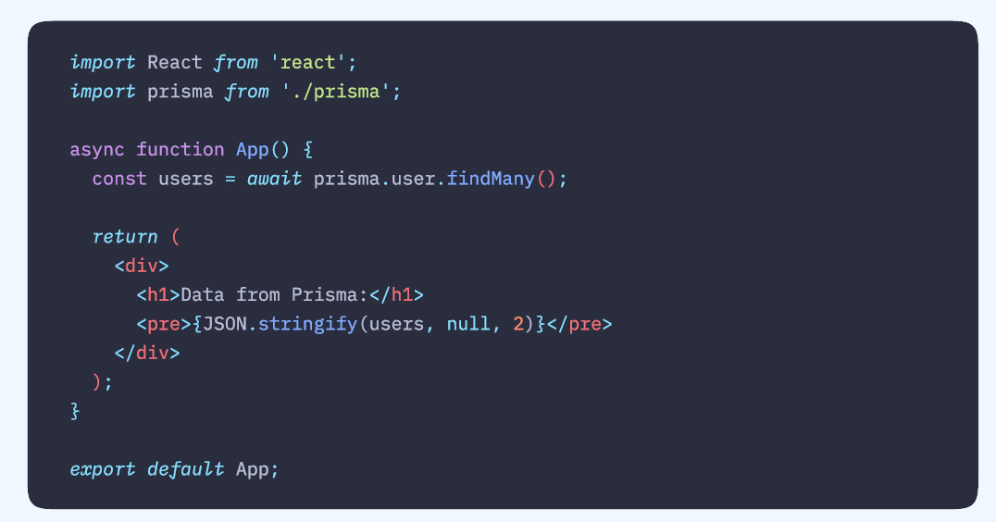
With React Server Components, we directly do fetch or any operations that we want to do without any need for hooks.
For example, if we want to make a call to our database and get a list of
items, we can do this in RSC
By Default , any kind of components you’ll write in Next.Js are React Server Components which are guaranteed to run only on Server

Slide 9
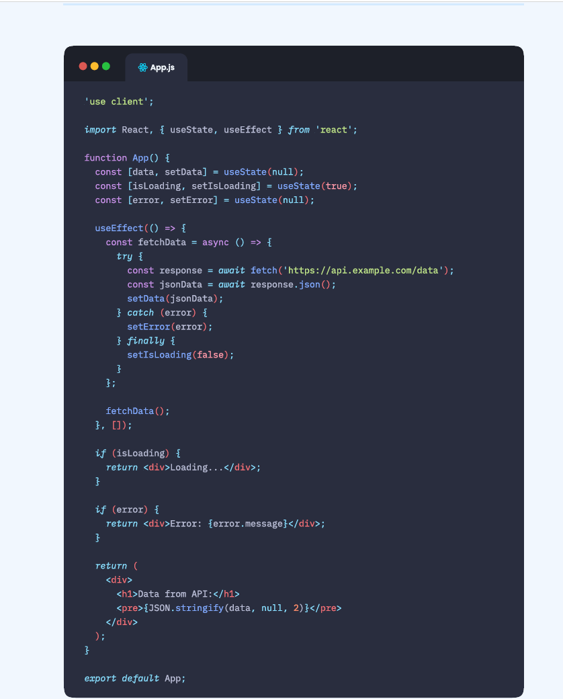
‘use client’
With this above line this component run on client side

Slide 10
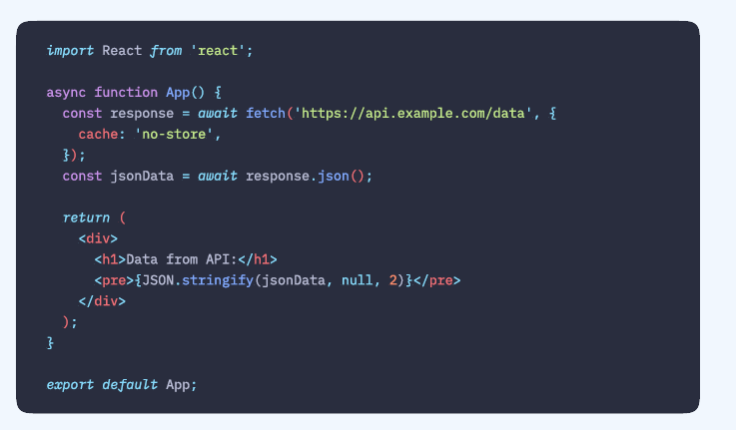
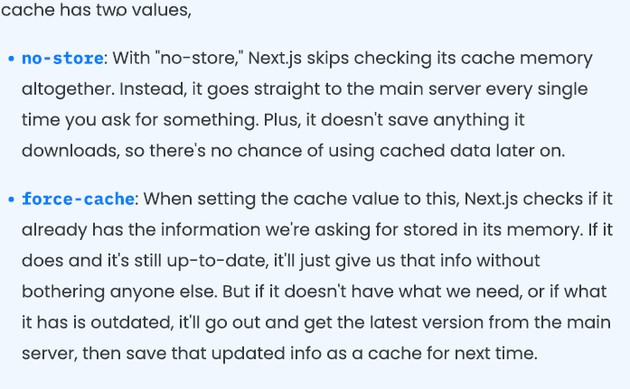
What if we need to refresh or reprocess the component or content every time a user send a request?➔cache

Slide 11
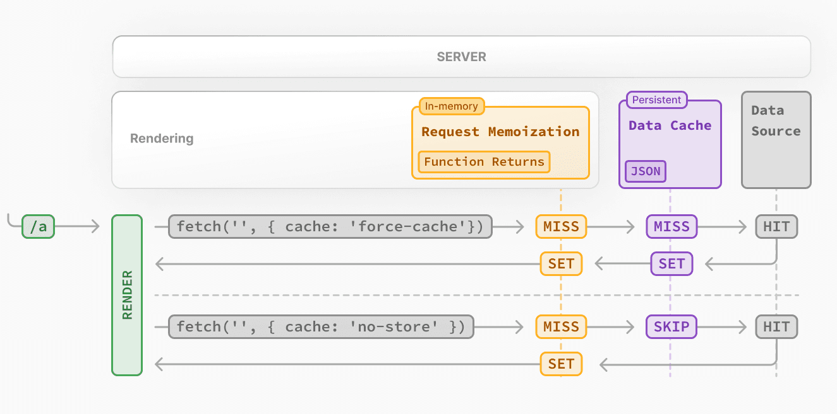
The first time a fetch request with the 'force-cache' option is called during rendering, Next.js checks the Data Cache for a cached response.
If a cached response is found, it's returned immediately and memoized.
If a cached response is not found, the request is made to the data source, the result is stored in the Data Cache, and memoized.
For uncached data (e.g. no cache option defined or using { cache: 'no-store' }), the result is always fetched from the data source, and memoized.
Whether the data is cached or uncached, the requests are always memoized to avoid making duplicate requests for the same data during a React render pass.

Slide 12
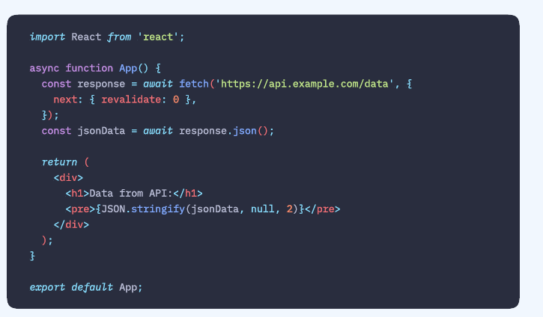
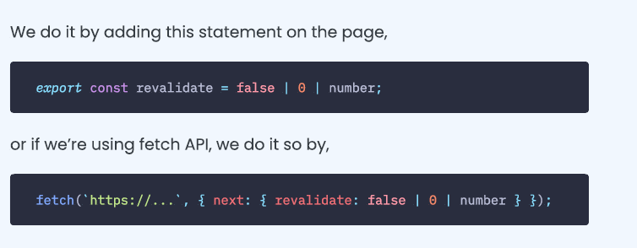
Time Based cache
The whole basis of these rendering strategies is to cache the data depending on time.
We know that by default, Next.js uses Static Site Generation, which caches everything.
So what if we define this method at the time we want?
Means, revalidate the cache whenever we want to.
This code will not cache anything and every request will hit the server and get fresh data

Slide 13
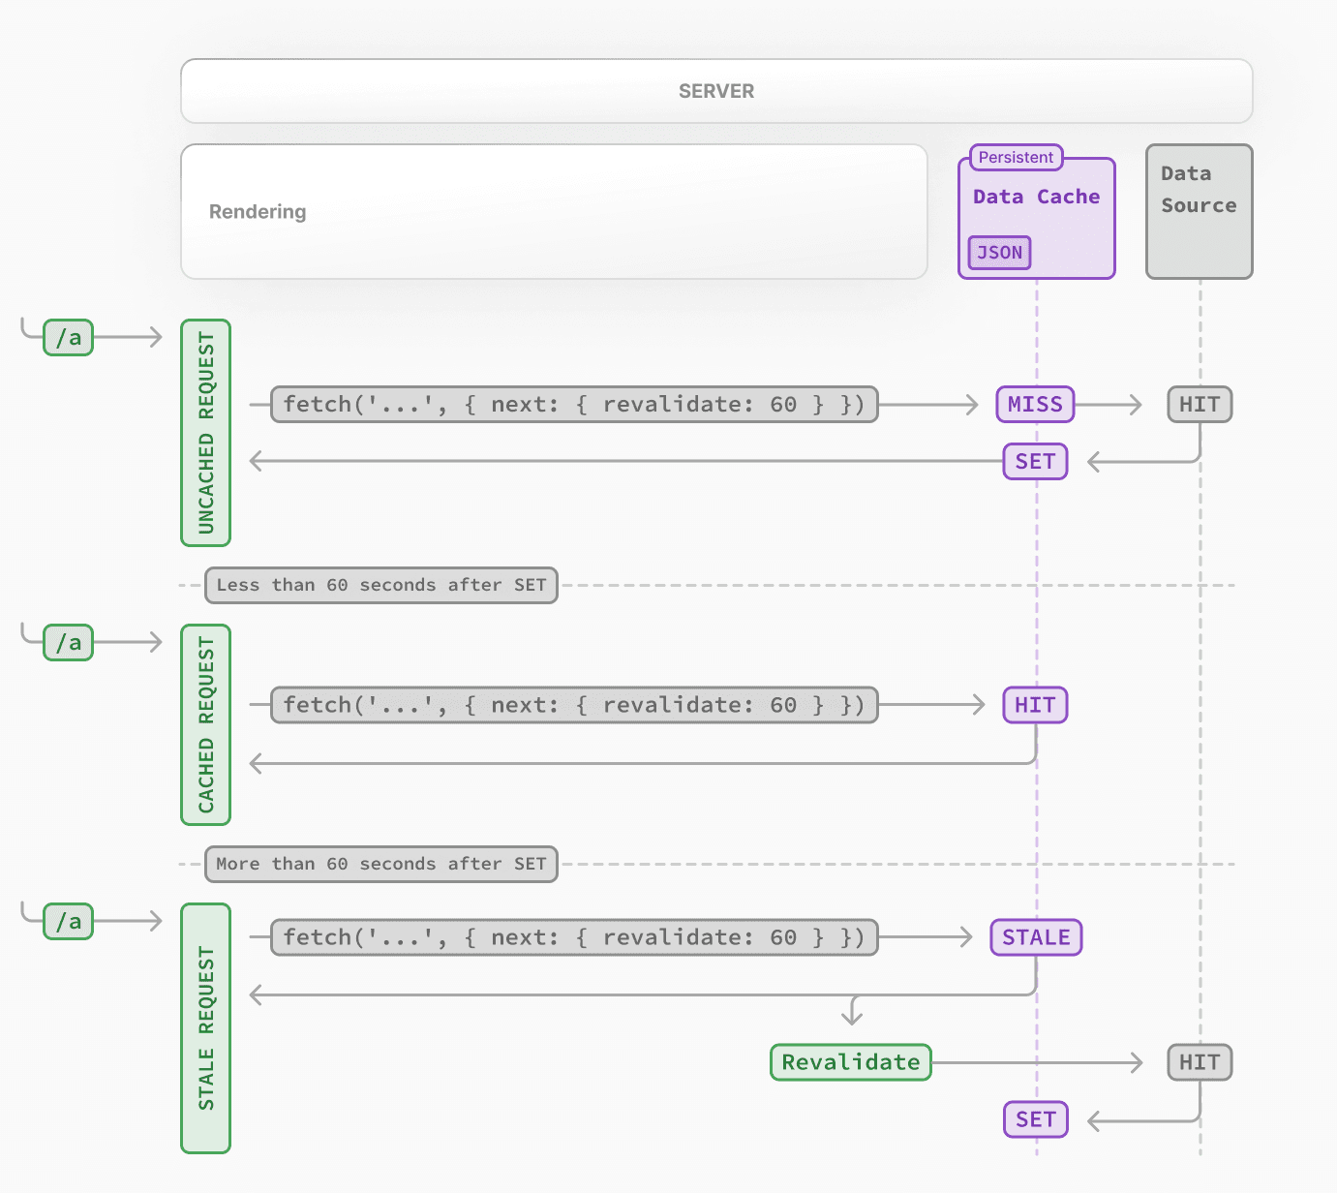
The first time a fetch request with revalidate is called, the data will be fetched from the external data source and stored in the Data Cache.
Any requests that are called within the specified timeframe (e.g. 60-seconds) will return the cached data.
After the timeframe, the next request will still return the cached (now stale) data.
Next.js will trigger a revalidation of the data in the background.
Once the data is fetched successfully, Next.js will update the Data Cache with the fresh data.
If the background revalidation fails, the previous data will be kept unaltered.
This is similar to stale-while-revalidate behavior.

Slide 14
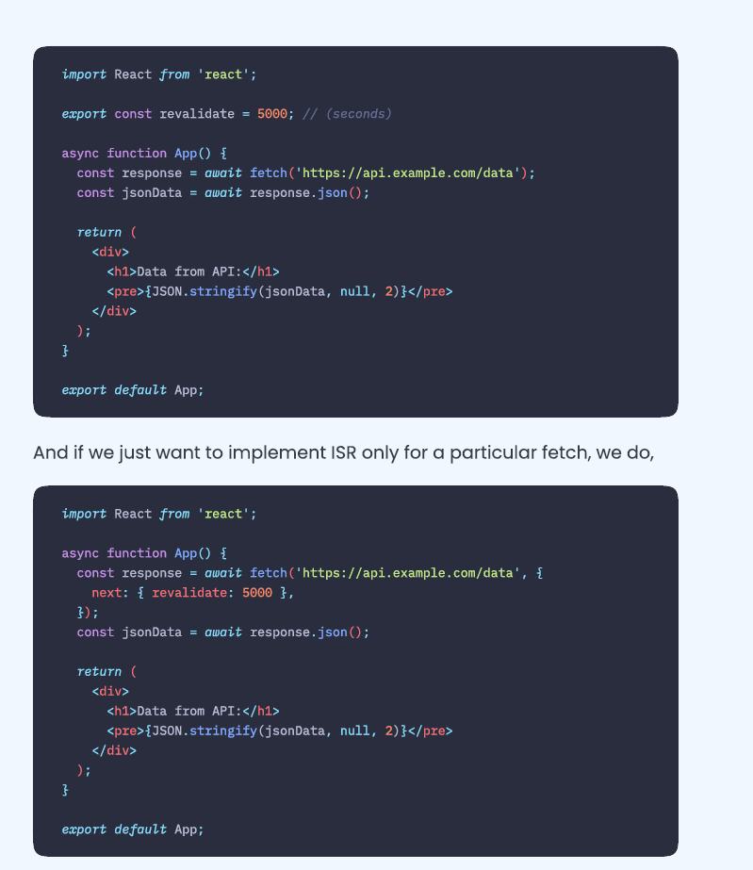

Slide 15

PPR➔ Partial pre rendering
Layout page can be static and SSG(static site generation) at built time
Some data may get loaded on demand basis so it can be SSR(Server side react component)

Slide 16
Caching in Next.js
Mechanism | What | Where | Purpose | Duration
Request Memoization | Return values of functions | Server | Re-use data in a React Component tree | Per-request lifecycle
Data Cache | Data | Server | Store data across user requests and deployments | Persistent (can be revalidated)
Full Route Cache | HTML and RSC payload | Server | Reduce rendering cost and improve performance | Persistent (can be revalidated)
Router Cache | RSC Payload | Client | Reduce server requests on navigation | User session or time-based
By default, Next.js will cache as much as possible to improve performance and reduce cost. This means routes are statically rendered and data requests are cached unless you opt out. The diagram below shows the default caching behavior: when a route is statically rendered at build time and when a static route is first visited.

Slide 17
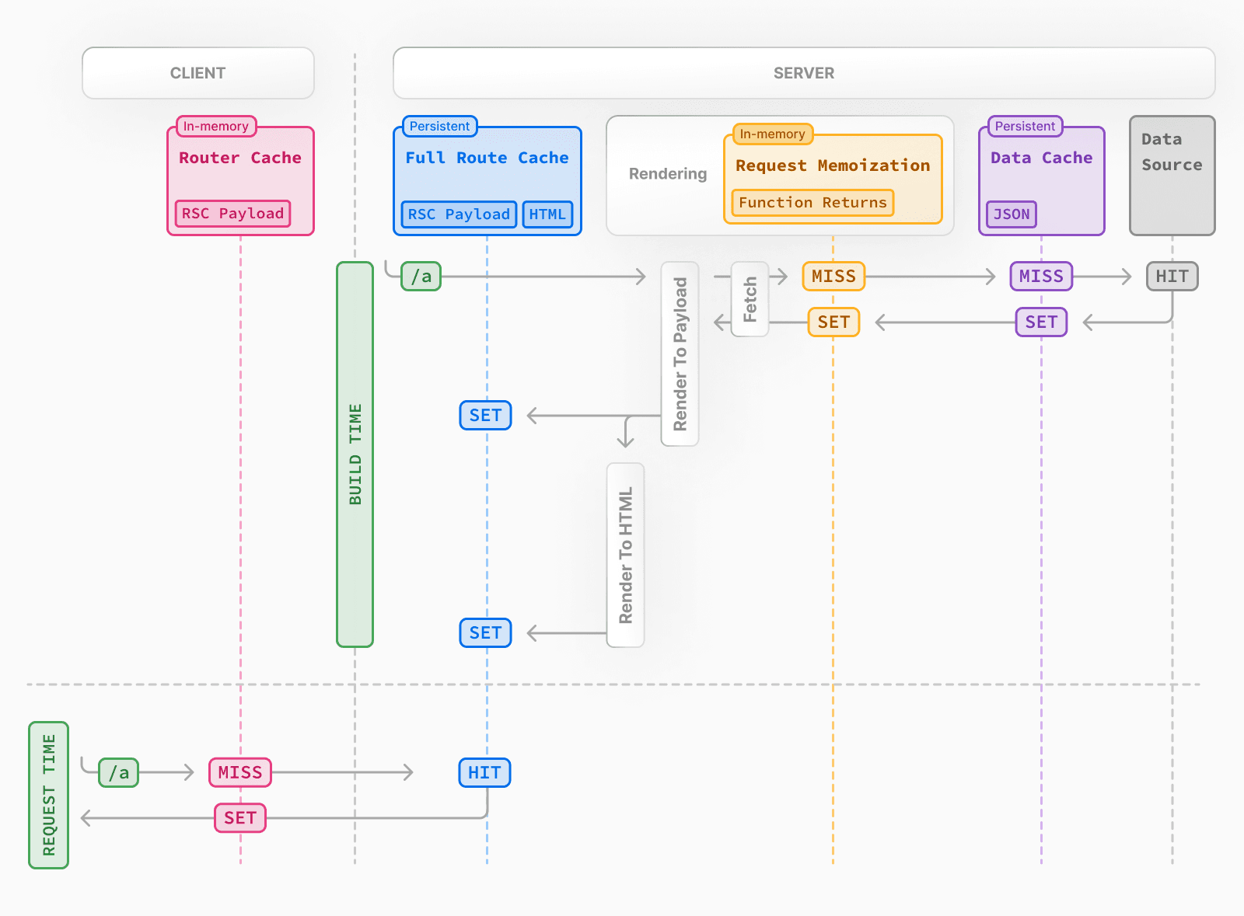

Slide 18
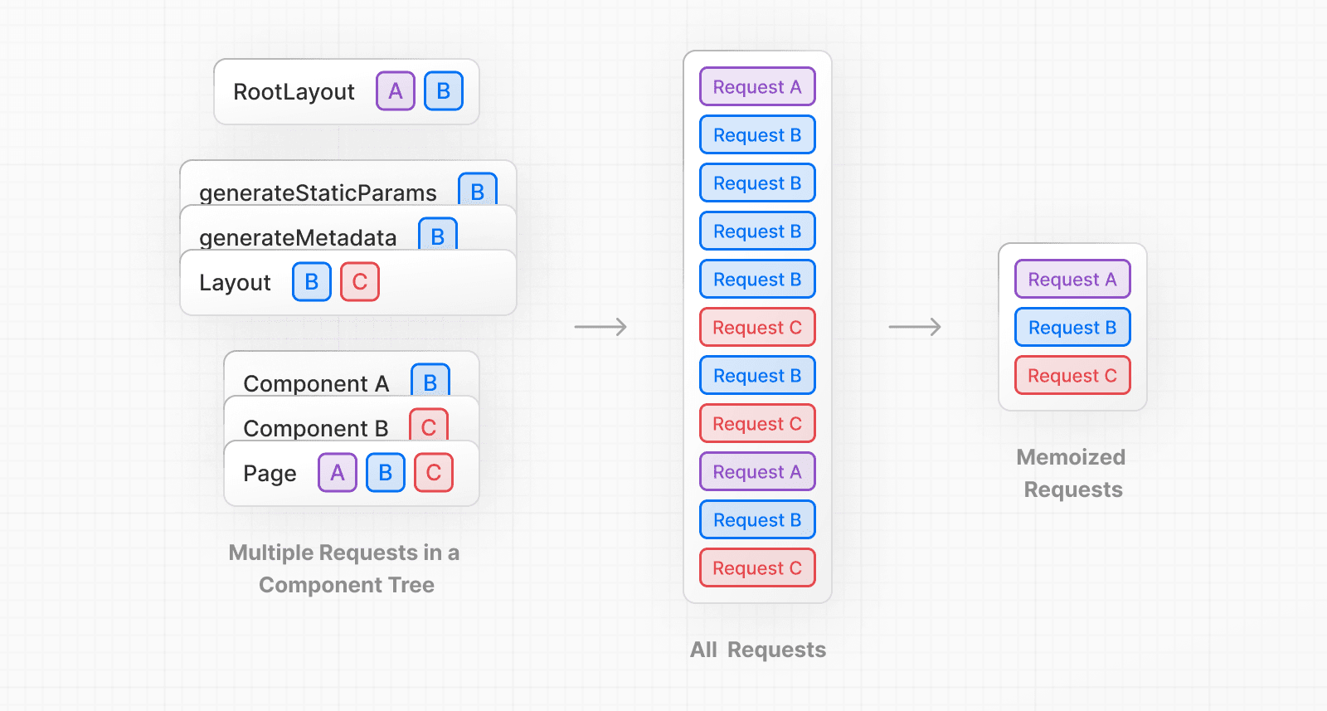
Request Memoization
Next.js extends the fetch API to automatically memoize requests that have the same URL and options. This means you can call a fetch function for the same data in multiple places in a React component tree while only executing it once.
For example,
if you need to use the same data across a route (e.g. in a Layout, Page, and multiple components),
you do not have to fetch data at the top of the tree, and forward props between components.
Instead, you can fetch data in the components that need it without worrying about the performance implications of making multiple requests across the network for the same data.

Slide 19
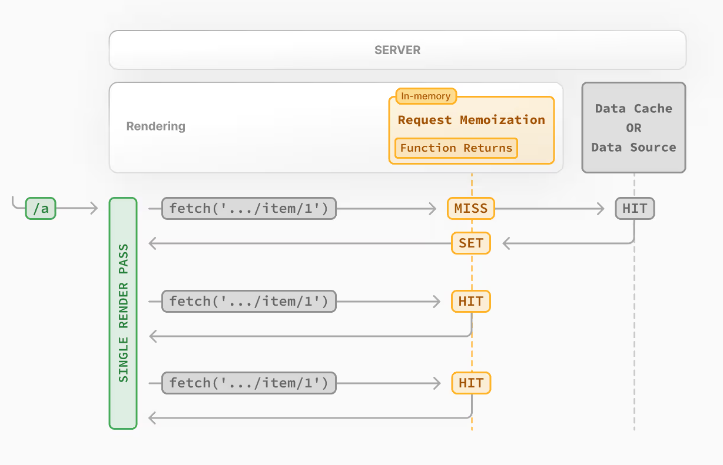
async function getItem() {
// The `fetch` function is automatically memoized and the result
// is cached
const res = await fetch('https://.../item/1')
return res.json()
}
// This function is called twice, but only executed the first time
const item = await getItem() // cache MISS
// The second call could be anywhere in your route
const item = await getItem() // cache HIT
How Request Memoization Works
While rendering a route, the first time a particular request is called, its result will not be in memory and it'll be a cache MISS.
Therefore, the function will be executed, and the data will be fetched from the external source, and the result will be stored in memory.
Subsequent function calls of the request in the same render pass will be a cache HIT, and the data will be returned from memory without executing the function.
Once the route has been rendered and the rendering pass is complete, memory is "reset" and all request memoization entries are cleared.

Slide 20
Good to know:
Request memoization is a React feature, not a Next.js feature. It's included here to show how it interacts with the other caching mechanisms.
Memoization only applies to the GET method in fetch requests.
Memoization only applies to the React Component tree, this means:
It applies to fetch requests in generateMetadata, generateStaticParams, Layouts, Pages, and other Server Components.
It doesn't apply to fetch requests in Route Handlers as they are not a part of the React component tree.
For cases where fetch is not suitable (e.g. some database clients, CMS clients, or GraphQL clients), you can use the React cache function to memoize functions.

Slide 21

Data Cache
Next.js has a built-in Data Cache that persists the result of data fetches across incoming server requests and deployments. This is possible because Next.js extends the native fetch API to allow each request on the server to set its own persistent caching semantics

Slide 22
Next.js 15 + React 19 - shadcn/ui
The Content Operating System | Sanity
Auth.js | Github
Vision |http://localhost:3000/studio/vision

