Slide 1
Static Metadata
Simply put, it’s information that doesn't change very often, if at all. This includes things like the page title, meta description, and meta keywords. Once set, these elements remain the same unless
intentionally updated by a website owner or developer. It's like writing your name on a label that's stuck on a box - it's there to stay unless you physically change it.
Dynamic Metadata
As you can guess, it’s information that can change based on various factors like user interactions, search queries, or other conditions.
This type of metadata is often generated automatically by a website’s content management system (CMS) or scripting languages.
For instance, the meta description might change depending on the specific search term a user uses or based on the content of the page.
It's like a label that updates itself depending on what's inside the box or who's looking at it.
Understood?

Slide 2
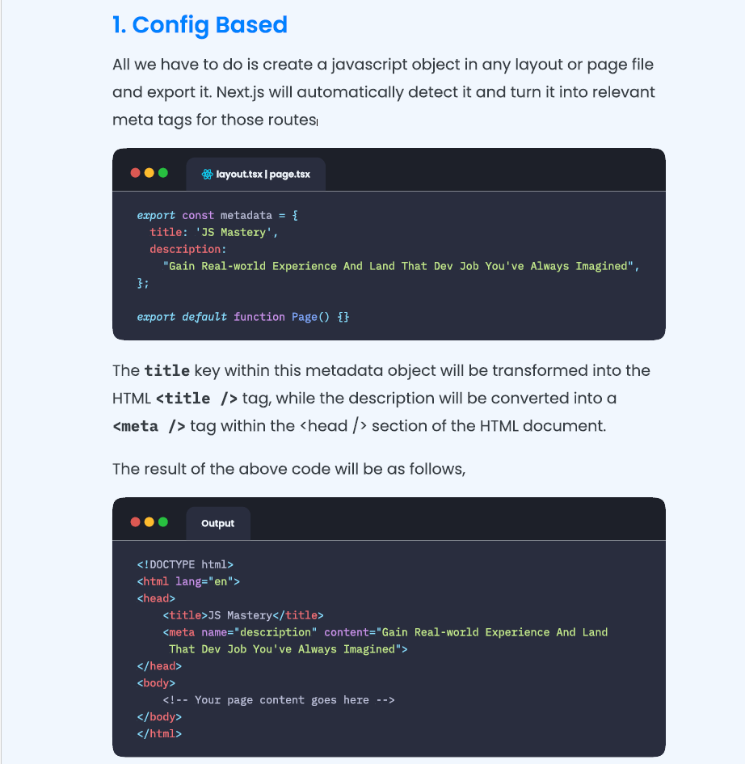
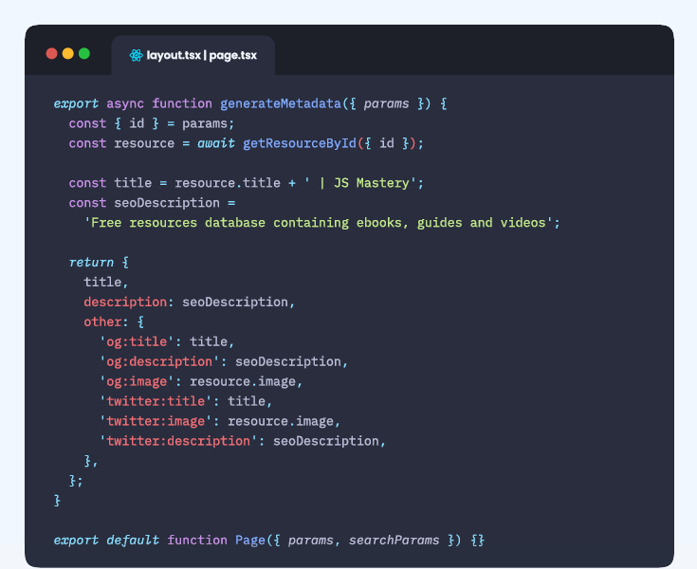
Dynamic Metadata
If there are dynamically generated pages, i.e., dynamic routes, that we
want search engines to index—which is a best practice—we can use the generateMetadata function in Next.js to produce metadata specifically tailored for these pages.

Slide 3
