Slide 1
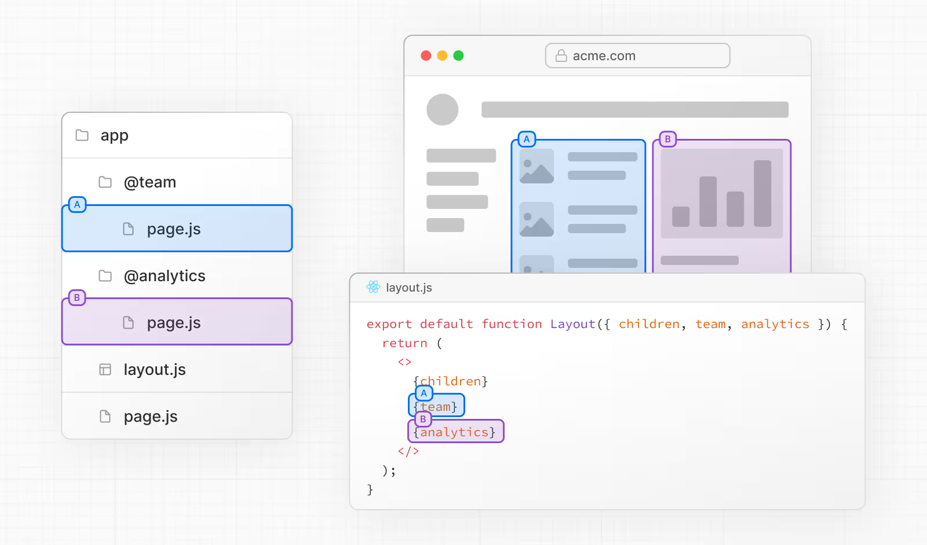
Parallel Routes
Parallel Routes allows you to simultaneously or conditionally render one or more pages within the same layout.
They are useful for highly dynamic sections of an app, such as dashboards and feeds on social sites.
For example, considering a dashboard, you can use parallel routes to simultaneously render the team and analytics pages:
Slots
Parallel routes are created using named slots.
Slots are defined with the @folder convention.
For example, the following file structure defines two slots: @analytics and @team:
export default function Layout({ children, team, analytics }) {
return (
<>
{children} {team} {analytics}
</>
)
}
However, slots are not route segments and do not affect the URL structure. For example, for /@analytics/views, the URL will be /views since @analytics is a slot. Slots are combined with the regular Page component to form the final page associated with the route segment. Because of this, you cannot have separate static and dynamic slots at the same route segment level. If one slot is dynamic, all slots at that level must be dynamic.

Slide 3
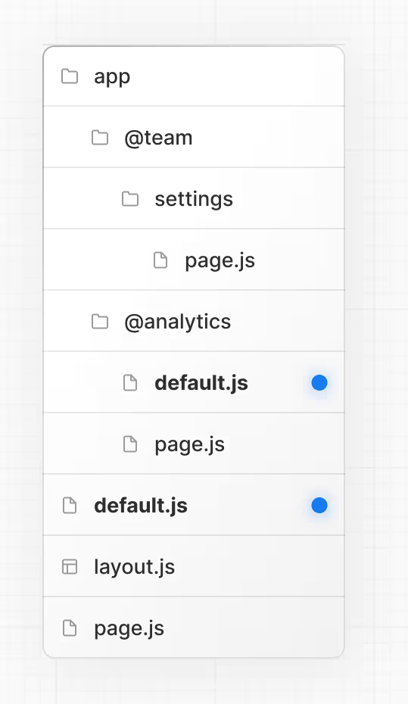
Active state and navigation
By default, Next.js keeps track of the active state (or subpage) for each slot. However, the content rendered within a slot will depend on the type of navigation:
Soft Navigation: During client-side navigation, Next.js will perform a partial render, changing the subpage within the slot, while maintaining the other slot's active subpages, even if they don't match the current URL.
Hard Navigation: After a full-page load (browser refresh), Next.js cannot determine the active state for the slots that don't match the current URL. Instead, it will render a default.js file for the unmatched slots, or 404 if default.js doesn't exist.
default.js
When navigating to /settings, the @team slot will render the /settings page while maintaining the currently active page for the @analytics slot.
On refresh, Next.js will render a default.js for @analytics. If default.js doesn't exist, a 404 is rendered instead.
Additionally, since children is an implicit slot, you also need to create a default.js file to render a fallback for children when Next.js cannot recover the active state of the parent page.
You can define a default.js file to render as a fallback for unmatched slots during the initial load or full-page reload.
Consider the following folder structure. The @team slot has a /settings page, but @analytics does not.

