Slide 1
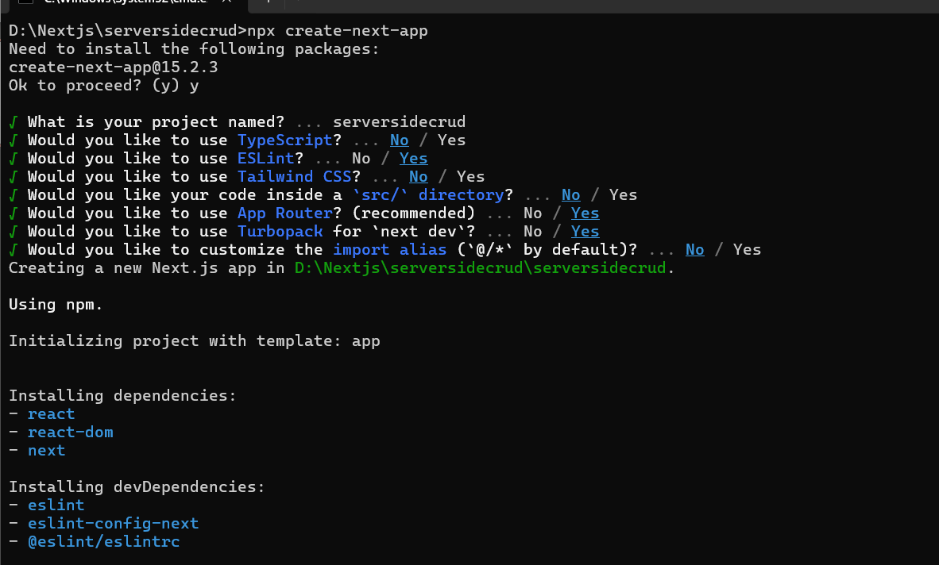

Slide 2
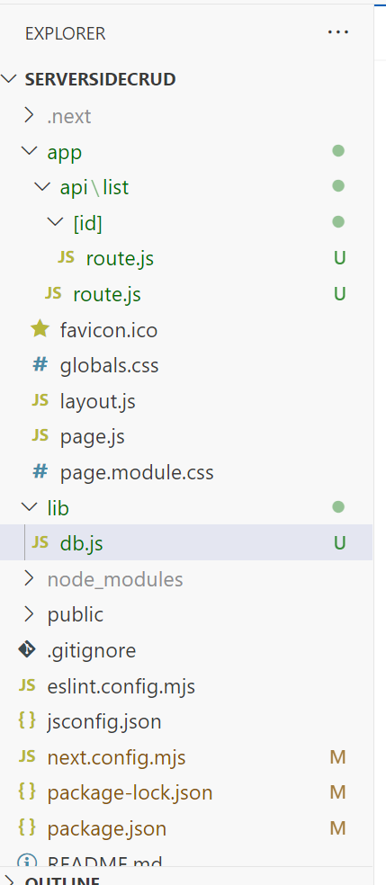
import mysql from "mysql2/promise";
export default async function query({ q, values = [] }) {
const dbconnection = await mysql.createPool({
host: process.env.MYSQL_HOST,
post: process.env.MYSQL_PORT,
database: process.env.MYSQL_DATABASE,
user: process.env.MYSQL_USER,
password: process.env.MYSQL_PASSWORD,
});
try {
console.log('.......'+q);
const [results] = await dbconnection.execute(q, values);
console.log(results);
dbconnection.end();
return results;
} catch (error) {
throw Error(error.message);
}
}

Slide 3
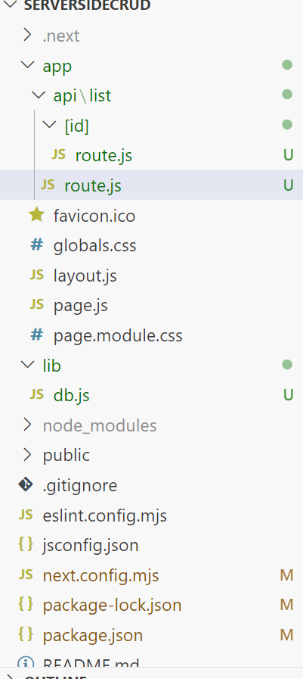
import { NextResponse } from 'next/server’;
// Import NextResponse for Next.js API response handling
import query from '../../../lib/db’;
// Assuming db is configured correctly for your MySQL setup
export async function GET() {
try {
// Fetch all posts from the 'product' table (ensure db query is correct)
const allPosts = await query({q:'SELECT * FROM product'});
console.log(allPosts);
// Return posts as a JSON response with status 200
return NextResponse.json(allPosts, { status: 200 });
} catch (error) {
// Handle errors if the query fails
console.error('Error fetching posts:', error);
// Return an error response with status 500
return NextResponse.json({ error: 'Failed to fetch posts' }, { status: 500 });
}
}

Slide 4
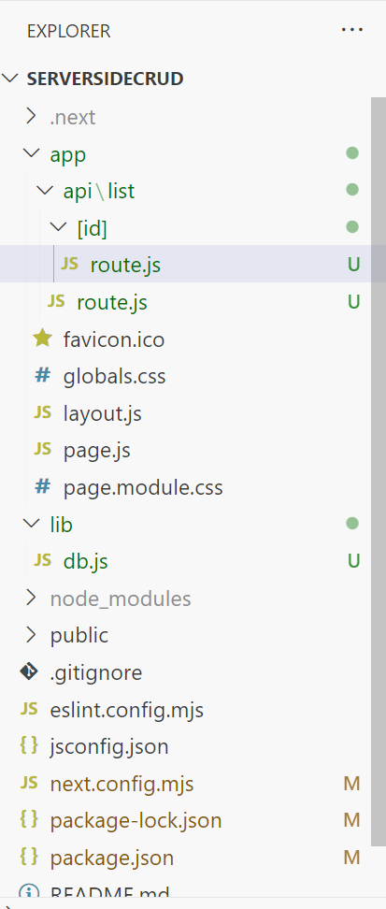
import { NextResponse } from 'next/server’;
// Import NextResponse for Next.js API response handling
import query from '../../../../lib/db’;
// Assuming db is configured correctly for your MySQL setup
export async function GET(request,{params}) {
try {
// Fetch all posts from the 'product' table (ensure db query is correct)
const allPosts = await query({q:'SELECT * FROM product where id = ? ',values:[params.id]});
console.log(allPosts);
// Return posts as a JSON response with status 200
return NextResponse.json(allPosts, { status: 200 });
} catch (error) {
// Handle errors if the query fails
console.error('Error fetching posts:', error);
// Return an error response with status 500
return NextResponse.json({ error: 'Failed to fetch posts' }, { status: 500 });
}
}

