Slide 1

Rotating Blocks: A Visual Tetris Puzzle Game
Team_No: 6
Sl. No. | Reg. No. | Name of the student
1 | BL.EN.U4CSE21162 | Prabhav Ravi Tammanashastri
2 | BL.EN.U4CSE21200 | Suhas S Bhat
3 | BL.EN.U4CSE21220 | Vijayakumar Soorya

Slide 2
Introduction
S
The project revitalizes the classic 1984 puzzle game, Tetris, by leveraging modern technologies like artificial intelligence (AI) and machine learning to enhance gameplay.
Using Unity ML-Agents Toolkit, intelligent agents are developed to learn, adapt, and dynamically improve their strategies through reinforcement learning.
Features like adaptive difficulty scaling and rotating blocks add complexity, providing a fresh and challenging gameplay experience while maintaining Tetris's timeless appeal.

Slide 3
Problem Statement
S
The absence of AI-driven elements in Tetris Game limits the potential for intelligent opponents and real-time difficulty scaling.
Players seek personalized, challenging experiences that combine strategy, reflexes, and visual appeal. Current versions fail to leverage advancements in AI and machine learning to enhance interactivity and gameplay.
This creates a need for reimagining Tetris with innovative technologies to modernize its appeal while preserving its classic charm.

Slide 4
Literature Survey
S
Name | Authors | Inference | Future Work
A multi-agent specification for the Tetris game. | Mar´ın-Lora, C., Chover, M., Sotoca, J. M (2022) | Establishes the study that games that permits the production of games as multi-agent systems | Gives Birth to Idea of being dependent on AI instead of manual control
Measuring control to dynamically induce flow in Tetris. | Lora-Ariza, D. S., S´anchez-Ruiz, (2022) | Dynamic difficulty adjustment (DDA) techniques are employed to adapt video game difficulty based on player performance | Idea of case-instance based reasoning instead of human thinking can be explored
Comparison of Game Playing AI Algorithms in Puyo Puyo Tetris. | Iwai, H., Sato, K., Alparslan, O (2024, August). | Algorithms which predict multiple moves ahead using DDA outperformed traditional methods. | Case Based Reasoning sees more necessity in evolving Times
Augmenting automated game testing with deep reinforcement learning. | Bergdahl, J., Gordillo, C., Tollmar, K., & Gisslén, L. (2020, August). | Deep Reinforcement Learning is used to detect frequent issues that occur during the game testing and to expand test details , find targeted weak spots, and mapping complexity. | DRL can be used to enhance and modernize Traditional Games like TicTacToe and Hangman

Slide 5
Literature Survey
P
Name | Authors | Inference | Future Work
Deep rein- forcement learning in immersive virtual reality exergame for agent movement guidance | Elor, A., Kurniawan, S. (2020, August) | Generative Adversarial Imitation Learning and Proximal Policy Optimization are used for better understanding of Game Dynamics | Gives Birth to Idea of being dependent on AI instead of manual control
Build- ing your kingdom imitation learning for a custom gameplay using unity ml-agents | Youssef, A. E., El Missiry, S., El-gaafary, I. N., ElMosalami, (2019) | Every player imprints his behavior on the clone through the use of imitation learning and reduces the amount of training data required and the computational time | Different agents may require Different AI Frameworks
Unity ML-Agents: Revolutionizing Gaming Through Reinforcement Learning | Raut, U., Galchhaniya, P., Nehete, A., (2024, July) | Allows developers to produce non-player characters (NPCs) that present unique and tailored challenges to gamers. | Agents can have their own Personality, their own states, their own actions etc

Slide 6
Literature Survey
P
Name | Authors | Inference | Future Work
RL-based Control of Smart Base Isolation System Using Unity ML-Agents. | Kim, H. S., Kang, J. W.(2024). | The results demonstrate that the Unity game engine may effectively be used to generate an RL environment for structural dynamic systems by appropriately presenting the dynamic responses | This Prompts people to give more open world gaming
Training unity machine learning agents using re- inforcement learning method | Urmanov, M., Alimanova, M., Nurkey, A (2019) | Outcomes of training machine learning agents depend heavily on a number of factors, including hyperparameter setting, environment rules, reward and penalty design, and training time. | The Game should be modelled more keeping all stakeholders with good humour.
Development of deep-learning-based autonomous agents for low-speed maneu- vering in Unity. | Berta, R., Lazzaroni, L., Capello, (2024). | Because high-level notions (such as obstacle avoidance) are abstracted, the agent must be trained in environments that are sufficiently complex s using ML Agents toolkit | Development with better Fine Tuning and better user accessible features and deployment of the Unity Game

Slide 7
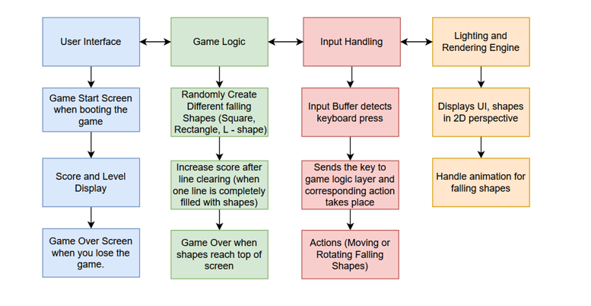
Architecture
P

Slide 8
Methodology
P
Board.cs
Clear Separation of Concerns:
The script separates functionality like spawning pieces, clearing lines, updating scores, and handling game-over logic effectively.
UI Integration:
The use of TextMesh Pro UGUI for score, level, and high score display ensures compatibility with modern UI systems in Unity.
Modularity:
Functions like IsValidPosition, ClearLines, and LineClear are self-contained, making the code easy to read and debug.
Audio Integration:
Line-clearing sound effects add an immersive element to the game.
Notes:
1. IsValidPosition
Validates if a tetromino can be placed in a specific position without colliding or going out of bounds by iterating through its cells.
2. ClearLines
Checks for full lines within the board, clears them, shifts rows downward, updates the score, and plays audio.
3. LineClear
Clears all tiles in a specific row and shifts the rows above it downward to fill the cleared space.
TextMesh Pro UGUI is a Unity component for rendering crisp, highly customizable text within the UI system, offering better performance and styling options than the default Text component.

Slide 9
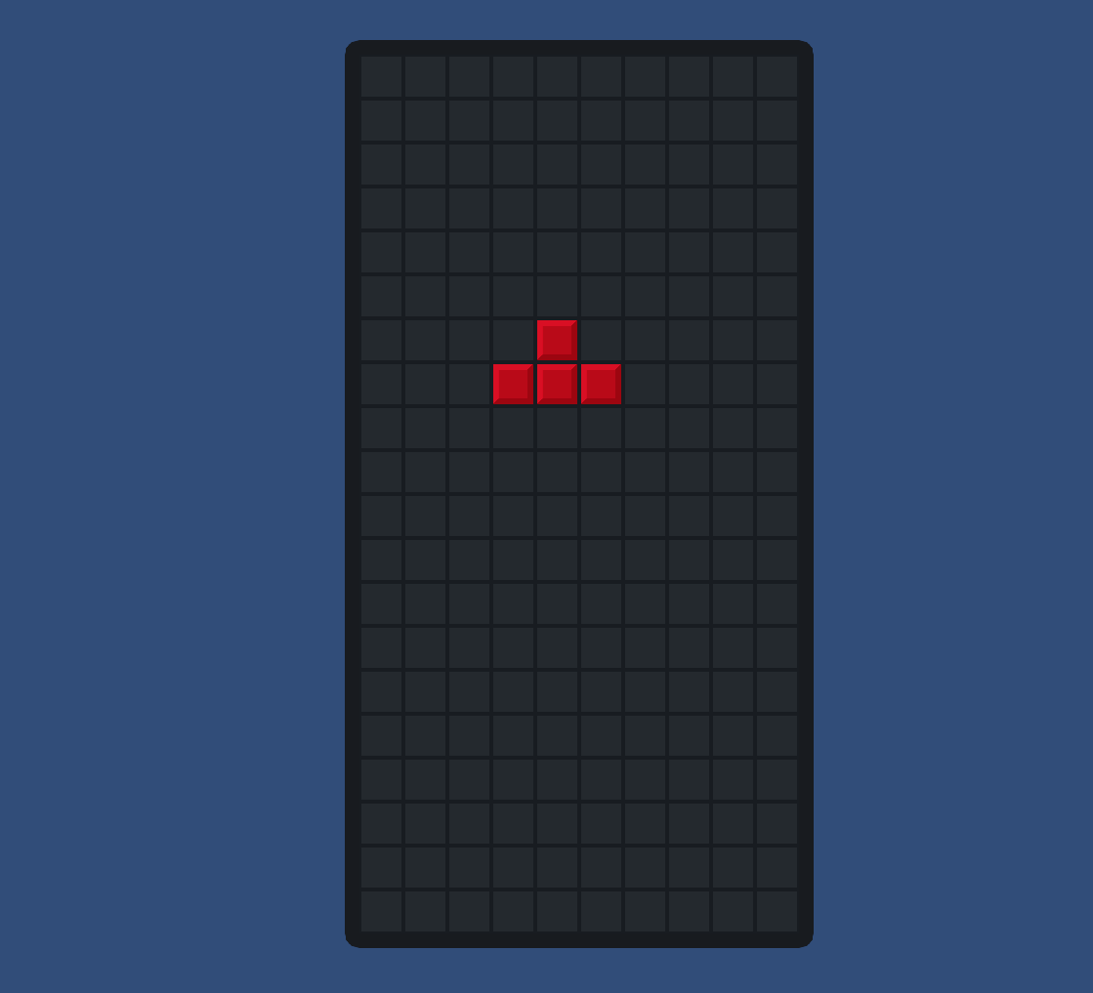
Methodology
P
Board.cs
Notes:
1. IsValidPosition
Validates if a tetromino can be placed in a specific position without colliding or going out of bounds by iterating through its cells.
2. ClearLines
Checks for full lines within the board, clears them, shifts rows downward, updates the score, and plays audio.
3. LineClear
Clears all tiles in a specific row and shifts the rows above it downward to fill the cleared space.
TextMesh Pro UGUI is a Unity component for rendering crisp, highly customizable text within the UI system, offering better performance and styling options than the default Text component.

Slide 10
Methodology
P
Piece.cs
Initialization and Management:
Handles initialization of a tetromino's data, position, and rotation.
Movement and Rotation:
Enables left, right, down movement, and rotations, ensuring validity using wall kicks and board constraints.
Stepping and Locking:
Automatically moves the piece down periodically, locking it in place if no further downward movement is possible.
Hard Drops:
Instantly places the piece at the lowest possible valid position.
Wall Kicks and Rotation Matrix:
Ensures pieces fit even when rotations cause collisions, adjusting their position using predefined offsets.
Notes:
ApplyRotationMatrix
Rotates each cell of the piece using a predefined rotation matrix based on its type.
TestWallKicks
Tests translations (wall kicks) to find a valid position for the rotated piece.
GetWallKickIndex
Retrieves the correct wall kick offset index based on the current and next rotation.
Wrap
Keeps rotation indices within bounds by wrapping them around the valid range.

Slide 11
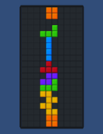
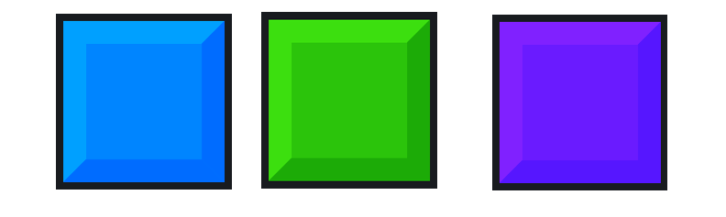
Methodology
P
Piece.cs
Notes:
ApplyRotationMatrix
Rotates each cell of the piece using a predefined rotation matrix based on its type.
TestWallKicks
Tests translations (wall kicks) to find a valid position for the rotated piece.
GetWallKickIndex
Retrieves the correct wall kick offset index based on the current and next rotation.
Wrap
Keeps rotation indices within bounds by wrapping them around the valid range.

Slide 12
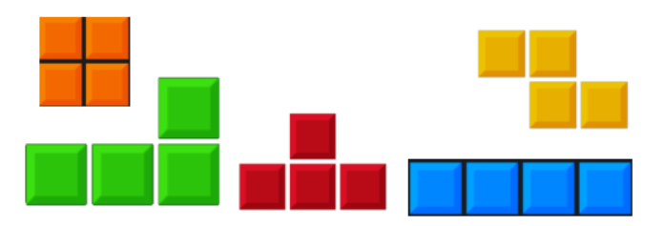
Methodology
P
Tetromino.cs
Defines Tetromino Types:
Enumerates the different types of Tetris shapes
Holds Data for Each Tetromino:
Encapsulates tile representation, shape configuration, and wall kick offsets.
Initialization:
Prepares tetromino-specific cell positions and wall kick data for gameplay.

Slide 13
Methodology
S
MainMenu.cs
PlayGame
Loads the gameplay scene named "SampleScene" when called.
Exit Game
Closes the application and logs an exit message for debugging in the Unity editor.
Data.cs
Rotation Handling:
The Rotation Matrix and wall kick data ensure smooth Tetromino rotation and valid positioning on the board.
Shape Definitions:
The Cells dictionary provides a blueprint for each Tetromino's initial configuration.
Wall Kicks:
When rotation causes a collision, the wall kick adjustments reposition the Tetromino to a valid spot.

Slide 14
Methodology
S
Implementing ML Agents in Unity:
Go to package manager and download version of ML Agents corresponding to unity editor version and python version
Install pytorch for implementing reinforcement learning algorithms
Create a tetris_config.yaml file that will store model parameters
Run in command line :
mlagents-learn tetris_config.yaml —run-id=test1
Play in Unity Editor

Slide 15
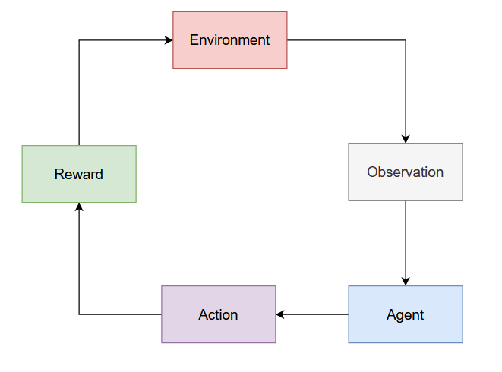
RL Training Loop

Slide 16
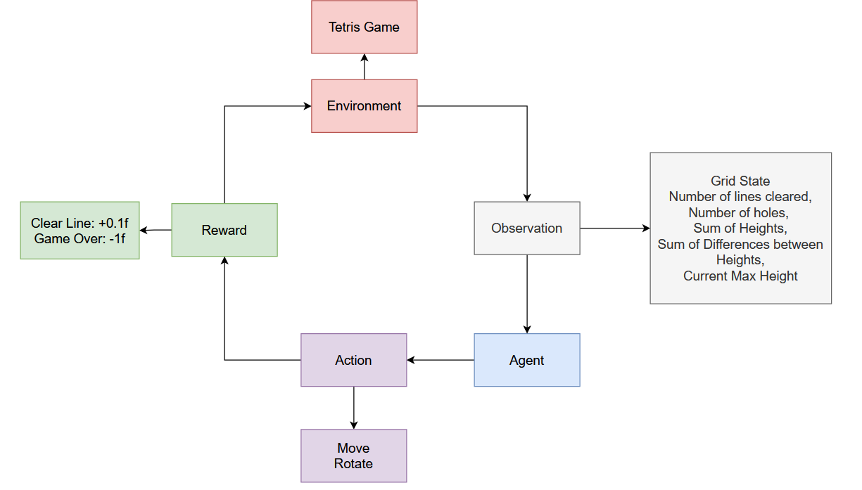
RL Training Loop

Slide 17
RL Algorithm
Proximal Policy Optimization Algorithm:
Model free : Learns from interacting with the environment to discover optimal decision
Policy Based : Finds which action the agent should take
On Policy Algorithm : Learns from the policy it is currently using
Neural Network Based
Works well for video games, robotics and autonomous driving cars.

Slide 18
RL Algorithm Hyperparameters
Tetris_config.yaml
trainer_type: ppo
hyperparameters:
batch_size: 128
buffer_size: 4096
learning_rate: 3.0e-4
num_epoch: 3
network_settings:
normalize: true
hidden_units: 128

Slide 19
Hyperparameters
reward_signals:
extrinsic:
gamma: 0.99
threaded: true
max_steps: 5.0e5
checkpoint_interval: 50000

Slide 20
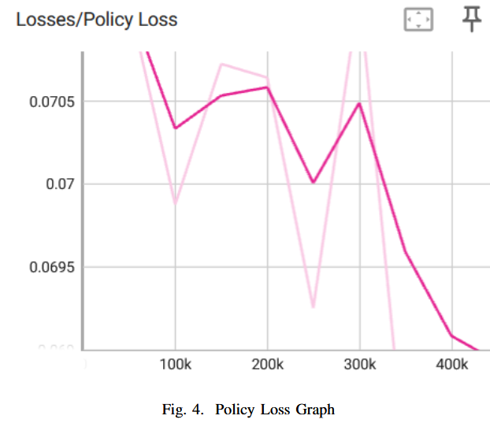
Results and Analysis

Slide 21
Results and Analysis

Slide 22
Conclusion
The integration of core Tetris mechanics in Unity, combined with reinforcement learning, creates a dynamic and engaging gameplay experience. The scripts—Piece.cs, Board.cs, Tetromino.cs, and Data.cs—work together to ensure smooth gameplay, line clearing, game-over handling, and intelligent AI. The use of reinforcement learning enhances the AI’s adaptability, making the game more challenging and rewarding. For future work, further optimization of the AI's learning process could be explored, potentially integrating advanced neural networks. Additionally, expanding the game features with multiplayer capabilities and enhanced graphics would enrich the overall player experience.

Slide 23
THANK YOU

