Slide 1
Supply Chain Ontology & Governed Conversational Analytics
CoCo CLI Hackathon GCC Edition — Prototype Presentation
One Ontology. One Answer. Any Persona.
Author: Prabhjot Kaur (Solo) | Platform: Snowflake + CoCo CLI (Built 100% with CoCo)
System Blueprint Inventory: 52+ Snowflake Objects | 4 Cortex Agents | 5 Reusable Skills | 3 MCP Servers | 3 Automations

Slide 2
The Problem: Fragmented Logic vs. Governed Ontology
The Operational Chaos (Before)
• Same Question, Different Answers: Supply chain teams (procurement, planning, logistics) query the same underlying raw data tables but calculate core metrics inconsistently.
• Spreadsheet Silos: Metrics like OTD%, Fill Rate, DOI, and Landed Cost get computed via localized spreadsheets, customized BI definitions, or disjointed ad-hoc SQL.
• Standup Friction: Conflicting analytics reports force alignment arguments during every operational standup meeting.
• Manual Waste: 30 to 60 minutes spent on manual report compilation every single morning per operational team.
• Lack of Orchestration: Zero enterprise-wide alerts and zero centralized governance rules.
Target Audience Persona Needs
• Procurement Manager: Tracks supplier scorecards, long-term landed cost movements, critical material reorder points, and automated write-actions for purchase order logs with explicit justification parameters.
• Planning Analyst: Oversees system-wide inventory asset health, demand projection timelines driven by integrated ML forecasting code, fulfillments risk scoring matrices, and part gap logic charts.
• Logistics Coordinator: Inspects transit tracking data feeds, routes delay flags, computes carrier on-time thresholds, and directly fires operational shipment expedite commands linked across Jira and Slack systems.

Slide 3
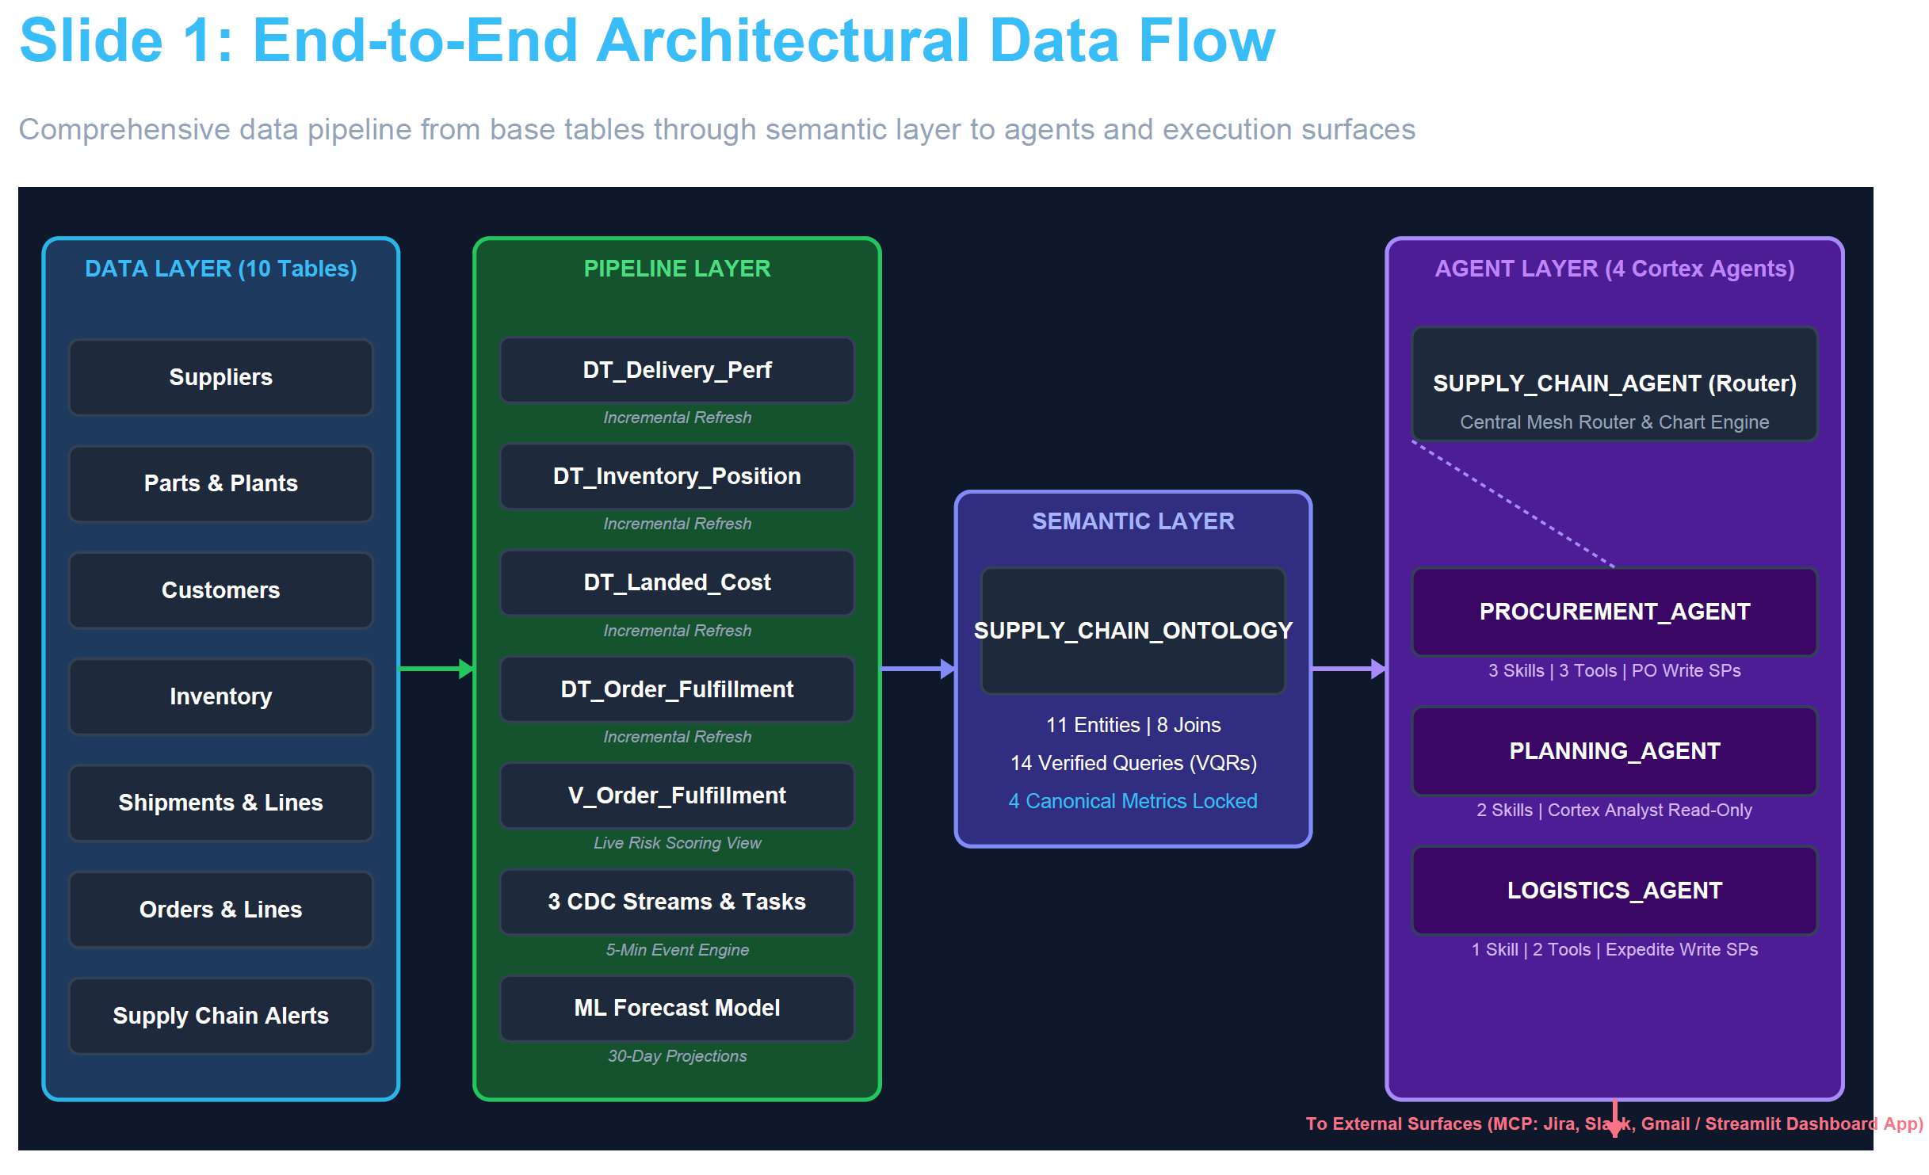

Slide 4
Architecture Step 1: Base Tables & Modern Audit Design
System Data Layer Composition (9 Functional Base Tables + 1 Alert Sink)
• Master Reference Catalog (4 Tables): SUPPLIERS (Name, country, baseline lead time, master quality metric), PARTS (SKU metadata catalog, category grouping, standard unit material cost, weight), PLANTS (Manufacturing footprints, distribution warehouses, operational capacities), and CUSTOMERS (Global customer registry, market segments, target regions).
• Operational Tracking Layer (5 Tables): SHIPMENTS (Header-level logistics log, transport mode, carrier tracking data), SHIPMENT_LINES (Line-level breakdown, item mapping, inbound quantities), ORDERS (Customer request headers, booking timestamps, priority levels), ORDER_LINES (Requested SKUs, pricing allocations, delivery status fields), and INVENTORY (Real-time storage status, quantity on hand, baseline safety levels).
• Operational Alert Sink (1 Table): SUPPLY_CHAIN_ALERTS (Tracks system-generated exceptions, alert types, execution states, upstream record links, and Jira reference IDs).
Strategic Design Choice: Eliminating Over-Engineered Logging Overheads
• Rejected Architecture Strategy: Deploying 9 concurrent streams, 9 capture tasks, and 1 massive custom master audit table to parse change data loops across all tables universally.
• The Flaw: Over-engineered and heavy. Master catalogs scale slowly and change rarely. Constructing continuous structural CDC code here creates unnecessary compute and maintenance costs.
• Selected Split Data Strategy: Leverage native Snowflake cloud features directly based on data profile categories without writing custom pipelines.
• Master Data Governance: Managed automatically via built-in Access History tracking (365 days retention). Captures query and mutation logs without managing pipeline configurations.
• Operational Data Governance: Handled completely via standard 90-day Time Travel retention boundaries, covering the operational lifecycle of orders and shipments flawlessly.

Slide 5
Architecture Step 2: Dynamic Tables & Refresh Modes
The 4 Pre-Aggregated Analytical Dynamic Engines
• DT_DELIVERY_PERF: Blends SHIPMENTS, SUPPLIERS, and PLANTS. Materializes OTD%, lead time metrics, and supplier late counts.
• DT_ORDER_FULFILLMENT: Blends ORDERS, ORDER_LINES, INVENTORY, CUSTOMERS, and PLANTS. Exposes base fill rate patterns and raw coverage timelines.
• DT_INVENTORY_POSITION: Integrates INVENTORY, PARTS, PLANTS, and ORDER_LINES. Exposes Days of Inventory (DOI), and highlights active reorder flags.
• DT_LANDED_COST: Merges SHIPMENTS, SHIPMENT_LINES, PARTS, SUPPLIERS, and PLANTS. Resolves total cost (Material + Freight share + Duty estimations).
Crucial Design Decision: Refresh Mode Optimization
• Rejected Pattern: Keeping time-dependent code like CURRENT_DATE() directly inside internal dynamic table definitions.
• The Trap: Pushing CURRENT_DATE() inside complex CTE joins blocks INCREMENTAL refresh logic. Snowflake defaults to a FULL refresh layout, which blocks stream deployment over dynamic tables.
• Selected Pattern: Extract time-dependent calculations out of the dynamic layer entirely. Standardize on REFRESH_MODE = INCREMENTAL with a 1-hour target lag constraint across all 4 dynamic engines.
• The Solution: Pushed live risk scoring calculations up into an adjacent view layer (V_ORDER_FULFILLMENT). Rows evaluate on-the-fly at query time while the underlying tables refresh incrementally and support downstream change tracking streams.

Slide 6
View Architecture: Live Multi-Factor Risk Scoring Engine
V_ORDER_FULFILLMENT Layer: Building the Composite 0-12 Risk Metric Matrix
• Factor 1: Stock Coverage Days ➔ Score 0 if >14 days | Score 1 if 7-14 days | Score 2 if 3-7 days | Score 3 if <3 days.
• Factor 2: Fulfillment Ratio ➔ Score 0 if ≥90% | Score 1 if 50-89% | Score 2 if 1-49% | Score 3 if 0%.
• Factor 3: Inbound Shipment Transit Health ➔ Score 0 if Early/On-Time | Score 1 if On-Schedule In-Transit | Score 2 if Late 1-3 days | Score 3 if Late 4+ days or missing upstream links.
• Factor 4: Urgency Timeline ➔ Score 0 if >14 days remaining | Score 1 if 7-14 days | Score 2 if 3-7 days | Score 3 if <3 days or past due status.
Risk Level Classifications & Action Threshold Triggers
• LOW RISK (Total Score 0-2): Order execution tracks completely on schedule. Normal continuous tracking, no flags.
• MEDIUM RISK (Total Score 3-5): Early exception warning patterns detected. System registers warning flags and updates monitoring dashboard logs.
• HIGH RISK (Total Score 6-8): Delayed order resolution highly probable. Triggers manual validation request and flags immediate remediation path.
• CRITICAL RISK (Total Score 9-12): Material stockout certain without intervention. Triggers downstream multi-step task loops and automates alerting vectors.

Slide 7
Architecture Step 3: Minimalist Event-Driven Alert Pipeline
Operational Stream Strategy (Reduced from 9 Streams down to 3 Target Streams)
• STREAM_SHIPMENTS (Deployed on SHIPMENTS): Watches operational logistics changes; isolates route delays or carrier adjustments.
• STREAM_INVENTORY (Deployed on INVENTORY): Catches material drawdowns; fires instantly when stock levels breach localized safety bounds.
• STREAM_ORDER_RISK (Deployed on DT_ORDER_FULFILLMENT): Captures algorithmic calculations; logs changes when an order flips to High or Critical.
Targeted Automation Task Strategy (3 Dedicated Operational Action Components)
• TASK_SHIPMENT_DELAY_ALERT: Consumes STREAM_SHIPMENTS data. Polls every 5 minutes using SYSTEM$STREAM_HAS_DATA. Pushes immediate exception summaries directly to Slack channel vectors and triggers the automated shipment expedite workflow.
• TASK_INVENTORY_LOW_ALERT: Consumes STREAM_INVENTORY data. Evaluates part constraints against reorder points and automatically signals the procurement agent to initialize material sourcing analysis playbooks.
• TASK_ORDER_RISK_ALERT: Consumes STREAM_ORDER_RISK records. Inspects live views to extract high-risk scores and inserts structured exceptions into SUPPLY_CHAIN_ALERTS to link downstream Jira tickets.

Slide 8
The Governance Backbone: SUPPLY_CHAIN_ONTOLOGY
Structural Integration: 11 Entities, 8 Strategic Relationships, and 4 Canonical Metrics
• Metric 1: On-Time Delivery % (OTD%) ➔ Formula: SUM(on_time_count) * 100.0 / NULLIF(SUM(total_shipments), 0) | Source: DT_DELIVERY_PERF
• Metric 2: Fill Rate % ➔ Formula: SUM(fulfilled_quantity) / SUM(ordered_quantity) * 100.0 | Source: DT_ORDER_FULFILLMENT
• Metric 3: Days of Inventory (DOI) ➔ Formula: on_hand_quantity / daily_demand_calculation | Source: DT_INVENTORY_POSITION
• Metric 4: Landed Cost per Unit ➔ Formula: material_cost_base + freight_allocation + estimated_duty_charges | Source: DT_LANDED_COST
Implementation Pattern: SYSTEM$CREATE_SEMANTIC_VIEW_FROM_YAML (868 Lines)
• Single Definition Lock: Canonical metrics are compiled directly within the semantic layer framework. No client application or sub-agent can override calculation code dynamically.
• Logical Routing Engine: Translates standard text inputs directly into query constraints. Point queries for past data target structural base tables, while complex analytics route to dynamic tables.
• Abstracted Business Vocabulary: Completely strips out cryptic database column syntax. Translates underlying physical names into plain business concepts like 'Carrier Performance' or 'Landed Overheads'.

Slide 9
Semantic Guardrails: 14 Verified Query Records (VQRs)
Pre-Validated Question-to-SQL Mappings to Prevent Silent Calculation Hallucinations
• Core Metric Group (1-4): Explicit templates tracking supplier OTD lookups, plant fill rate percentages, precise double-filtering for part-plant DOI evaluations, and 3-component total landed cost math calculations.
• Threshold Trigger Group (5-8): Mappings protecting intent phrases like 'at risk orders' (maps to High/Critical states), 'parts needing reorder' (maps to reorder_point bounds), and complex mathematical filters like DOI values dropped below 3 days.
• Time-Series Horizon Group (9-10): Pre-built monthly grouping aggregations protecting trend timelines across moving multi-month horizons for both supplier delivery history and plant fulfillment lines.
• Cross-Domain Group (11-14): Validated schemas managing complex multi-table joins. Enforces exact join conditions for mixed questions like comparing supplier costs against delivery metrics, or matching late shipments to open orders.
Cortex Analyst Resolution Priority Hierarchy
• Priority 1 ➔ Exact VQR Structure Match: Emits pre-validated, hand-shake SQL code with absolute mathematical precision.
• Priority 2 ➔ Dynamic Semantic View Synthesis: Generates dynamic SQL logic using defined dimensions, measures, and entity relationships.
• Priority 3 ➔ Out-of-Scope Safe Refusal: If requests stray outside semantic boundaries, the engine returns a clean notification rather than inventing text.

Slide 10
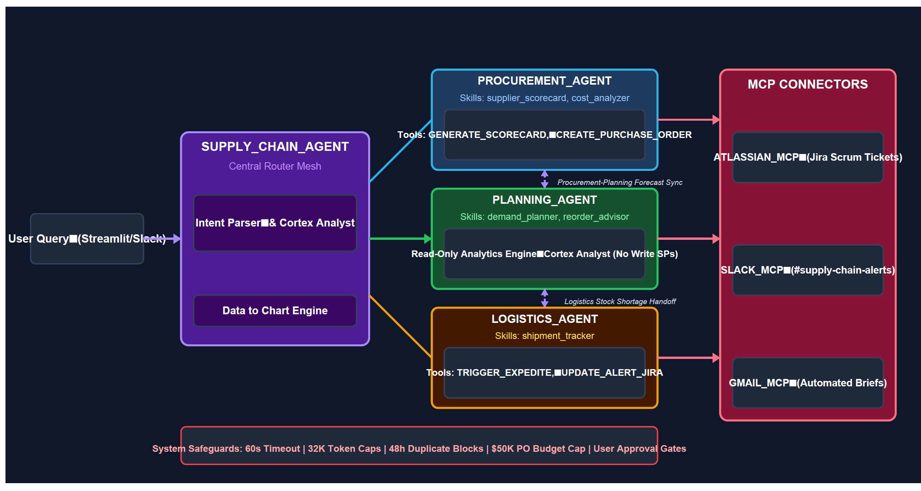

Slide 11
Multi-Agent Architecture: Primary Router Framework
SUPPLY_CHAIN_AGENT: Central Orchestrator & Smart Routing Mesh
• The Central Interface: Serves as the primary touchpoint for all user requests, parsing intents and maintaining data visibility.
• Core Capabilities: Resolves data-lookup requests directly using Cortex Analyst and renders data visualizations with data_to_chart tools.
• Smart Delegation Strategy: Holds zero internal skills directly. Delegates deep analytical queries down to specialized domain sub-agents via integrated agent_toolset routing logic.
• System Constraints: Enforces 60-second runtime ceilings and 32,000 token boundaries. Uses tool_not_accessible = ACCEPT to support graceful fallback if users lack underlying access roles.
Specialized Handoff Scenarios
• Logistics to Procurement Transition: When a shipment risk assessment isolates an underlying stock shortage rather than an expected transit delay, the Logistics sub-agent hands off tracking data directly to the Procurement reorder workflow.
• Procurement to Planning Transition: When bulk reorder evaluations require forward-looking projections, the Procurement agent queries the Planning sub-agent to fetch ML demand forecast intervals.

Slide 12
Domain-Specific Sub-Agents & Capability Profile
PROCUREMENT_AGENT (Sourcing & Financial Guardrails)
Owns 3 specialized skills (supplier_scorecard, cost_analyzer, reorder_advisor) and executes 3 database write procedures (GENERATE_SCORECARD, CREATE_PURCHASE_ORDER, UPDATE_SUPPLIER_RATING). Tracks cost optimization metrics, validates supplier capacities, and routes directly to Jira, Gmail, and Slack systems.
PLANNING_AGENT (Demand Forecasting & Inventory Optimization)
Analytics-focused specialist. Contains zero database write permissions. Evaluates inventory parameters using 2 core skills (demand_planner, reorder_advisor). Connects directly to Cortex Analyst and interacts externally via Slack channel connections.
LOGISTICS_AGENT (In-Transit Tracking & Operational Remediation)
Logistics remediation engine. Tracks transport routes via the shipment_tracker skill. Calls 2 write-back procedures (TRIGGER_EXPEDITE, UPDATE_ALERT_JIRA) to update records, initialize tracking tickets via Jira, and send Slack notifications.

Slide 13
Modular Architecture: Reusable Stage-Hosted Skills
Declarative Playbook Strategy (Markdown Files Hosted Globally on SKILL_STAGE)
• supplier_scorecard: Instructs agents to evaluate vendor delivery histories. Pulls composite data structures from GENERATE_SCORECARD UDF, automatically ranks candidate vendors, and flags poor performers.
• cost_analyzer: Drives granular material cost deep-dives. Breaks unit costs into raw material, freight allocations, and destination country duties. Cross-references quality data to map a clear value-metric matrix.
• demand_planner: Manages forecasting engine calls. Pulls statistics from the multi-series Snowflake ML model, extracts trend angles, detects seasonality, and implements strict training data anomaly filters.
• reorder_advisor: Connects complex workflows. Scans stock gaps, queries demand predictions, reviews vendor options, evaluates budget constraints, and compiles editable purchase order proposals.
• shipment_tracker: Monitors global logistics execution. Classifies moving shipments into 4 risk tiers, models delays using carrier history, and drives the system expedite pipeline for critical transit failures.
Structural Distinction: Skills vs. Custom Tools
• Playbook Skills (Flexible Thinking Framework): Markdown files that define analytical playbooks. They teach agents how to process complex conditions and structure recommendations step-by-step.
• Custom Tools (Deterministic Code Blocks): Registered Snowflake stored procedures and UDFs with strict input constraints. They manage database writes and interface mutations safely and predictably.

Slide 14
Custom Tools & Writing Logic with Guardrails
The 5 Stored Procedures & UDF Components
• GENERATE_SCORECARD (UDF): Read-only logic block. Computes a multi-factor vendor score (40% On-Time Delivery performance, 30% item quality rating, 30% landed cost positioning).
• CREATE_PURCHASE_ORDER (Stored Procedure): Validates part registries, checks vendor limits, runs quantity checks, enforces budget limits ($50K cap), and logs new orders into physical data rows.
• TRIGGER_EXPEDITE (Stored Procedure): Unified logistics tool. Modifies transport priority codes, populates tracking timestamps, logs alerts, and calls external systems via MCP vectors.
• UPDATE_SUPPLIER_RATING (Stored Procedure): Adjusts vendor tiers. Implements strict bounds (max 1-tier adjustment per execution) and logs manual overrides with text tracking fields.
• UPDATE_ALERT_JIRA (Stored Procedure): Database-to-ticket mapper. Matches fresh engineering issue keys back to active exceptions in SUPPLY_CHAIN_ALERTS to maintain complete lifecycle tracking.
Deep Dive: End-to-End Transit Expedite Workflow Execution Mechanics
Step 1: System Identification ➔ The agent runs the shipment_tracker skill to flag transport delays and isolate order risk impacts.
Step 2: Guardrail Evaluation ➔ Validates record states, enforces a 48-hour duplicate block, and checks the 3-escalation limit constraint.
Step 3: Interface Confirmation ➔ Presents the entire operational proposal to the user, blocking execution until receiving explicit approval.
Step 4: Database Update ➔ Executes the stored procedure to update row priorities and log active rows into the internal exceptions database.
Step 5: Jira Issue Projection ➔ Calls ATLASSIAN_MCP to construct an engineering tracking issue and routes it based on issue type.
Step 6: Real-Time Team Alerting ➔ Links tracking metrics across Slack channels and auto-closes tickets when material deliveries are logged.

Slide 15
Role-Based Access Control & Column Masking Matrix
Security Split Design Choice: Base Masking over Fragmented Views
• Rejected Security Design: Constructing hundreds of individual role-specific views (e.g., 3 separate filtered views per table) to split user access boundaries.
• The Flaw: Creates massive object overhead (~39 extra views) and fragments semantic architectures, forcing maintenance code updates whenever base rules change.
• Selected Security Design: Standardize on 5 native column masking policies deployed directly onto physical base tables and analytical dynamic engines.
• The Logic: Snowflake manages data access security at the engine level. The semantic model maps to the same central database for all users, maintaining structural consistency automatically.
The 5 Engine-Level Masking Policies & Persona Boundaries
• COST_DATA_MASK: Masks unit pricing, freight metrics, and landed costs. Completely restricts Planning and Logistics roles while granting full access to Procurement.
• SUPPLIER_DETAIL_MASK: Limits vendor health profiles and carrier details. Restricts the Planning analyst while allowing visibility for Procurement and Logistics.
• CUSTOMER_DATA_MASK: Protects client registries and geographic segments. Isolates the Planning analyst while masking data for Procurement and Logistics.
• SAFETY_STOCK_MASK: Protects buffer values. Restricts Procurement and Logistics roles while allowing visibility for Planning analysts.
• REORDER_POINT_MASK: Restricts access to reorder thresholds. Grants access to Procurement and Planning roles while masking data for Logistics coordinators.
• Infrastructure Override Exemption: The infrastructure role (SC_AGENT_ROLE) bypasses masking constraints to process multi-domain lookup queries safely without mutating row structures.

Slide 16
CoCo Workspace Life-Cycle Milestones & Verification
1. Planning Phase Milestones
Explored global supply chain behavior patterns inside CoCo workspaces. Drafted structural block-flows, mapped operational entities, and designed a 10-phase layout plan. Generated a comprehensive 2,100+ line architecture document.
2. Development Phase Milestones
Compiled all 44 distinct system files through the CoCo engine interface. Generated 565+ rows of referentially consistent synthetic data to accelerate development testing. Configured the 868-line semantic view and built a persona-aware Streamlit interface.
3. Execution Phase Milestones
Deployed 52 data layer objects down to active cloud instances via the CoCo CLI. Set up 3 scheduled cron tasks (Logistics at 7:30 AM, Planning at 8:00 AM, Procurement at 8:30 AM IST) using cortex automation commands to distribute daily updates via Slack and Gmail.
4. Testing & Validation Phase Milestones
Executed functional unit-testing sweeps across different profiles. Verified metric consistency (ensuring OTD targets resolve exactly to 50.0% globally), tested security masking bounds, checked procedural validation logic, and resolved app parsing bugs.

Slide 17
Live Execution Surfaces, Connectors & Business Impact
Production Interfaces & MCP Connections
• Streamlit Application Layer: Multi-view architecture deployed to SiS. Automatically detects active roles via CURRENT_ROLE(), loads persona-specific dashboards, and embeds natural language chat blocks at the bottom of every page.
• Staggered Automated Briefs: Automations execute sequentially on weekdays. Logistics feeds Planning, which feeds Procurement to provide highly contextual updates.
• Model Context Protocol (MCP) Connectors: Implements 3 external integration channels: ATLASSIAN_MCP for ticket management, GMAIL for scheduled summary delivery, and SLACK_MCP for continuous team channels.
Measurable Architectural Value Metrics
• 100% Metric Calculation Alignment: Strips out data calculation fragmentation across teams; every persona shares a single source of truth.
• Sub-Minute Time to Strategic Insight: Drastically cuts data lookups down from 30 to 60 minutes of manual gathering to instant answers.
• Instant Turnaround Remediation: Reduces operational resolution latency to a single step by nesting workflows within the conversational interface.
• Scalable Enterprise Blueprint: Adding new metrics or operational integrations is entirely modular. Update semantic configurations or connect additional MCP servers without re-writing basic code links.

