Slide 1
UI
CLIENT
SERVER
WEB SCRAPER
Local Files
Server Side Files

Slide 2
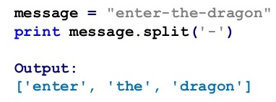
Output of { os.listdir("F:/News/across_toi/") }
Split Function Example

Slide 3
Formats
Directory Structure
News_type/news_title.txt
News_type/news_title.jpg
Text File For Each News
  Data within the file is separated by the character #
  The file stores the data in the following format
  news headline # image title # news detail
Format of the data Sent to the Client
Image_File_nameaAaAaAaAaAaAaAaAaAaAImage_file_dataaAaAaAaAaAaAaAaAaAaA
Text_file_nameaAaAaAaAaAaAaAaAaAaAText_file_dataaAaAaAaAaAaAaAaAaAaA

