Slide 1
Assignment 1: RFC 9260: STREAM CONTROL TRANSMISSION PROTOCOL Course Code - Course Name: - COMP4039 – Network Foundations Program: T433 - Cybersecurity Section: A Term: - Winter 2024 Group Number: 06
Student Names - ID:
Prabhjot Singh Sains – 101495218
Rahul Patel - 101378458
Jai Deep Rawat - 101503760
M. Salmaan Mustafa Shah – 10151007

Slide 2
INTRODUCTION
SCTP (Stream Control Transmission Protocol) was made for sending phone signals over the internet.
It works on the internet's basic system, making sure data is sent and received correctly.
SCTP can handle different sizes of data and sends them one after the other in separate "streams".
It can put several pieces of data together to send them more efficiently and keeps working even if there are problems with the internet.
SCTP is good at avoiding traffic jams and protecting against certain types of attacks.
It's useful for things like making video calls online.

Slide 3
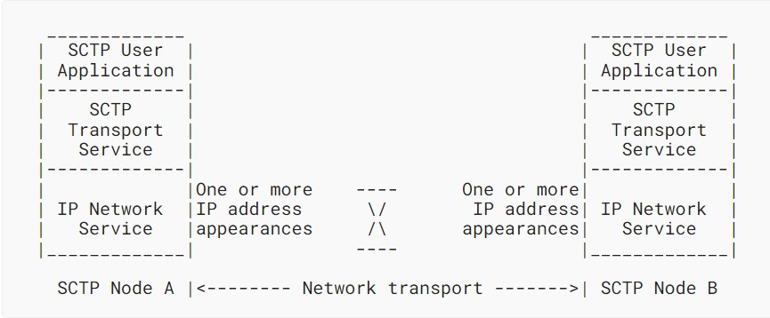
Architectural View of SCTP
SCTP serves as a mediator between user applications and the IP network.
Guarantees reliable and orderly message delivery.
Prevents loss or mixing up of messages during transmission.
Facilitates smooth communication between SCTP peers.
Simplifies communication processes for user applications.

Slide 4
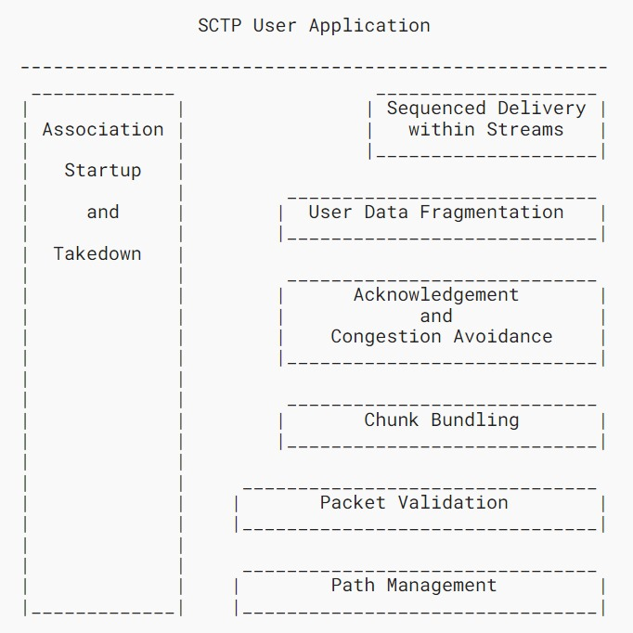
Functional View of SCTP
Association Startup and Takedown
Sequenced Delivery within Streams
User Data Fragmentation
Acknowledgement and Congestion Avoidance
Chunk Bundling
Packet Validation
Path Management

Slide 5

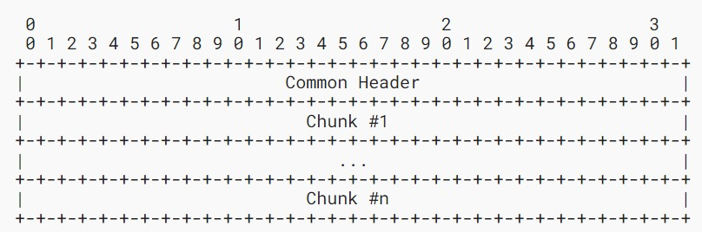
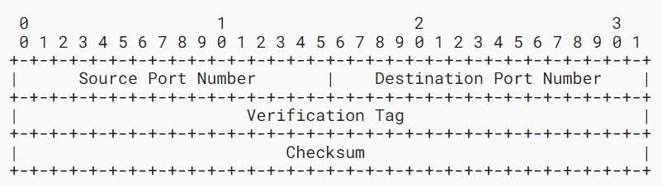
SCTP Packet Format & SCTP Common Header Field Descriptions
SCTP Packet Format:
A SCTP packet format consists of a common header and a chunk or multiple chunks. A user data message can be fragmented into multiple chunks if it does not fit into one SCTP packet.
SCTP Common Header Field Descriptions:
Source Port Number (16 bits)
Destination Port Number (16 bits)
Verification Tag (32 bits)
Checksum (32 bits)

Slide 6
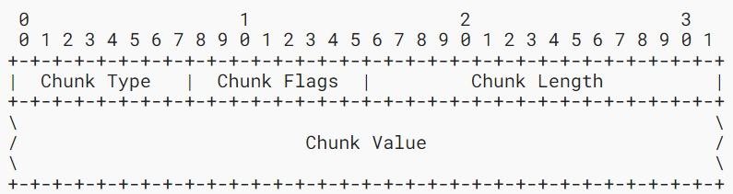
Chunk Field Descriptions
Chunk Type (8 bits)
Chunk Flags (8 bits)
Chunk Length (16 bits)
Chunk Value (variable length)

Slide 7
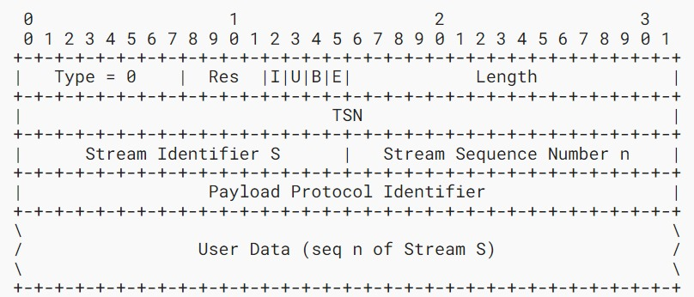
Payload Data
Res (4 bits)
I bit (1 bit)
U bit (1 bit)
B bit (1 bit)
E bit (1 bit)
Length (16 bits)
TSN (32 bits)
Stream Identifier (16 bits)
Stream Sequence Number (16 bits)
User Data (variable length)
Payload Protocol Identifier (32 bits)

Slide 8
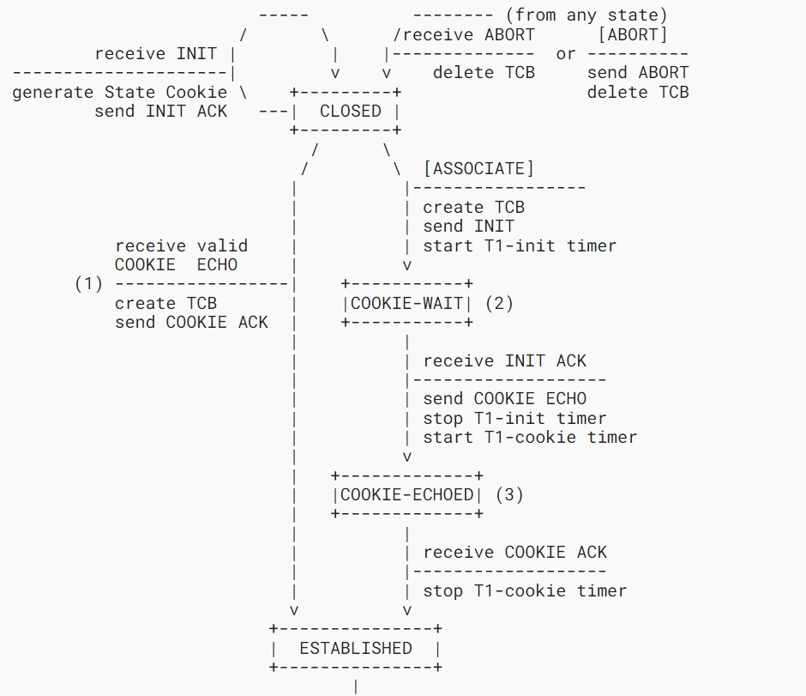
SCTP association
Initialization
Response
Cookie Exchange
Acknowledgment
Completion

Slide 9
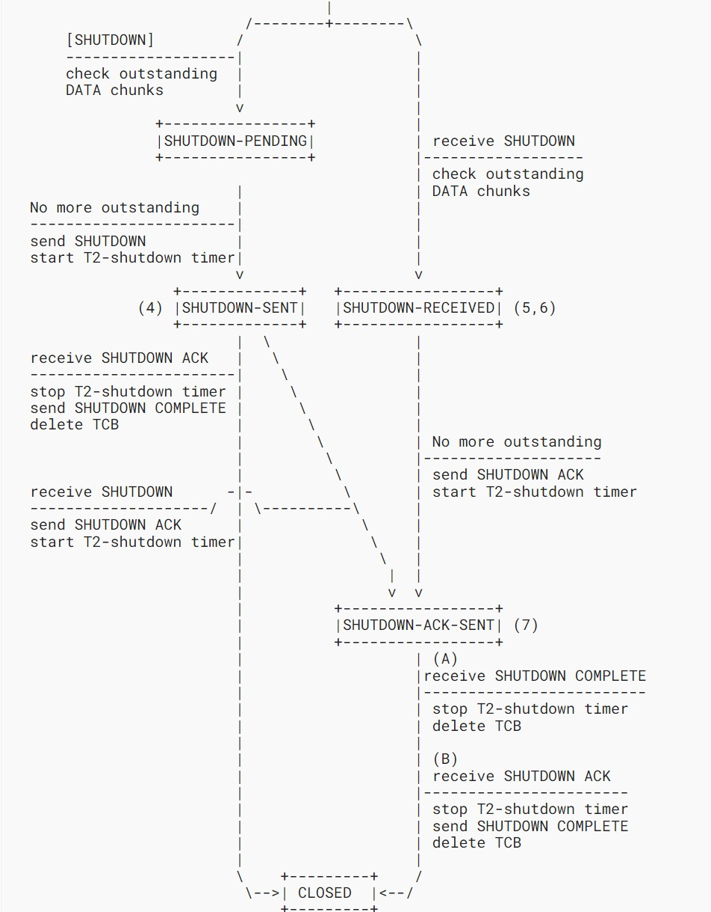
Termination of Association
Termination Methods
Abort
Shutdown

