Slide 1
RFM Customer
Segmentation
500K+
Transactions
£8.72M
Identifying high-value customers, revenue risk
and geographic concentration
Total Revenue
Prabhjot Kaur · UCI Online Retail Dataset · Python + MySQL + Power BI

Slide 2
PROBLEM STATEMENT
How is revenue distributed across customer segments and countries,
and where is the business most exposed to concentration or revenue risk?
01
04
Which customer segments drive the highest revenue?
How is revenue distributed across countries?
02
05
How much revenue is currently at risk from declining engagement?
Which countries are most dependent on specific segments?
03
06
Which segments have the highest purchase frequency?
How concentrated is revenue within high-value groups?

Slide 3
DATA & METHODOLOGY
Dataset
RFM Methodology
Source
Step 1 — Aggregate
UCI Online Retail Dataset
(Machine Learning Repository)
Recency, Frequency, Monetary
calculated per customer using SQL
Step 2 — Score
Records
NTILE(4) quartile-based scoring
for R, F, M independently
500K+ transactions
4,334 unique customers
Step 3 — Segment
Key columns
Champions, Loyal, At Risk,
Churned, Others via CASE logic
Invoice No, Customer ID,
Quantity, Unit Price,
Invoice Date, Country
Visualization
Power BI — 2-page dashboard
Overview + Segment Drill-Through

Slide 4
KEY FINDINGS
75.36%
Champions (31.1% of customers) generate 75.36% of total revenue — £6.57M.
The Others segment has the most customers (33.46%) but contributes far less revenue.
Revenue is driven by customer value, not customer volume.
£1.27M
90.39%
82.82%
Revenue at Risk
UK Customer Share
UK Revenue Share
At Risk + Churned customers
14.6% of total revenue
3,916 of 4,334 customers
extreme geographic concentration
No other country exceeds 3.3%
high single-market dependency
The business is structurally dependent on a small group of Champions in a single market. Revenue concentration (UK: 82.82%) and customer concentration (UK: 90.39%) both signal significant geographic and retention risk.

Slide 5
SEGMENT ANALYSIS — REVENUE & CUSTOMERS
Revenue by Customer Segment
Customers by Segment

Slide 6
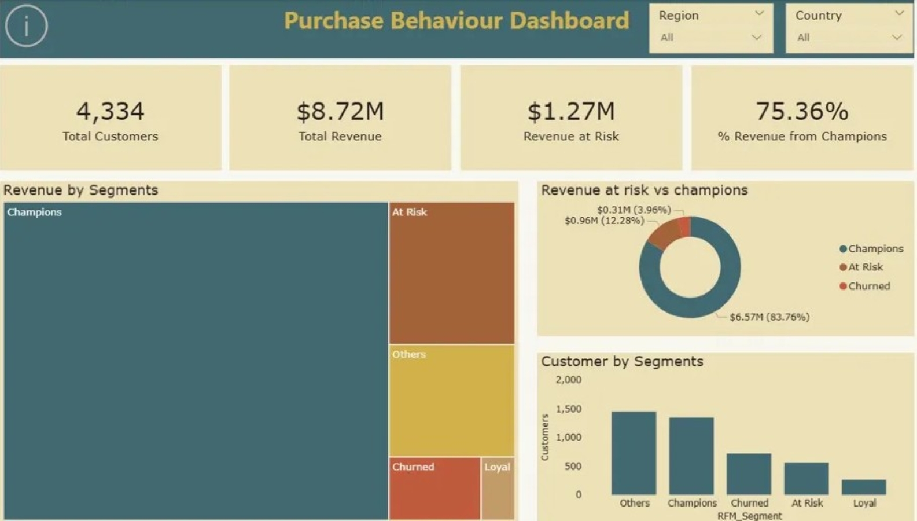
POWER BI DASHBOARD — OVERVIEW
Purchase Behaviour Dashboard

Slide 7
Thank You
Tools used: Python (Pandas) · MySQL · Power BI
Dataset: UCI Online Retail — Machine Learning Repository
Portfolio: prabhjottkaur.github.io
500K+
4,334
75.36%
£1.27M
Transactions
Customers
Revenue — Champions
Revenue at Risk

