Slide 1
ROAS Diagnostic
Analysis
1,800+
Ad Campaigns
3.07
Diagnosing why campaigns underperform
and where ad spend is being lost
ROAS Threshold (P25)
Prabhjot Kaur · Global Ads Dataset · Power BI + MySQL

Slide 2
PROBLEM STATEMENT
Why are 35% of ad campaigns generating low ROAS,
and where exactly is performance breaking down?
01
04
How do CTR, CPC, CVR, and CPA differ between Low and High ROAS campaigns?
Which industries are most affected by low ROAS?
02
05
Which platforms show the largest CPC gap?
Is the issue localized to specific segments or system-wide?
03
06
Which countries show the most Low ROAS campaigns?
At which funnel stage does performance break down?

Slide 3
DATA & METHODOLOGY
Dataset
Tools & Metrics
Source
MySQL
Global Ads Dataset (1,800 records)
KPI queries, ROAS grouping, segment analysis
Power BI
Segmentation
2-page dashboard — Overview + Diagnosis
DAX measures, cross-filtering slicers
Low ROAS: below 3.07 (25th percentile)
High ROAS: above 3.07
ROAS threshold
Key dimensions
25th percentile cutoff = 3.07
(SUM-based DIVIDE method)
Platform (3), Country (7), Industry (5),
Campaign Type, Ad Segment (600+)
Core KPIs
CTR, CPC, CVR, CPA — compared
between Low and High ROAS groups

Slide 4
KEY FINDINGS — FUNNEL BREAKDOWN
The funnel breaks at the middle — not the top
CTR gap was only −1.47% (nearly identical) — but CPC was 55% higher and CVR dropped 40% in Low ROAS campaigns
CTR
OK
CPC
ISSUE
CVR
ISSUE
CPA
ISSUE
−1.47%
→
+55%
→
−40%
→
+157%
Nearly identical
Traffic costs more
Clicks don't convert
2.5× more expensive
Pattern held across 600+ segment combinations — confirming this is a system-wide conversion inefficiency, not a problem isolated to any single country, platform, or industry.
Avg CPA Low ROAS: $79.93 vs Avg CPA High ROAS: $28.27 → Low ROAS campaigns cost 2.83× more per customer acquired

Slide 5
PLATFORM ANALYSIS — CPC & CONVERSION RATE
CPC by Platform — Low vs High ROAS
Conversion Rate by Platform — Low vs High ROAS

Slide 6
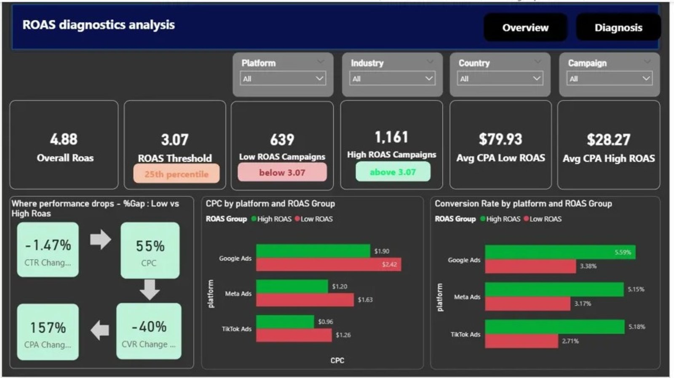
POWER BI DASHBOARD — OVERVIEW
ROAS Diagnostics Dashboard

Slide 7
Thank You
Tools used: MySQL · Power BI · DAX
Dataset: Global Ads Dataset (1,800 campaigns)
Portfolio: prabhjottkaur.github.io
1,800+
639
+55%
+157%
Campaigns analyzed
Low ROAS campaigns
CPC gap
CPA gap

