Slide 1
Supply Chain
Delay Analysis
169K
Total Orders
54.9%
Identifying what drives late deliveries
and where the business should focus
Late Delivery Rate
Prabhjot Kaur · DataCo Supply Chain Dataset · Power BI + SQL

Slide 2
PROBLEM STATEMENT
What factors are driving customer delivery delays,
and where should the business focus to reduce them?
01
04
Which shipping mode causes the most delays?
How do shipping mode & region interact?
02
05
Which regions have the highest delay rates?
Are delays increasing over time?
03
06
Which product categories are delay-prone?
Which customer segments are most affected?

Slide 3
DATA & METHODOLOGY
Dataset
Tools & Metrics
Source
SQL
DataCo Supply Chain Dataset (Kaggle)
Exploratory analysis, view creation, segmentation queries
Power BI
Records
Interactive dashboard — 2 pages, 8 visuals, 3 slicers
169K orders (after deduplication from 180K)
Core metric
Key columns
Late Delivery Rate = Late orders / Total orders × 100
delivery_status, days_shipping_real,
days_shipment_scheduled, order_region,
shipping_mode, category_name
Delay metric
Avg Delay = days_shipping_real − days_shipment_scheduled

Slide 4
KEY FINDINGS
95.3%
First Class shipping has a 95.3% late delivery rate — the worst of all modes.
Standard Class (the cheapest option) is the most reliable at 38.1% late.
This pattern holds consistently across every region.
57.6%
0.57
Canada
Central Africa late rate
Avg delay days overall
Best performing region
Highest regional rate, but all regions cluster
between 49–58% — delay is systemic, not geographic
Delays are consistent in severity across regions —
no single area is dramatically worse
49.4% late rate — consistently outperforms all
other regions across every shipping mode
The delay problem is not regional — it is structural. First Class and Second Class shipping systematically fail to meet their own schedules across all 23 regions.

Slide 5
SHIPPING MODE ANALYSIS
Late Delivery Rate by Shipping Mode
First Class
95.3% · 1.00 days late
Worst performer — tighter schedules = easier to miss
Second Class
76.8% · 1.99 days late
Most severe delays when late
Same Day
45.7% · 0.48 days late
Moderate — smaller window means less buffer
Standard Class
38.1% · On time / early
Most reliable — loose schedules absorb delays

Slide 6
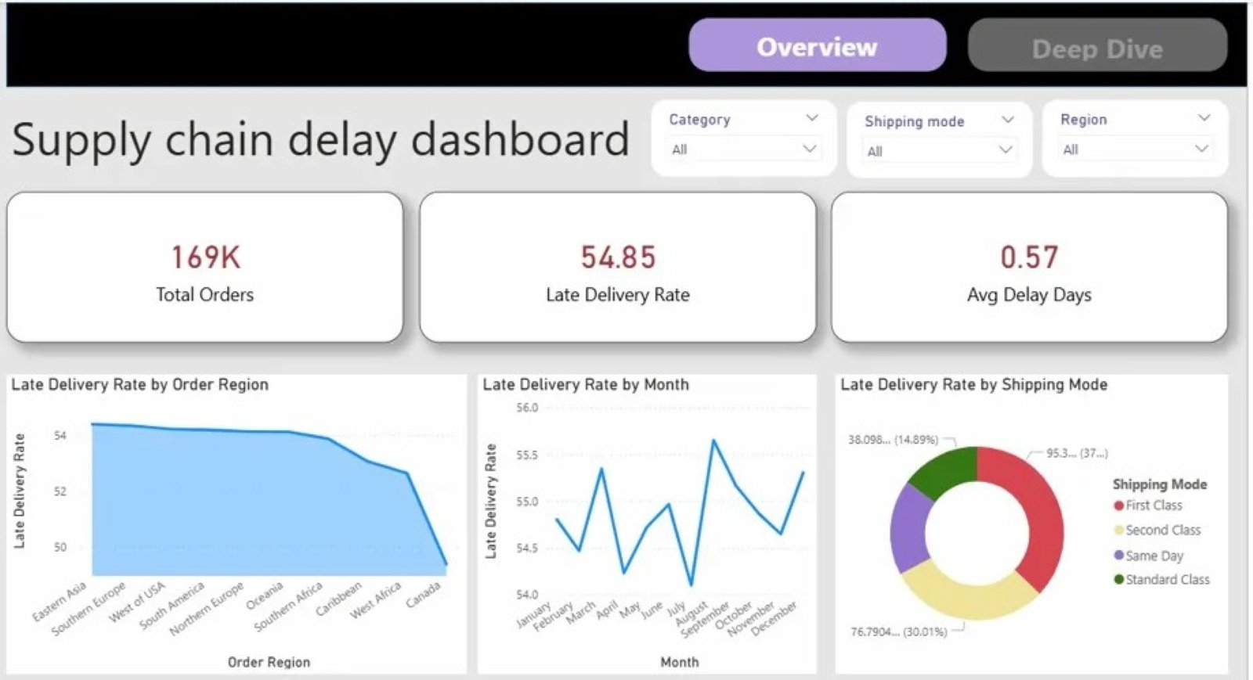
POWER BI DASHBOARD — OVERVIEW
Supply Chain Delay Dashboard

Slide 7
Thank You
Tools used: SQL · Power BI · Excel (Power Query)
Dataset: DataCo Supply Chain — Kaggle
Portfolio: prabhjottkaur.github.io
169K
54.9%
95.3%
38.1%
Orders analyzed
Overall late rate
First Class late rate
Standard Class late rate

