Slide 1
Twitter Sentiment Analysis
By
Prabhjot Singh (0774364)
Under the Guidance of,
Dr. Savita Seharawat

Slide 2
Introduction
In this study, natural language processing to do sentiment analysis on the Twitter dataset. The text field's polarity was broken down into three categories: positive, negative, and neutral. A sentiment is an attitude, belief, or conclusion brought on by a sensation. Sentiment analysis, commonly referred to as opinion mining, examines how individuals feel about particular things.
Many social media platforms disclose their application programming interfaces (APIs), which motivates academics and developers to gather and analyse data. For instance, Twitter currently has three different versions of APIs available namely the REST API, the Search API, and the Streaming API.

Slide 3
Overview
Goal: Analyze twitter data concerning autism awareness and find out which is the better tool for sentiment analysis
Sentiment analysis is the identification of opinions from text to determine how the writer feels about a topic
Evaluate Python based sentiment analysis tool:
  Scikit Learn

Slide 4
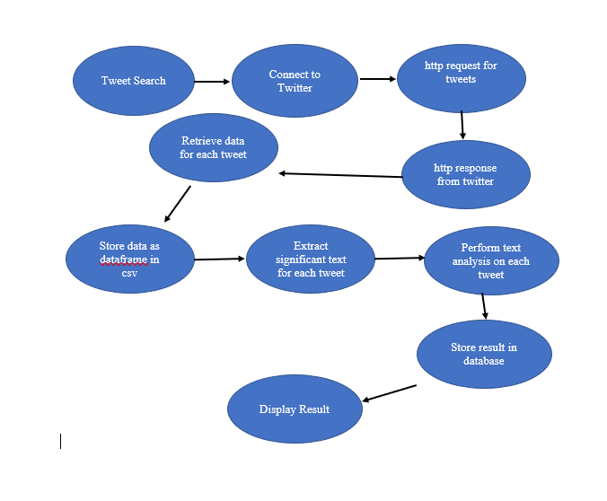
SYSTEM DESIGN

Slide 5
Data Set
Attribute’s Name | Count | Data Type | Null Values
User_Name | 30124 | Object | 0
User_loaction | 18423 | object | 11701
User_description | 28968 | object | 1156
User_created | 30124 | object | 5462
User_followers | 30124 | int64 | 0
User_friends | 30124 | object | 0
User_favourites | 30124 | Int64 | 0
User_verified | 30124 | bool | 0
Date | 30124 | object | 0
Text | 30124 | object | 0
Hashtags | 21687 | object | 8437
Source | 30124 | object | 0
Is_retweet | 30124 | bool | 0

Slide 6
Data Cleaning
Data cleaning is the process of making sure that the data is reliable, consistent, and useable. Data can be cleaned by locating mistakes or corruptions, fixing them, erasing them, or manually processing the data as necessary to stop them from happening again. Most data cleaning tasks can be completed using software tools, while some need manual labor. Although it might be challenging, maintaining firm data requires that you complete this activity.
  Remove irrelevant data
    The texts are used only for this study: Column header ‘text’
    Rows containing non-English tweets removed
    All $URLS, emoticons, #hashtags and @mentions removed
    Punctuations and additional white spaces were removed from the tweets.
  Remove duplicate values
  All tweets were converted to lower case
  Data exported and saved in a separate CSV file using python’s pandas

Slide 7
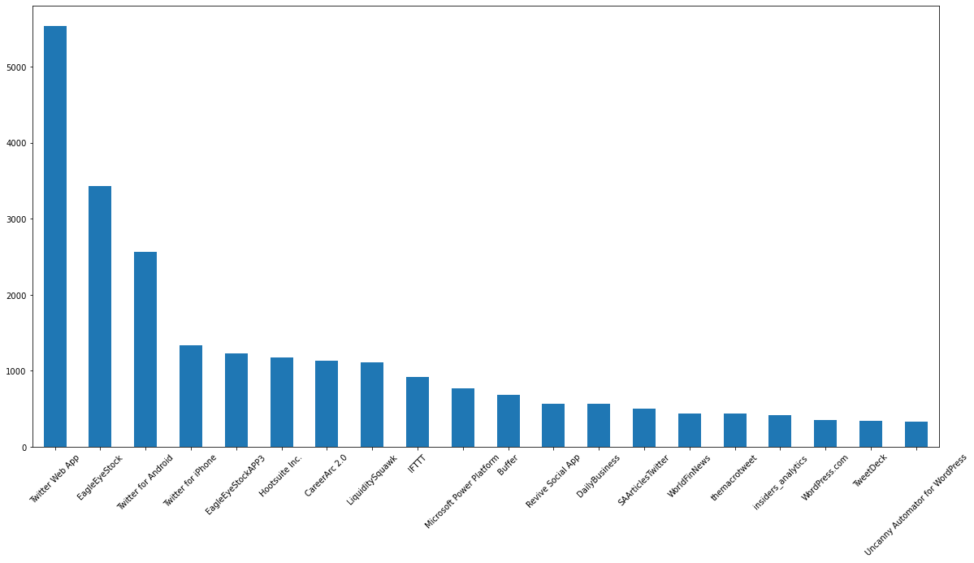
Top Most Source used by users

Slide 8
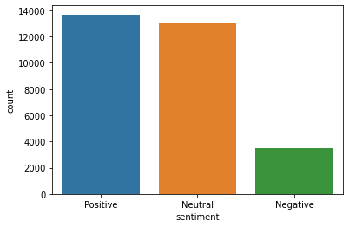
Sentiment Analysis

Slide 9
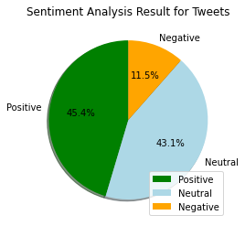
Sentiment Analysis Pie Chart
 | Total | Percentage (%)
Positive | 13676 | 45.4%
Neutral | 12979 | 43.09%
Negative | 3469 | 11.52%

Slide 10
TF-IDF CountVectorizer
TF-IDF is an abbreviation for Term Frequency Inverse Document Frequency. This is very common algorithm to transform text into a meaningful representation of numbers which is used to fit machine algorithm for prediction.
Term frequency is defined as the number of times a word appears in a document divided by the total number of words in the document.

Slide 11
Machine Learning - Naïve Bayes Classifier
Testing
Goal - Finding the sentiment of given test data file.
- Generate Feature set(x) for test data file.
-For each document is test set find
Decision1=log P(x| label= pos)+log P(label=pos)
Similarly calculate
Decision2=log P(x| label= neg)+log P(label=neg)
Compare decision 1&2 to compute whether it has Negative or Positive sentiment.

Slide 12
DOC | TEXT | CLASS
1 | I loved the movies | +
2 | I hated the movies | -
3 | a great movies. good movies | +
4 | poor acting | -
5 | great acting. a good movies | +
Documents with positive outcomes.
DOC | I | loved | the | movies | hated | a | great | poor | acting | good |  | CL ASS
1 | 1 | 1 | 1 | 1 |  |  |  |  |  |  |  | +
3 |  |  |  | 2 |  | 1 | 1 |  |  |  | 1 | +
5 |  |  |  | 1 |  | 1 | 1 |  | 1 |  | 1 | +
Now, let’s look at the negative examples
DOC | I | loved | the | Movies | hated | a | great | poor | acting | good | CLASS
2 | 1 |  | 1 | 1 | 1 |  |  |  |  |  | -
4 |  |  |  |  |  |  |  | 1 | 1 |  | -

Slide 13
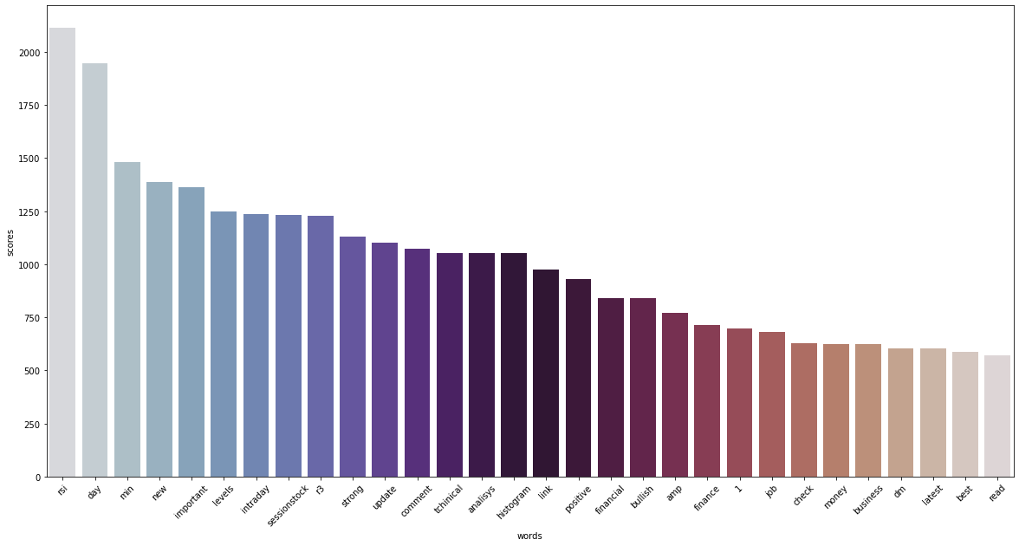
Tokens in tweets for positive analysis
Total Number of tokens in tweets for positive analysis

Slide 14
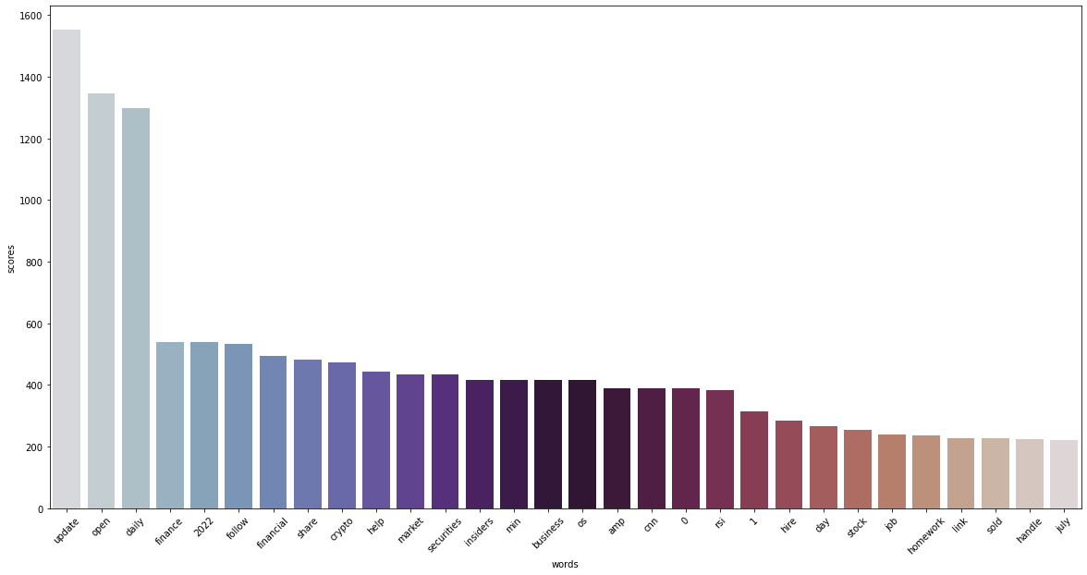
Tokens in tweets for Negative analysis
Total Number of tokens in tweets for negative analysis
Total number of tokens used in sentiment tweets for negative tokens: This figure, tells us about the negative token of all negative tweets

Slide 15
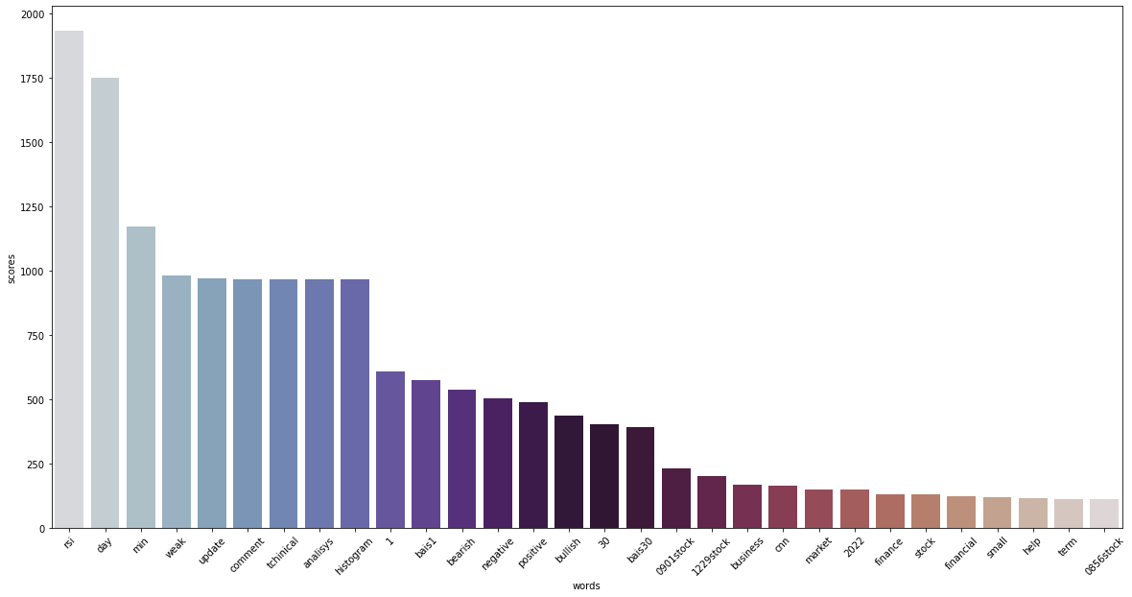
Total Number of Neutral token

Slide 16
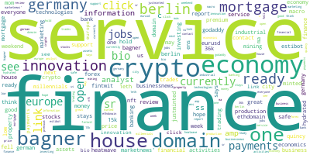
Word Cloud
Word cloud about the positive tweets.

Slide 17
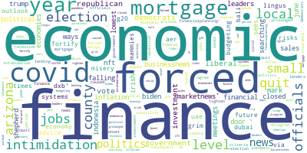
Word cloud about the negative tweets

Slide 18
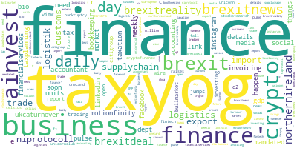
Word cloud about the neutral tweets.

Slide 19
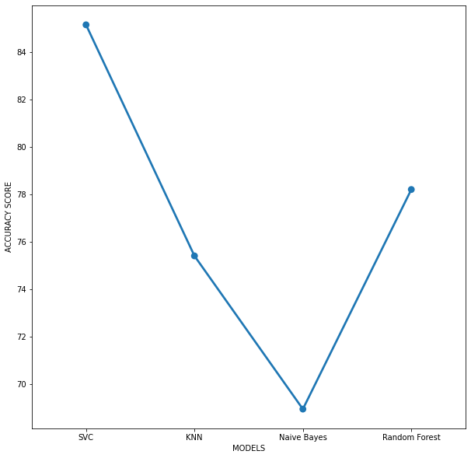
Model | Score
SVM | 0.851381
kNN | 0.753920
Random Forest | 0.689320
Naive Bayes | 0.781926
Figure 11: Comparison of All models

Slide 20
Thank You

