Slide 1
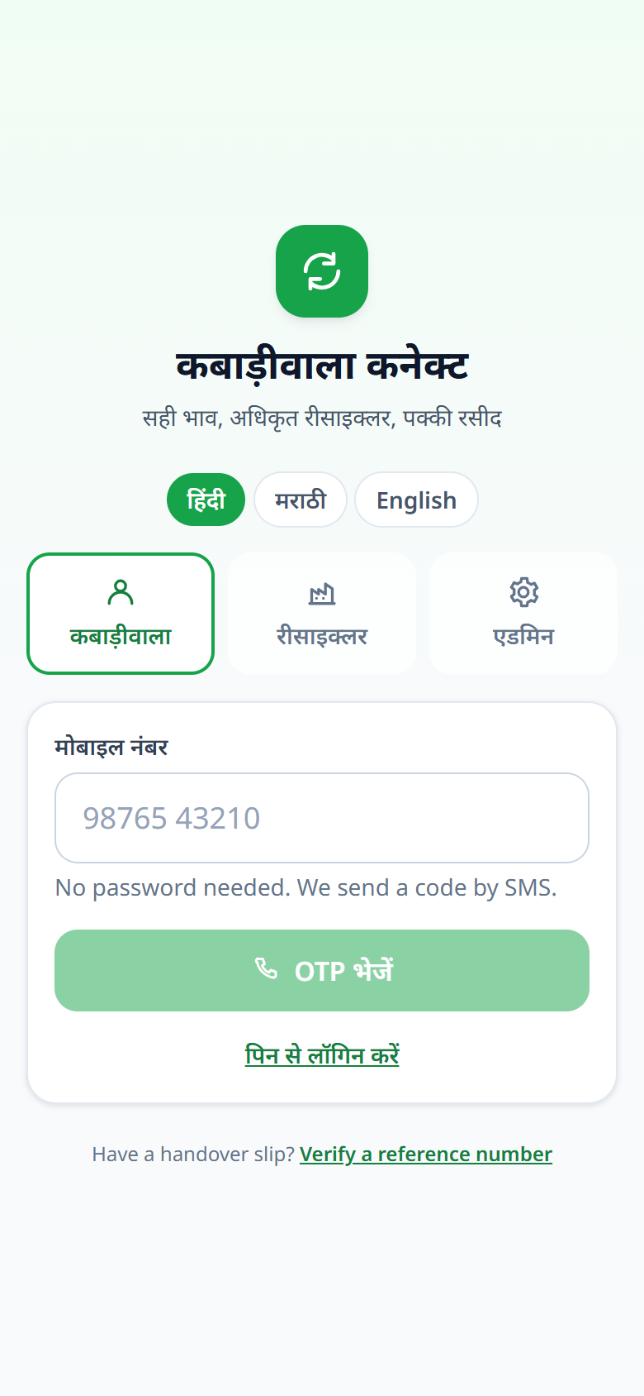
KC
KABADIWALA CONNECT
CIRCULAR E-WASTE MARKETPLACE · INDIA
Kabadiwala
Connect
A vernacular, offline-tolerant marketplace that links India’s informal e-waste collectors to authorized recyclers — with fair, transparent prices and a fully traceable handover trail.
PROBLEM Informal collectors handle most of India’s e-waste but stay outside the formal chain — opaque prices, unsafe processing, no record.
SOLUTION One simple app: photograph scrap → get an instant fair value → match an authorized recycler → verified handover → digital payment.
Hindi · Marathi · English Offline-first E-Waste (Management) Rules, 2022
Notes:
Kabadiwala Connect connects India’s informal e-waste collectors (kabadiwalas) with authorized recyclers. Problem: opaque prices, unsafe backyard processing, no traceability. Solution: a low-literacy, multilingual, offline-tolerant app for fair pricing, matching, verified handover and digital payment. On the right is the actual Hindi login screen.

Slide 2
HOW IT WORKS
Scrap to settlement, in six steps
1
2
3
4
5
6
SNAP
VALUE
MATCH
PICKUP
VERIFY
PAID
Photograph the lot; add weight & condition
Instant, explainable ₹ estimate
Nearby authorized recyclers respond
Weighbridge check + photos at handover
Public HRN & chain of custody
Digital payout to the collector
THE PRICE IS A FORMULA, NOT A BLACK BOX
estimated_value = reference_price/kg × weight × condition_factor
condition_factor — working 1.15 · mixed 1.00 · non-working 0.90 · damaged 0.75
A fair price the collector can see and trust — every lot priced the same, transparent way.
Notes:
End-to-end flow: snap → value → match → pickup → verify → paid. The valuation is a transparent rule (reference price per kg × approximate weight × condition factor), not an AI black box — this is key to trust with low-literacy users.

Slide 3
WHO IT SERVES
Four stakeholders, one traceable loop
K
Collector
R
Recycler
A
Admin / Regulator
The Kabadiwala
Authorized facility
Platform & CPCB
Lists scrap fast, in their language
Sees a fair, upfront price
Digital payment + earnings history
Works even on a weak connection
Steady, sorted supply of materials
Incoming requests within service radius
Weighbridge & handover records
Compliance-ready documentation
Live oversight & analytics
Authorizes recyclers (CPCB)
Auditable, traceable handovers
Fair-market & unit-economics view
ENVIRONMENT & SOCIETY Safer processing, higher material recovery, and a formal digital record for EPR / CPCB compliance.
146 kg
E
responsibly settled
Notes:
Three active roles in the app — Collector (kabadiwala), Recycler, Admin/Regulator — plus the fourth stakeholder everyone serves: the environment and society. Shared outcome is safe, traceable, compliant recovery.

Slide 4
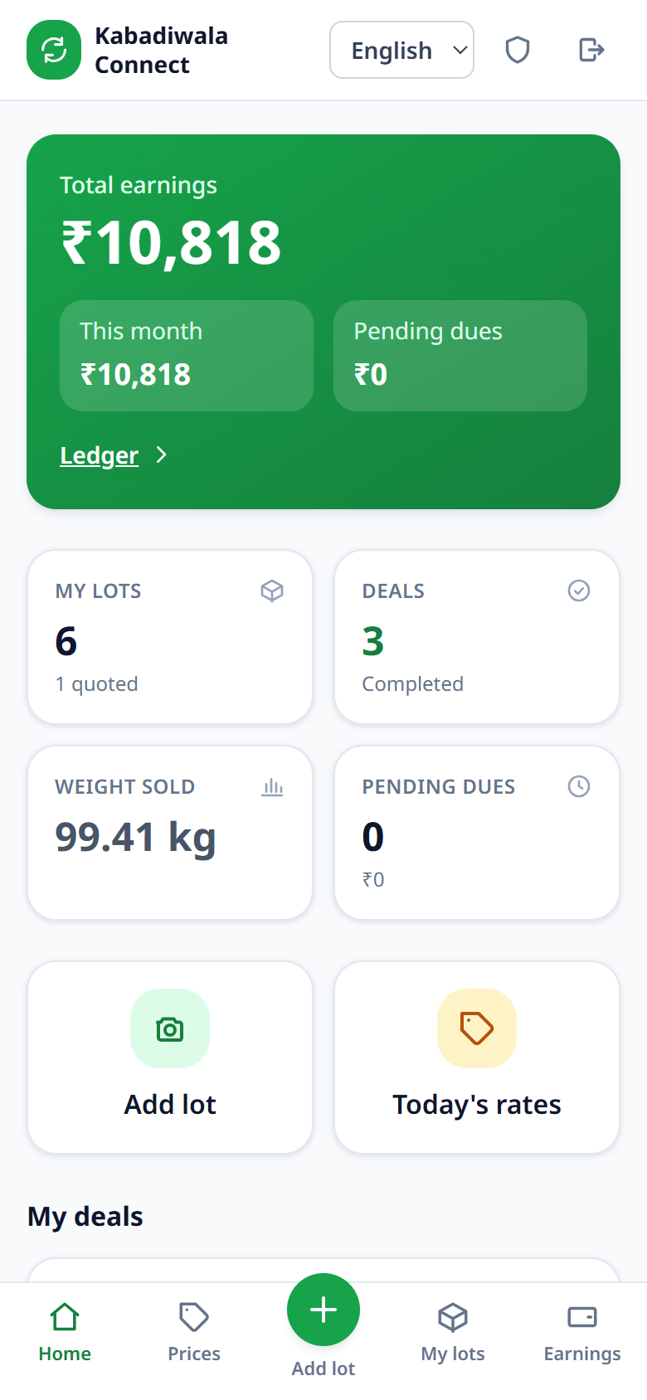
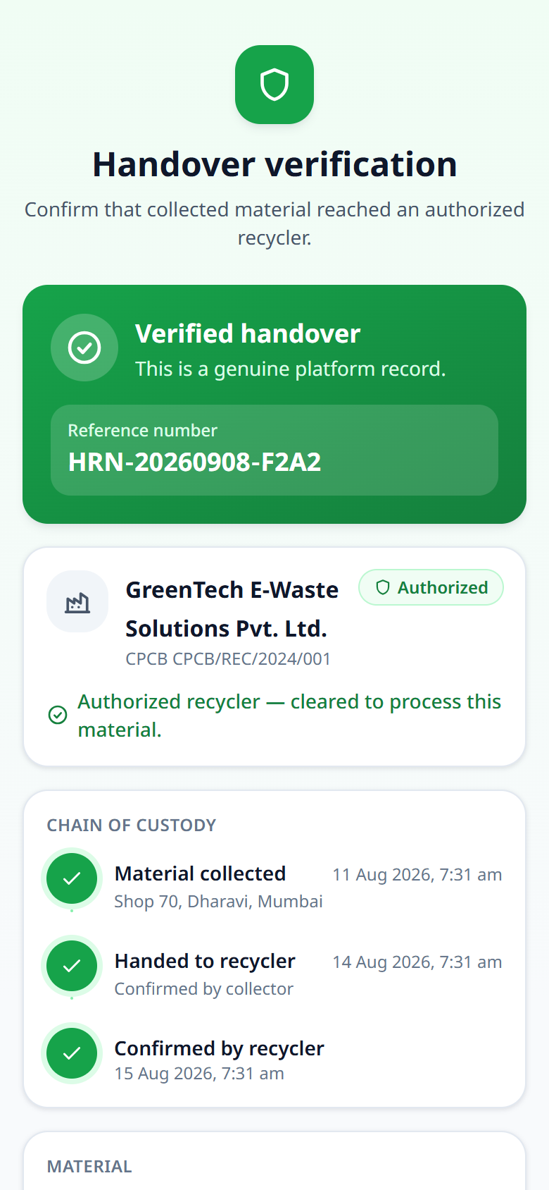
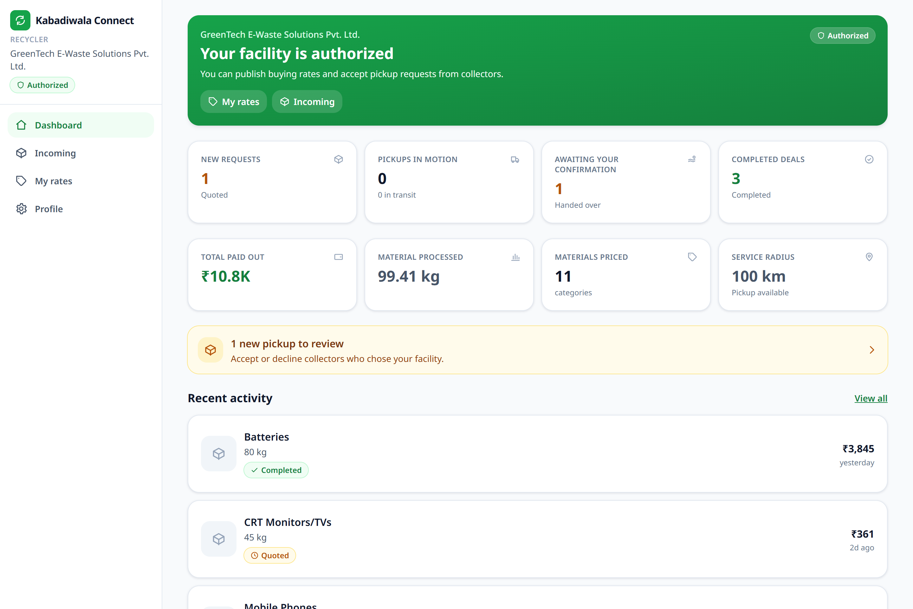
THE PRODUCT
In the hands of every user
COLLECTOR HOME
PUBLIC VERIFY
RECYCLER DASHBOARD
Earnings, lots & deals at a glance
Anyone can check a handover
Incoming requests, payouts & material processed — with service-radius matching
Notes:
Real screenshots from the running app. Left: the collector’s Hindi mobile home (earnings ₹10,818, 6 lots) and the public handover-verification page. Right: the recycler’s desktop dashboard with live requests, payouts and material processed.

Slide 5
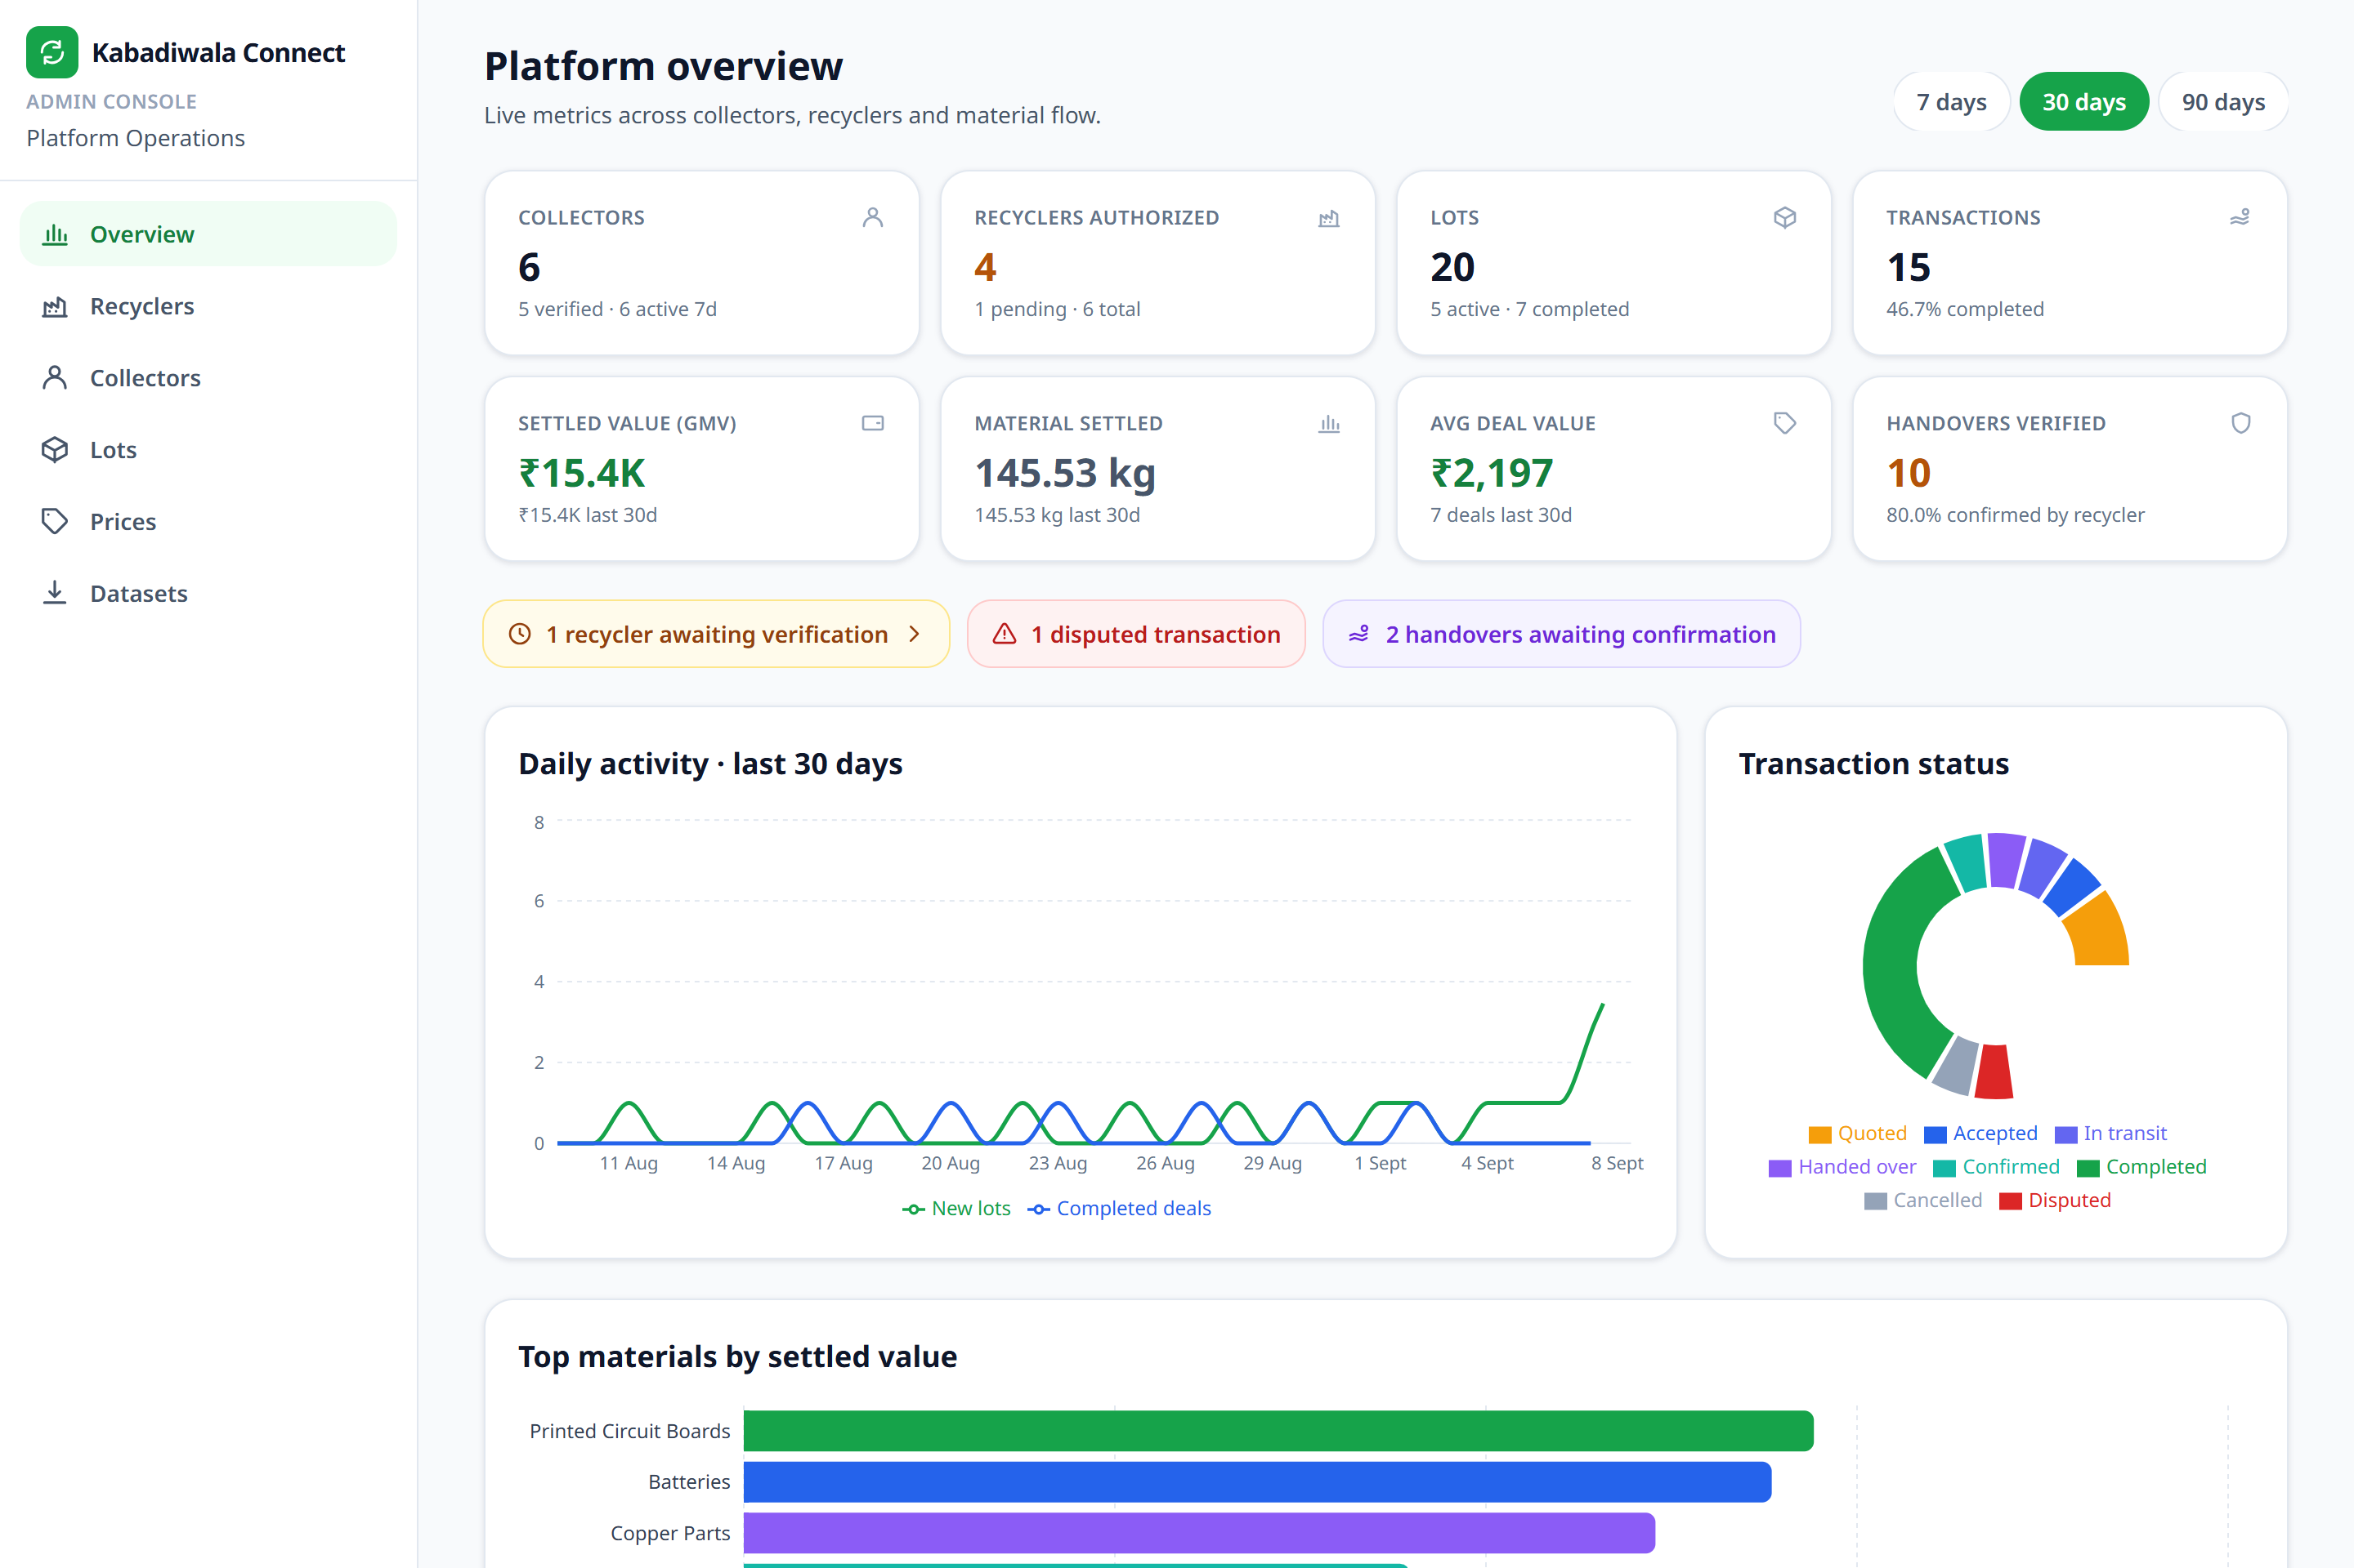
DATA & TRACEABILITY
Priced, matched, and fully accounted for
₹15.4K
146 kg
settled value (GMV)
material settled
2,337
10
price data points
handovers verified
SEVEN LINKED DATASETS
Materials
Prices
Recyclers
Transactions
Traceability
Collectors
AI samples
ADMIN ANALYTICS — LIVE PLATFORM DATA
HRN-20260908-F2A2
Verifiable at /verify/:reference — full chain of custody
Authorized recycler GreenTech · CPCB/REC/2024/001
Notes:
The platform produces a clean, linked dataset (materials, prices, recyclers, transactions, traceability, collectors, and AI training samples). Real seeded figures: ₹15.4K settled GMV, 146 kg settled, 2,337 price points, 10 verified handovers. Every handover carries a public HRN reference checkable at /verify/:reference.

Slide 6
WHAT’S NEXT
From a working platform to circular infrastructure
NOW
NEXT
LATER
Live today
0–6 months
The vision
Rule-based fair pricing
Hindi / Marathi / English, offline-first
Verified handovers (HRN + QR)
Collector, recycler & admin dashboards
ML price & photo-based grading
(7 training samples already logging)
UPI wallet & instant settlement
Route & pickup aggregation
CPCB / EPR-credit integration
Carbon & recovery impact accounting
Multi-city, more languages
Micro-credit for collectors
Kabadiwala Connect — turning India’s informal recyclers into a fair, traceable, circular economy.
KC
Notes:
Now: everything shown today is live (rule-based pricing, multilingual/offline, verified handovers, dashboards). Next (0–6 mo): move pricing from rules to ML using the training samples already being logged; UPI settlement; pickup routing. Later: CPCB/EPR credits, carbon accounting, multi-city scale, collector micro-credit.

