Slide 1
Data Science Project
PRABH SHARAN SINGH- 2018CSC1045

Slide 2
Analysis of Summer and Winter Olympic medal
winners till 2012
More than 35,000 medals have been awarded at the Olympics since 1896. The first two Olympiads awarded silver medals and an olive wreath for the winner, and the IOC retrospectively awarded gold, silver, and bronze to athletes based on their rankings. Dataset includes a row for every Olympic athlete that has won a medal since the first games.
Acknowledgements
Data was provided by the IOC Research and Reference Service and published by The Guardian's Datablog.

Slide 3
Tidyverse-
Tidyverse is a collection of essential R packages for data science. The packages under the tidyverse umbrella help us in performing and interacting with the data. There are a whole host of things you can do with your data, such as subsetting, transforming, visualizing, etc.
ggplot2
ggplot2 is a system for declaratively creating graphics, based on The Grammar of Graphics. You provide the data, tell ggplot2 how to map variables to aesthetics, what graphical primitives to use, and it takes care of the details
dplyr
dplyr provides a grammar of data manipulation, providing a consistent set of verbs that solve the most common data manipulation challenges.
tidyr
tidyr provides a set of functions that help you get to tidy data. Tidy data is data with a consistent form: in brief, every variable goes in a column, and every column is a variable.

Slide 4
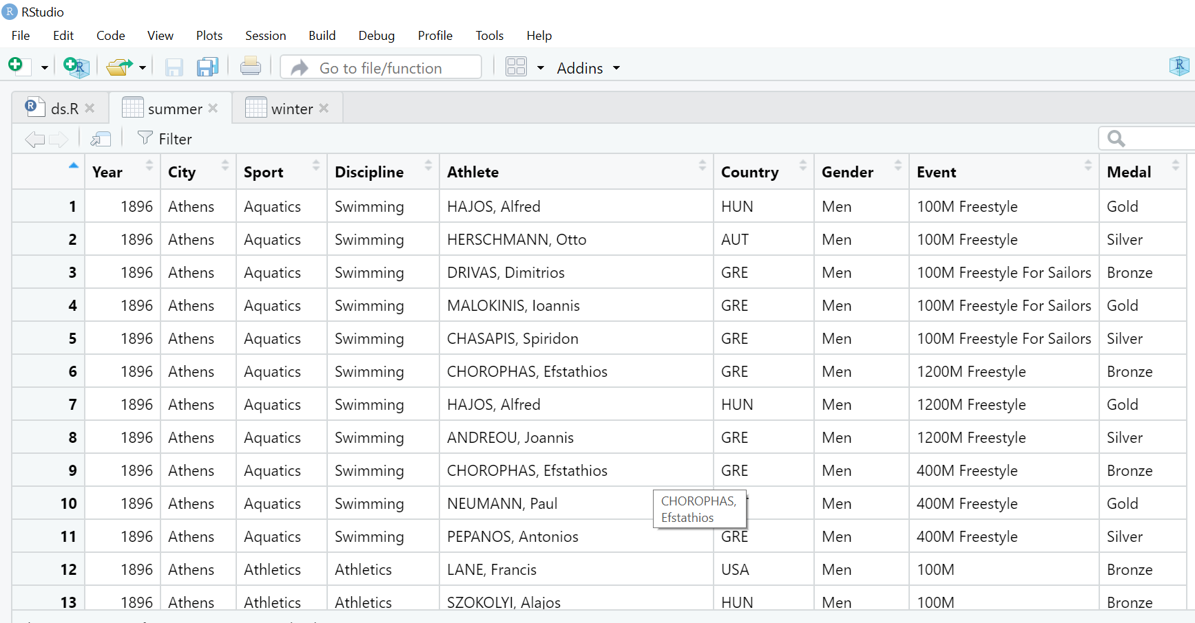
Summer and winter Olympic medal winners dataset-

Slide 5
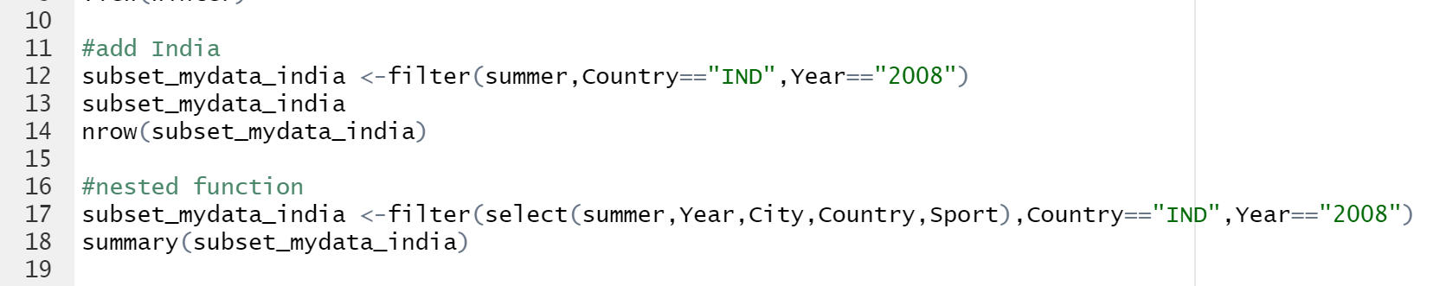
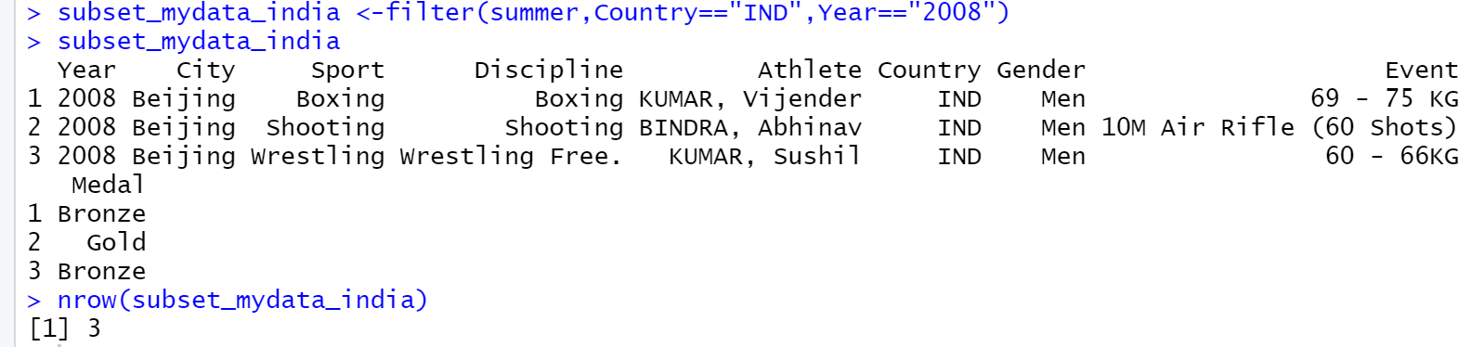
All medals won by Indian athletes in 2008 Summer Olympics-

Slide 6
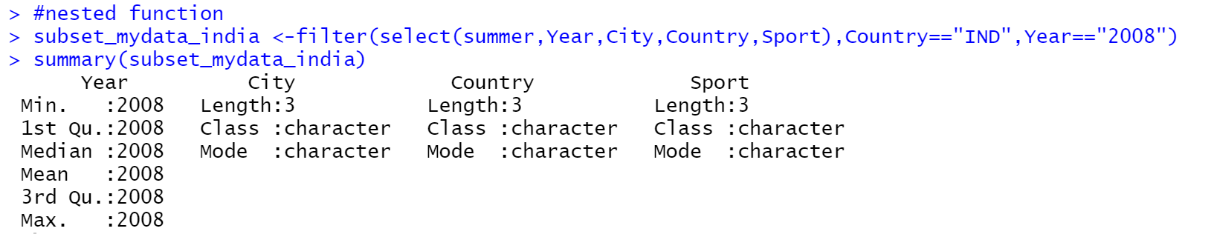
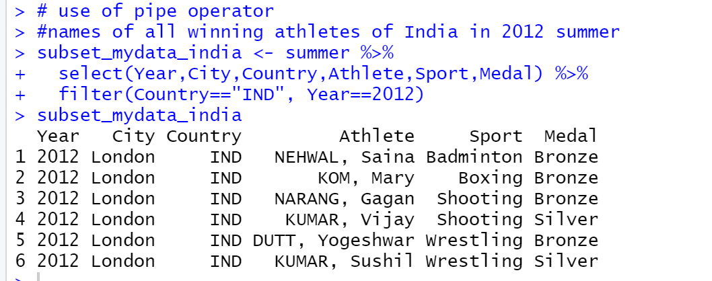

Slide 7
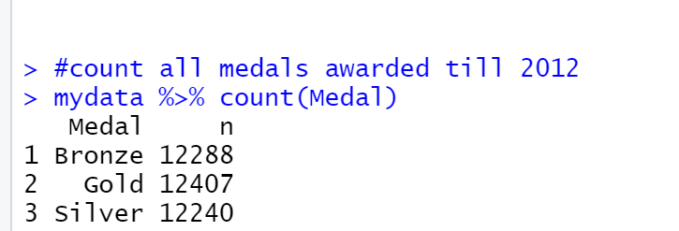
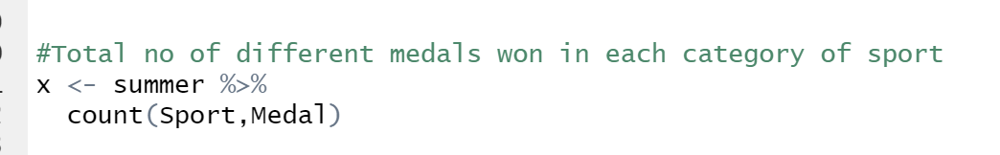
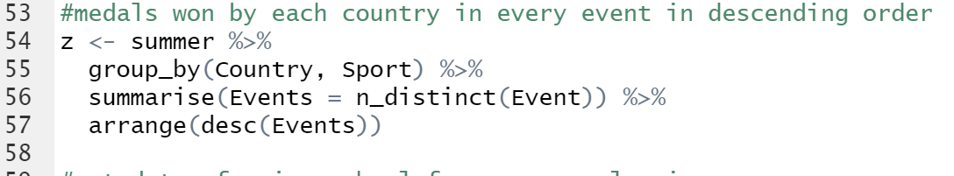

Slide 8
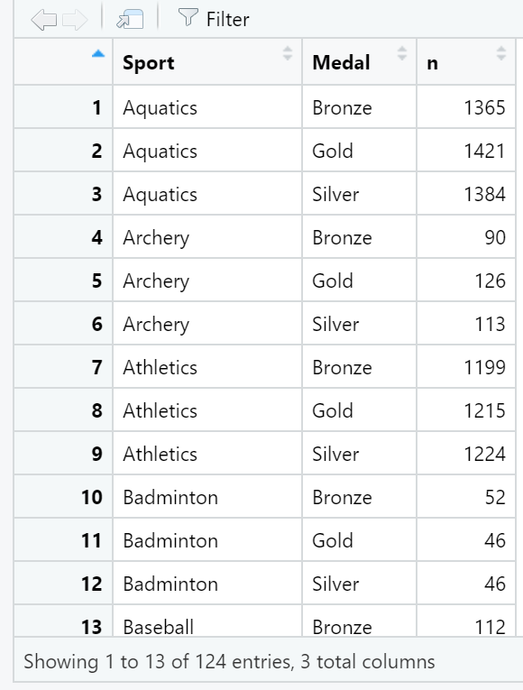
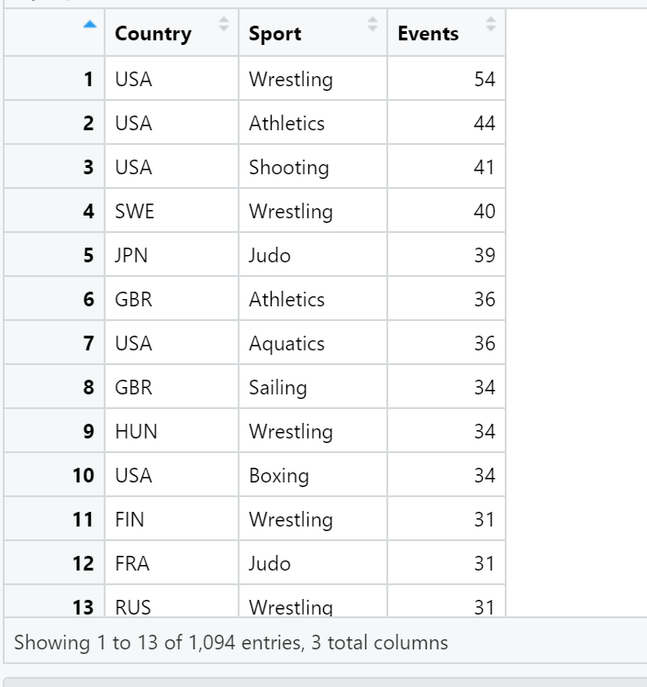

Slide 9
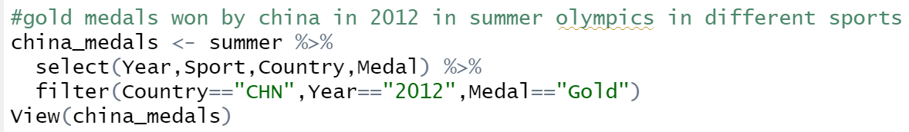
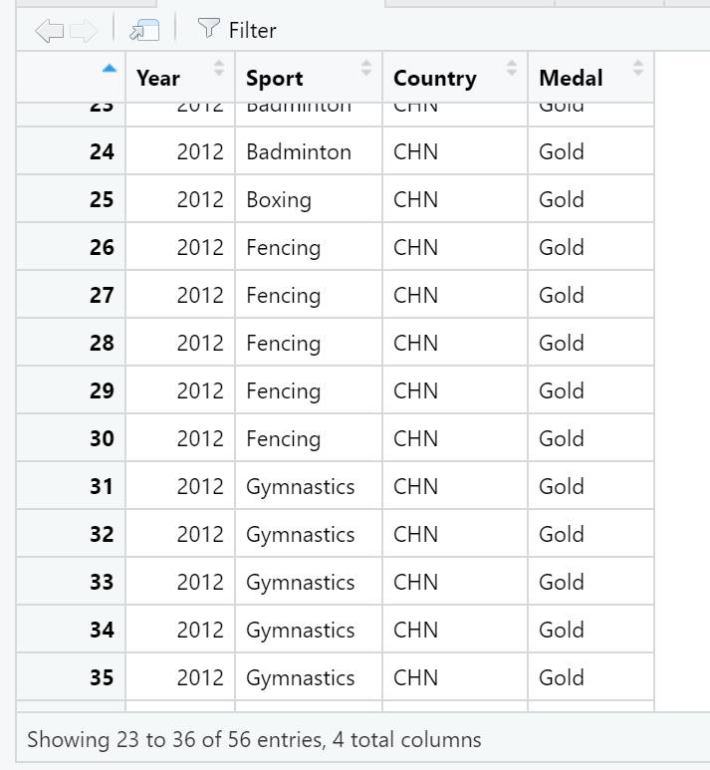

Slide 10
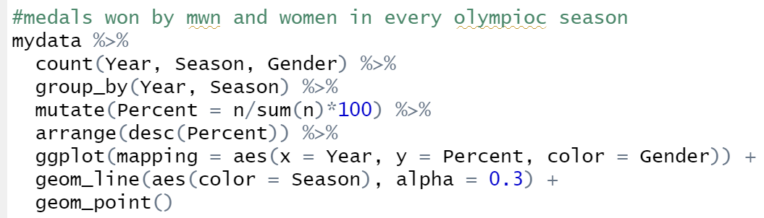
Geom_point -The point geom is used to create scatterplots. The scatterplot is most useful for displaying the relationship between two continuous variables. It can be used to compare one continuous and one categorical variable, or two categorical variables.
Geom line- Connect observations, ordered by x value.

Slide 11
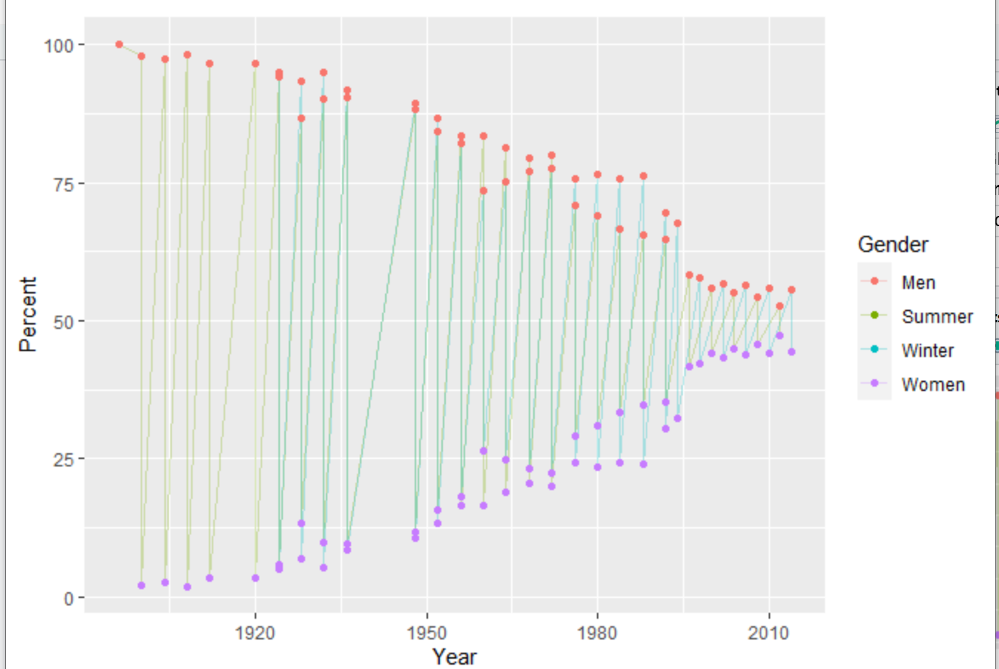

Slide 12
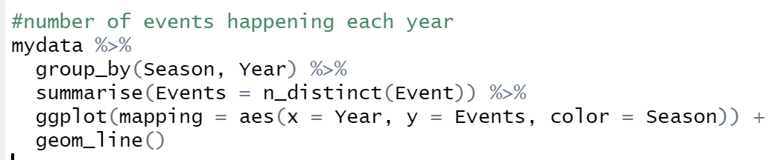
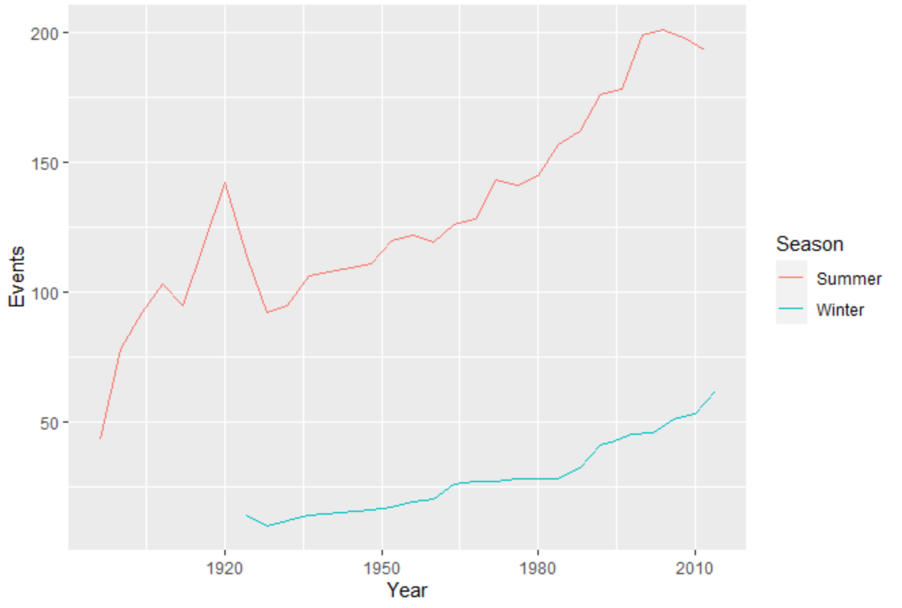

Slide 13
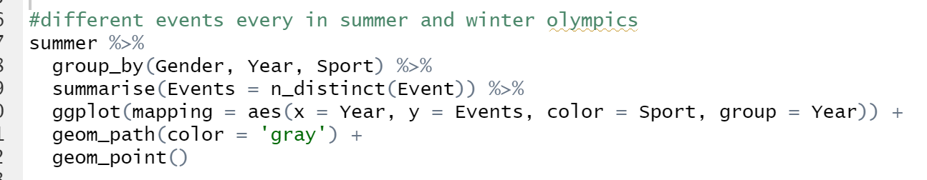
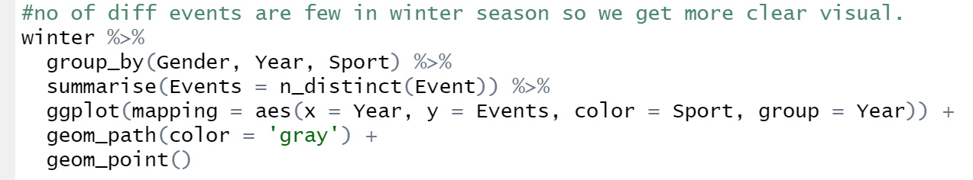

Slide 14
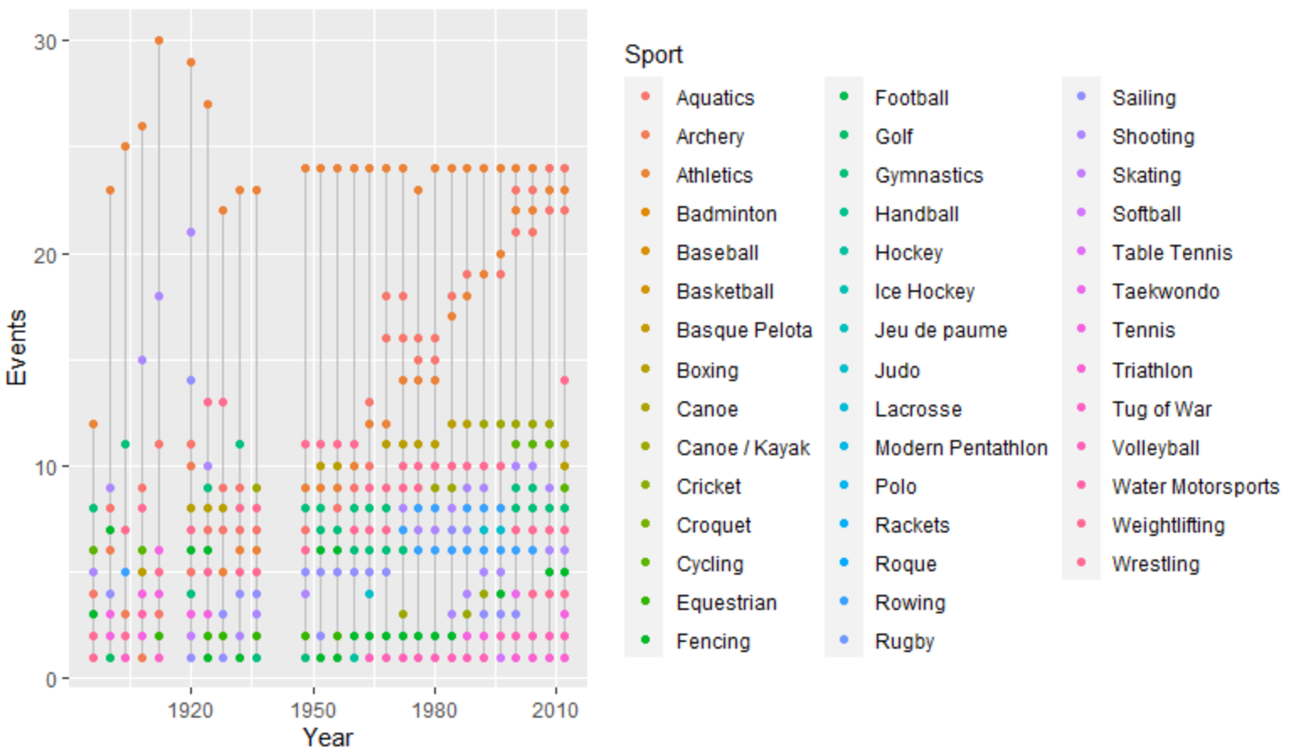
Different events in summer olympics each year-

Slide 15
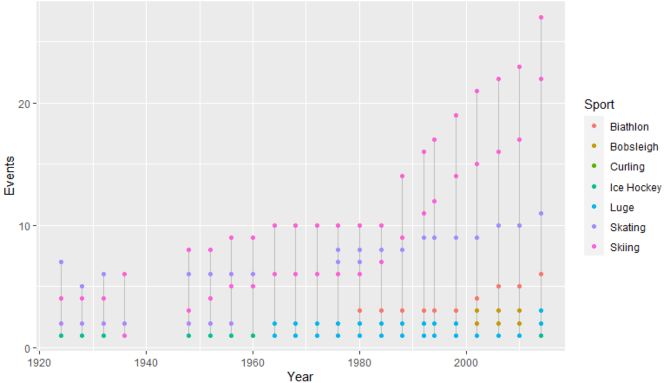
Different events organized during winter olympics, far less than summer olympics-

Slide 16
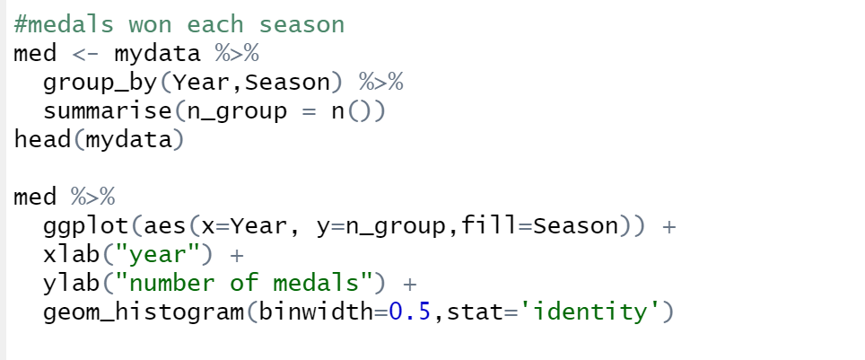
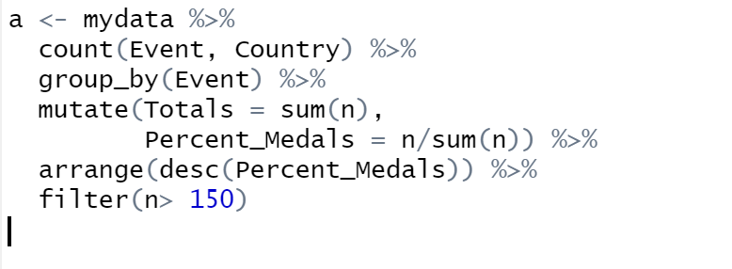
Mutate- adds new variables
and preserves existing.
xlab(label)- for the x axis label
ylab(label) - for the y axis label
Geom histogram-making a histogram

Slide 17
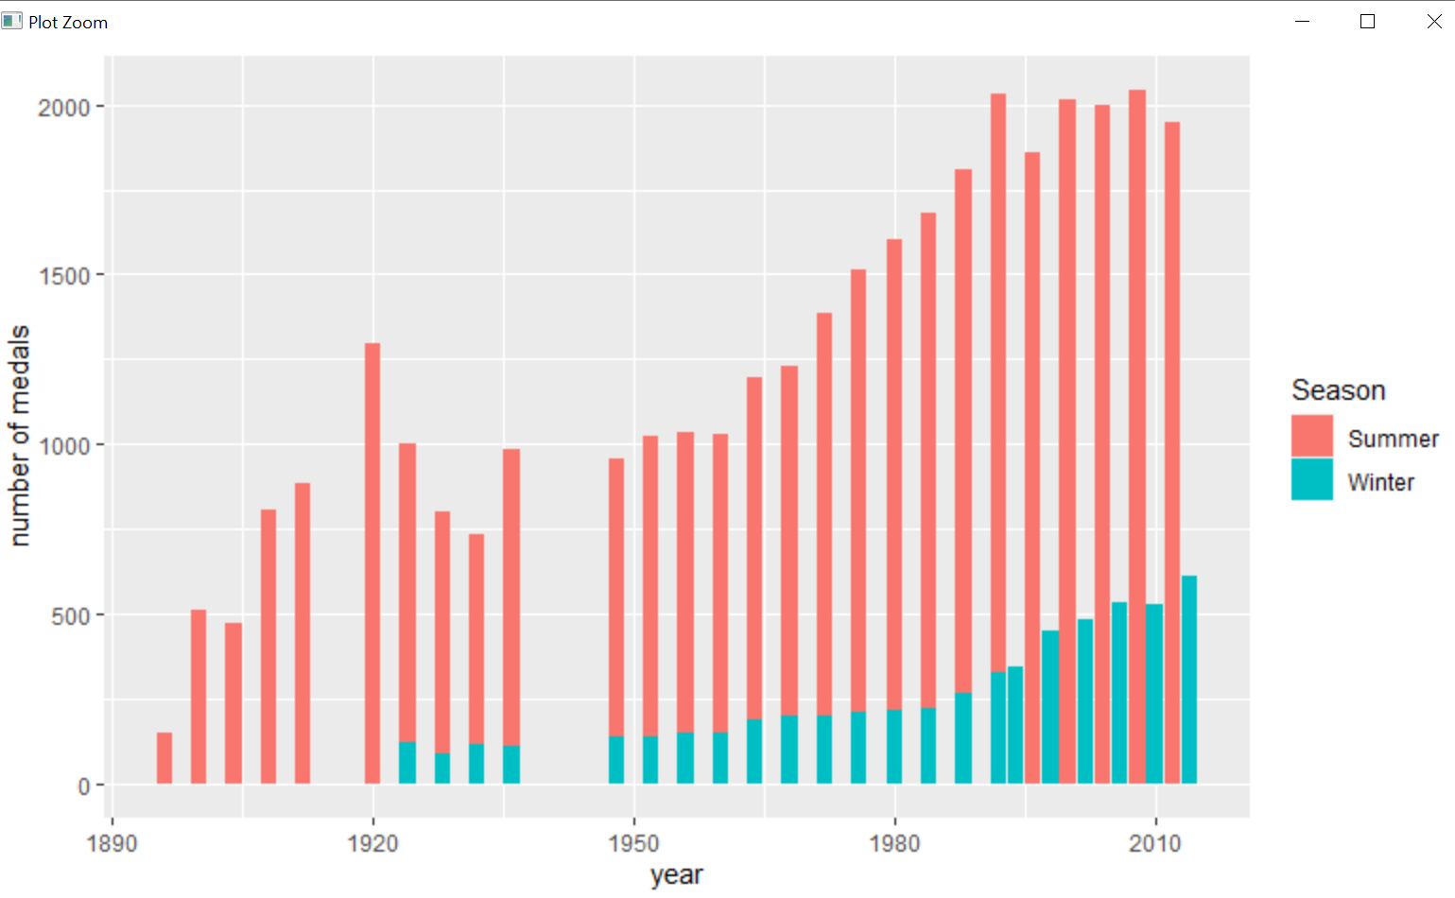
Medals won in each season of olympics till 2012-

Slide 18
