Slide 1
WEEK 8 Presented by: Shaikh Sadik Rahman(12231823 ParbhuRam Khadka(12268198), Sanjaya Poudel (12240769) Course: Cyber Security Technologies

Slide 2
CVE-2022-22965 (Spring Framework RCE Vulnerability)
CVE-ID | CWE | CAPEC | ATT&CK | Used by Threat Actor?
CVE-2022-22965 | CWE-94: Improper Control of Generation of Code ('Code Injection') | CAPEC-137: Parameter Injection | T1059: Command and Scripting Interpreter | Yes
 |  |  | T1071: Application Layer Protocol | Yes
 |  |  | T1027: Obfuscated Files or Information | Yes
Rationale:
Likely to be Exploited: The Spring Framework vulnerability is a remote code execution (RCE) flaw considered as one of the most significant risk factors which is actively exploited by the attackers. Due to this, the Threat Actor may use the vulnerability to execute preformed malicious code as well as perform arbitrary commands on the affected systems.
Action: As RCE vulnerabilities are highly severe, it is suggested to apply the fast patching procedure.

Slide 3
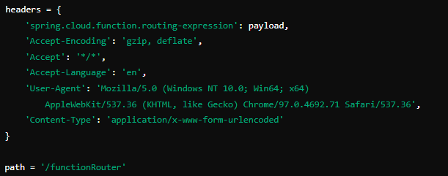
CVE-2022-22965 (Spring Framework RCE Vulnerability)

Slide 4
CVE-2021-44228 (Apache Log4j Vulnerability - Log4Shell)
CVE-ID | CWE | CAPEC | ATT&CK | Used by Threat Actor?
CVE-2021-44228 | CWE-20: Improper Input Validation | CAPEC-111: HTTP Response Splitting | T1190: Exploit Public-Facing Application | Yes
 |  |  | T1071: Application Layer Protocol | Yes
 |  |  | T1059: Command and Scripting Interpreter | Yes
Rationale:
Highly Likely to be Exploited: This vulnerability known as Log4Shell enables the attackers to control the log data that the Log4j system processes resulting to RCE. It has been noticed that various Threat Actors are frequent in exploiting this vulnerability because of its prevalence across industries.
Action: The updates must be made without delay along with the patching as well. Either remove or limit the existing susceptible versions of Log4j or limit its use till the issuance of the patches.

Slide 5
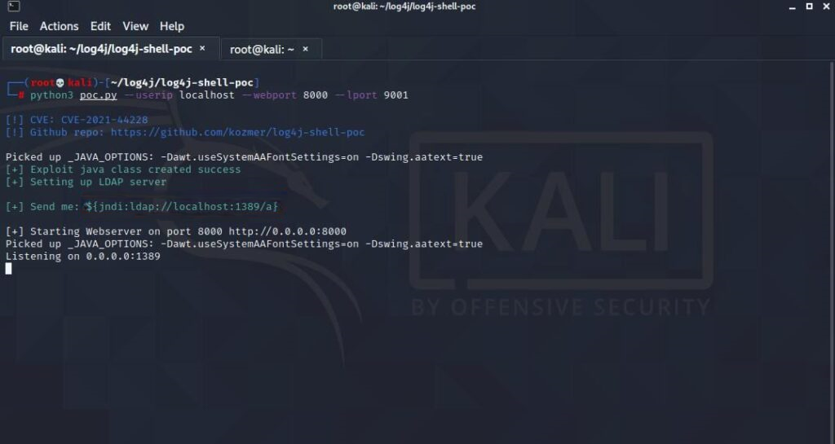
CVE-2021-44228 (Apache Log4j Vulnerability - Log4Shell)

Slide 6
CVE-2020-1472 (Zerologon Vulnerability)
CVE-ID | CWE | CAPEC | ATT&CK | Used by Threat Actor?
CVE-2022-22965 | CWE-94: Improper Control of Generation of Code ('Code Injection') | CAPEC-137: Parameter Injection | T1059: Command and Scripting Interpreter | Yes
 |  |  | T1071: Application Layer Protocol | Yes
 |  |  | T1027: Obfuscated Files or Information | Yes
Rationale:
Likely to be Exploited: Zerologon gives an attacker full domain controller privileges without any prior knowledge of the password. It is a very severe form of vulnerability because can be exploited to achieve full control of a network. This could equally be used by the Threat Actor to easily compromise an entire enterprise environment.
Action: Secure the domain controllers and plug the hole so that an attack cannot occur.

Slide 7
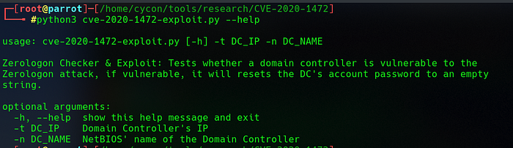
CVE-2020-1472 (Zerologon Vulnerability)

