Slide 1
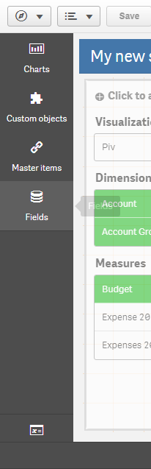
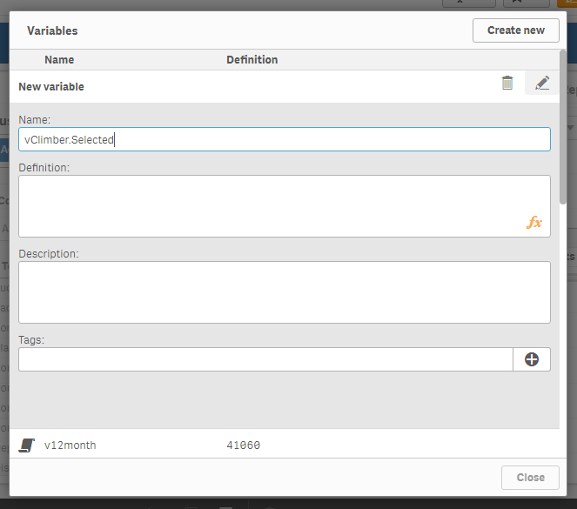
Click here to add New Variable
Click here to Save
Enter the Name of the Variable
Click here to Open Variable Editor

Slide 2
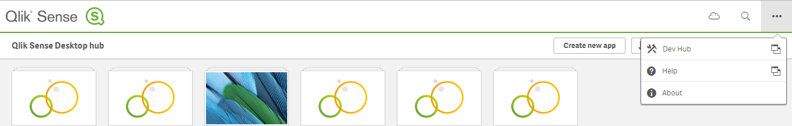
Open Qliksense Dev-Hub

Slide 3
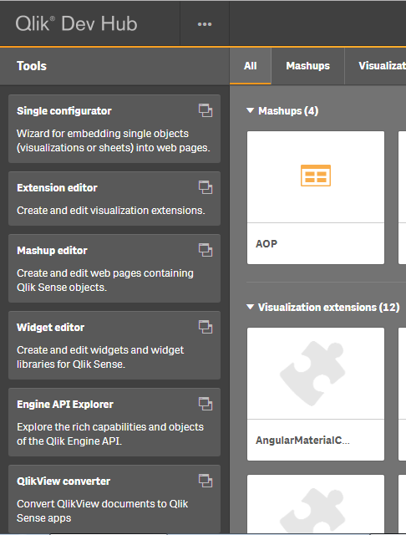
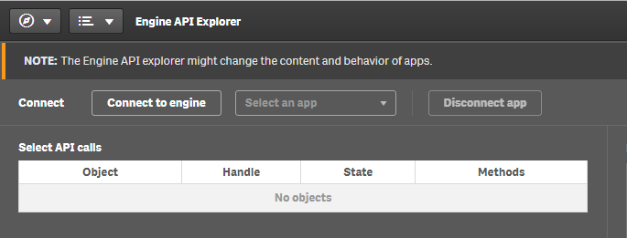
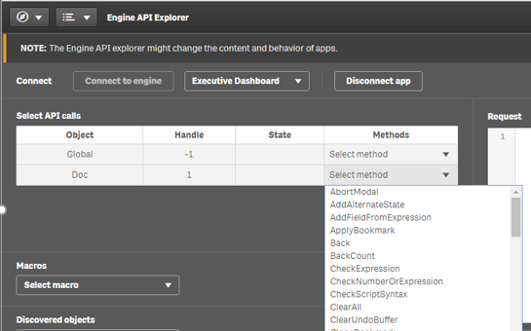
Select The app from dropdown
Select Connect to Engine Button
Select “GetVariableByName” Method
Open Engine API Explorer

Slide 4
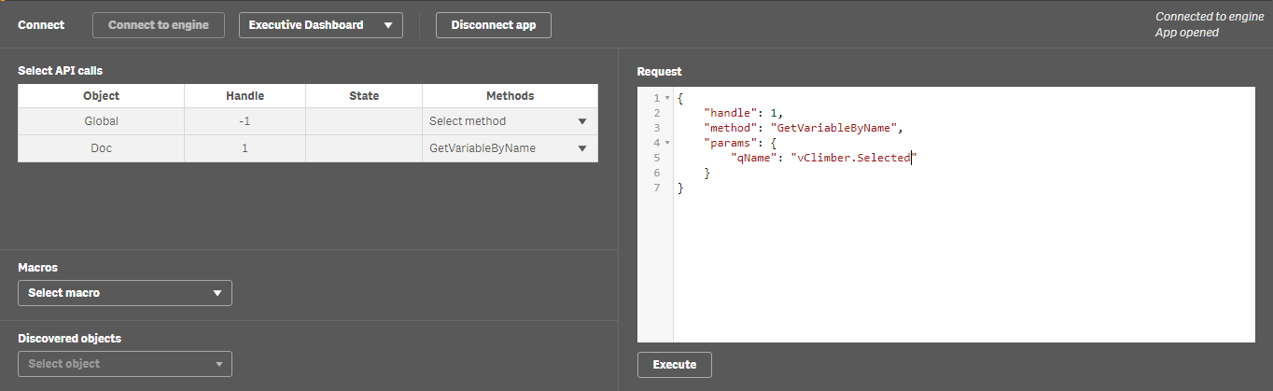
Enter the variable that is created in first step
Execute the Method

Slide 5
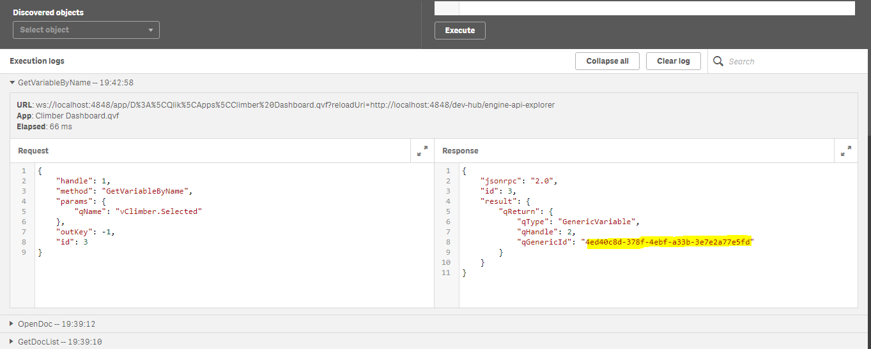
Expand the Log
Copy the qGenericId

Slide 6
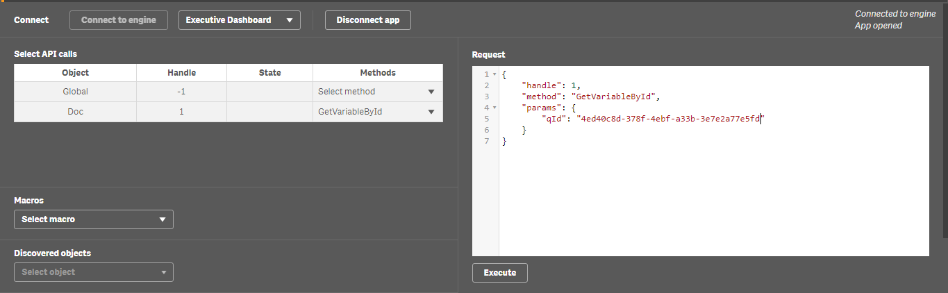
Enter the variable id copied in the previous step
Execute the Method

Slide 7
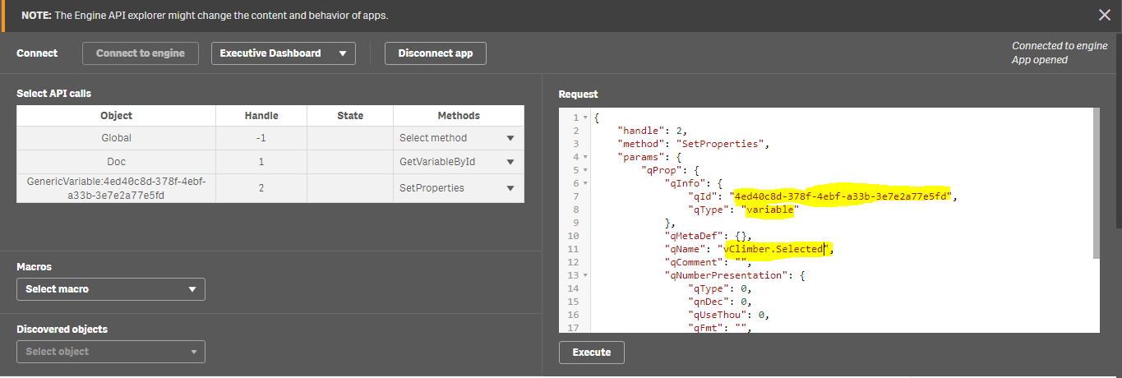
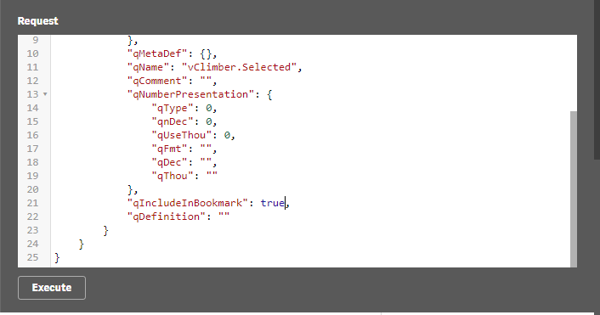
Enter the variable id, Name and type
Execute the Method
Set “qIncludeInBookmark” To “true”

Slide 8
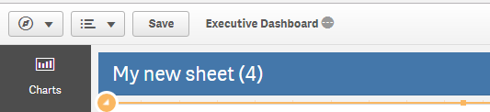
Save the application

Slide 9
