Slide 1


L&T’s involvement in the defense and aerospace sectors in India and
globally has been a key aspect of its business and revenue generation
showcasing the company’s commitment and engineering prowess
to supporting India and its ally’s national security objectives.
L&T’s involvement in defense sector dates back in 1950’s when the
company started manufacturing equipment for Indian armed forces
and began started offering solutions and responding to the RFI’s
(Request for Information) notices from the defense ministry.
The company’s defense solutions encompasses of land based weapon
delivery systems, air defense, artillery systems, naval vertical launch
systems with fire control systems, combat engineering systems,
communications, avionics, etc. L&T is also involved in making launching
and tracking systems for ISRO’s aviation sector and space missions.
https://annualreview.larsenturbo.com/defence-aerospace.html
According to official press release of 1st march 2024, L&T was awarded a
major contract by the ministry of Defense for the supply of HPR over-the
horizon radars for Indian air force. These radars are equipped with next
generation long range ariel surveillance

Slide 2
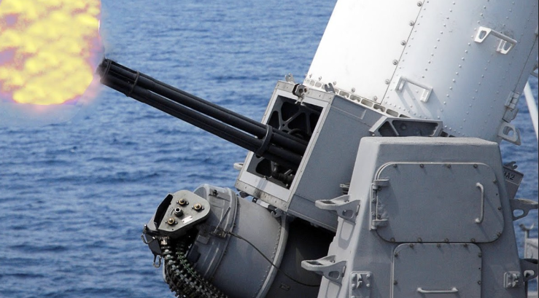
Earlier this, L&T also signed a major contract for the supply of
Indigenously developed Close-in weapon systems for Indian navy and
Indian coast guard . CIWS is planned for deployment at various
locations across the coast of India to protect vital assets from all
types of low flying, low signature ariel threats including UAVs thereby
contributing immensly to the country’s last layer of ariel defense.
https://www.larsenturbo.com/pressreleases/2024-03-01-it-signs-major-
contract-for-high-power-radars/
L&T has also executed or is executing Indian navy’s shipbuilding projects
in partnership with its French and German counterparts under “Make
in India” program with considerable Transfer of Technology clause.
Its portfolio for naval systems include :-
Frontline warships like Destroyers, Frigates and Corvettes
2. Landing platforms docks
Diving, Survey, Underwater research vessels
Offshore patrol vessels, Fast interceptor boats, etc
https://www.lntshipbuilding.com/products-services/new-construction
-defence-shipbuilding/

Slide 3
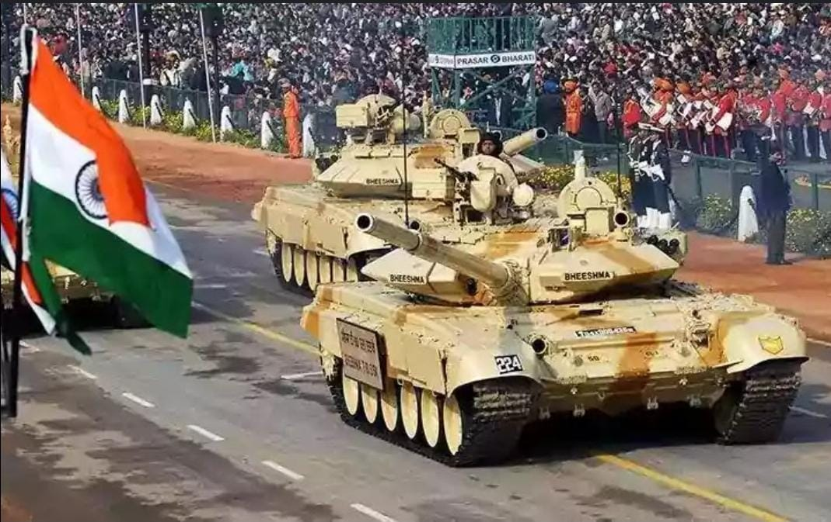

Further, Larsen and Turbo (L&T) played a pivotal role in Indian army’s
howitzer project K9 in partnership with South korea’s Hanwha
defense. It was the prime bidder of this program which involved the
delivery 100 such platforms under license with an option 100 more
If founded necessary.
The K9 mobiled howitzer systems delivered by L&T featured
more than 80% indigenous work packages and above 50%
Indigenization by value at the program level. This lead to exposure
of local workforce of L&T to foreign platforms, and this skill can
further be used while making such indigenous platforms.
L&T also has a proven record in submarine building. It has experience
in manufacturing of submarine grade low alloy steels. It has partnered
with DRDO for indigenous development of Fuel cell air-independent
propulsion system, the crucial technology which will enable diesel
electric submarines to operate underwater for 2-3 weeks continuously.
Leveraging, the track record it gained over decades, L&T has today
accomplished the in-house design for midjet submarines starting
from the very fast fundamentals, basic design, and technical design
and had it certified for the operations of Indian navy.

Slide 4
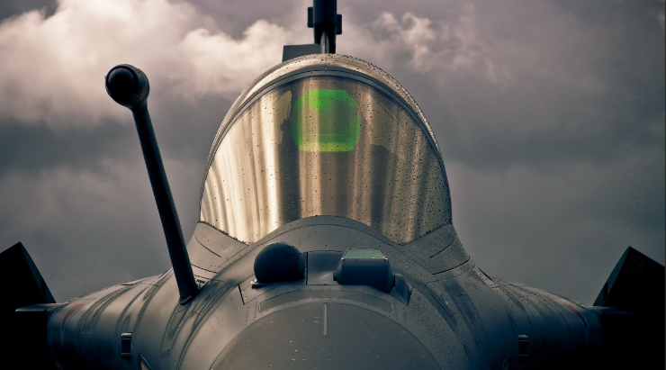
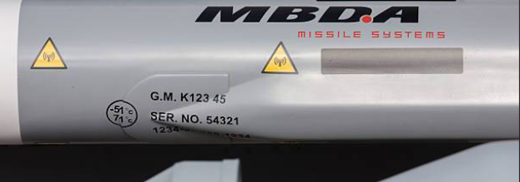
L&T is also involved in various Indian airforce’s projects. The Tejas Mk1
from Initial operational clearance block, tail number SP-16 is flying with
wings made by L&T. The full structure ( both left and right ) part of wings
was manufactured under HAL-L&T’s public-private partnership model.
https://www.onmanorama.com/news/india/2019/03/25/tejas-flies-on-l-and-t-
wings-hal-ioc-fighter.html
L&T was also garnered a multi year $100 million+ electric air mobility
Deal from Jaunt air mobility. As part of this subcontract, L&T will open
An engineering and R&D centre in Quebec province of Canada to provide engineering services for electrical vertical
takeoff and landing air taxi.
L&T facilities include state-of-the-art Greenfield shipyard near Chennai which is used for assembly and integration of
naval and land based systems, it also has a precision manufacturing and systems complex at Coimbatore which produces
airframe assemblies, components and subsystems. It also has a strategic electronics center at Banglore which undergoes
manufacturing of military communication systems and avionics.
It has a 51:49 joint venture with MBDA missile systems,
which is an European multi-national missile consortium.
This was seen as a major achievement, as in part of
this JV, L&T will manufacture different land based, sea
based & air based missile systems for Indian armed forces
under Transfer of Technology from original manufacturer.

