Slide 1

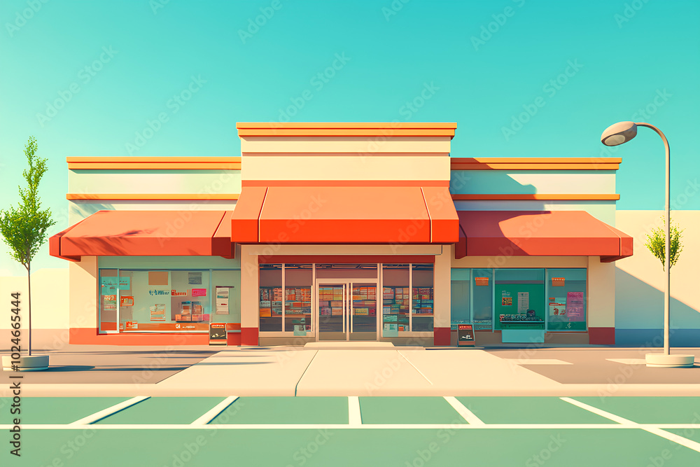
A SQL PROJECT ON
GROCERY STORE MANAGEMENT
Presented by
Digoju Prabhukumar

Slide 2
Introduction
The Retail and Grocery domain involves managing inventory, suppliers, customer orders, employees, and product categories.
Effective data handling enables businesses to track sales and revenue, monitor stock availability, and evaluate daily operations.
This project simulates a mini grocery store database, modeling entities such as products, orders, and suppliers, and the relationships among them.
It offers hands-on experience in understanding data relationships and operational workflows.
Students use SQL to extract and transform data, gaining valuable business insights.
The goal is to improve decision making and operational efficiency through data analysis.

Slide 3
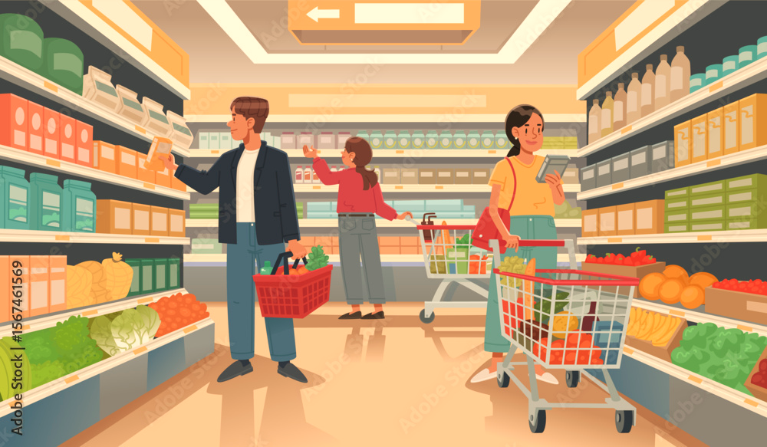
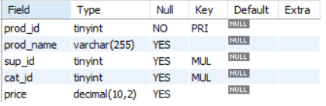



Tables
Products table
Suppliers table
Categories table
Customers table

Slide 4

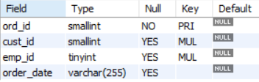
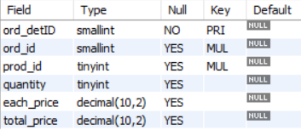
Tables
Orders table
Employees table
Order_details table

Slide 5
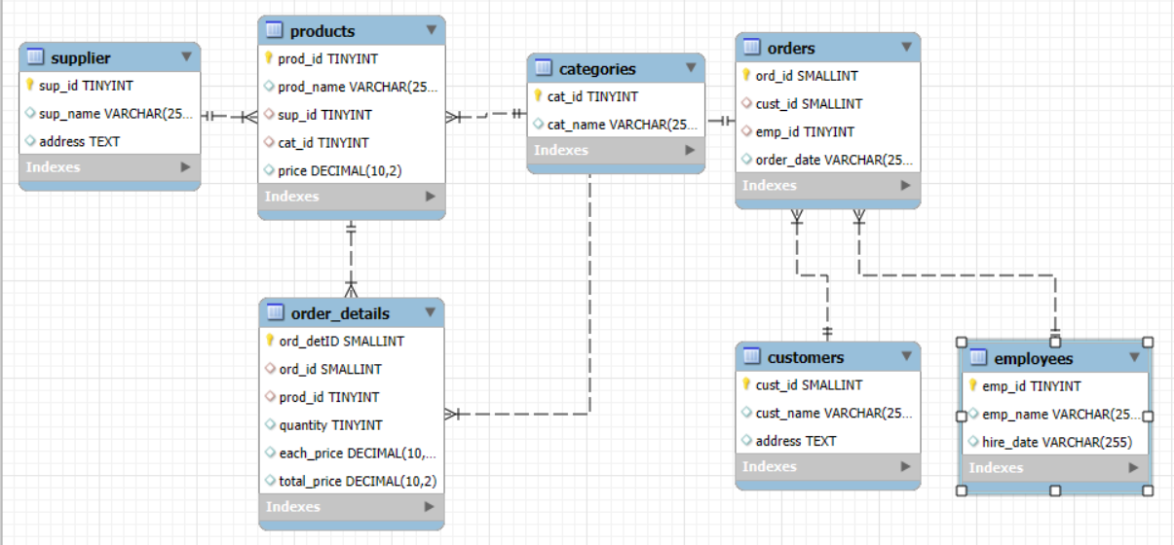
ER Diagram

Slide 6
Problem Statement
In the dynamic environment of a retail grocery store, managing and analyzing large volumes of data related to products, suppliers, customers, and orders is crucial for efficient operations and informed decision making. This project aims to design and implement a relational database system that captures essential store activities and enables users to retrieve and analyze data through SQL. The system will support complex queries to identify key business insights such as top performing products, high value customers, and revenue patterns, while reinforcing practical SQL skills including joins, aggregations, subqueries, and filtering.

Slide 7
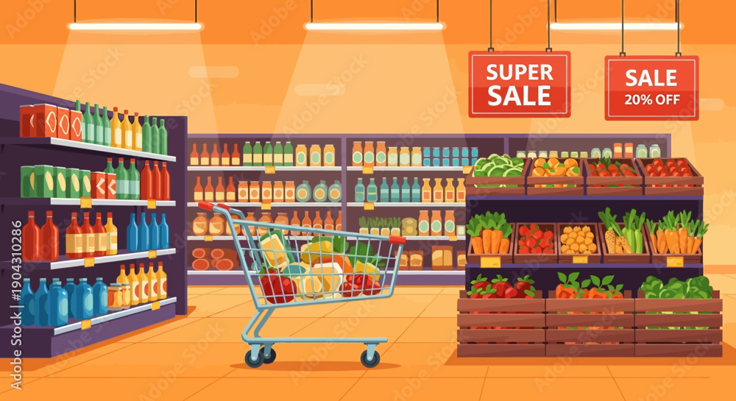


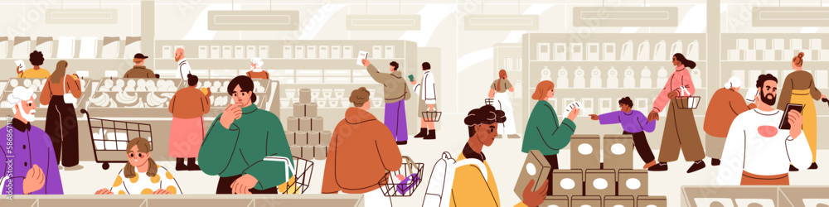
Analysis Questions :
Customer Insights
1.How many unique customers have placed orders?

Slide 8
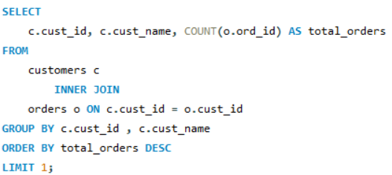

2.Which customers have placed the highest number of orders?

Slide 9
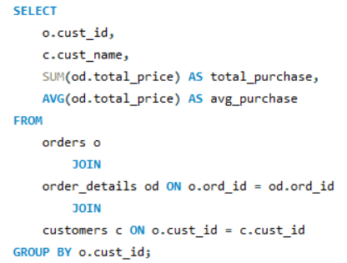
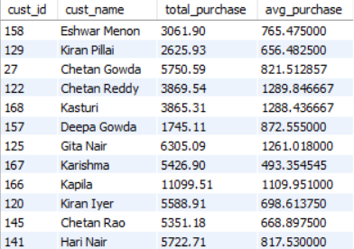
3.What is the total and average purchase value per customer?

Slide 10
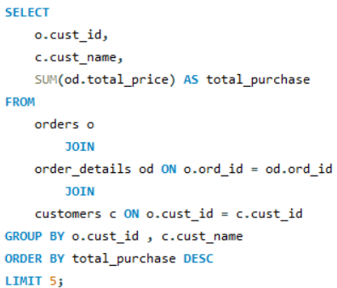
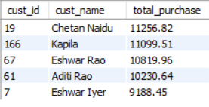
4. Who are the top 5 customers by total purchase amount?

Slide 11
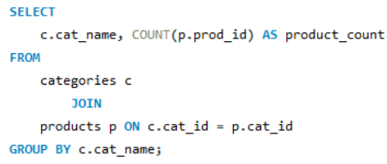
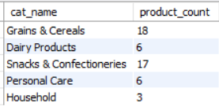
Product Performance
1. How many products exist in each category?

Slide 12
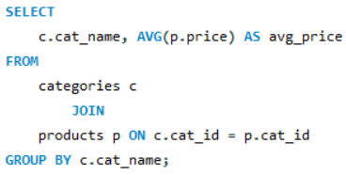
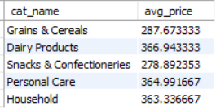
2. What is the average price of products by category?

Slide 13
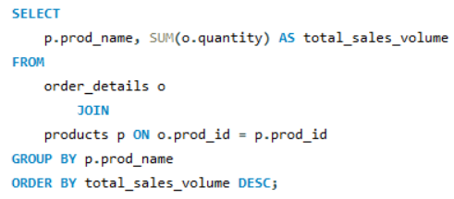
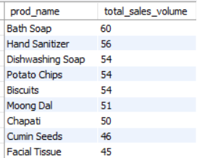
3. Which products have the highest total sales volume (by quantity)?

Slide 14
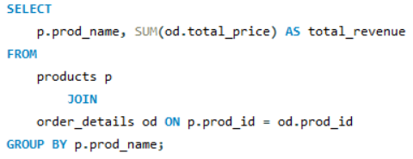
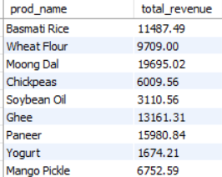
4. What is the total revenue generated by each product?

Slide 15
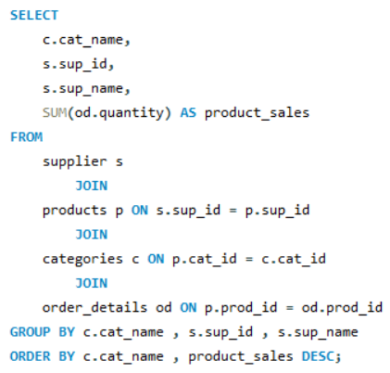
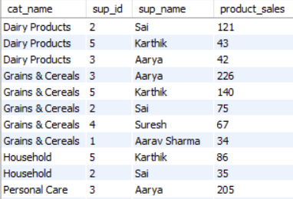
5. How do product sales vary by category and supplier?

Slide 16
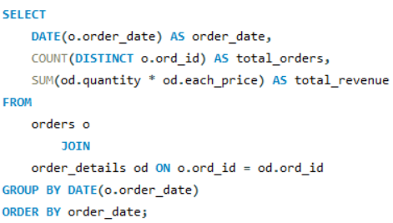

Sales and Order Trends
Analyze business performance through orders and revenue over time.
How many orders have been placed in total?

Slide 17
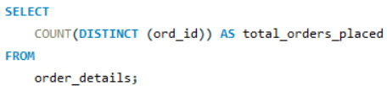

2. How many orders have been placed in total?

Slide 18
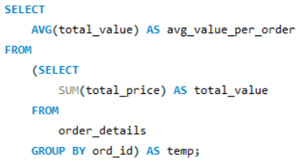

3. What is the average value per order?

Slide 19
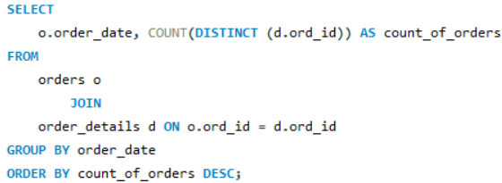

4. On which dates were the most orders placed?

Slide 20
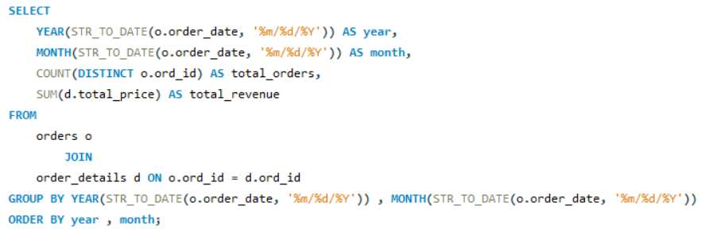
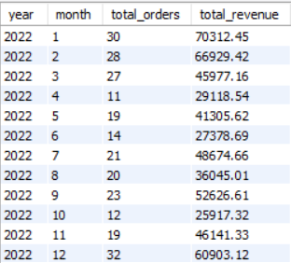
5. What are the monthly trends in order volume and revenue?

Slide 21


Supplier Contribution
1.How many suppliers are there in the database?

Slide 22
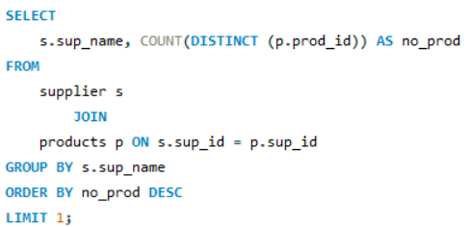

2.Which supplier provides the most products?

Slide 23
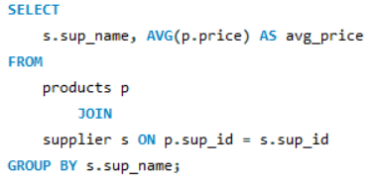
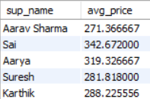
3.What is the average price of products from each supplier?

Slide 24
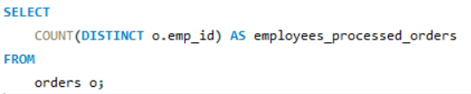

Employee Performance
1.How many employees have processed orders?

Slide 25
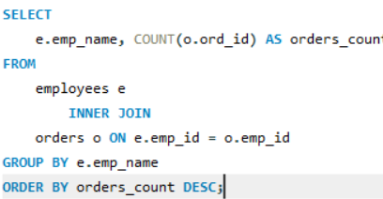
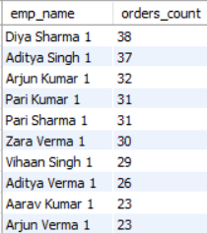
2.Which employees have handled the most orders?

Slide 26
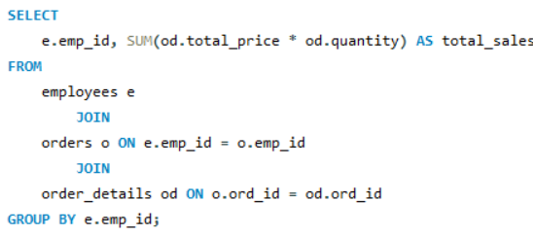
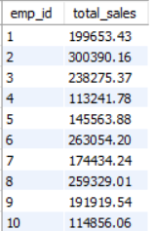
3.What is the total sales value processed by each employee?

Slide 27
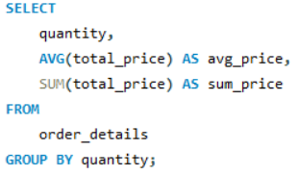
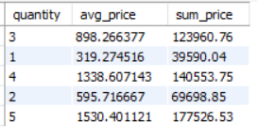
Order Details Deep Dive
1. What is the relationship between quantity ordered and total price?

Slide 28
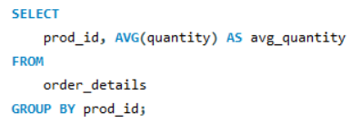
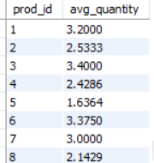
2. What is the average quantity ordered per product?

Slide 29
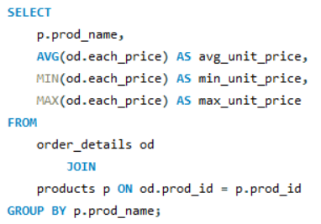
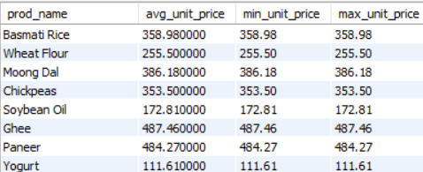
3. How does the unit price vary across products and orders?

Slide 30
Conclusion
This SQL-based Grocery Store Management project demonstrates how SQL can be used to efficiently manage and analyze grocery store data. By working with customer, product, sales, inventory, and transaction data, the project provides useful insights into store operations and sales performance.
The analysis helps identify best-selling products, customer purchasing patterns, sales trends, and inventory requirements. Overall, the project shows how database management and SQL queries can support better decision-making, improve operational efficiency, and help manage a grocery store effectively.

Slide 31

THANK YOU
Digoju Prabhukumar

