Slide 1
A WEB SCRAPING
ELECTRIC VEHICLE MARKET INTELLIGENCE
PRESENTED BY
D.PRABHUKUMAR
Notes:
Introduce the project: an automated scraper that collects electric vehicle specs and prices from EV Database and saves them as a CSV.

Slide 2




Project objectives
What this project set out to do
Automate collection
Capture 12 data fields
Scrape EV specs and prices from EV Database with Python, instead of copying them by hand.
Price, range, battery, charging speed, efficiency, weight, acceleration, towing, cargo and more.
Build a clean CSV
Make it reusable
Save everything in one tidy file that is ready for analysis, charts and machine learning.
Python, Requests, BeautifulSoup and Pandas make it easy to run again for fresh data.
Notes:
Four goals: automate, capture 12 data fields, produce a clean CSV, and keep the scraper reusable.

Slide 3
Data source
EV Database: a public site comparing EVs sold in Europe (price, range, charging, performance)
https://ev-database.org/#group=vehicle-group&rs-pr=10000_100000& … &p=0-{i}
What the filters in the URL mean
rs-pr
rs-er
rs-ac
rs-dcfc
Price: €10,000 – €100,000
Real range: 0 – 1,000 km
0–100 km/h: 2 – 23 sec
DC fast charge: 0 – 400 kW
rs-ef
rs-w
rs-c
p=0-{i}
Efficiency: 100 – 350 Wh/km
Weight: 1,000 – 3,500 kg
Cargo: 0 – 5,000 L
Page number, i = 1 to 140
Notes:
The scraper loops the page number i from 1 to 140 (range(1, 141) in the code).

Slide 4






Tech stack
Six simple Python tools do all the work
Python 3
Requests
BeautifulSoup4
The core scripting language.
Sends HTTP calls with a custom header.
Reads the HTML and picks out tags.
Pandas
NumPy
time.sleep()
Builds the DataFrame and exports the CSV.
Supplies NaN for missing values.
Pauses 3 seconds between requests.

Slide 5





Pipeline architecture
From live web pages to a CSV file in six steps
Target pages
1
HTTP request
2
Parse HTML
3
Loop the page index 1 to 140 over the ev-database.org URL.
requests.get() sends a custom header with a browser-style user_agent.
BeautifulSoup finds every item-data box on the page.
Extract fields
4
Build table
5
Export CSV
6
Read 12 fields per box, or NaN if a tag is missing.
12 parallel lists become one Pandas table.
df.to_csv() saves EV_EXTRACTED.csv.

Slide 6
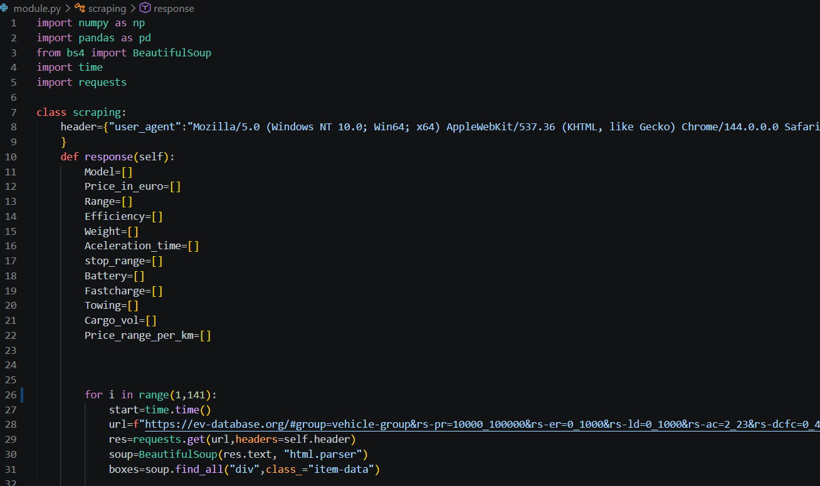
Code walkthrough 1: setup and page loop
What this code does
Imports and the scraping class
Custom header dictionary with a browser-style user_agent string
12 empty lists, one per CSV column
for i in range(1, 141) loops over 140 pages
BeautifulSoup finds every div.item-data box

Slide 7
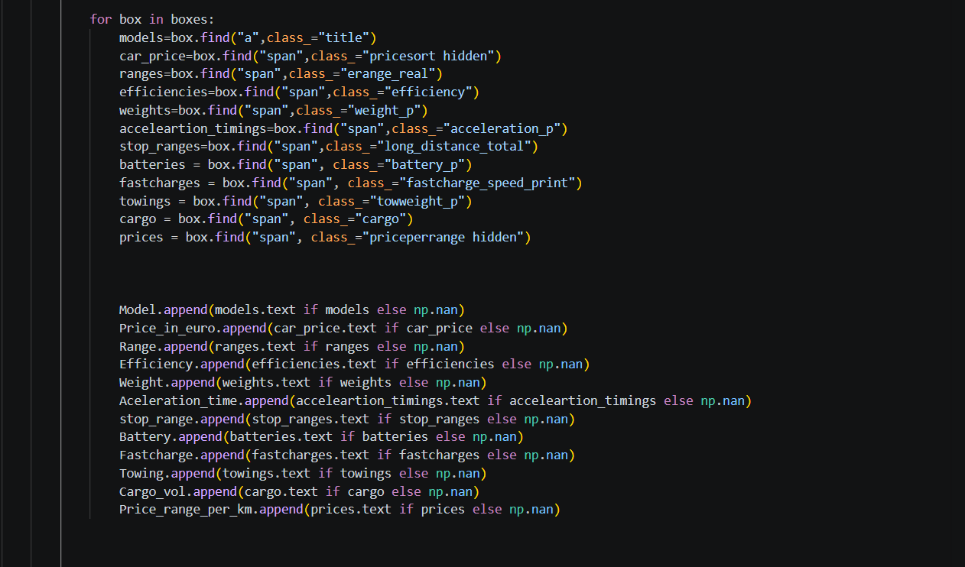
Code walkthrough 2: extracting fields
What this code does
Each box holds the data of one car
box.find() looks up one tag per field
Tags such as a.title and span.erange_real
append() saves the text, or np.nan if the tag is missing

Slide 8
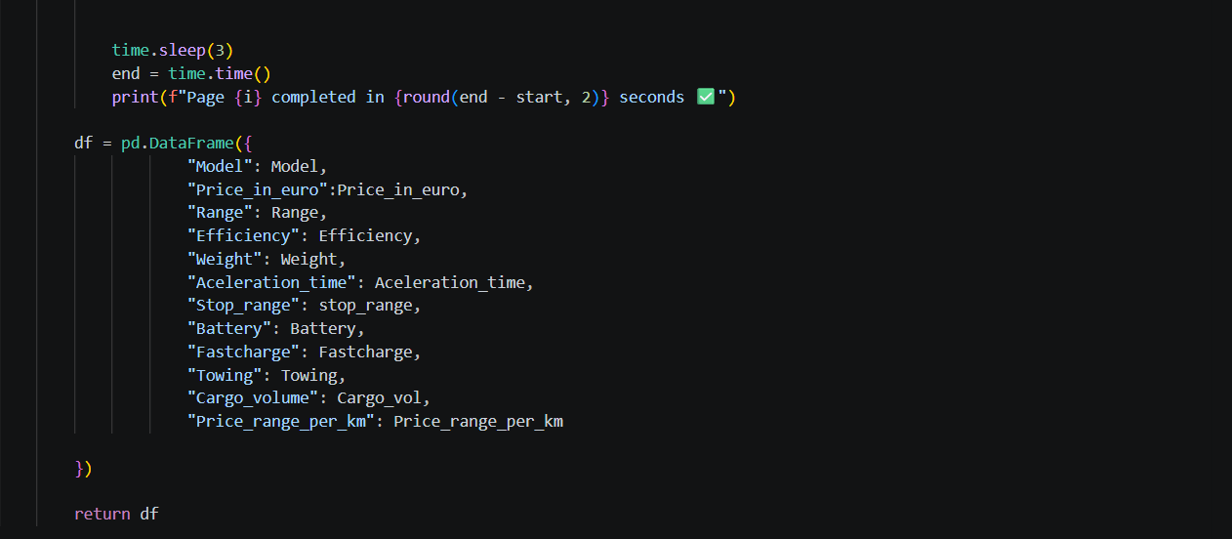
Code walkthrough 3: build the DataFrame
What this code does
time.sleep(3) pauses 3 seconds between pages
Prints how long each page took
12 lists become one Pandas DataFrame
return df hands the table back to run.py

Slide 9
Field extraction map
Each listing is a div.item-data box; one HTML tag feeds each CSV column
CSV column | HTML selector (tag.class) | Example value (first row)
Model | a.title | MG MG4 Electric 64 kWh
Price_in_euro | span.pricesort hidden | 37255
Range | span.erange_real | 360 km
Efficiency | span.efficiency | 171 Wh/km
Weight | span.weight_p | 1726 kg
Aceleration_time | span.acceleration_p | 7.9 sec
Stop_range | span.long_distance_total | 405 km
Battery | span.battery_p | 61.7 kWh
Fastcharge | span.fastcharge_speed_print | 115 kW
Towing | span.towweight_p | 500 kg
Cargo_volume | span.cargo | 363 L
Price_range_per_km | span.priceperrange hidden | 103

Slide 10
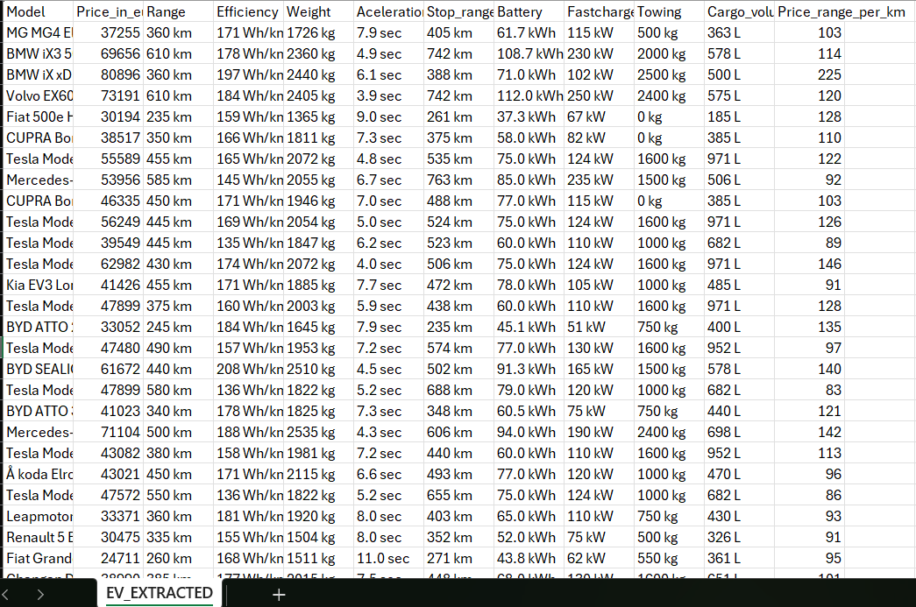
Execution and output
Run run.py once and the CSV is saved
run.py
from module import scraping
obj = scraping()
df = obj.response()
df.to_csv("EV_EXTRACTED.csv",
index=False)
≈ 7 min
of waiting only: 140 pages × 3 sec pause = 420 sec, plus the time for each request
EV_EXTRACTED.csv in Excel: 169,960 rows × 12 columns

Slide 11
Dataset snapshot
What the scraper collects across 140 pages
169,960
1,214
74
12
rows scraped (140 pages)
unique rows after removing duplicates
car brands
columns of data
1,214 unique listings × 140 page loops = 169,960 rows
All 140 loops return the same listing, so 168,746 rows are repeats and need removing before analysis.
Notes:
169,960 = 1,214 unique listings x 140 page loops. Every loop returns the same page because everything after # stays in the browser. Re-run run.py to confirm the final row count.

Slide 12
Key metrics at a glance
Averages and extremes across the 1,214 unique listings
€65,403
376 km
€17,698
average listed price
average real-world range
cheapest: Dacia Spring Electric 45
€384,930
720 km
2.0 sec
priciest: Rolls-Royce Spectre
longest range: Lucid Air Grand Touring
fastest 0–100 km/h: Lucid Air Sapphire

Slide 13
Top brands by listings
Unique model variants per manufacturer (top 10)
114
variants from Mercedes-Benz, the most of any brand
53%
of all listings come from just these 10 brands (641 of 1,214)

Slide 14
Price vs range
Each dot is one of the 1,214 unique listings
+0.89
battery size ↔ range: the strongest link
+0.55
price ↔ range: pricier EVs go further
−0.56
price ↔ 0–100 time: pricier EVs accelerate faster

Slide 15





Challenges and learnings
What we found while checking the data
Duplicate rows
Filters not applied
Doubled model names
All 140 page loops fetch the same listing: 168,746 of 169,960 rows are repeats.
Text after # stays in the browser, so 176 listings cost more than the €100,000 filter.
688 of 1,214 listings repeat the title twice, so names need cleaning.
Missing values handled
Polite rate limit
Fragile selectors
Each field falls back to np.nan. Our data had 0 gaps.
time.sleep(3) between pages lowers the load on the site.
Class names like erange_real could break after a site redesign.

Slide 16
Conclusion and future scope
What we achieved and where to go next
Conclusion
Future scope
Built an automated scraper for EV data
Collected 169,960 records with 12 attributes
Found 1,214 unique listings from 74 brands
Saved a CSV ready for analysis and charts
Showed the value of Python web scraping for EV market research
Fix pagination so each page returns new listings
Remove duplicates and clean model names automatically
Add more EV websites as data sources
Schedule scraping to track price changes over time
Build a dashboard and a price prediction model

Slide 17

Thank you
D.PRABHUKUMAR
Web Scraping Project on Electric Vehicle Market Intelligence

