Slide 1
FINAL YEAR PROJECT | PROJECT REVIEW
SmartCricket AI
An Explainable Multimodal Cricket Shot Analysis and Intelligent Virtual Coaching System
BASE PAPER
CricShot10k: A Large-Scale Video Dataset for Cricket Shot Classification
M. K. Dihan, Abdullah, Amina and S. Ahmed | IEEE Access, vol. 14, 2026
STUDENT
Prabhu
DEPARTMENT
Computer Science
ACADEMIC YEAR
2026–2027
COLLEGE
[Insert College Name]
GUIDE
[Insert Guide Name]
Photo: Javs1233, Wikimedia Commons, CC BY-SA 4.0
Notes:
Good morning. My project is SmartCricket AI. In simple words, it is a web app that looks at a photo or a short video of a batter and tells them which shot they played, how their body moved, and what to practise next. It is built on the CricShot10k paper from IEEE Access, 2026. I will cover the problem, the base paper, what I added, how it works, the results, and a short demo.

Slide 2


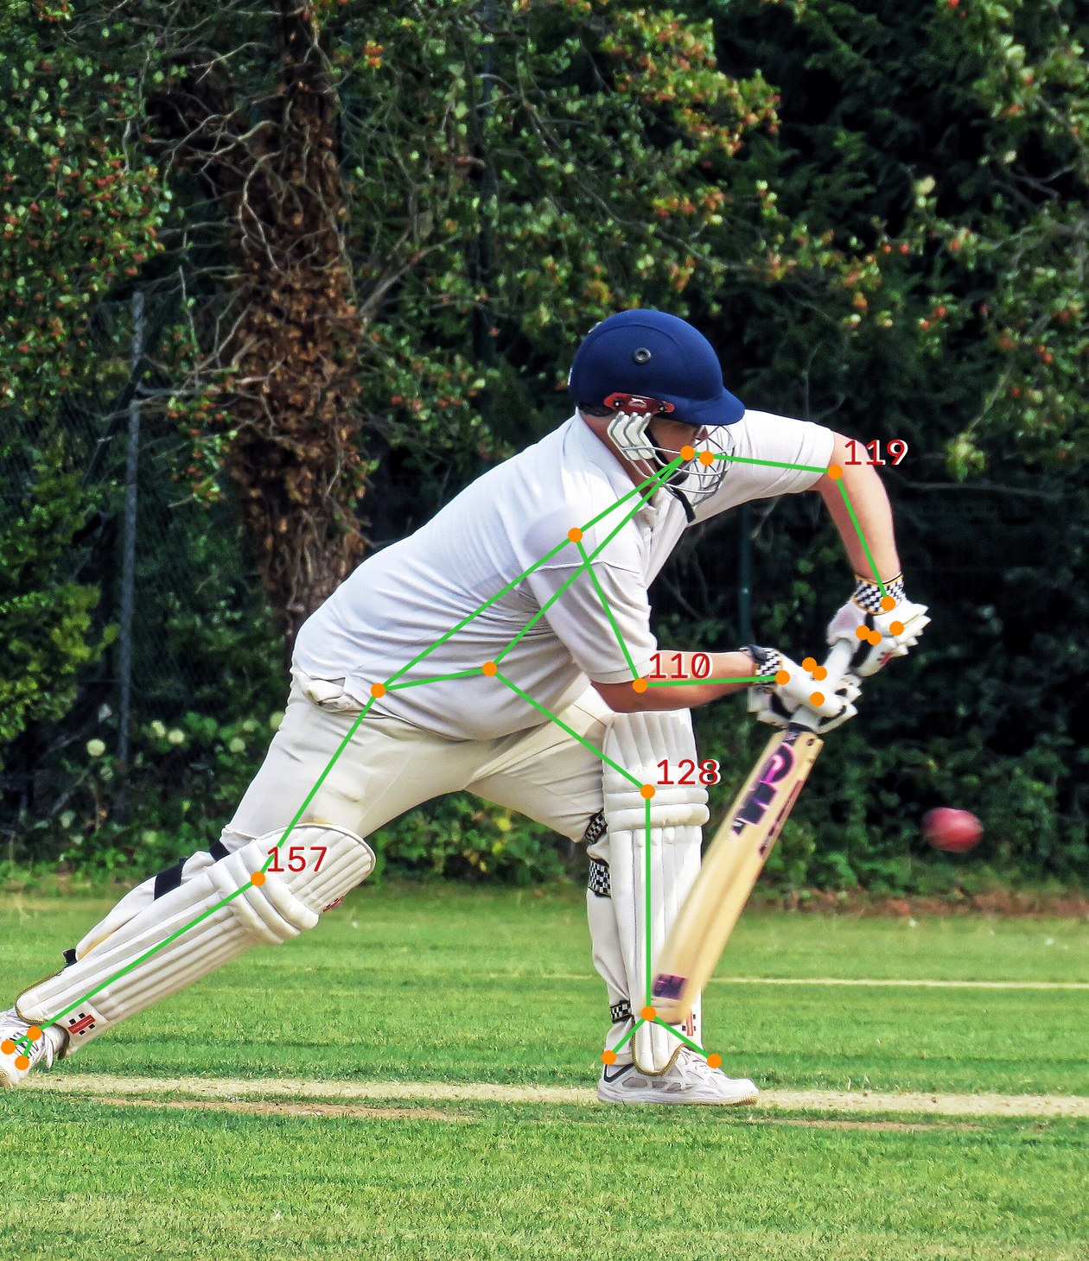


Abstract: The Project in One Slide
SECTION 1 | ABSTRACT
The problem
Starting point
Batting shots are tagged by hand. It is slow, and players rarely get feedback on how they moved.
The CricShot10k dataset: 10,086 one-second clips in 15 shot types, and its CricShotNet model.
What I built
Main result
A web app: photo posture report, video shot analysis, heatmaps, comparison with a model player, AI coach and daily training.
Adding body pose to video raised accuracy from 56.2% to 63.9% on 1,289 test clips (statistically significant).
Photo: Acabashi, CC BY-SA 4.0; skeleton by SmartCricket AI
Notes:
This one slide is the whole project. The problem: shots are tagged by hand and players get little feedback. The base paper gave a big dataset and a strong model. I built a full web app around it, and I tested one research question: does adding the body skeleton to the video help? It does: accuracy went up by about 8 points, and a statistical test shows this is not luck.

Slide 3
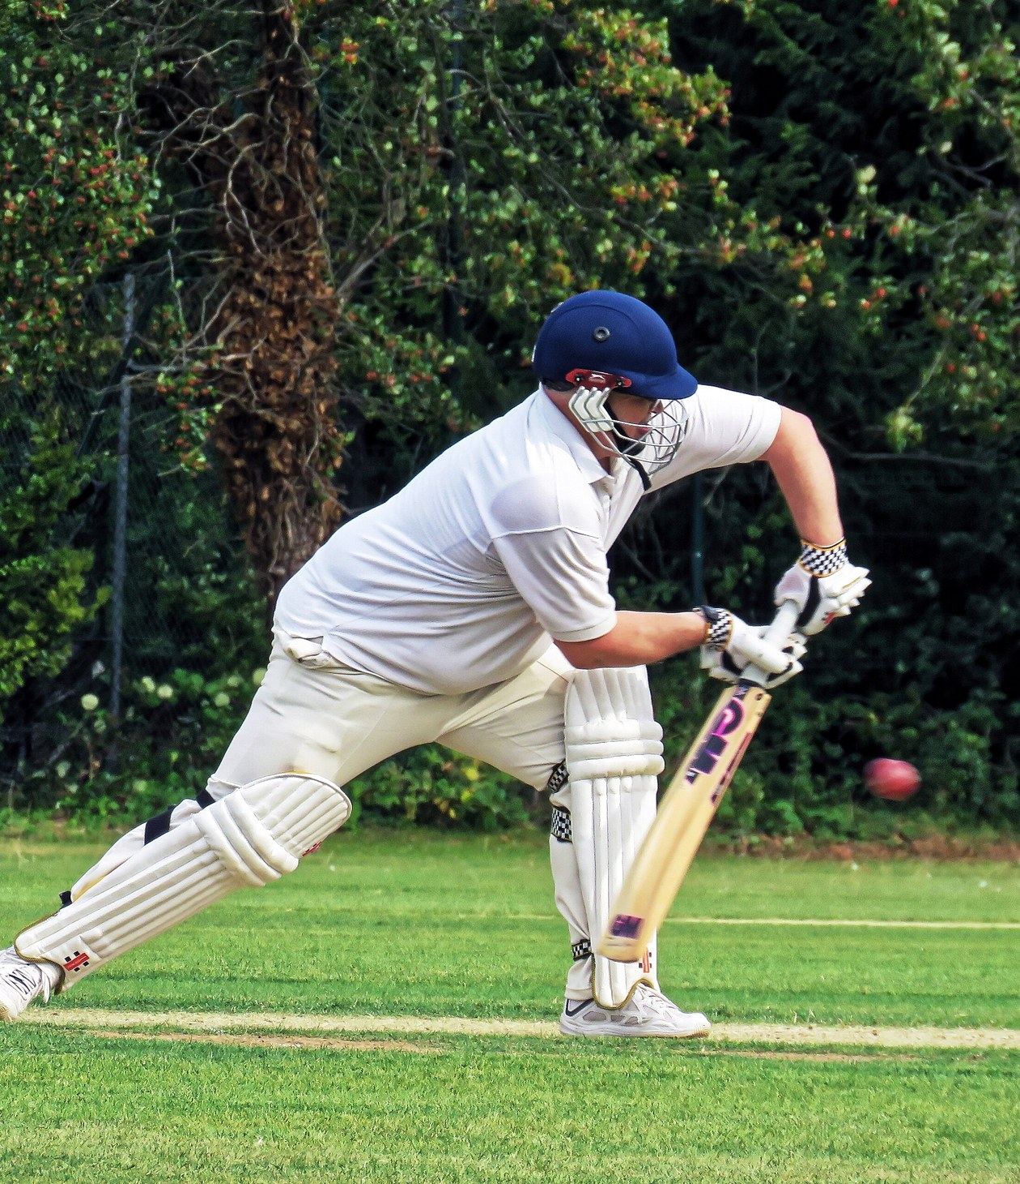




Why This Project
SECTION 1 | INTRODUCTION
Manual work is slow
Feedback is rare
Someone has to watch every ball and type the shot. Across many matches and nets sessions this does not scale.
Club players and students seldom have a coach watching every session.
AI already helps
My idea
Tennis, football and baseball already use pose tracking and video models.
Take a strong published model, make it explain itself, and put it in an app a player can use every day.
Photo: Acabashi, Wikimedia Commons, CC BY-SA 4.0
Notes:
Why does this matter? Tagging shots by hand is slow. Most players do not have a coach at every session. Other sports already use AI for this. So my idea was to take a proven model and turn it into a useful, honest tool for players and coaches.

Slide 4
Project Objectives
SECTION 1 | OBJECTIVES
1
2
3
4
5
Rebuild the base model
Add body pose
Compare the models
Build photo and video modes
Explain and coach
Train the CricShotNet-style video model (EfficientNetV2-S + GRU) on CricShot10k.
Find 33 body points with MediaPipe and turn them into joint angles.
Video only, pose only and video + pose on the same test clips.
One web app: HTML, CSS, JavaScript front end and FastAPI back end.
Heatmaps, comparison with a model player, an AI coach and a daily training plan.
DONE
DONE
DONE
DONE
DONE
Notes:
There were five objectives, and all five are complete. One: rebuild the base model. Two: add the body skeleton. Three: compare video only, pose only and both together. Four: build the app with photo and video modes. Five: make it explain its answers and coach the player.

Slide 5
Literature Survey
SECTION 2 | LITERATURE SURVEY
Work | Data | Method | Reported | Gap
Hoque et al., 2023 (KUCricShot) | 1,278 clips, 4 shots | LRCN | 73% | Few shots, right-handers only
Sen et al., 2021 (CricShotClassify) | 1,867 clips, 10 shots | VGG16 + GRU | 93% | Long clips, possible overlap
Rao et al., 2025 | 1,922 clips, 6 shots | Pose landmarks only | 80% | Pose alone misses the bat
Dihan et al., 2026 (CricShot10k) | 10,086 clips, 15 shots | CricShotNet | 89% | Base paper
Each paper's own figure on its own data, so the numbers are not directly comparable.
CricShot10k is about five times bigger than the next dataset, so I chose it.
Notes:
Only a few papers classify cricket shots from video. The older datasets are small. Rao et al. used only the body skeleton, which misses the bat. CricShot10k is five times bigger than any other, which is why I chose it as my base paper.

Slide 6
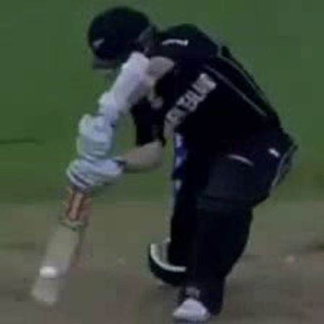
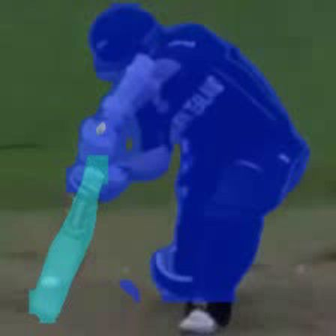
Existing System: CricShotNet (Base Paper)
SECTION 2 | EXISTING SYSTEM
Broadcast clip
1 second
Crop
YOLOv11 finds batter
Sample
15 frames
Tint
bat and batter
EfficientNetV2-S
reads each frame
GRU (128)
follows the swing
Answer
1 of 15 shots
What the authors report
89%
top-1 accuracy
97%
top-2
99%
top-3
Cropping + tinting: 89.1% vs 85.8% with cropping only.
Hardest pair: pull and hook (13% confused).
Crop and tint: Figs. 11-12 of the base paper, CC BY 4.0
Notes:
This is the base paper's system. A one-second clip is cropped around the batter, 15 frames are picked, the bat and batter are tinted, then EfficientNet reads each frame and a GRU follows the swing over time. It reports 89% accuracy. These are the authors' numbers, not mine.

Slide 7





Existing System: Disadvantages
SECTION 2 | EXISTING SYSTEM
No explanation
No app
Broadcast video only
It gives a label and a number, but not why.
Released as data and code only. No upload page, no feedback.
Not tested on phone or nets videos.
Pose not used
No photo support
Confidence not checked
Body movement is ignored, so no posture feedback.
Many players only have a photo of their stance.
A score of 90% may not really mean 90% right.
Notes:
To be fair to the authors, these are gaps for my goal, not mistakes in their paper. Their model does not explain itself, there is no app, it is only tested on TV footage, it does not use body pose, it cannot take a photo, and its confidence scores are not calibrated.

Slide 8



Proposed System: Two Ways to Analyse a Batter
SECTION 3 | PROPOSED SYSTEM
Photo mode
Upload photo
JPG or PNG
Quality check
light, blur, view
33 body points
MediaPipe
Joint angles
2D and 3D
Posture report
picture + table
Video mode
Upload clip
MP4, MOV, AVI
Track batter
15 frames
Classify shot
video + pose
Explain
heatmap, key frame
Compare
with a model player
AI Coach
Daily training
Live mirror
Explains every result in plain words, using only the measured numbers. Speaks with a voice too.
Three drills a day from the player's own weak spots, levels, streaks and a weekly report.
Camera mode: live skeleton, rep counting, voice commands and phone mode.
Notes:
My system has two ways in. Photo mode: upload a photo, the app checks the picture quality, finds 33 body points, measures the joint angles and gives a posture report. Video mode: upload a short clip, the app follows the batter, names the shot, shows where the model looked, and compares the movement with a model player. On top of both sit the AI coach, a daily training plan and a live camera mirror.

Slide 9






All Features at a Glance
SECTION 3 | NEW IN THIS PROJECT
Photo posture report
Video shot analysis
Heatmaps
Key-frame timeline
Angles, visibility and a 3D view from one photo.
Shot name, honest confidence and top-3 answers.
Shows where on the frame the model looked.
Shows which moment of the swing decided it.
Compare with a pro
Movement analysis
AI Coach + voice
Training coach
Joint-by-joint gap to a reference clip (DTW).
Works on any clip, even without a trained model.
Answers questions from the measured facts only.
Daily drills, check-in, quiz, levels and XP.
Live mirror
Phone mode
History and PDF
Admin console
Live skeleton, rep count, Shadow the Pro.
Scan a QR code and use the phone camera.
Every result saved; one-click PDF report.
Players, reference clips and model results.
Notes:
These are all twelve features in the finished app. I will show each one with a real screenshot in the module slides. Everything you see later is a real screen from the running system, not a mock-up.

Slide 10




Proposed System: Advantages
SECTION 3 | ADVANTAGES
Photo or video
Answers you can check
Knows when it is unsure
A quick check from a photo, a full analysis from a clip.
Heatmap, key frame and skeleton for every clip.
Low-confidence clips are flagged, not guessed.
Plain-language feedback
Private
Low cost
The coach separates 'Measured' facts from 'General tip'.
Live mirror runs on the device; nothing is uploaded.
Free tools; trained on a free Colab GPU; runs on a laptop CPU.
Notes:
The main advantages: it works with photos and videos, every answer can be checked visually, it admits when it is unsure, the coach never invents numbers, the live mirror keeps video on the device, and everything runs on free tools and a normal laptop.

Slide 11
System Architecture
SECTION 4 | SYSTEM DESIGN
Browser (front end) HTML, CSS, JavaScript pages: dashboard, photo, video, training, live mirror, admin
API layer FastAPI: sign-in with roles, uploads, results as JSON
Preprocessing OpenCV: read photo, pick 15 frames, quality check, follow the batter
Shot classifier
EfficientNetV2-S + GRU + pose, Grad-CAM, calibrated
Pose analysis
MediaPipe 33 points, angles, 3D, DTW compare
PostgreSQL + files
users, analyses, drills, chat
AI Coach (Gemini)
explains stored numbers only
Dashboard and reports
progress, history, PDF
Notes:
Read it top to bottom. The browser sends a photo or clip to FastAPI. OpenCV prepares it. Videos go to the shot classifier, and both photos and videos go to pose analysis. Results are saved in PostgreSQL, the AI coach explains them, and the dashboard and PDF reports show them to the player.

Slide 12





Software Description
SECTION 4 | SOFTWARE
Front end
Back end
Deep learning
Vision
Tools
HTML5, CSS3
Vanilla JavaScript
Chart.js charts
Web Speech (voice)
Python FastAPI
Uvicorn server
PostgreSQL
JWT sign-in, roles
PyTorch
EfficientNetV2-S
GRU + attention
Temperature scaling
OpenCV
MediaPipe Pose (33 points)
Grad-CAM heatmaps
DTW comparison
Google Colab (T4 GPU)
VS Code, Git
pytest (64 tests)
Gemini API (coach)
Notes:
All tools are free and open source except the language model API used by the coach. No front-end framework is used; it is plain HTML, CSS and JavaScript. The models were trained on a free Google Colab GPU, and there are 64 automated tests.

Slide 13
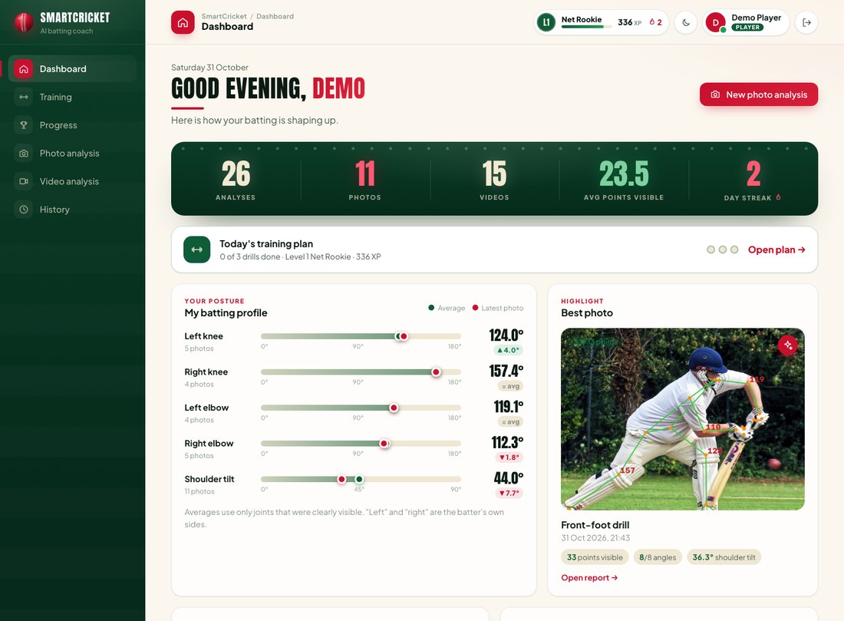
M1 User Interface and Sign-in
SECTION 5 | MODULE 1
Two roles: player and admin, each with their own pages.
Secure sign-in: hashed passwords and tokens; sign-out clears the session.
Dashboard: scoreboard, today's plan, batting profile and best photo.
Works on phones: the layout adapts to any screen size.
Real screenshot of the SmartCricket AI application
Notes:
Module one is the interface. A player and an admin see completely different pages. After sign-in the player lands on this dashboard: the numbers at the top, today's training plan, the batting profile with joint angles, and the best photo so far.

Slide 14
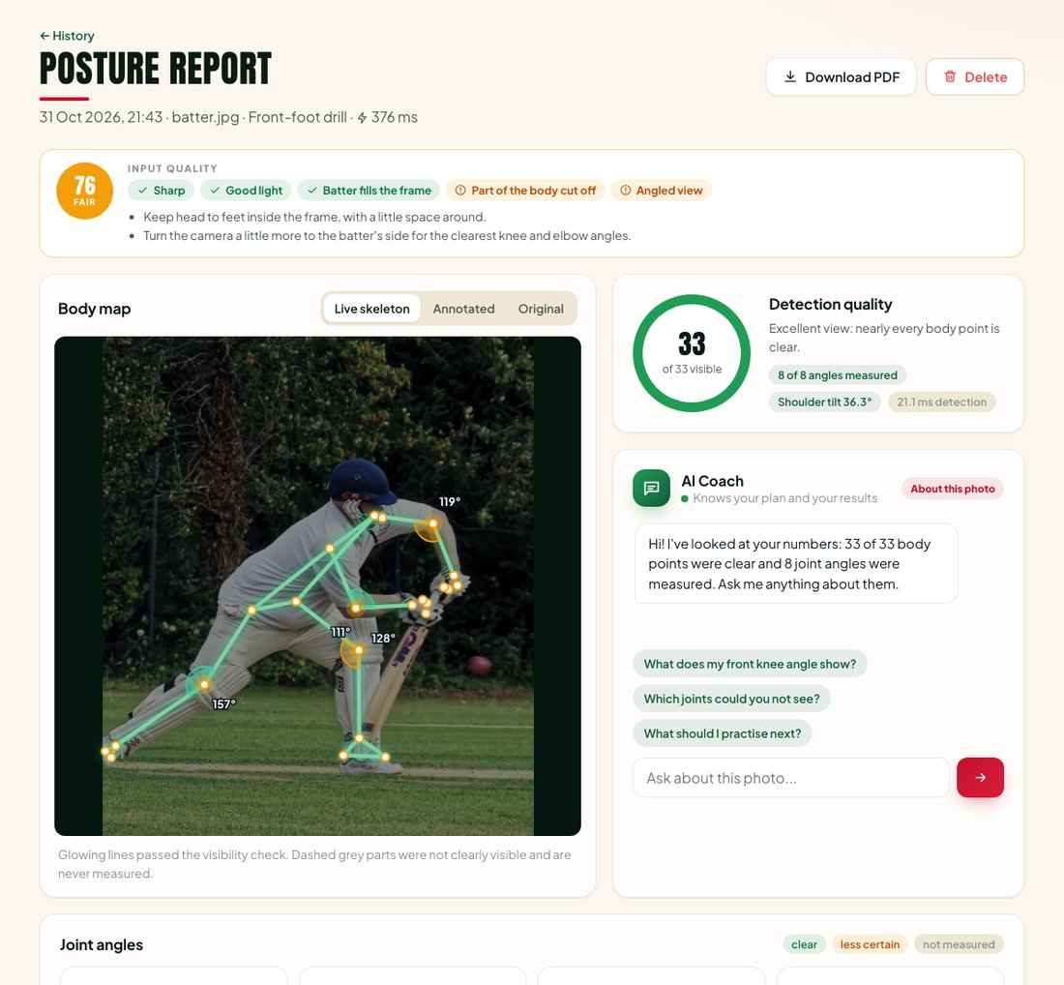
M2 Photo Posture Report
SECTION 5 | MODULE 2
Quality check first: light, blur, body size and camera angle, with a tip to fix each.
33 body points: found by MediaPipe; unclear points are greyed out, never guessed.
Joint angles: knee, elbow, shoulder and hip, in 2D and 3D.
No shot guess: one photo cannot show the swing, so it reports posture only.
Real screenshot of the SmartCricket AI application
Notes:
Module two is photo mode. First the app checks the photo quality and gives tips. Then it finds 33 body points and measures the joint angles. Points it cannot see clearly are greyed out. It does not guess the shot from one photo, because a shot is a movement.

Slide 15
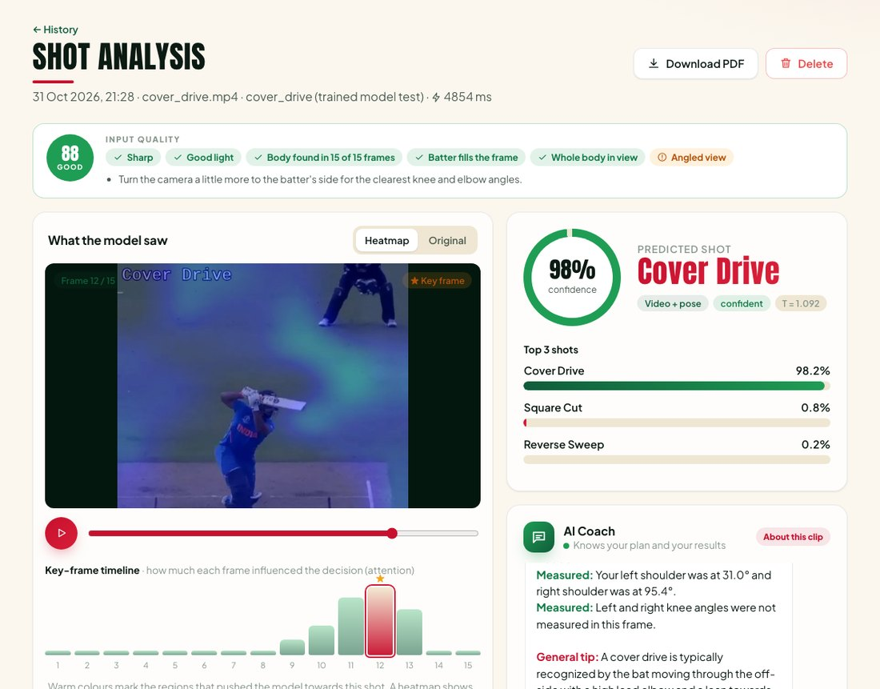
M3 and M4 Video Shot Analysis
SECTION 5 | MODULES 3 AND 4
Prepare: check the file, follow the batter, pick 15 frames.
Classify: video + pose model names 1 of 15 shots with top-3 answers.
Honest confidence: calibrated, so 90% means about 90% right; unsure clips are flagged.
Explain: heatmap on the frame and a key-frame timeline.
Real screenshot of the SmartCricket AI application
Notes:
Modules three and four handle video. The app checks the clip, follows the batter even when other players are in view, picks 15 frames, and the model names the shot. Here it says cover drive with 98% confidence. The heatmap shows where it looked and the timeline shows which moment mattered most.

Slide 16
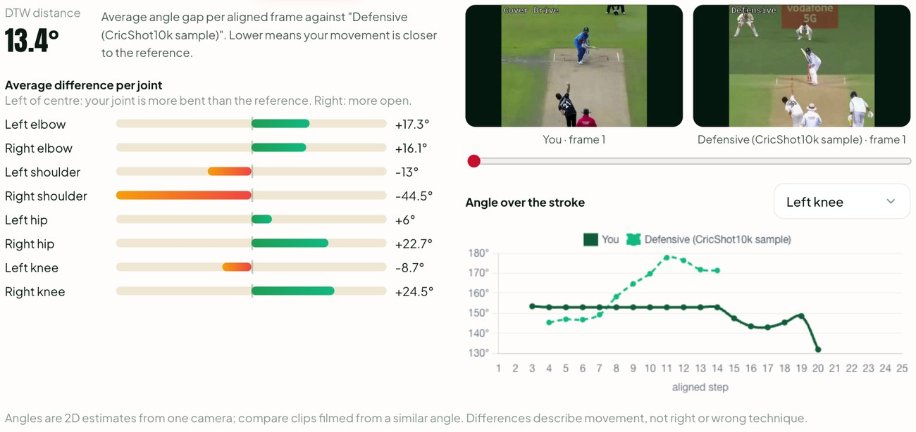
M5 Compare with a Model Player
SECTION 5 | MODULE 5
Pick a reference: a clip of a good player playing the same shot.
DTW alignment: lines up both swings even if one is faster.
Joint-by-joint gap: shows which joint differs most, in degrees.
3D view: rotate the body skeleton to see it from any side.
Real screenshot of the SmartCricket AI application
Notes:
Module five compares the player with a model player. Dynamic Time Warping lines up the two swings even if one is faster, then shows the angle gap for every joint. For example, here the right shoulder differs by 44 degrees.

Slide 17
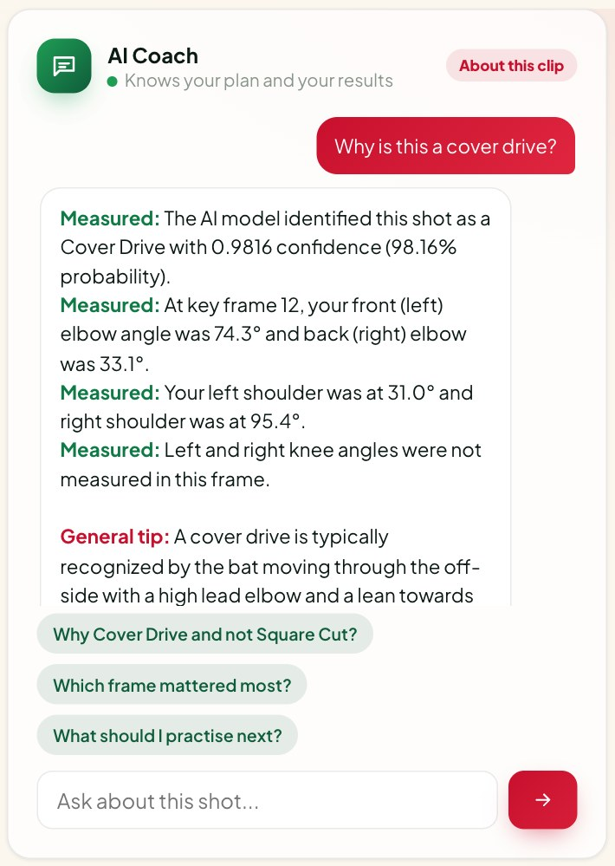
M6 and M7 AI Coach
SECTION 5 | MODULES 6 AND 7
One coach everywhere: on results, training and progress pages.
Grounded: only the stored numbers are sent; a check rejects any made-up number.
Two kinds of line: 'Measured' facts and 'General tip' advice.
Voice: reads answers aloud and takes spoken questions.
Real screenshot of the SmartCricket AI application
Notes:
Modules six and seven are explanations and the AI coach. The coach only gets the measured numbers, never the video. Every line is marked Measured or General tip, and a software check rejects any reply with a number that was not measured. It can also speak.

Slide 18
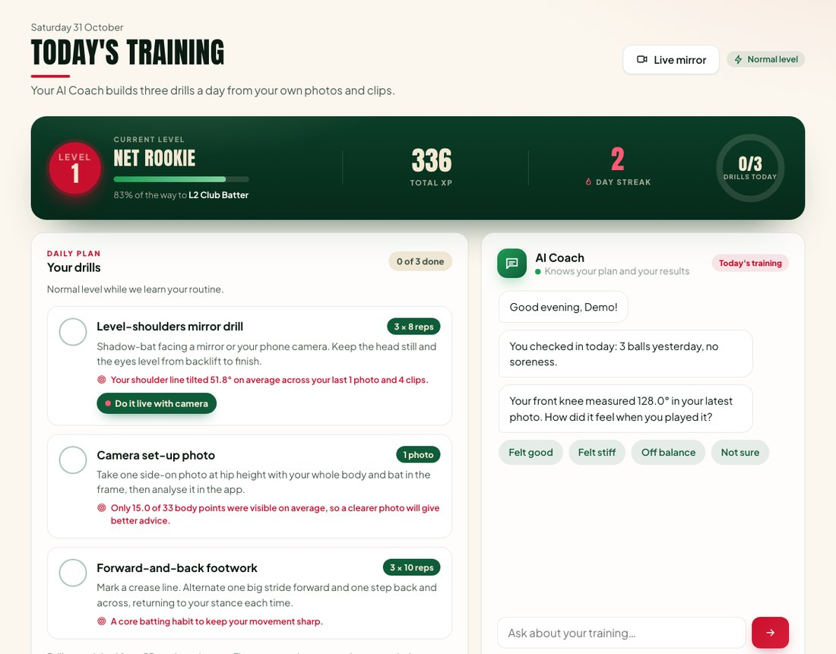
M9 Daily Training Coach
SECTION 5 | MODULE 9
Three drills a day: chosen from the player's own weak joints.
Adapts: check-in about sleep and soreness; harder or easier next day.
Motivation: levels from Net Rookie to Pro, XP, streaks and a daily quiz.
Weekly report: summary written by the coach every week.
Real screenshot of the SmartCricket AI application
Notes:
Module nine is the training coach. Every day it picks three drills from the player's weak spots. A morning check-in about sleep and soreness changes the difficulty. Levels, points and streaks keep players coming back, and every week the coach writes a summary.

Slide 19
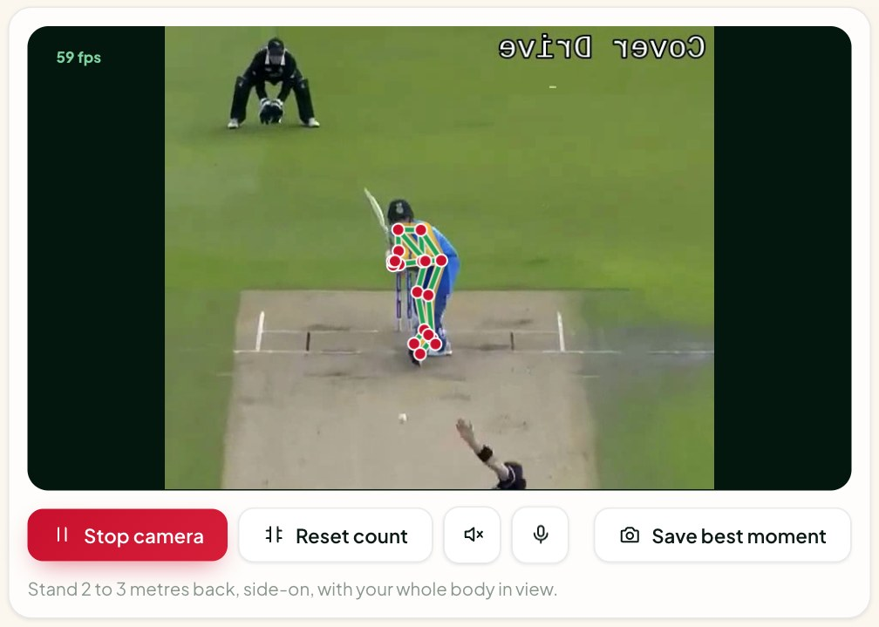
Live Mirror and Phone Mode
SECTION 5 | MODULE 9 | LIVE
Live skeleton: 30 to 60 frames per second, on the device; nothing is uploaded.
Counts reps: and speaks corrections; voice commands start and stop it.
Shadow the Pro: a gold ghost of a model player to copy.
Phone mode: scan a QR code and use the phone camera in the nets.
Real screenshot; clip from CricShot10k [1], CC BY 4.0
Notes:
The live mirror uses the camera. The skeleton is drawn live on the device, reps are counted, and the voice coach speaks. Shadow the Pro shows a gold ghost of a good player to copy. Phone mode lets a player scan a QR code and use their phone at the nets.

Slide 20
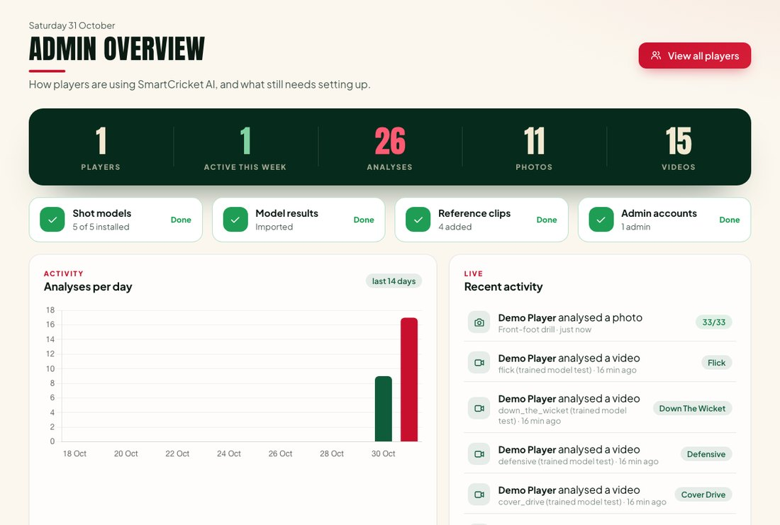
M8 History, Reports and Admin
SECTION 5 | MODULE 8
History: every photo and clip saved with its result; search and filter.
Reports: one-click PDF and CSV export.
Progress: trends, weekly numbers and levels.
Admin console: players, reference clips, setup checklist and model results.
Real screenshot of the SmartCricket AI application
Notes:
Module eight stores everything. Players see their history and download a PDF. The admin console, shown here, lists players and activity, manages reference clips, and shows the accuracy of each trained model.

Slide 21
Results: Does Pose Help?
SECTION 6 | RESULTS AND DISCUSSION
+7.8 points
accuracy from adding pose to video (56.2% to 63.9%)
p < 0.0001
McNemar test: the gain is real, not luck
89.6%
of clips have the right shot in the top 3
3D pose did not beat 2D pose (difference not significant).
Notes:
This is the main result. Video alone got 56% accuracy, pose alone 50%, and video plus pose 64%. That is a gain of almost 8 points, and McNemar's test says the chance of this being luck is less than one in ten thousand. The base paper reports 89%, but it uses YOLO cropping and a fully trained backbone; I used a frozen backbone on a free GPU, so my numbers are lower. My question was whether pose helps, and the answer is yes.

Slide 22


Results: Trust, Robustness and Speed
SECTION 6 | RESULTS AND DISCUSSION
Honest confidence (E5)
Camera angle (E10)
Pose reliability (E6)
Calibration error fell for every model, by 22% to 44%. A shown 80% now means about 80% right.
Pose helped most for front-on clips: 47.3% to 57.6% macro-F1.
Shoulders and hips found in about 69% of frames; wrists are hardest.
Speed on a laptop CPU
Heatmaps (E7)
Testing
Photo report under 50 ms. Video shot about 3 s. Live mirror 30-60 fps.
Clear focus on bat and batter for some shots; weak for others, reported honestly.
64 automated tests pass: unit, integration and system tests.
Notes:
Other results. After calibration the confidence numbers are honest. Pose helped most when the batter faces the camera. The body is found reliably for shoulders and hips. On a normal laptop a photo takes under 50 milliseconds and a video about 3 seconds. Heatmaps are clear for some shots and weak for others, and I report that honestly. All 64 automated tests pass.

Slide 23



Conclusion and Future Work
SECTION 7 | CONCLUSION
What was achieved
Future work
Built: a complete web app with photo, video, live and coaching features.
Proved: adding body pose to video improves shot recognition (+7.8 points).
Trustworthy: calibrated confidence, heatmaps and a coach that never invents numbers.
Useful: daily training plan, progress tracking and PDF reports.
YOLO cropping and full fine-tuning to close the gap to 89%
Video transformers (Video Swin, TimeSformer)
More shots: leave, leg glance, back-foot punch
A mobile app and live match streams
Notes:
To conclude: I built the full app, I showed that body pose really helps, and I made the system honest about its answers. In future I would add YOLO cropping and full training to reach the paper's accuracy, try video transformers, add more shot types, and build a mobile app.

Slide 24
References
SECTION 8 | REFERENCES
[1] M. K. Dihan, Abdullah, Amina and S. Ahmed, "CricShot10k: A large-scale video dataset for cricket shot classification," IEEE Access, vol. 14, pp. 23428-23447, 2026.
[2] M. Tan and Q. V. Le, "EfficientNetV2: Smaller models and faster training," Proc. ICML, 2021.
[3] K. Cho et al., "Learning phrase representations using RNN encoder-decoder," arXiv:1406.1078, 2014.
[4] V. Bazarevsky et al., "BlazePose: On-device real-time body pose tracking," arXiv:2006.10204, 2020.
[5] R. R. Selvaraju et al., "Grad-CAM: Visual explanations from deep networks," Proc. IEEE ICCV, 2017.
[6] C. Guo, G. Pleiss, Y. Sun and K. Q. Weinberger, "On calibration of modern neural networks," Proc. ICML, 2017.
[7] H. Sakoe and S. Chiba, "Dynamic programming algorithm optimization for spoken word recognition," IEEE Trans. ASSP, 1978.
[8] C. G. Rao et al., "Cricket shot classification from video using body pose landmarks," Proc. ICAECT, 2025.
[9] A. Sen et al., "CricShotClassify," Sensors, vol. 21, no. 8, 2021.
[10] S. W. Hoque et al., "KUCricShot: A dataset for developing detection model of cricket shots," Proc. ICCIT, 2023.
Notes:
Reference one is the base paper. The others are the standard papers for each method I used: EfficientNet, GRU, MediaPipe's BlazePose, Grad-CAM, calibration and Dynamic Time Warping, plus the related cricket papers.

Slide 25
Thank You
Questions and live demo
Prabhu
Department of Computer Science, [Insert College Name]
Guide: [Insert Guide Name]
Photos: Javs1233 and Acabashi, Wikimedia Commons, CC BY-SA 4.0. Video frames and figures: Dihan et al. [1], CC BY 4.0. Screenshots: SmartCricket AI.
Notes:
Thank you. I am happy to answer questions, and I can show a live demo: upload a photo, upload a clip, ask the coach a question, and open the live mirror.

