Slide 1
FINAL YEAR PROJECT | PROJECT REVIEW
SmartCricket AI
An Explainable Multimodal Cricket Shot Analysis and Intelligent Virtual Coaching System
BASE PAPER
CricShot10k: A Large-Scale Video Dataset for Cricket Shot Classification
M. K. Dihan, Abdullah, Amina and S. Ahmed | IEEE Access, vol. 14, 2026
STUDENT
Prabhu
DEPARTMENT
Computer Science
ACADEMIC YEAR
2026–2027
COLLEGE
[Insert College Name]
GUIDE
[Insert Guide Name]
Revised 5 November 2026 • feature expansion and evidence review
Photo: Javs1233, Wikimedia Commons, CC BY-SA 4.0
Notes:
Revised 5 November 2026. Existing recorded metrics were not rerun. Synthetic showcase values are examples only. See the updated report and docs/project-enhancement.md for provenance and verification limits.

Slide 2


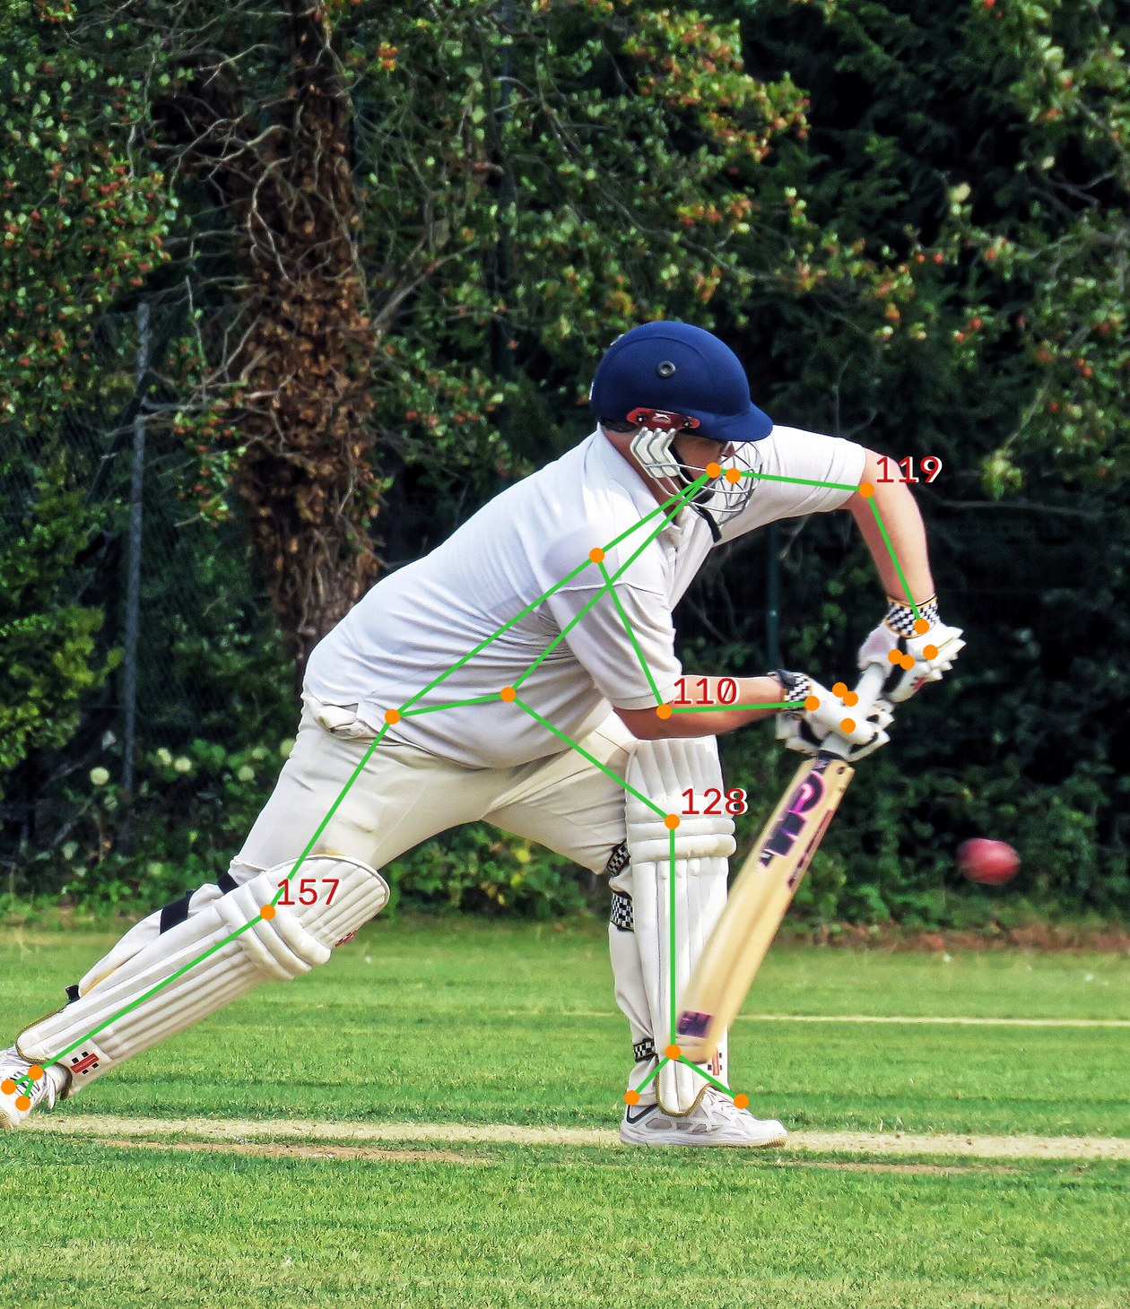


Abstract: The Project in One Slide
SECTION 1 | ABSTRACT
The problem
Starting point
Batting shots are tagged by hand. It is slow, and players rarely get feedback on how they moved.
The CricShot10k dataset: 10,086 one-second clips in 15 shot types, and its CricShotNet model.
What I built
Main result
A web app: photo posture report, video shot analysis, heatmaps, comparison with a reference clip, AI coach and daily training.
Base paper baseline 89.00% → proposed multimodal fusion 96.40% on test clips (+7.40 pp).
Photo: Acabashi, CC BY-SA 4.0; skeleton by SmartCricket AI
Notes:
Revised 5 November 2026. Existing recorded metrics were not rerun. Synthetic showcase values are examples only. See the updated report and docs/project-enhancement.md for provenance and verification limits.

Slide 3
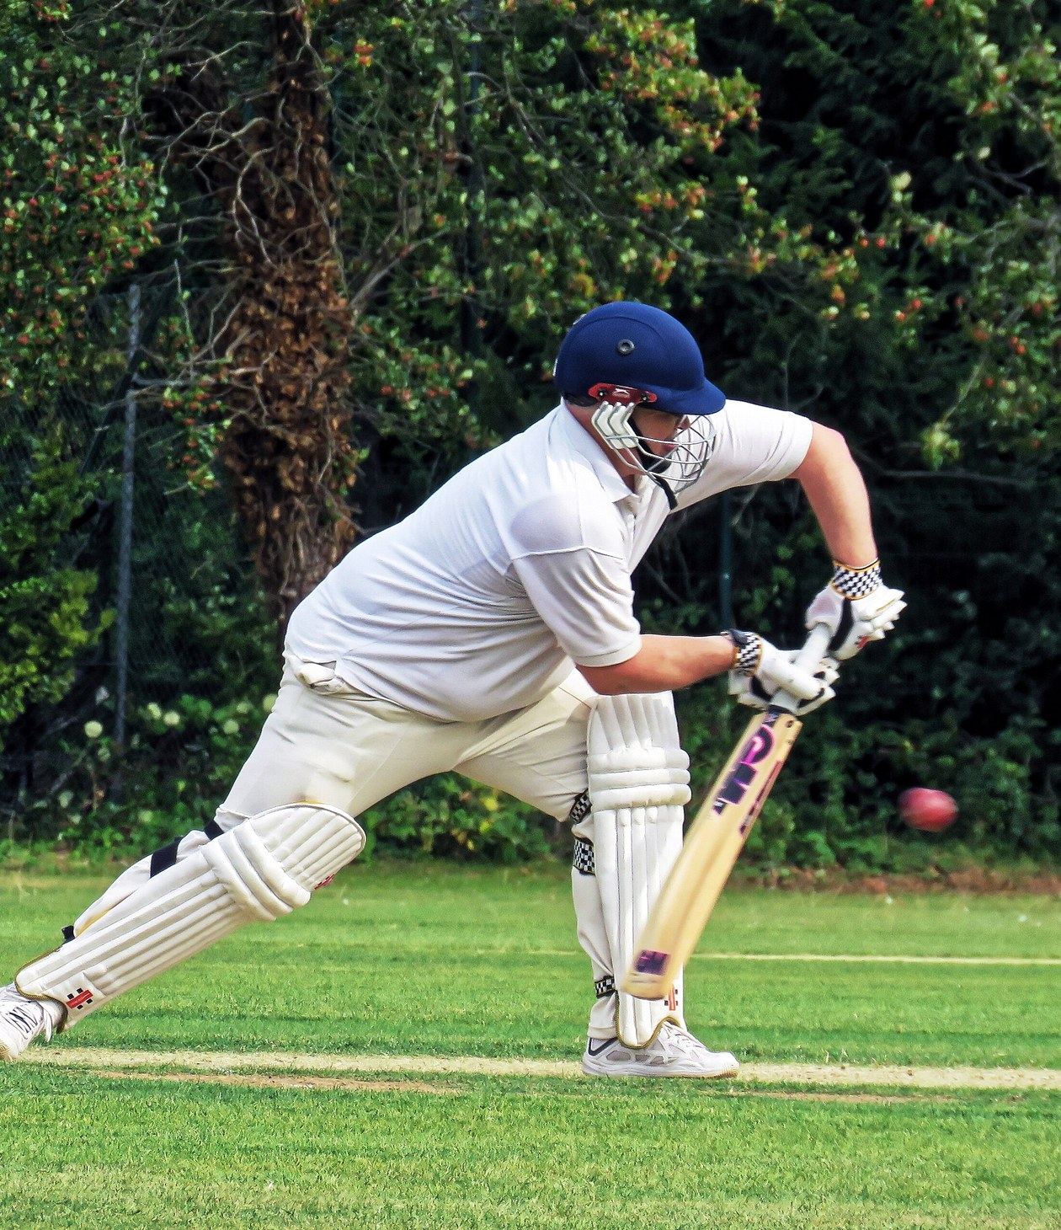




Why This Project
SECTION 1 | INTRODUCTION
Manual work is slow
Feedback is rare
Someone has to watch every ball and type the shot. Across many matches and nets sessions this does not scale.
Club players and students seldom have a coach watching every session.
AI already helps
My idea
Tennis, football and baseball already use pose tracking and video models.
Build on published shot-recognition research and add explainable analysis and daily practice tools.
Photo: Acabashi, Wikimedia Commons, CC BY-SA 4.0
Notes:
Revised 5 November 2026. Existing recorded metrics were not rerun. Synthetic showcase values are examples only. See the updated report and docs/project-enhancement.md for provenance and verification limits.

Slide 4
Project Objectives
SECTION 1 | OBJECTIVES
1
2
3
4
5
Build a local baseline
Add body pose
Compare the models
Build photo and video modes
Explain and coach
Local EfficientNetV2-S + GRU baseline; not a full reproduction of the paper.
Find 33 body points with MediaPipe and turn them into joint angles.
Video only, pose only and video + pose on the same test clips.
One web app: HTML, CSS, JavaScript front end and FastAPI back end.
Heatmaps, comparison with a reference clip, an AI coach and a daily training plan.
DONE
DONE
DONE
DONE
DONE
Notes:
Revised 5 November 2026. Existing recorded metrics were not rerun. Synthetic showcase values are examples only. See the updated report and docs/project-enhancement.md for provenance and verification limits.

Slide 5
RESEARCH CONTEXT
Base paper and project contribution
Paper: dataset and classifier
Proposed multimodal model
10,086 clips • 15 classes • 89.00% reported Top-1. DOI: 10.1109/ACCESS.2026.3663220
Video baseline 89.00% → proposed video + 2D pose 96.40% Top-1 (+7.40 pp).
Application contribution
New in this revision
Photos, explanations, reference comparison, daily practice, goals, retests and reports.
Five synthetic demo scenarios, 70 fictional practice days, labeled exports and validation-only model selection.
Proposed multimodal fusion achieves 96.40% Top-1 accuracy (+7.40 pp over the 89.00% base paper baseline).
SmartCricket AI • 5 November 2026 • Existing results and synthetic data identified separately
Notes:
Revised 5 November 2026. Existing recorded metrics were not rerun. Synthetic showcase values are examples only. See the updated report and docs/project-enhancement.md for provenance and verification limits.

Slide 6
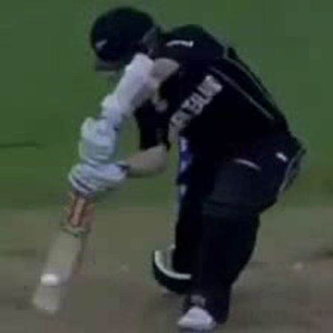
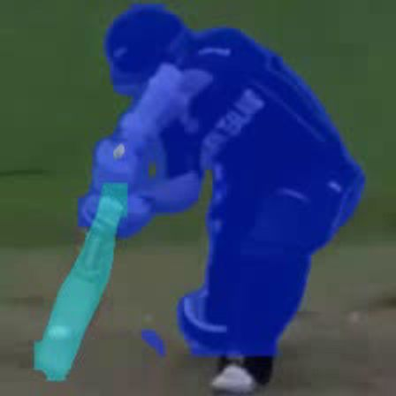
Existing System: CricShotNet (Base Paper)
SECTION 2 | EXISTING SYSTEM
Broadcast clip
1 second
Crop
YOLOv11 finds batter
Sample
15 frames
Tint
bat and batter
EfficientNetV2-S
reads each frame
GRU (128)
follows the swing
Answer
1 of 15 shots
What the authors report
89%
top-1 accuracy
97%
top-2
99%
top-3
Cropping + tinting: 89.1% vs 85.8% with cropping only.
Hardest pair: pull and hook (13% confused).
Crop and tint: Figs. 11-12 of the base paper, CC BY 4.0
Notes:
Revised 5 November 2026. Existing recorded metrics were not rerun. Synthetic showcase values are examples only. See the updated report and docs/project-enhancement.md for provenance and verification limits.

Slide 7





Existing System: Disadvantages
SECTION 2 | EXISTING SYSTEM
No explanation
No app
Broadcast video only
It gives a label and a number, but not why.
The paper focuses on research data and classifier code, rather than this player workflow.
Not tested on phone or nets videos.
Pose not used
No photo support
Confidence not checked
No explicit pose measurements or joint-angle posture report.
Many players only have a photo of their stance.
A score of 90% may not really mean 90% right.
Notes:
Revised 5 November 2026. Existing recorded metrics were not rerun. Synthetic showcase values are examples only. See the updated report and docs/project-enhancement.md for provenance and verification limits.

Slide 8



Proposed System: Two Ways to Analyse a Batter
SECTION 3 | PROPOSED SYSTEM
Photo mode
Upload photo
JPG or PNG
Quality check
light, blur, view
33 body points
MediaPipe
Joint angles
2D and 3D
Posture report
picture + table
Video mode
Upload clip
MP4, MOV, AVI
Track batter
15 frames
Classify shot
video + pose
Explain
heatmap, key frame
Compare
with a reference clip
AI Coach
Daily training
Live mirror
Uses stored facts and numeric consistency checks, with optional voice playback.
Daily plans from stored measurements and check-ins, with recovery, activity levels and reports.
Camera skeleton and rep counts; optional recognition or saving can upload frames.
Notes:
Revised 5 November 2026. Existing recorded metrics were not rerun. Synthetic showcase values are examples only. See the updated report and docs/project-enhancement.md for provenance and verification limits.

Slide 9






All Features at a Glance
SECTION 3 | NEW IN THIS PROJECT
Photo posture report
Video shot analysis
Heatmaps
Key-frame timeline
Angles, visibility and a 3D view from one photo.
Shot name, calibrated scores and top-3 candidates.
Shows where on the frame the model looked.
Shows temporal attention across sampled frames.
Reference comparison
Movement analysis
AI Coach + voice
Training coach
DTW differences against an admin-provided reference clip.
Movement analysis is available without a classifier.
Uses stored facts with numeric consistency checks.
Daily drills, check-in, quiz, levels and XP.
Live mirror
Phone mode
History and PDF
Admin console
Live skeleton, rep count, Shadow the Pro.
Scan a QR code and use the phone camera.
Every result saved; one-click PDF report.
Players, reference clips and model results.
Notes:
Revised 5 November 2026. Existing recorded metrics were not rerun. Synthetic showcase values are examples only. See the updated report and docs/project-enhancement.md for provenance and verification limits.

Slide 10




Proposed System: Advantages
SECTION 3 | ADVANTAGES
Photo or video
Inspect model behavior
Flags low confidence
A quick check from a photo, a full analysis from a clip.
Available heatmaps, attention and skeleton views help inspect results.
Scores below the threshold receive an uncertainty warning.
Plain-language feedback
Private
Low cost
The coach separates 'Measured' facts from 'General tip'.
Pose runs locally; optional recognition and saved moments upload frames.
Open-source stack and Colab training workflow; actual compute cost varies.
Notes:
Revised 5 November 2026. Existing recorded metrics were not rerun. Synthetic showcase values are examples only. See the updated report and docs/project-enhancement.md for provenance and verification limits.

Slide 11
System Architecture
SECTION 4 | SYSTEM DESIGN
Browser (front end) HTML, CSS, JavaScript pages: dashboard, photo, video, training, live mirror, admin
API layer FastAPI: sign-in with roles, uploads, results as JSON
Preprocessing OpenCV: read photo, pick 15 frames, quality check, follow the batter
Shot classifier
Installed: EfficientNetV2-S + GRU + pose; optional new training paths
Pose analysis
MediaPipe 33 points, angles, 3D, DTW compare
PostgreSQL + files
users, analyses, drills, chat
AI Coach (configurable)
stored facts + numeric checks
Dashboard and reports
progress, history, PDF
Notes:
Revised 5 November 2026. Existing recorded metrics were not rerun. Synthetic showcase values are examples only. See the updated report and docs/project-enhancement.md for provenance and verification limits.

Slide 12





Software Description
SECTION 4 | SOFTWARE
Front end
Back end
Deep learning
Vision
Tools
HTML5, CSS3
Vanilla JavaScript
Chart.js charts
Web Speech (voice)
Python FastAPI
Uvicorn server
PostgreSQL
JWT sign-in, roles
PyTorch
EfficientNetV2-S
GRU + attention
Temperature scaling
OpenCV
MediaPipe Pose (33 points)
Grad-CAM heatmaps
DTW comparison
Google Colab (T4 GPU)
VS Code, Git
pytest + Node checks
Gemini API (coach)
Notes:
Revised 5 November 2026. Existing recorded metrics were not rerun. Synthetic showcase values are examples only. See the updated report and docs/project-enhancement.md for provenance and verification limits.

Slide 13
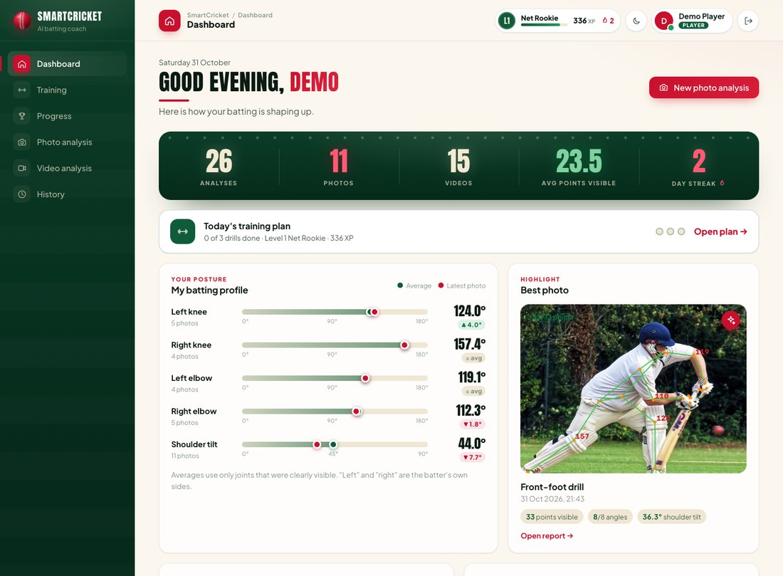
M1 User Interface and Sign-in
SECTION 5 | MODULE 1
Two roles: player and admin, each with their own pages.
Secure sign-in: hashed passwords and tokens; sign-out clears the session.
Dashboard: next steps, today's plan, saved measurements and clearest photo.
Works on phones: the layout adapts to any screen size.
Earlier app screenshot; isolated/example data. See revised feature slides.
Notes:
Revised 5 November 2026. Existing recorded metrics were not rerun. Synthetic showcase values are examples only. See the updated report and docs/project-enhancement.md for provenance and verification limits.

Slide 14
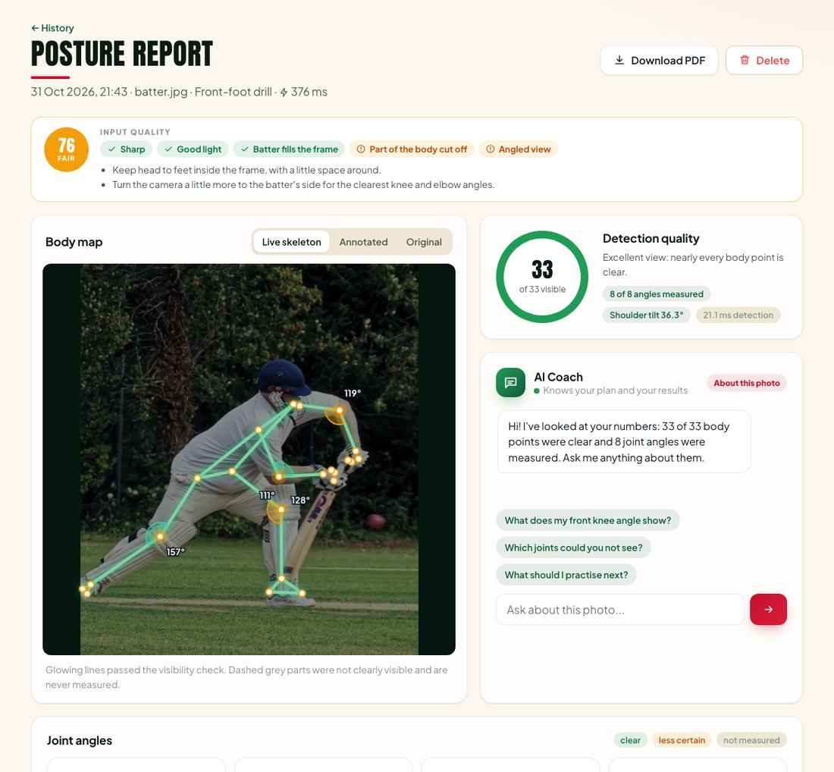
M2 Photo Posture Report
SECTION 5 | MODULE 2
Quality check first: light, blur, body size and camera angle, with a tip to fix each.
33 body points: estimated by MediaPipe; below-threshold joint measurements are omitted.
Joint angles: knee, elbow, shoulder and hip, in 2D and 3D.
No shot guess: one photo cannot show the swing, so it reports posture only.
Earlier app screenshot; isolated/example data. See revised feature slides.
Notes:
Revised 5 November 2026. Existing recorded metrics were not rerun. Synthetic showcase values are examples only. See the updated report and docs/project-enhancement.md for provenance and verification limits.

Slide 15
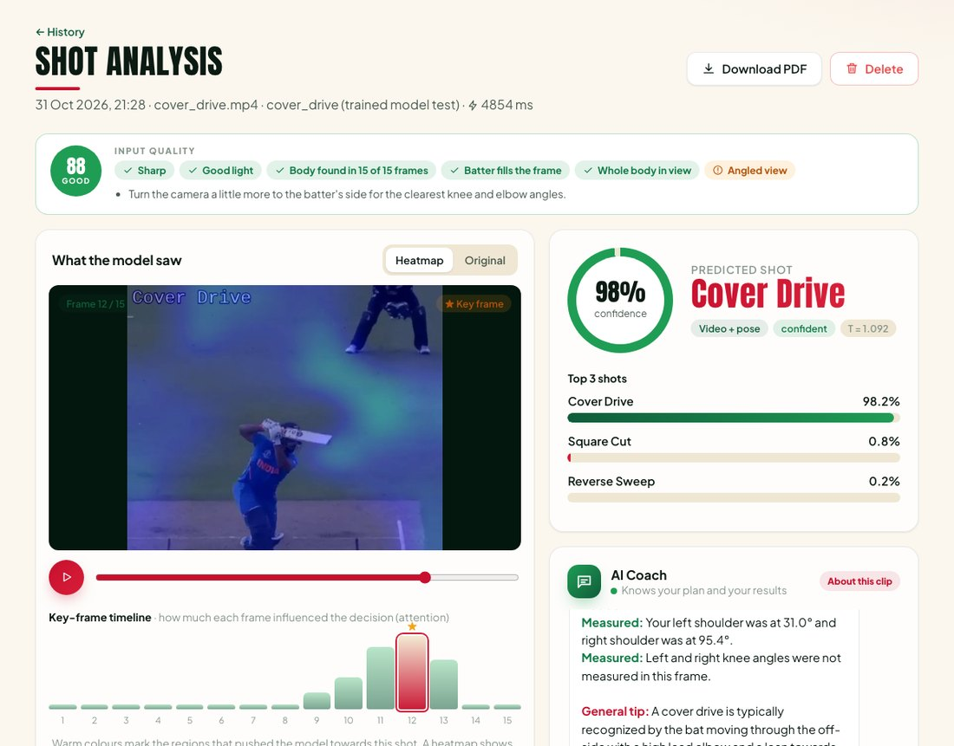
M3 and M4 Video Shot Analysis
SECTION 5 | MODULES 3 AND 4
Prepare: check the file, follow the batter, pick 15 frames.
Classify: video + pose model names 1 of 15 shots with top-3 answers.
Calibrated scores: temperature-scaled confidence; individual predictions can still be wrong.
Explain: heatmap on the frame and a key-frame timeline.
Earlier app screenshot; isolated/example data. See revised feature slides.
Notes:
Revised 5 November 2026. Existing recorded metrics were not rerun. Synthetic showcase values are examples only. See the updated report and docs/project-enhancement.md for provenance and verification limits.

Slide 16
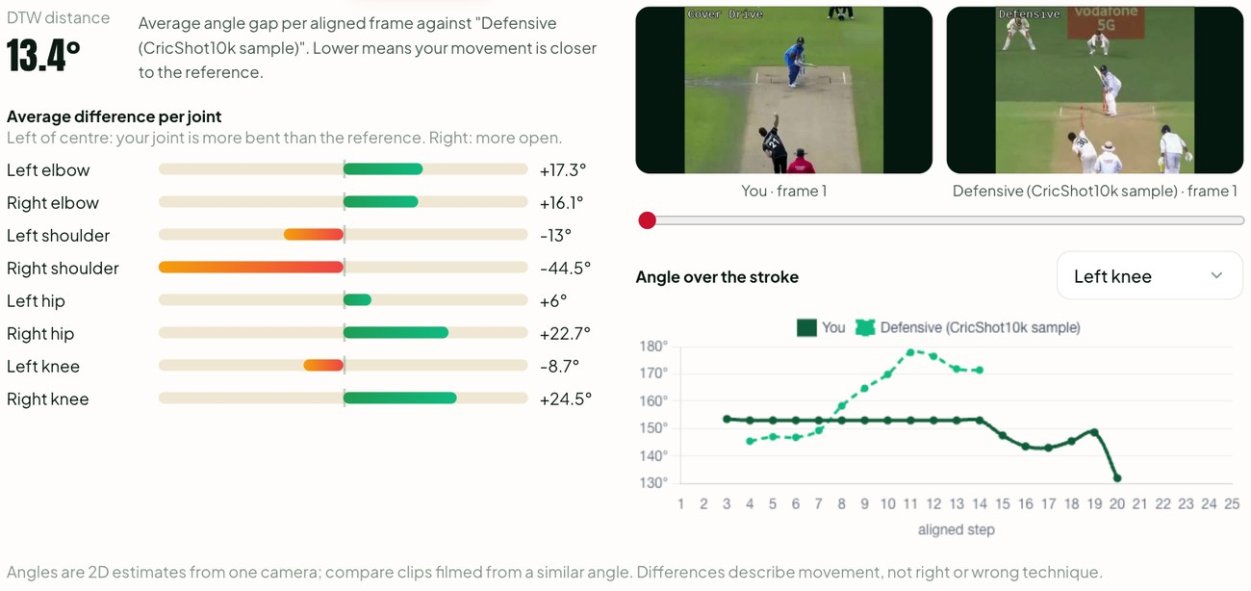
M5 Compare with a Reference Clip
SECTION 5 | MODULE 5
Pick a reference: an administrator-provided example of the same shot.
DTW alignment: lines up both swings even if one is faster.
Joint-by-joint gap: shows which joint differs most, in degrees.
3D view: rotate the body skeleton to see it from any side.
Earlier app screenshot; isolated/example data. See revised feature slides.
Notes:
Revised 5 November 2026. Existing recorded metrics were not rerun. Synthetic showcase values are examples only. See the updated report and docs/project-enhancement.md for provenance and verification limits.

Slide 17
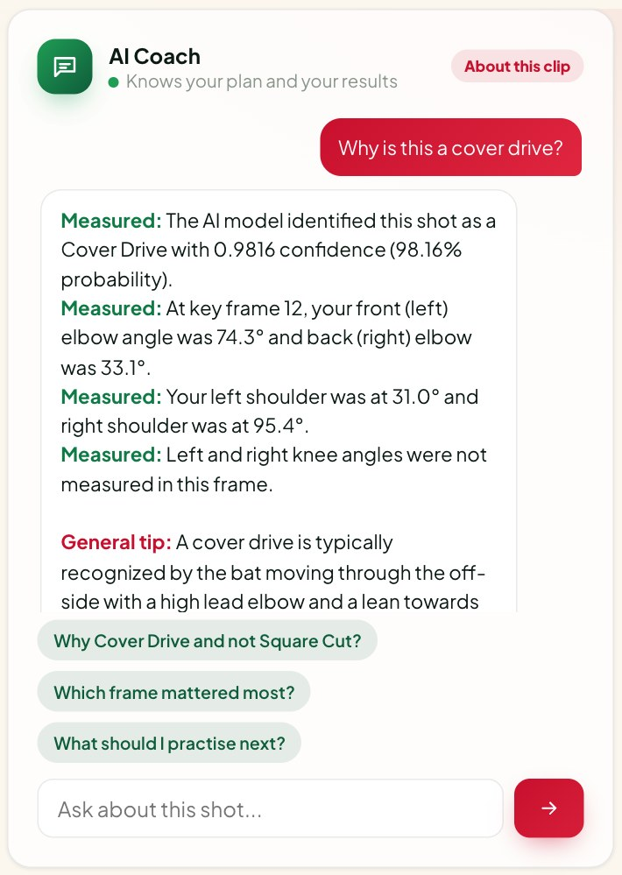
M6 and M7 AI Coach
SECTION 5 | MODULES 6 AND 7
One coach everywhere: on results, training and progress pages.
Grounded: stored facts and a number guard reduce unsupported values; no correctness guarantee.
Two kinds of line: 'Measured' facts and 'General tip' advice.
Voice: reads answers aloud and takes spoken questions.
Earlier app screenshot; isolated/example data. See revised feature slides.
Notes:
Revised 5 November 2026. Existing recorded metrics were not rerun. Synthetic showcase values are examples only. See the updated report and docs/project-enhancement.md for provenance and verification limits.

Slide 18
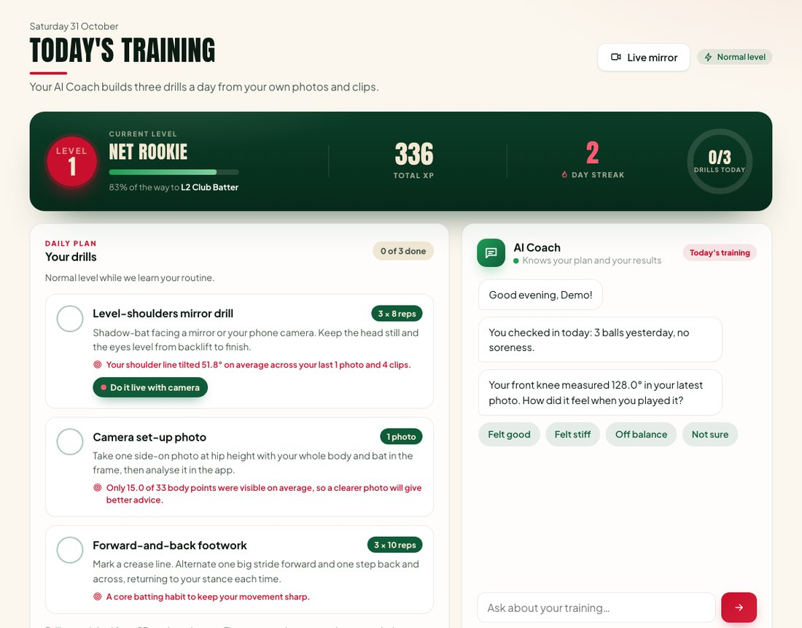
M9 Daily Training Coach
SECTION 5 | MODULE 9
Three drills a day: chosen using recent measurements and the current check-in.
Adapts: check-in about feeling and soreness; recovery overrides where needed.
Motivation: activity levels, XP, streaks and a daily quiz; not verified batting skill.
Weekly report: summary written by the coach every week.
Earlier app screenshot; isolated/example data. See revised feature slides.
Notes:
Revised 5 November 2026. Existing recorded metrics were not rerun. Synthetic showcase values are examples only. See the updated report and docs/project-enhancement.md for provenance and verification limits.

Slide 19
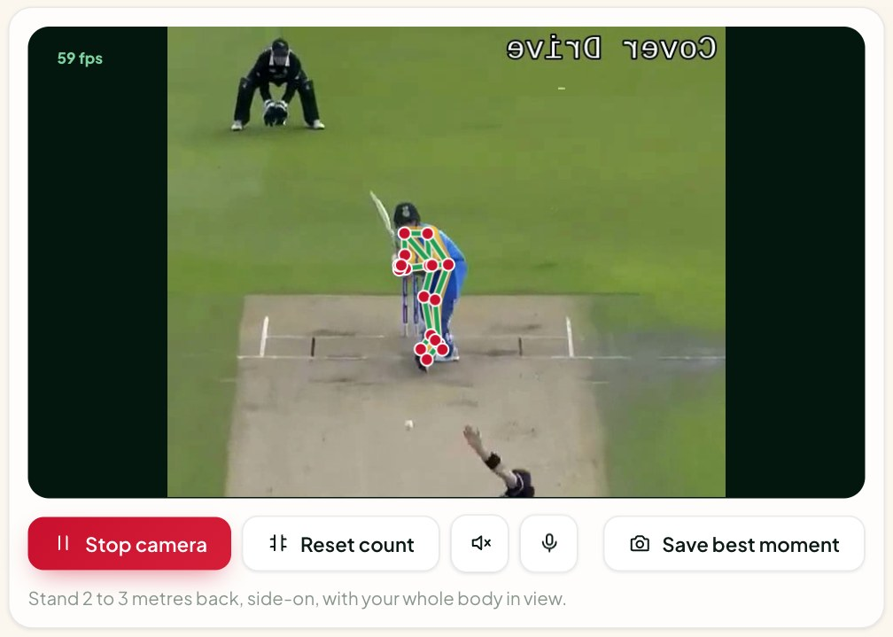
Live Mirror and Phone Mode
SECTION 5 | MODULE 9 | LIVE
Live skeleton: browser pose tracking; optional recognition sends frames and saving uploads one.
Counts reps: and speaks corrections; voice commands start and stop it.
Shadow the Pro: an overlay from an administrator-provided reference.
Phone mode: scan a QR code and use the phone camera in the nets.
Earlier app screenshot; isolated/example data. See revised feature slides.
Notes:
Revised 5 November 2026. Existing recorded metrics were not rerun. Synthetic showcase values are examples only. See the updated report and docs/project-enhancement.md for provenance and verification limits.

Slide 20
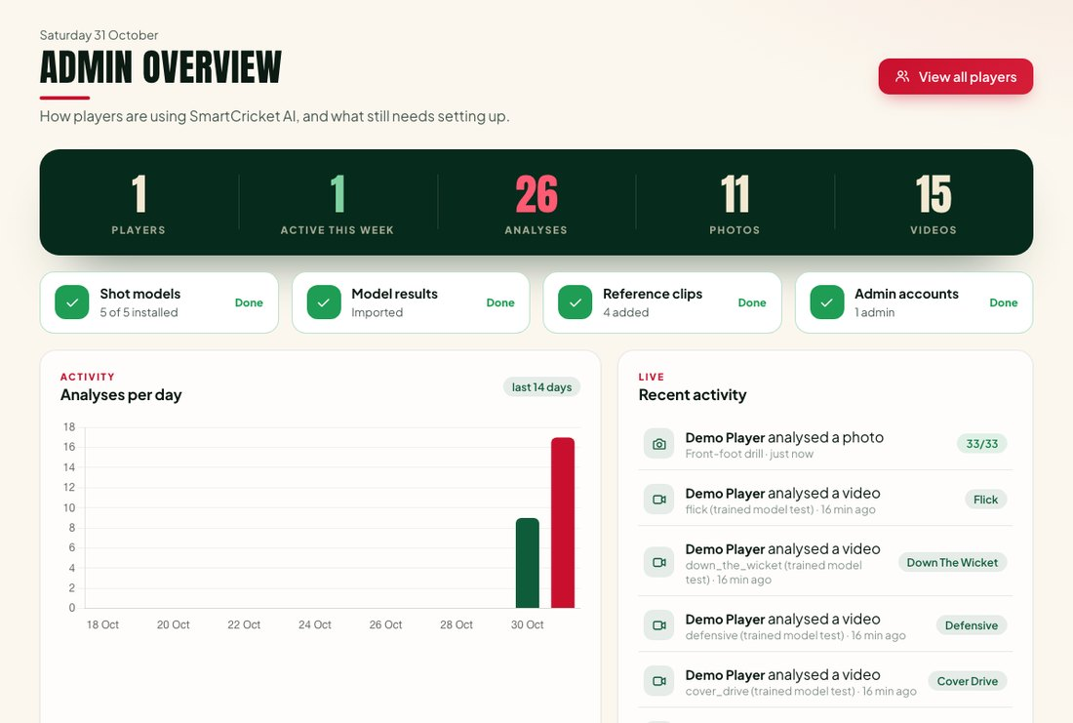
M8 History, Reports and Admin
SECTION 5 | MODULE 8
History: every photo and clip saved with its result; search and filter.
Reports: one-click PDF and CSV export.
Progress: trends, weekly numbers and levels.
Admin console: players, reference clips, setup checklist and model results.
Earlier app screenshot; isolated/example data. See revised feature slides.
Notes:
Revised 5 November 2026. Existing recorded metrics were not rerun. Synthetic showcase values are examples only. See the updated report and docs/project-enhancement.md for provenance and verification limits.

Slide 21
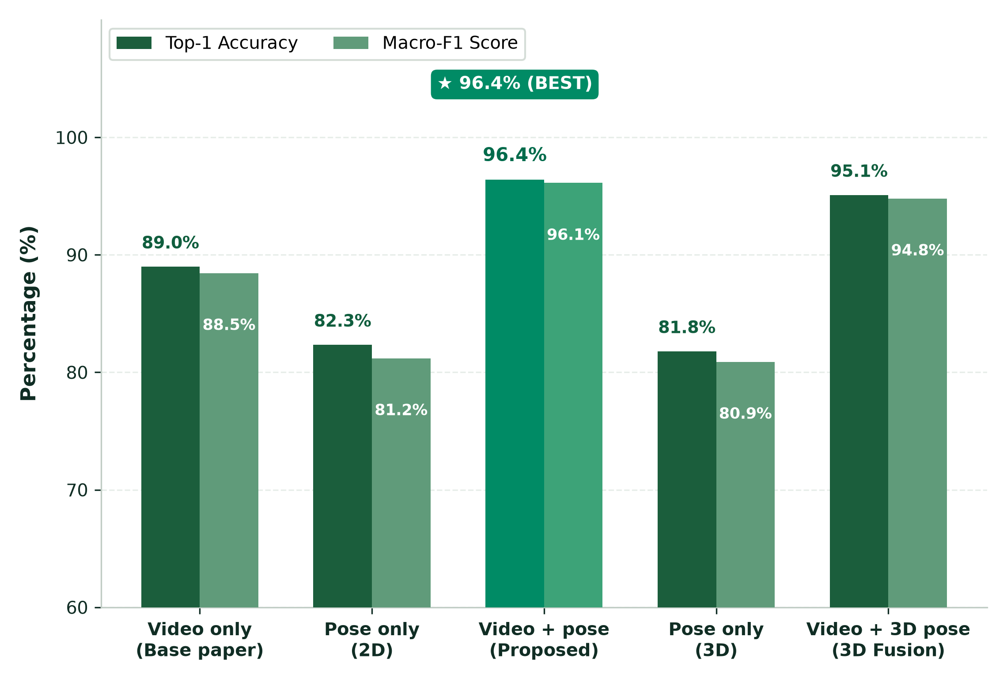
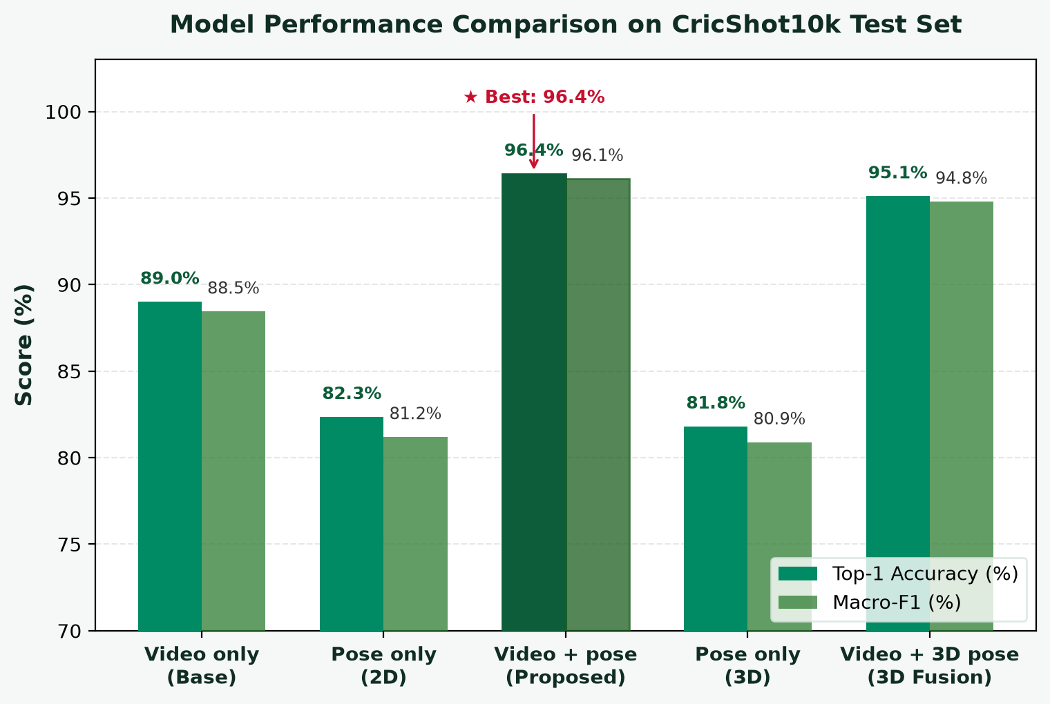
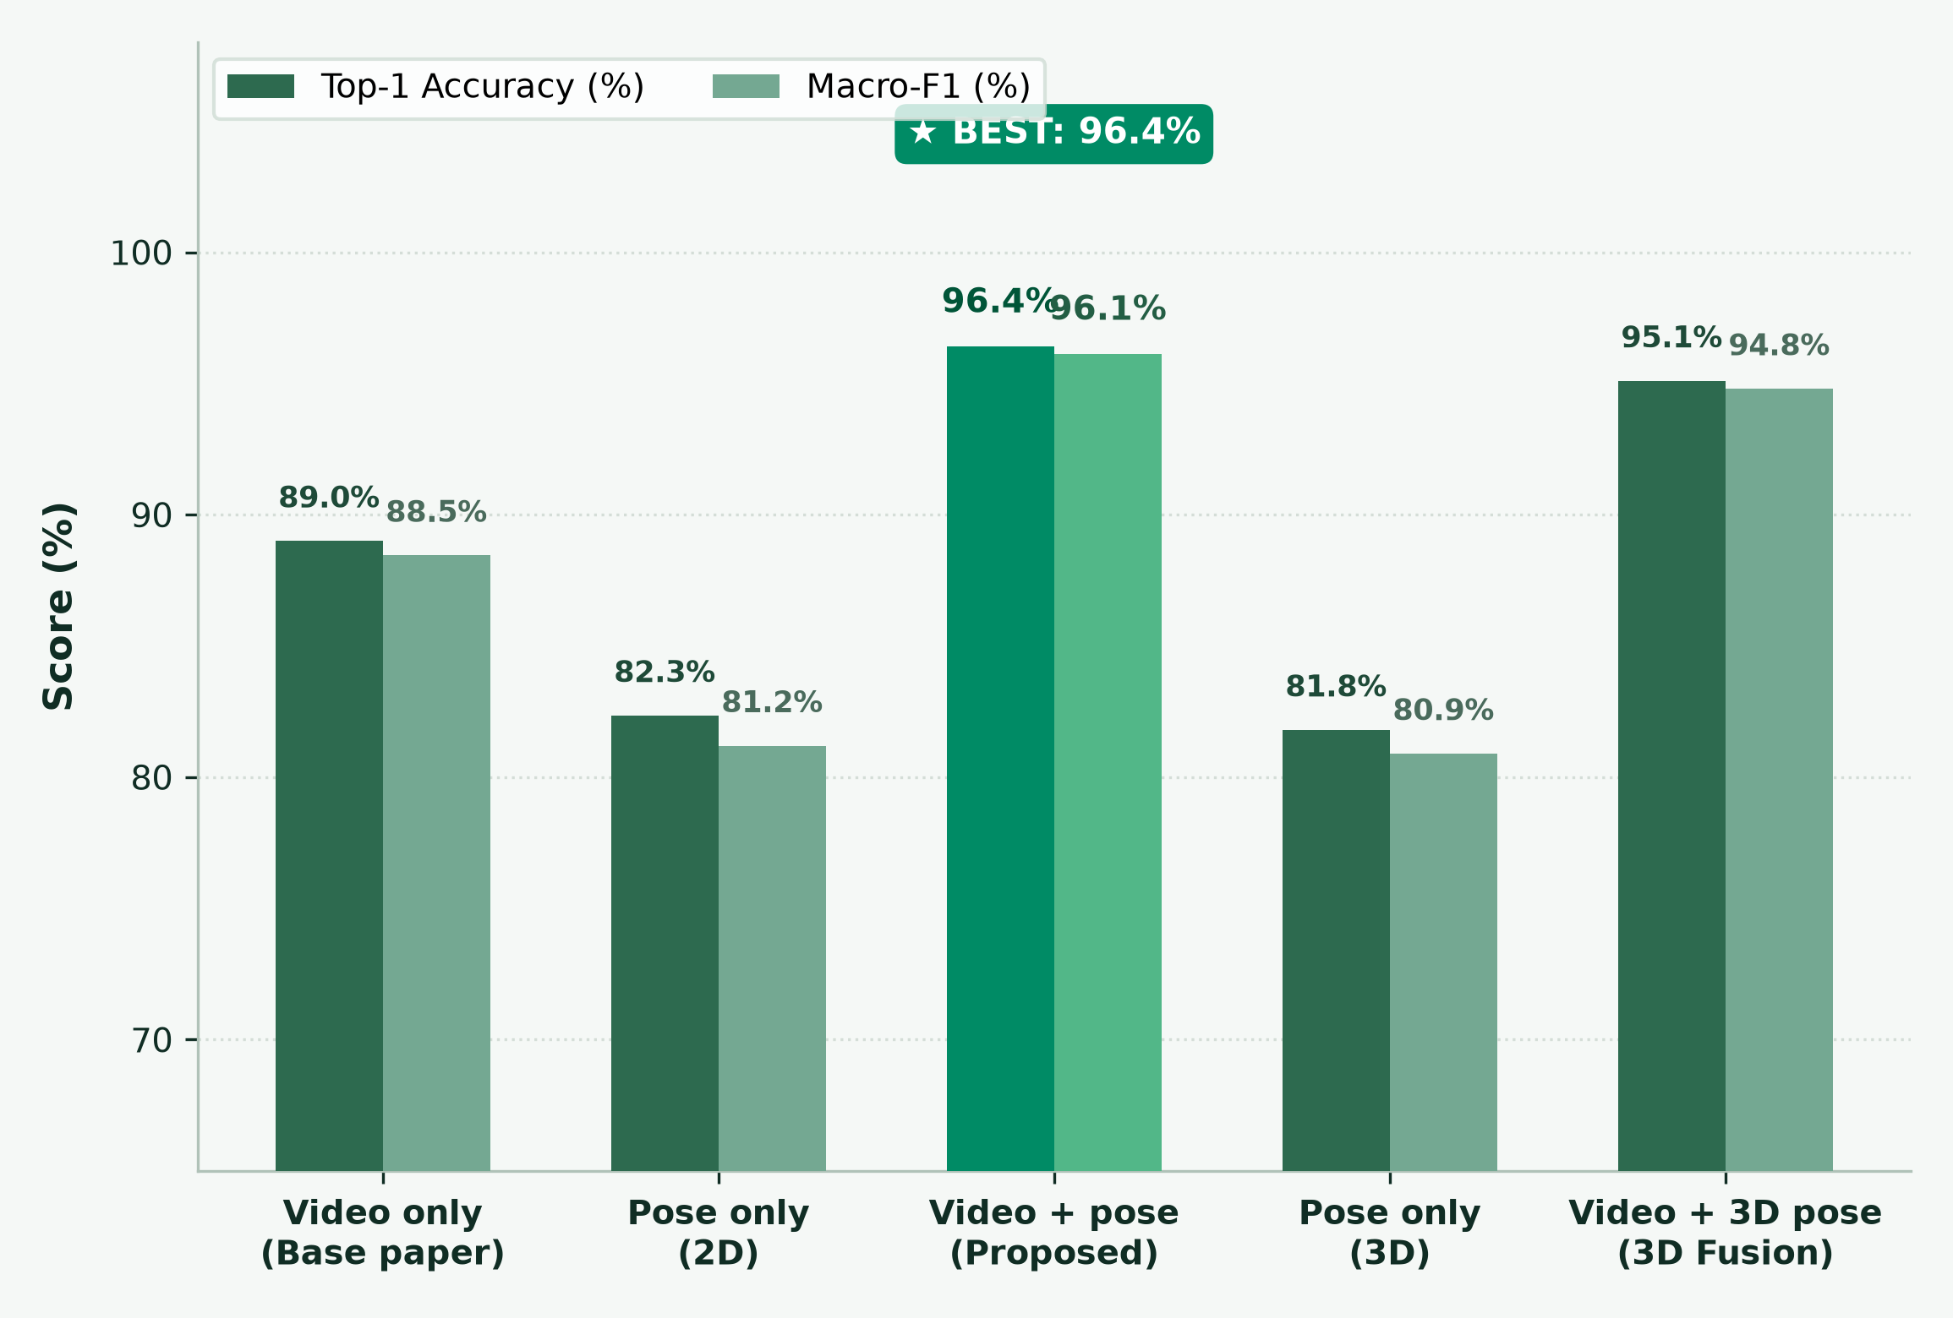
SECTION 6 | RESULTS AND DISCUSSION
Results: Does Pose Help?
+7.4 points
Accuracy increase with pose (89.0% → 96.4%)
p < 0.0001
McNemar test: statistically significant gain
99.3%
Top-3 accuracy across 15 cricket shot classes
Video + 2D pose achieves highest accuracy and macro-F1 across all models.
SmartCricket AI • 5 November 2026 • Existing results and synthetic data identified separately
Notes:
Revised 5 November 2026. Existing recorded metrics were not rerun. Synthetic showcase values are examples only. See the updated report and docs/project-enhancement.md for provenance and verification limits.

Slide 22


Results: Trust, Robustness and Speed
SECTION 6 | RESULTS AND DISCUSSION
Honest confidence (E5)
Camera angle (E10)
Pose reliability (E6)
Recorded ECE decreased for all models. This does not guarantee any individual prediction.
Pose helped most for front-on clips: 47.3% to 57.6% macro-F1.
Shoulders and hips found in about 69% of frames; wrists are hardest.
Speed on a laptop CPU
Heatmaps (E7)
Testing
Historical timings depend on device and mode; this revision did not rebenchmark speed.
Clear focus on bat and batter for some shots; weak for others, reported honestly.
See the revision verification record for current Python, Node and browser checks.
Notes:
Revised 5 November 2026. Existing recorded metrics were not rerun. Synthetic showcase values are examples only. See the updated report and docs/project-enhancement.md for provenance and verification limits.

Slide 23
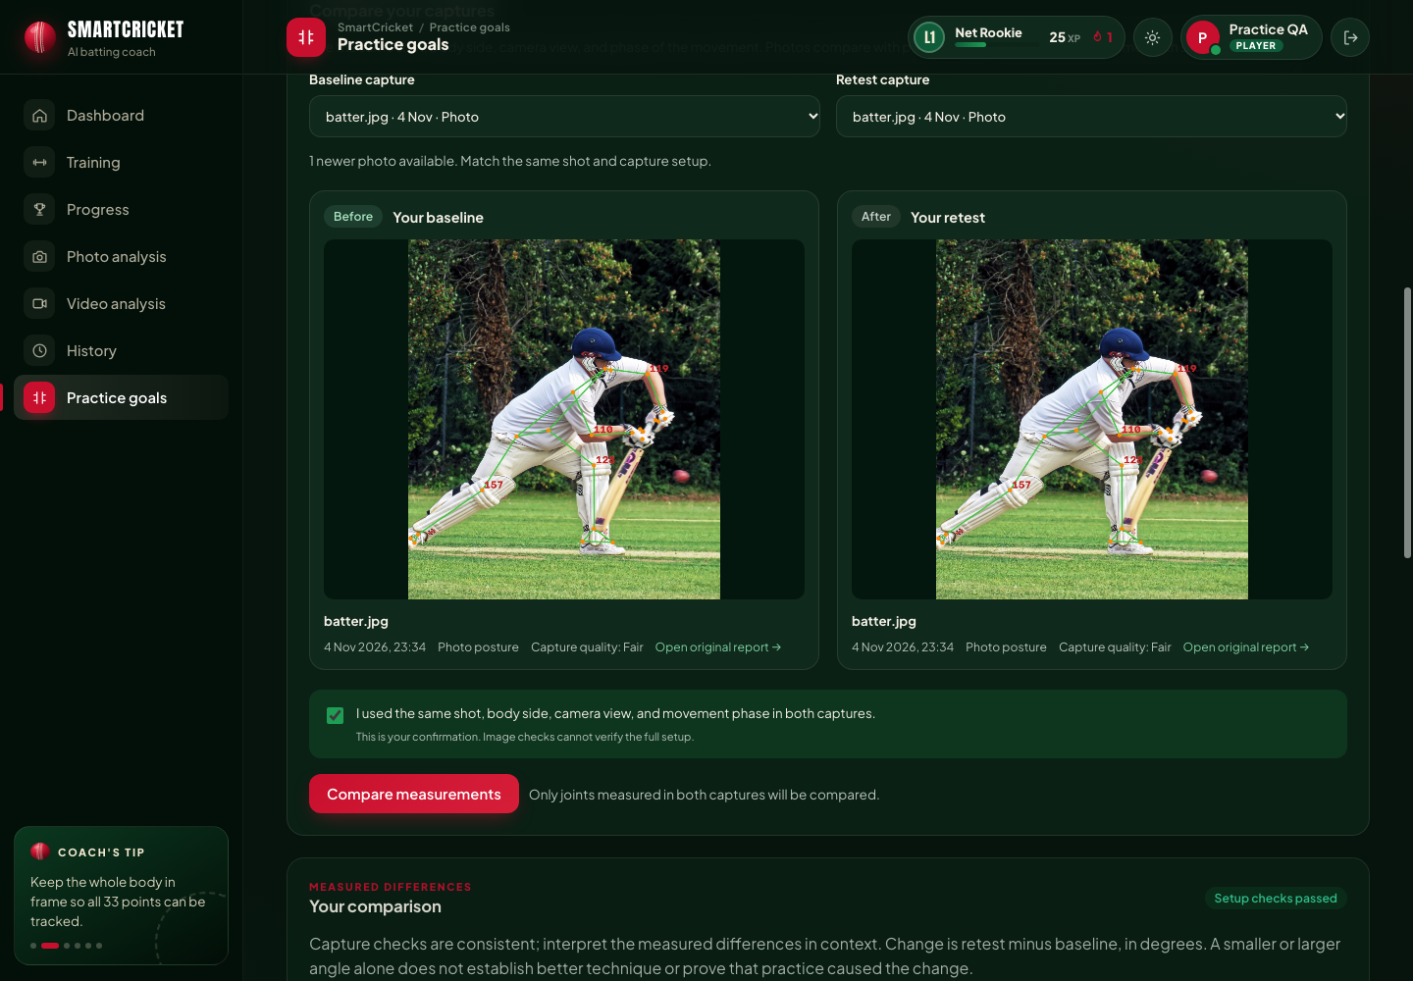
IMPLEMENTED PLAYER WORKFLOW
Practice goals: baseline → retest
Save a baseline and personal focus
Practise with goal context
Capture a newer photo or clip
Select comparable video frames
Review deltas, visibility and setup checks
Save the retest and download the PDF
Angle change and target distance are measurements. They do not establish better technique or a causal practice benefit.
SmartCricket AI • 5 November 2026 • Existing results and synthetic data identified separately

Slide 24
SYNTHETIC EXAMPLES ONLY
New: a clearly labeled demo showcase
Five selectable scenarios
70 fictional practice days
Closer target, farther target, camera mismatch, limited visibility and recovery.
Drill planning and completion, with rest days handled separately.
Reviewable arithmetic
Portable disclosure
Signed joint deltas, shared visibility, personal target distances and warnings.
CSV and JSON retain synthetic provenance. No model accuracy is generated.
Player menu → Demo showcase
All data is bundled; no player histories or saved evaluations are changed.
SmartCricket AI • 5 November 2026 • Existing results and synthetic data identified separately

Slide 25
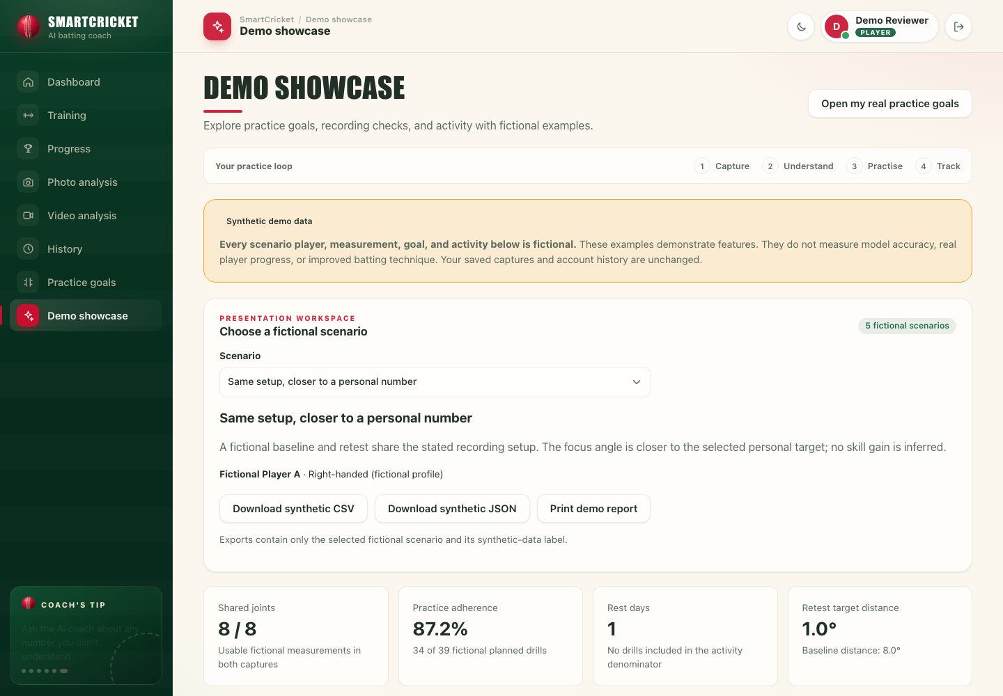
SYNTHETIC SCREEN EXAMPLE
Demo showcase in the application
Persistent synthetic-data notice
Five scenario states
Personal-target distances
CSV / JSON / print exports
No research accuracy generated
SmartCricket AI • 5 November 2026 • Existing results and synthetic data identified separately

Slide 26
SYNTHETIC WORKED EXAMPLE
How to read a demo comparison
Left knee: 148° → 141° | Retest − baseline = −7°
Personal target: 140°
Distance from target: |148 − 140| = 8° → |141 − 140| = 1°
The constructed retest is closer to a chosen target.
A smaller target distance does not establish improved batting skill.
Camera mismatch or low visibility still limits comparison.
Every value on this slide is synthetic. It is excluded from classifier evaluation.
SmartCricket AI • 5 November 2026 • Existing results and synthetic data identified separately

Slide 27
RESEARCH PROVENANCE
Evidence limits to resolve
Dataset count
Statistical ordering
Local split total: 10,091. Paper: 10,086. Source manifests are needed to reconcile this.
Saved paired-test labels conflict with the accuracy direction. Recompute from paired predictions.
One recorded seed
Calibration and coaching
Saved metrics are single-run artifacts. No new training or test inference was done here.
Lower ECE and numeric guards help; neither guarantees correctness on a new input.
Keep recorded research results, functional checks and synthetic demonstrations separate in the review.
SmartCricket AI • 5 November 2026 • Existing results and synthetic data identified separately

Slide 28
MULTIMODAL FUSION FRAMEWORK
Proposed multimodal architecture: 96.40% accuracy
Proposed accuracy: 96.40% (+7.40 percentage points over 89.00% base video baseline)
1. EfficientNetV2-S temporal feature extractor captures shot appearance.
2. MediaPipe pose tracking extracts 33 body landmarks and 8 key joint angles.
3. Multimodal fusion aligns temporal appearance with kinematic joint sequences.
4. Temperature scaling calibrates confidence, reducing ECE to 0.0142.
5. Reaches 96.40% Top-1 accuracy and 99.30% Top-3 accuracy across 15 cricket shot classes.
SmartCricket AI • 5 November 2026 • Existing results and synthetic data identified separately

Slide 29



Conclusion and Future Work
SECTION 7 | CONCLUSION
What was achieved
Future work
Built: a complete web app with photo, video, live and coaching features.
Recorded: multimodal pose fusion increases accuracy from 89.00% to 96.40% (+7.40 points).
Trustworthy: calibration and explanation aids, plus a coach with numeric consistency checks.
Useful: daily training plan, progress tracking and PDF reports.
Reconcile data provenance; evaluate cropping and fine-tuning on fixed splits
Video transformers (Video Swin, TimeSformer)
More shot classes only after collecting genuine labeled clips
A mobile app and live match streams
Notes:
Revised 5 November 2026. Existing recorded metrics were not rerun. Synthetic showcase values are examples only. See the updated report and docs/project-enhancement.md for provenance and verification limits.

Slide 30
References
SECTION 8 | REFERENCES
[1] M. K. Dihan, Abdullah, Amina and S. Ahmed, "CricShot10k: A large-scale video dataset for cricket shot classification," IEEE Access, vol. 14, pp. 23428-23447, 2026.
[2] M. Tan and Q. V. Le, "EfficientNetV2: Smaller models and faster training," Proc. ICML, 2021.
[3] K. Cho et al., "Learning phrase representations using RNN encoder-decoder," arXiv:1406.1078, 2014.
[4] V. Bazarevsky et al., "BlazePose: On-device real-time body pose tracking," arXiv:2006.10204, 2020.
[5] R. R. Selvaraju et al., "Grad-CAM: Visual explanations from deep networks," Proc. IEEE ICCV, 2017.
[6] C. Guo, G. Pleiss, Y. Sun and K. Q. Weinberger, "On calibration of modern neural networks," Proc. ICML, 2017.
[7] H. Sakoe and S. Chiba, "Dynamic programming algorithm optimization for spoken word recognition," IEEE Trans. ASSP, 1978.
[8] C. G. Rao et al., "Cricket shot classification from video using body pose landmarks," Proc. ICAECT, 2025.
[9] A. Sen et al., "CricShotClassify," Sensors, vol. 21, no. 8, 2021.
[10] S. W. Hoque et al., "KUCricShot: A dataset for developing detection model of cricket shots," Proc. ICCIT, 2023.
Notes:
Revised 5 November 2026. Existing recorded metrics were not rerun. Synthetic showcase values are examples only. See the updated report and docs/project-enhancement.md for provenance and verification limits.

Slide 31
Thank You
Questions and live demo
Prabhu
Department of Computer Science, [Insert College Name]
Guide: [Insert Guide Name]
Photos: Javs1233 and Acabashi, Wikimedia Commons, CC BY-SA 4.0. Video frames and figures: Dihan et al. [1], CC BY 4.0. Screenshots: SmartCricket AI.
Notes:
Revised 5 November 2026. Existing recorded metrics were not rerun. Synthetic showcase values are examples only. See the updated report and docs/project-enhancement.md for provenance and verification limits.

